Slide 1

COIMBATORE INSTITUTE OF TECHNOLOGY COIMBATORE-14 DEPARTMENT OF AI&DS
21CSL22-PYTHON PROGRAMMING LABORATORY
Date of Exam:24.07.2023
Student Members:
71762208002-AAKASH M V
71762208003-ADITHYA B
71762208032-NARESH KUMAR P
71762208049-SHAKTHI NANDHAN P

Slide 2
COIMBATORE INSTITUTE OF TECHNOLOGY COIMBATORE-14 DEPARTMENT OF AI&DS
PROJECT TITLE
TO DO LIST

Slide 3
COIMBATORE INSTITUTE OF TECHNOLOGY COIMBATORE-14 DEPARTMENT OF AI&DS
AIM OF THE PROJECT
To keep track of pending tasks and categorize them

Slide 4
COIMBATORE INSTITUTE OF TECHNOLOGY COIMBATORE-14 DEPARTMENT OF AI&DS
INTRODUCTION ABOUT THE PROJECT
A TO DO LIST, also known as a task list or checklist, is a widely used tool that helps individuals organize and manage their tasks and responsibilities effectively. It serves as a simple yet powerful method to track, prioritize, and accomplish various tasks or goals within a specific timeframe. Whether you are a student, a professional, a homemaker, or anyone with tasks to complete, a TO DO LIST can be an indispensable tool for improving productivity and reducing stress.

Slide 5
COIMBATORE INSTITUTE OF TECHNOLOGY COIMBATORE-14 DEPARTMENT OF AI&DS
ALGORITHM/FLOWCHART

Slide 6
COIMBATORE INSTITUTE OF TECHNOLOGY COIMBATORE-14 DEPARTMENT OF AI&DS
SOFTWARE
Python
Tkinter
Sqlite3

Slide 7
COIMBATORE INSTITUTE OF TECHNOLOGY COIMBATORE-14 DEPARTMENT OF AI&DS
SOURCE CODE:
Mainmenu.py
SqliteHelper.py
TaskAdder.py
ShowER.py
Checklist.py

Slide 8
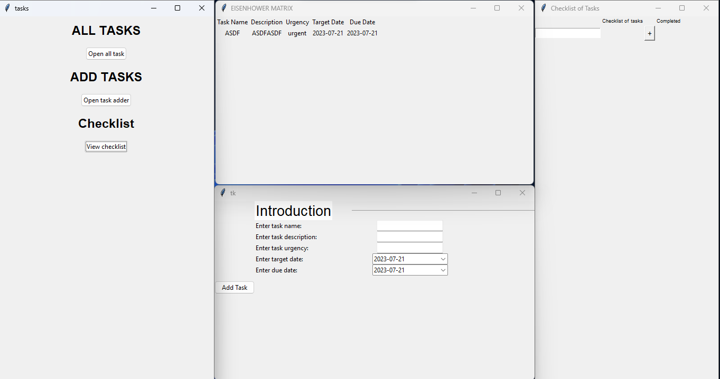
COIMBATORE INSTITUTE OF TECHNOLOGY COIMBATORE-14 DEPARTMENT OF AI&DS
Output

Slide 9
COIMBATORE INSTITUTE OF TECHNOLOGY COIMBATORE-14 DEPARTMENT OF AI&DS
RESULTS AND DISCUSSION
From this project we learnt what the python modules Tkinter and Sqlite 3 can do and we have successfully implemented a to do list where we can keep our work organised and we make sure that we don’t forget any of our work and finish them within the deadline.

Slide 10
COIMBATORE INSTITUTE OF TECHNOLOGY COIMBATORE-14 DEPARTMENT OF AI&DS
CONCLUSION
Thus The Python task management program provides an efficient and user-friendly solution for organizing tasks and priorities. Its robust functionality enhances productivity and reduces task oversight risks. This project highlights Python's effectiveness in addressing real-world challenges.

Slide 11
COIMBATORE INSTITUTE OF TECHNOLOGY COIMBATORE-14 DEPARTMENT OF AI&DS
HACKATHON PROBLEM STATEMENT
How can you develop a tool that predicts crop yield and suggests optimal irrigation and fertilization methods?

Slide 12
COIMBATORE INSTITUTE OF TECHNOLOGY COIMBATORE-14 DEPARTMENT OF AI&DS
IDEA SOLUTION
1. Gather historical crop yield, weather, and soil data.
2. Train machine learning models for crop yield prediction and optimal irrigation/fertilization suggestions.
3. Develop a user-friendly interface for data input and display of predictions.
4. Test and validate the tool using real-world data and farmer feedback.
5. Deploy the tool and maintain it with regular updates for continuous improvement.

Slide 13
COIMBATORE INSTITUTE OF TECHNOLOGY COIMBATORE-14 DEPARTMENT OF AI&DS
THANK YOU

