Slide 1
Employee Data Analysis using Excel
STUDENT NAME: SHAKTHI PRIYA . K
REGISTER NO: 2213331042142
DEPARTMENT: COMMERCE
COLLEGE: BHARATHI WOMENS COLLEGE

Slide 2
PROJECT TITLE
Employee Salary Analysis using Excel

Slide 3


AGENDA
Problem Statement
Project Overview
End Users
Our Solution and Proposition
Dataset Description
Modelling Approach
Results and Discussion
Conclusion
3/21/2024 Annual Review

Slide 4

PROBLEM STATEMENT
The goal is to analyze the salary data of employees within the organization to assess compensation fairness, identify trends, and make data-driven recommendations for adjustments. The analysis should include examining salary distributions, comparing salaries across different departments, positions, and demographics, and evaluating if the current pay structure aligns with industry standards and organizational goals.

Slide 5

PROJECT OVERVIEW
To analyze the salary data of employees within the organization to ensure fair compensation, identify trends, and recommend adjustments as needed.
.
Data Collection: Gather salary information, job titles, departments, demographic details, and industry benchmarks. Analysis: Distribution Analysis: Examine overall salary distribution and identify outliers.

Slide 6

WHO ARE THE END USERS?
The end users of the employee salary analysis typically include: HR Professionals: To make informed decisions on salary adjustments and ensure fair compensation practices. Management and Executives: For strategic decision-making regarding salary policies and budget planning. Finance Team: To align salary expenditures with financial planning and forecasts.

Slide 7

OUR SOLUTION AND ITS VALUE PROPOSITION
Our solution involves a comprehensive analysis of employee salary data to provide insights into compensation fairness, trends, and industry benchmarks. This includes data collection, statistical analysis, comparative studies, and benchmarking against industry standards.

Slide 8
Dataset Description
Employee ID: Unique identifier for each employee. Name: Employee’s full name (optional for analysis). Department: Department where the employee works. Job Title: Position or role of the employee. Salary: Annual base salary of the employee.

Slide 9

THE "WOW" IN OUR SOLUTION
Holistic Analysis: Provides a 360-degree view of compensation by integrating salary data with demographic and performance metrics, offering a comprehensive understanding of pay equity and trends. Benchmarking Precision: Uses up-to-date industry benchmarks to ensure that the organization's salaries are competitive, helping to attract and retain top talent.
3/21/2024 Annual Review
9

Slide 10
MODELLING
Descriptive Statistics: Use measures like mean, median, standard deviation, and quartiles to summarize salary distributions. Comparative Analysis: Apply t-tests or ANOVA to compare salaries across different groups (e.g., departments, genders) and identify significant differences.
10

Slide 11
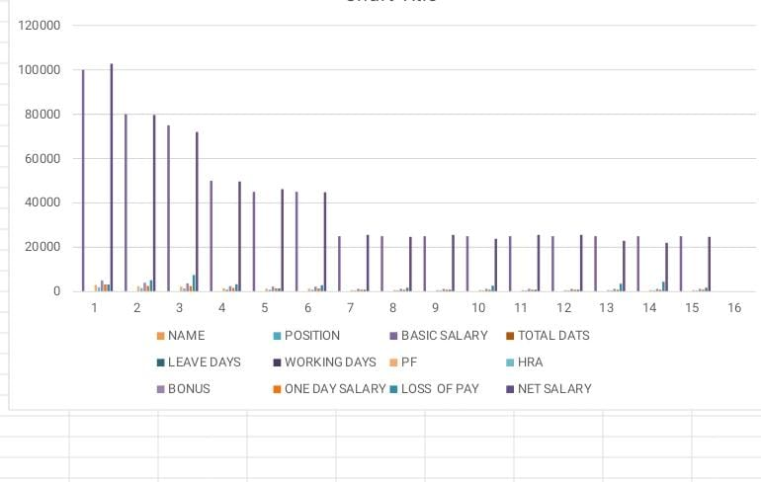
RESULTS
11

Slide 12
conclusion
The employee salary analysis provides a detailed view of compensation practices within the organization. By leveraging various modeling techniques, including descriptive statistics, comparative analysis, regression, and trend analysis, the solution uncovers critical insights into salary distribution, equity, and competitiveness.

