Slide 1

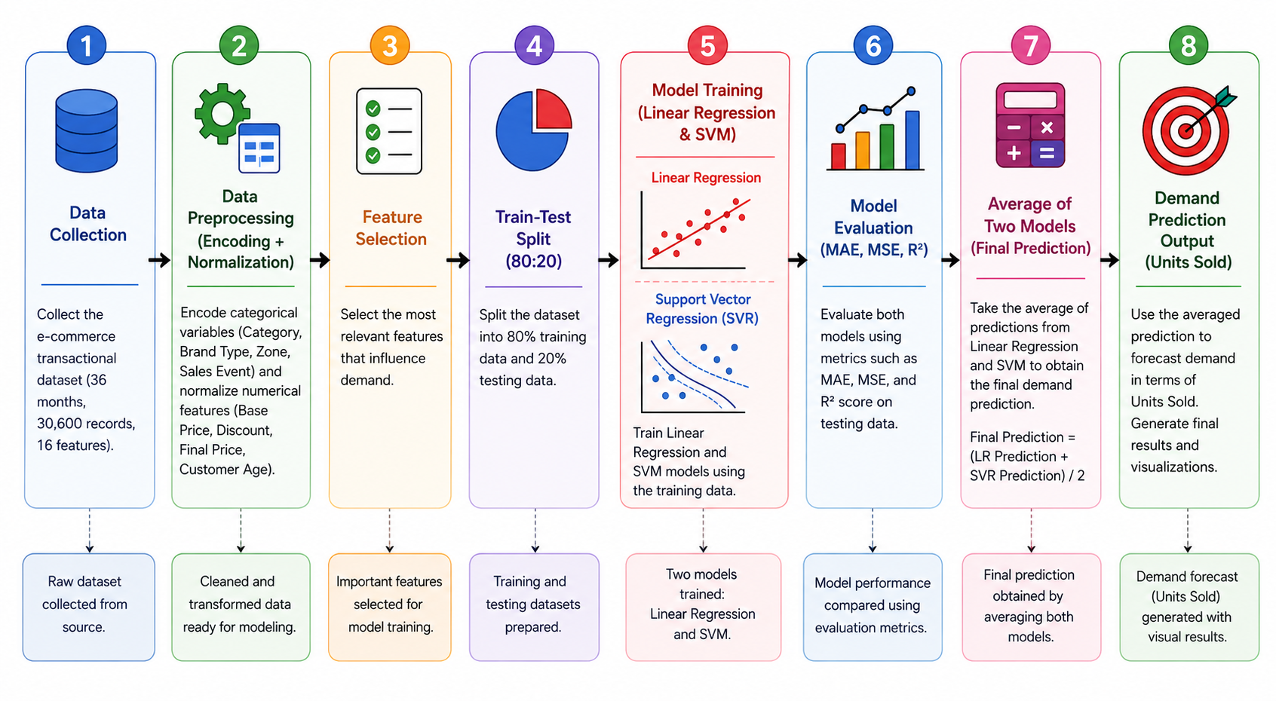
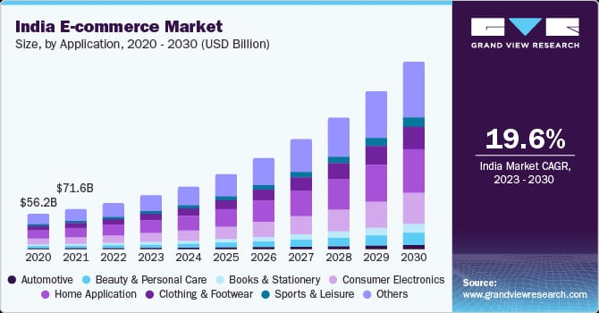
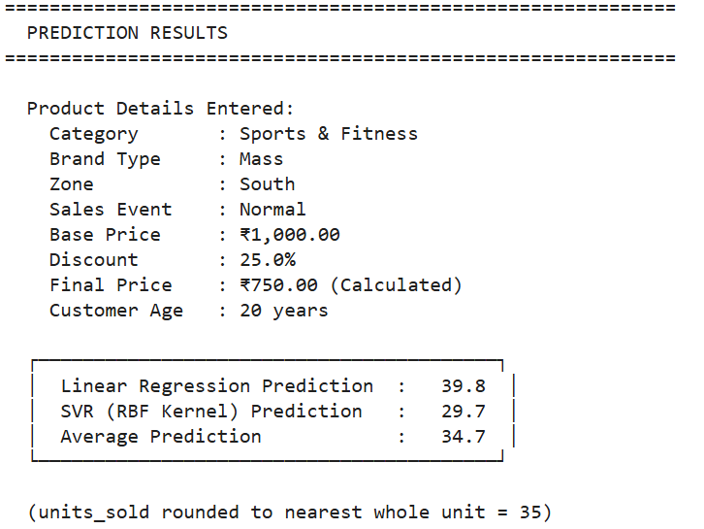
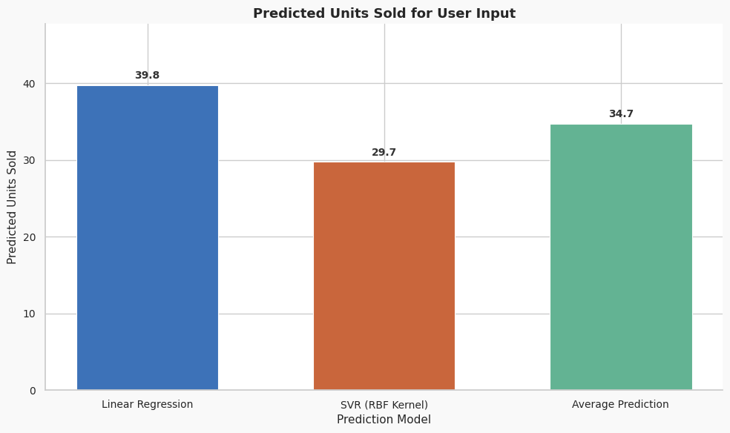
Project Title: Market Demand Prediction Using LR and SVM Under Guidance : Dr. Manjunath C R
Students Name: Ranna, Shakthi Vel K, Veeru Gowda G R
Students USN:1GA23CS135, 1GA23CS151, 1GA23CS191
Abstract
System Architecture
The rapid growth of e-commerce and FMCG industries has increased the need for accurate demand forecasting systems for inventory and business management. This project proposes a Machine Learning-based demand forecasting system using Linear Regression and Support Vector Machine (SVM). The dataset collected from Kaggle contains pricing, sales, and customer-related features. The system performs preprocessing, feature selection, model training, evaluation, and prediction generation. Final predictions are generated by averaging both model outputs to improve forecasting reliability. The proposed system achieved reliable performance using metrics such as Accuracy, Precision, Recall, MAE, RMSE, and R² Score.
The proposed system architecture is designed for demand forecasting in e-commerce and FMCG sectors using Machine Learning techniques. The system begins with dataset collection from Kaggle, containing features such as Category, Brand Type, Zone, Sales Event, Base Price, Discount, Final Price, and Customer Age.
In the preprocessing stage, missing values and duplicate records are handled, categorical features are encoded, and numerical features are normalized. The processed data is divided into training and testing datasets using an 80:20 ratio.
Linear Regression and Support Vector Machine (SVM) models are trained using the training dataset. The models are evaluated using metrics such as Accuracy, Precision, Recall, MAE, RMSE, and R² Score. Finally, the outputs of both models are averaged to generate the final demand prediction.
Architecture Flow
Dataset → Preprocessing → Feature Selection → Train-Test Split → Linear Regression & SVM Training → Evaluation → Average Prediction Output.
Brief Introduction
The rapid growth of the e-commerce industry, especially in FMCG, electronics, and retail sectors, has increased the need for accurate demand forecasting systems. Businesses require intelligent systems to predict product demand, manage inventory, reduce overstocking and understocking, and improve financial planning.
This project proposes a Machine Learning-based demand forecasting system using Linear Regression and Support Vector Machine (SVM). The system analyzes pricing, sales, and customer-related features such as Category, Brand Type, Zone, Sales Event, Base Price, Discount, Final Price, and Customer Age to predict product demand in terms of units sold.
Source: Grand View Research Report, 2023.
Results
Conclusion
The proposed system successfully generated demand predictions using Linear Regression and SVM models. The evaluation results showed balanced forecasting performance for both regression and classification metrics.
Performance Metrics
Linear Regression Accuracy : 67.76%
SVR Accuracy : 68.15%
Linear Regression R² Score : 0.3549
SVR R² Score : 0.3510
Prediction Output
Linear Regression Prediction : 39.8 Units
SVR Prediction : 29.7 Units
Average Prediction : 34.7 Units
Predicted Units Sold (Rounded Value) : 35 Units
The results demonstrate that the proposed system effectively predicts e-commerce product demand using both linear and non-linear Machine Learning models.
The project successfully implemented a Machine Learning-based demand forecasting system for e-commerce and FMCG analytics using Linear Regression and Support Vector Machine (SVM). The system analyzed pricing, sales, and customer-related features to predict product demand accurately. By combining linear and non-linear prediction models, the proposed system improved forecasting reliability and prediction efficiency
The project included data preprocessing, model training, evaluation, and prediction generation using Python and Scikit-learn. The developed system reduced manual effort and demonstrated the practical application of Machine Learning techniques in inventory management and business decision-making

