Slide 1

6th Semester
Machine Learning (CSE23602)
Review
Project Title | Predictive Market Demand Analysis in E-Commerce Using Linear Regression and Support Vector Machine (SVM)
Student USN | 1GA23CS135 | Student Name | Ranna
 | 1GA23CS151 |  | Shakthi Vel K
 | 1GA23CS191 |  | Veeru Gowda G R

Slide 2

Problem Statement
E-commerce and FMCG industries generate large volumes of sales and pricing data.
Inaccurate demand forecasting leads to:
Overstocking
Understocking
Financial loss
Poor inventory management
Traditional forecasting methods cannot effectively handle dynamic market trends and customer behavior.
Businesses require intelligent systems for accurate demand prediction and decision-making.
The proposed system uses Machine Learning techniques to improve forecasting reliability and efficiency.

Slide 3

Introduction
Rapid growth of e-commerce and FMCG industries increases the need for accurate demand forecasting.
Businesses require intelligent systems for inventory management and financial planning.
Traditional forecasting methods cannot effectively handle changing market trends.
The proposed system uses Linear Regression and SVM for demand prediction.
Final predictions are generated by averaging both model outputs.

Slide 4

Industry Need
Businesses require accurate demand forecasting for inventory and supply chain management.
Incorrect forecasting leads to overstocking and understocking.
E-commerce and FMCG industries generate large volumes of dynamic sales data.
Machine Learning helps improve forecasting accuracy and business decision-making.
Intelligent forecasting systems reduce manual effort and financial loss.

Slide 5
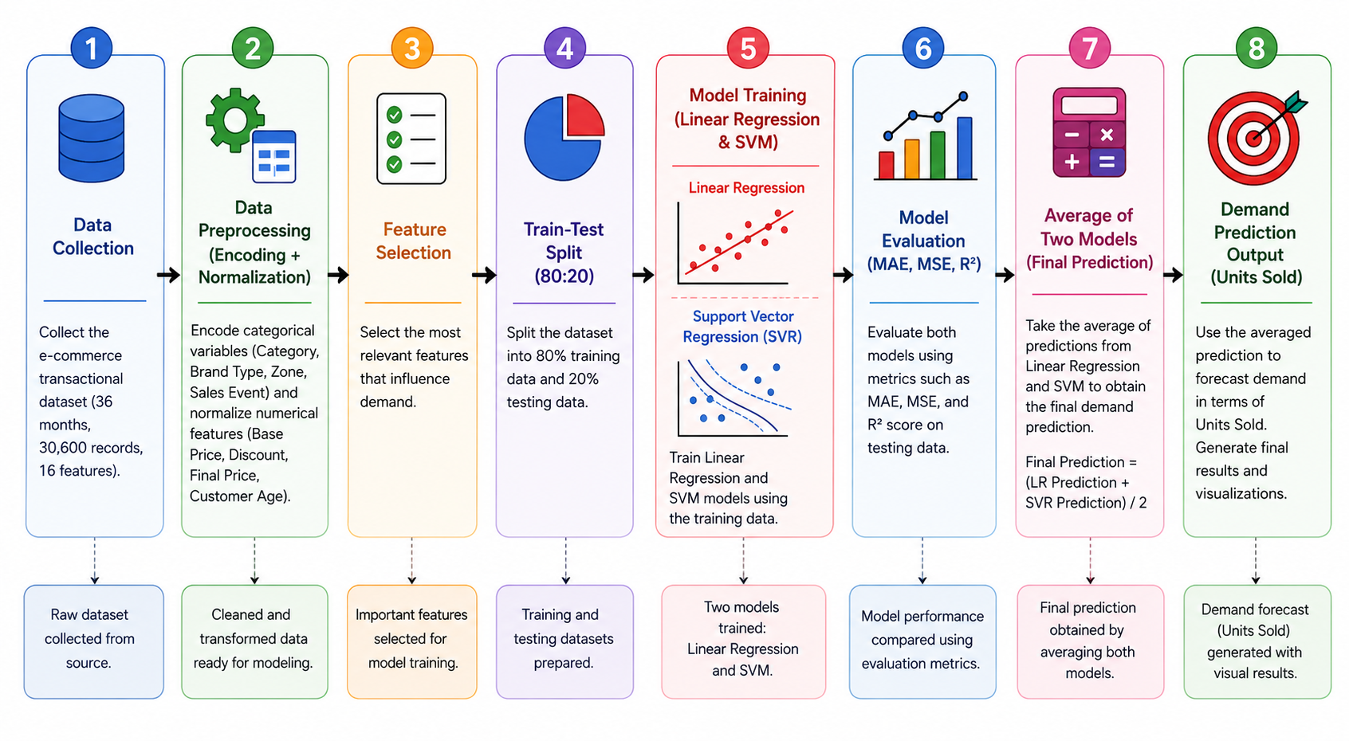
System Architecture

Slide 6

Model Training
The dataset was divided into training and testing datasets using an 80:20 ratio.
Linear Regression and Support Vector Machine (SVM) models were trained using the training dataset.
Linear Regression captured linear demand patterns.
SVM with the RBF kernel handled non-linear demand behavior.
Final predictions were generated by averaging the outputs of both models.

Slide 7
Performance Evaluation Results
Metrics | Linear Regression | SVR (RBF Kernel)
MAE | 13.3367 | 13.3003
MSE | 283.8068 | 285.5472
RMSE | 16.8466 | 16.8981
R² Score | 0.3549 | 0.3510
Precision | 0.6206 | 0.6442
Recall | 0.6996 | 0.6273
Accuracy | 0.6776 | 0.6815
F1-Score | 0.6578 | 0.6356
Error Analysis
Linear Regression achieved better Recall and R² Score.
SVR achieved better Accuracy and Precision.
Final predictions were generated by averaging both model outputs.

Slide 8
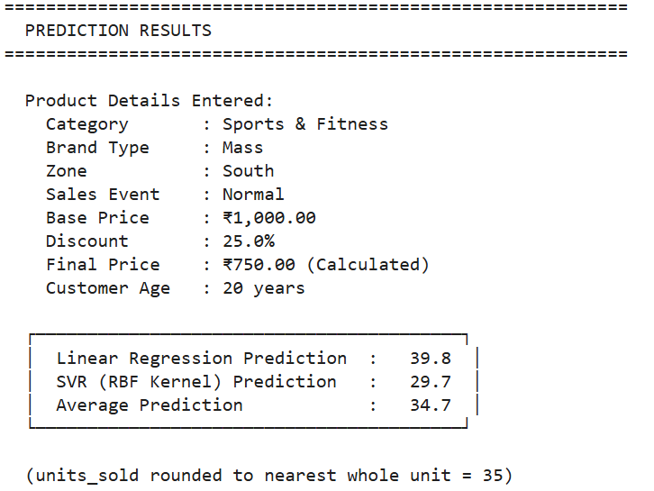
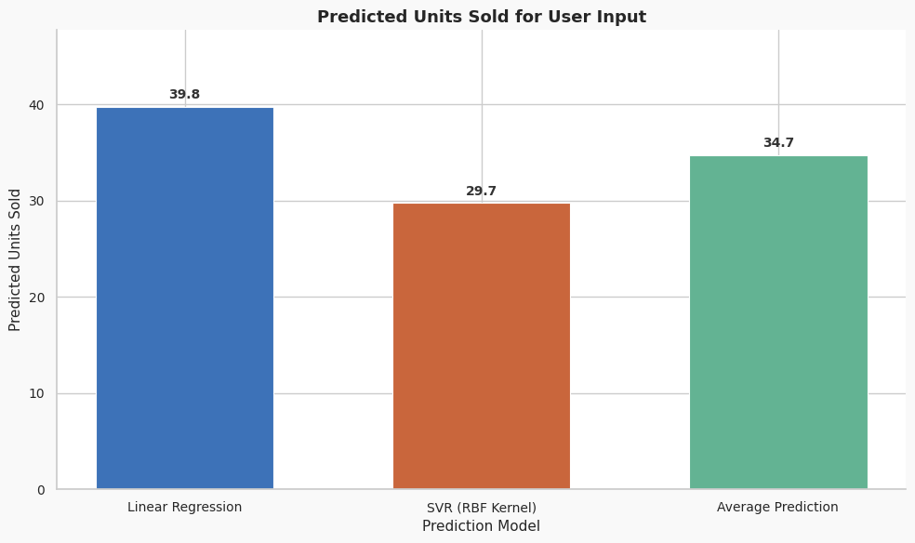
Results
The system generated demand predictions using Linear Regression and SVR models.
Linear Regression predicted 39.8 units and SVR predicted 29.7 units.
The average prediction was 34.7 units, rounded to 35 units sold.
Based on the threshold value, the product was classified as High Demand.
The combined model improved forecasting reliability and inventory decision-making.

Slide 9

Business Impact
Reduces overstocking and understocking
Improves inventory management
Supports supply chain planning
Helps financial and business decision-making
Reduces manual effort in demand analysis
Improves forecasting reliability using Machine Learning techniques

Slide 10

Conclusion
Successfully implemented a Machine Learning-based demand forecasting system.
Used Linear Regression and Support Vector Machine (SVM) algorithms for prediction.
Improved forecasting reliability by averaging both model outputs.
Achieved reliable performance using evaluation metrics such as Accuracy, Precision, Recall, MAE, RMSE, and R² Score.
The system helps improve inventory management and business decision-making in e-commerce and FMCG industries.

Slide 11
Q & A

Slide 12
Thank You

