Slide 1
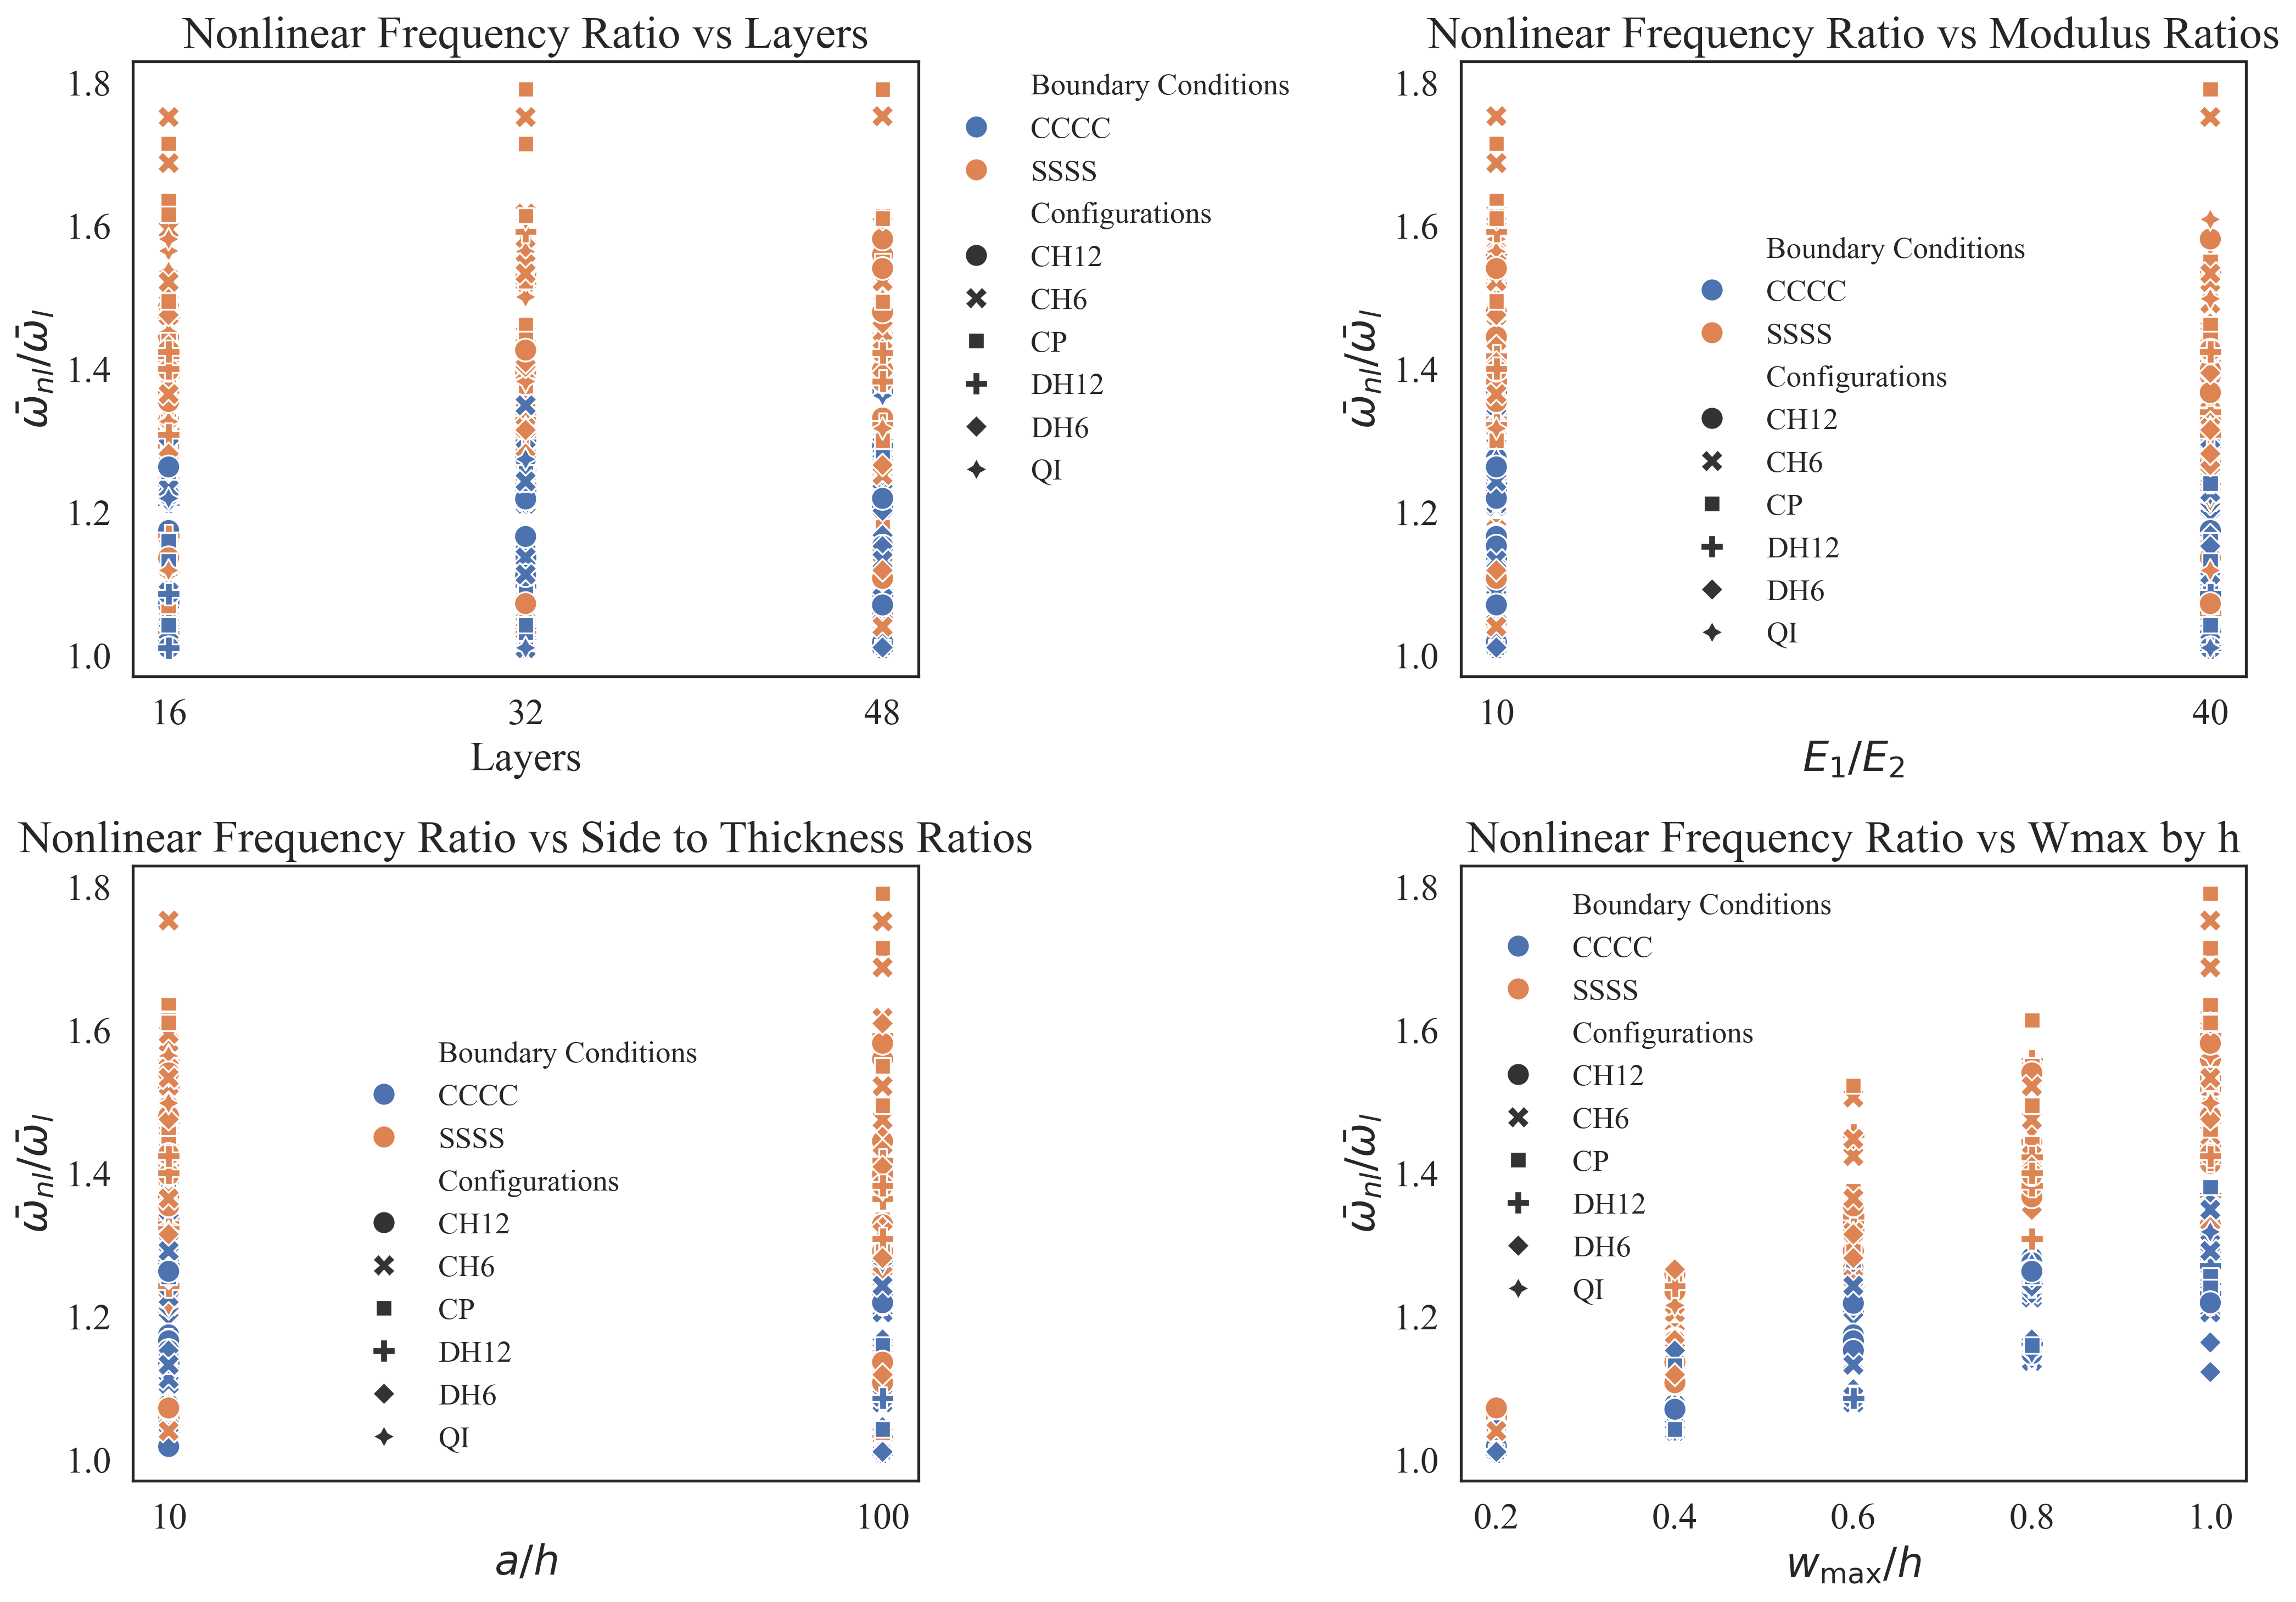
(a)
Nonlinear Frequency Ratio vs
Layers
(b)
Nonlinear Frequency Ratio vs
Modulus Ratio
(c)
(d)
Nonlinear Frequency Ratio vs
Side to Thickness Ratio
Nonlinear Frequency Ratio vs
Amplitude to Thickness Ratio

Slide 2
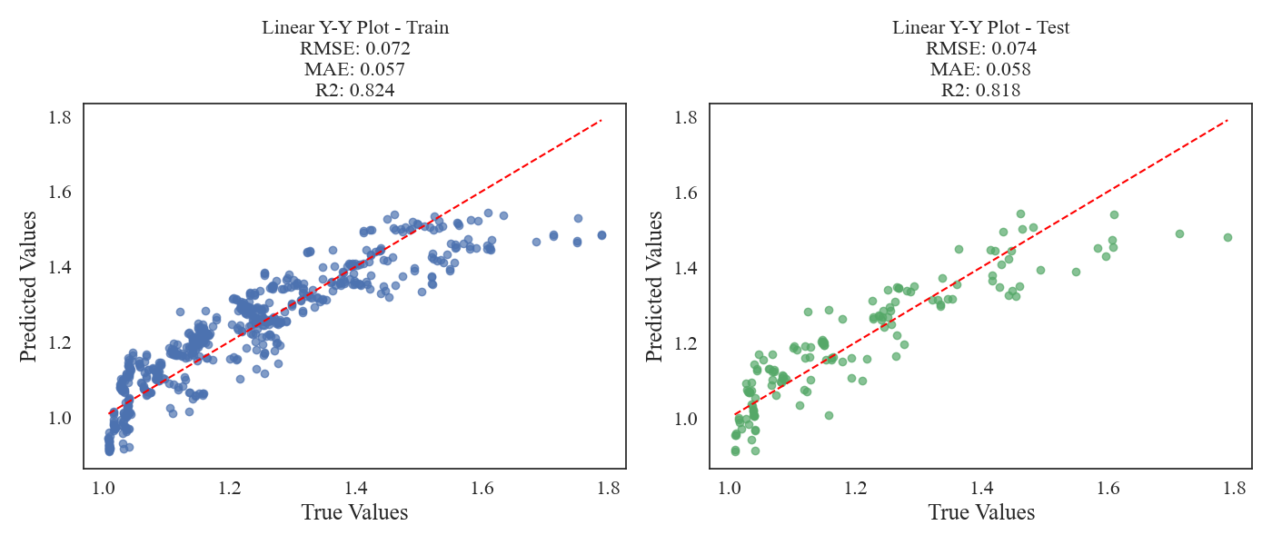
(a)
(b)

Slide 3
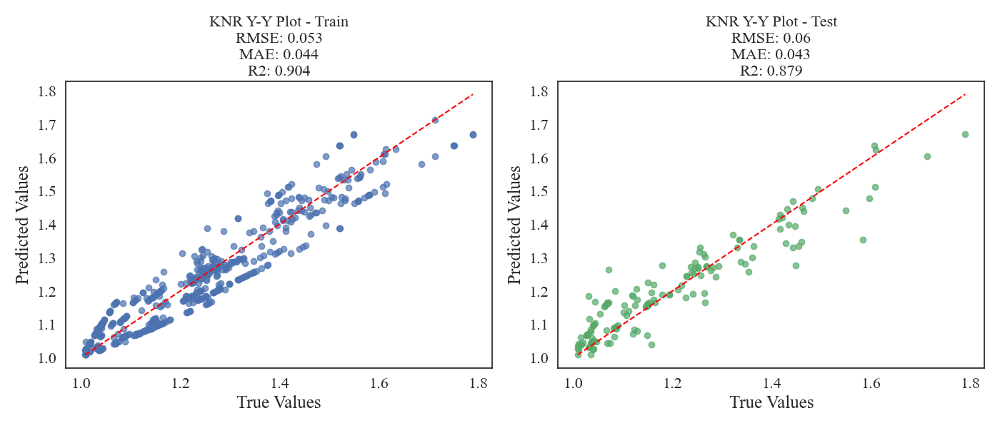
(a)
(b)

Slide 4
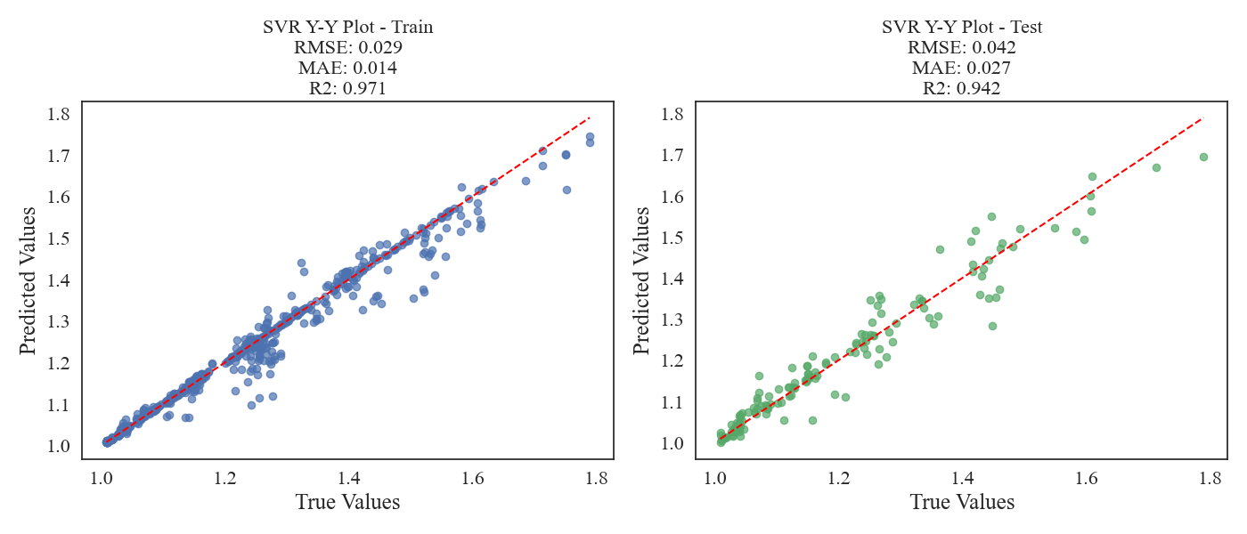
(a)
(b)

Slide 5
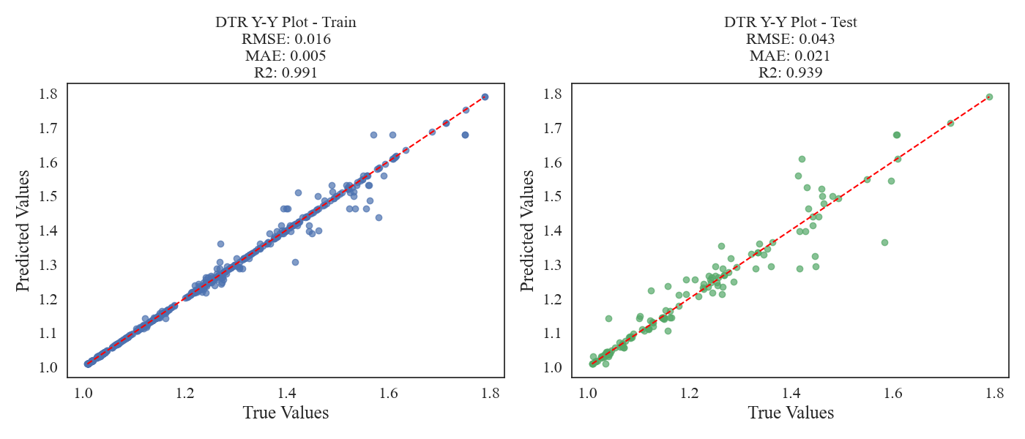
(a)
(b)

Slide 6
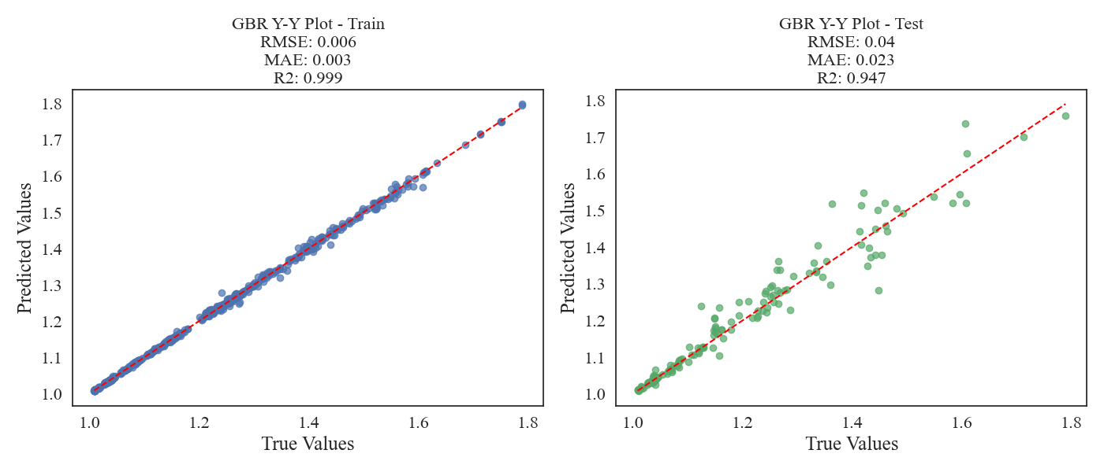
(a)
(b)

Slide 7
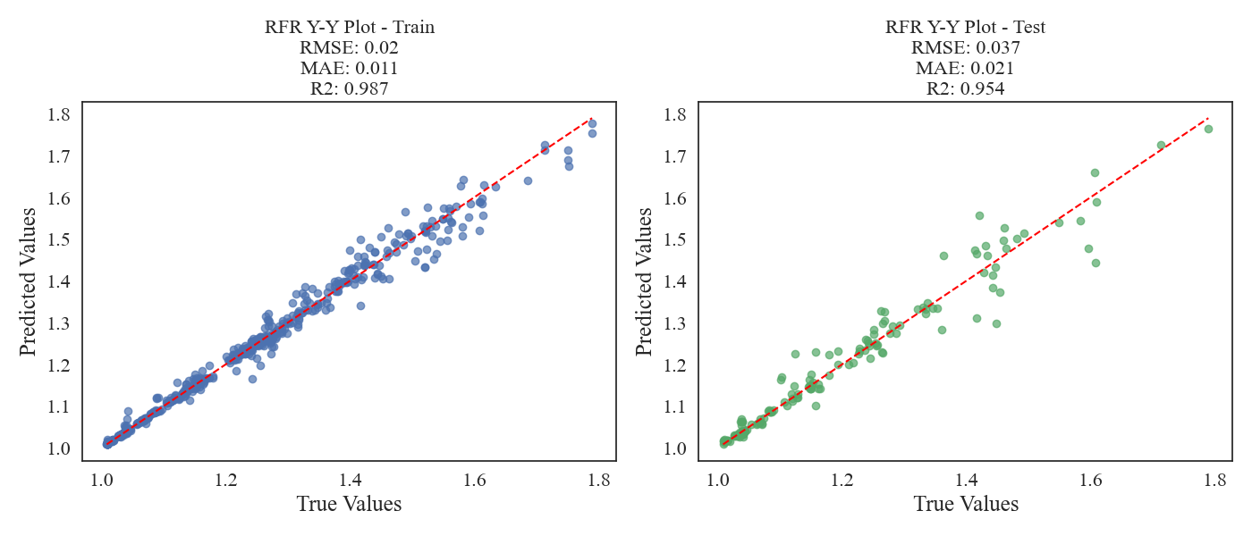
(a)
(b)

Slide 8
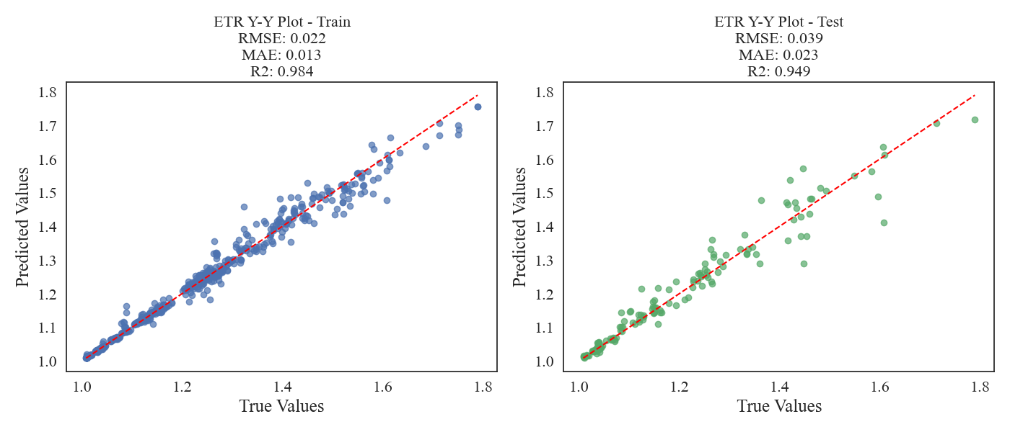
(a)
(b)

Slide 9
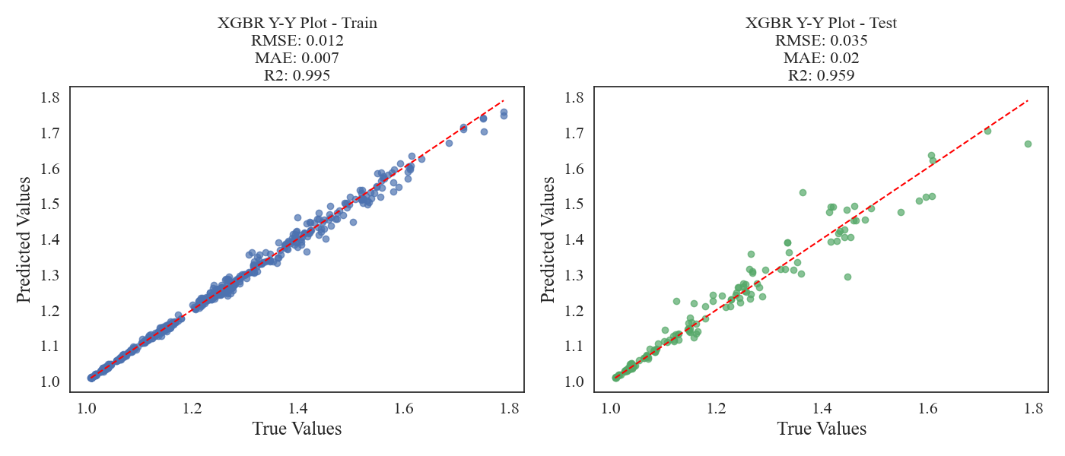
(a)
(b)

Slide 10
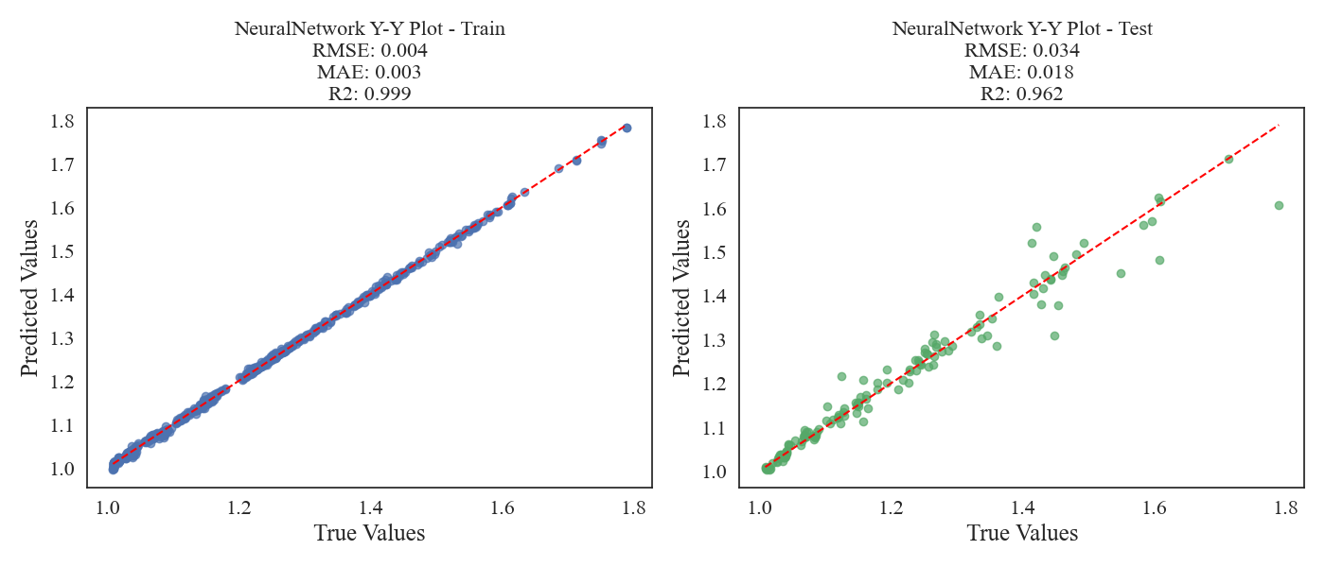
(a)
(b)

Slide 11
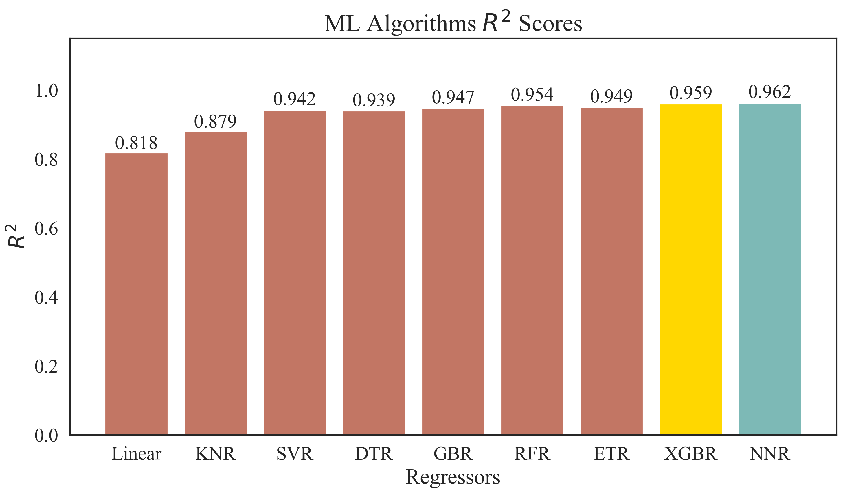
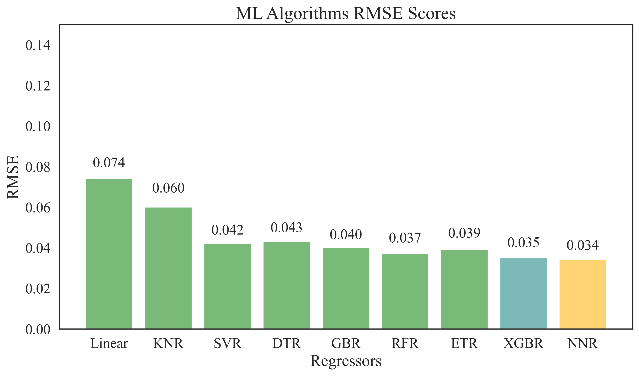
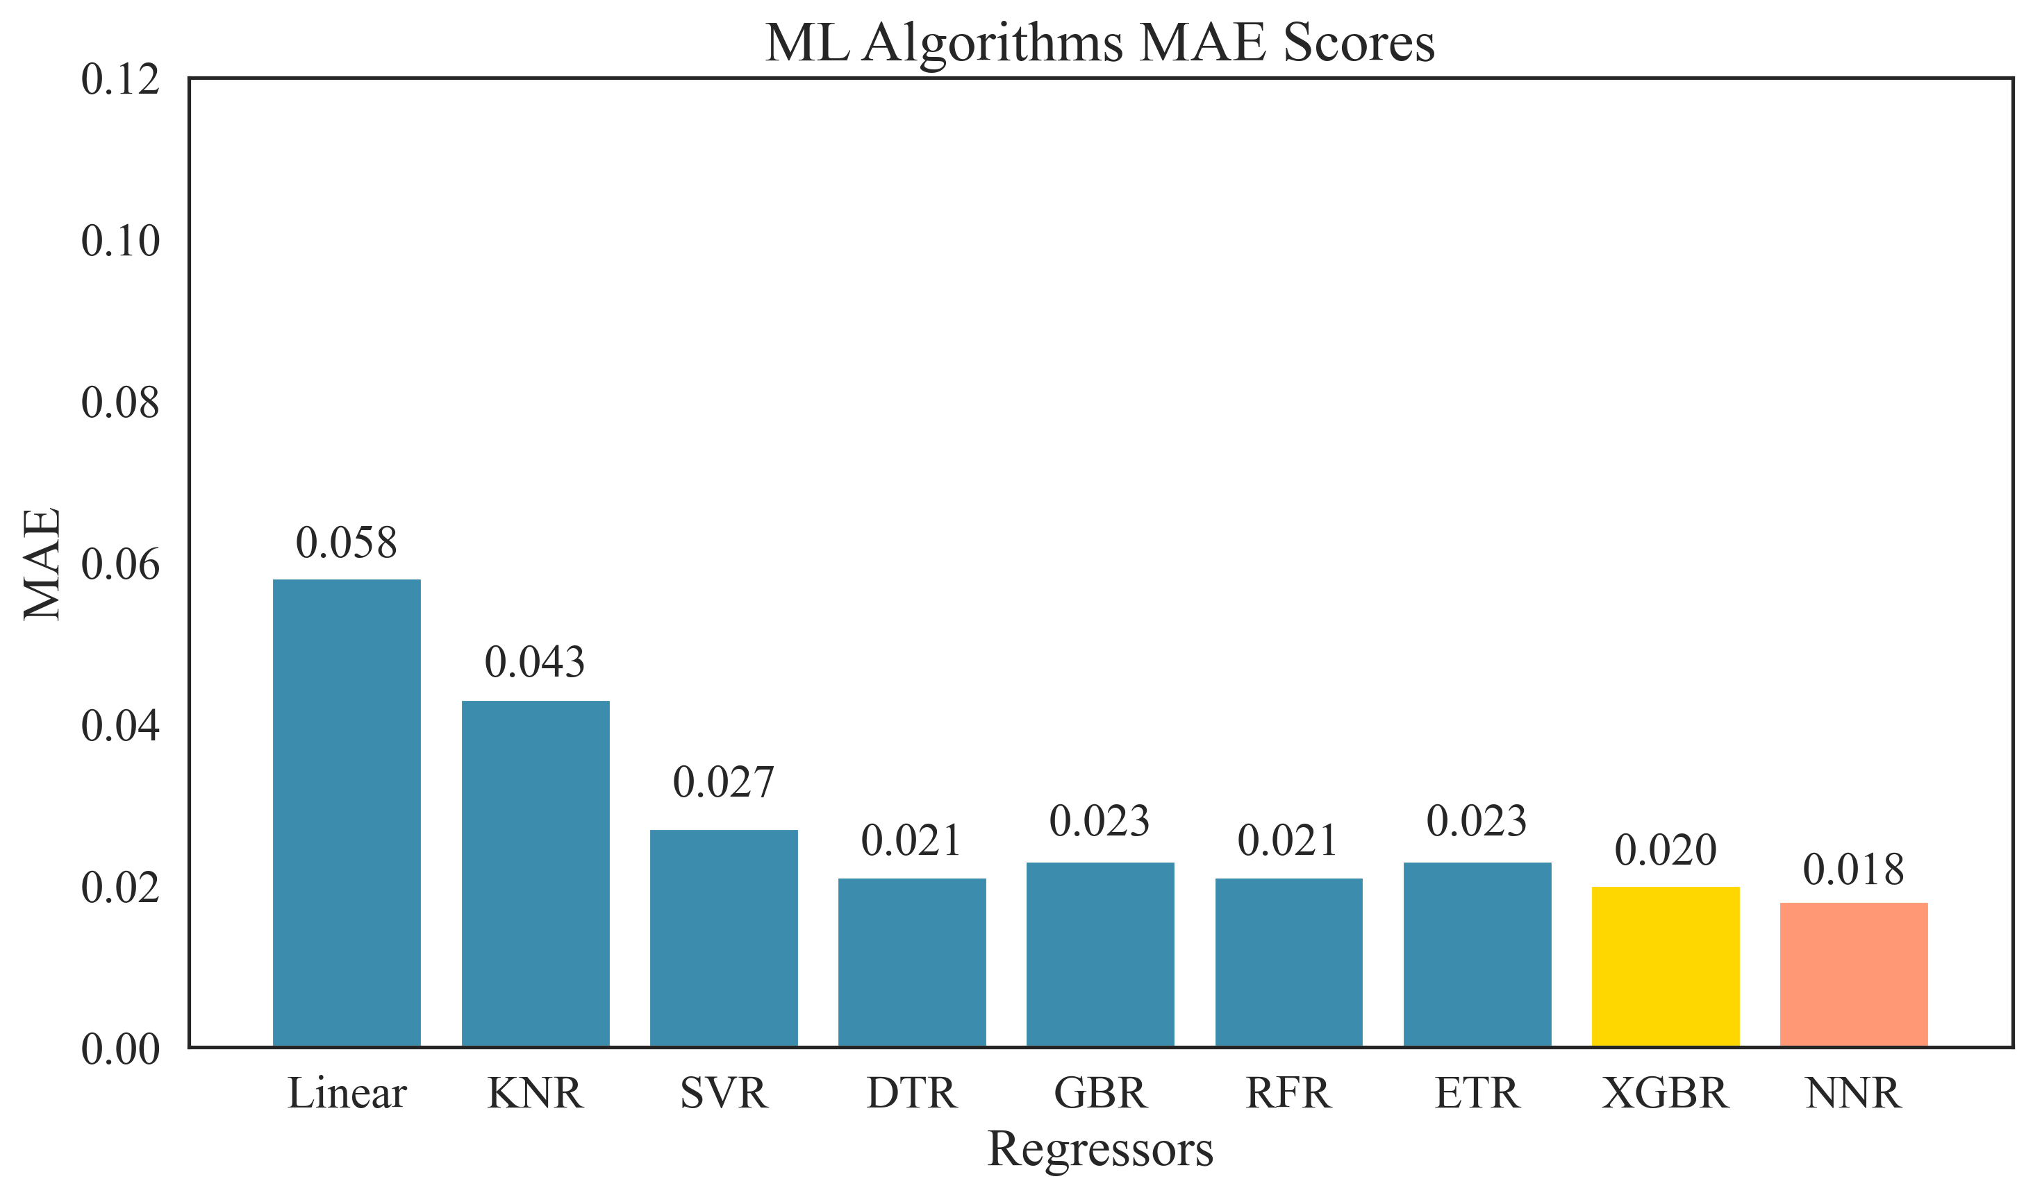
(a)
(b)
(c)

Slide 12
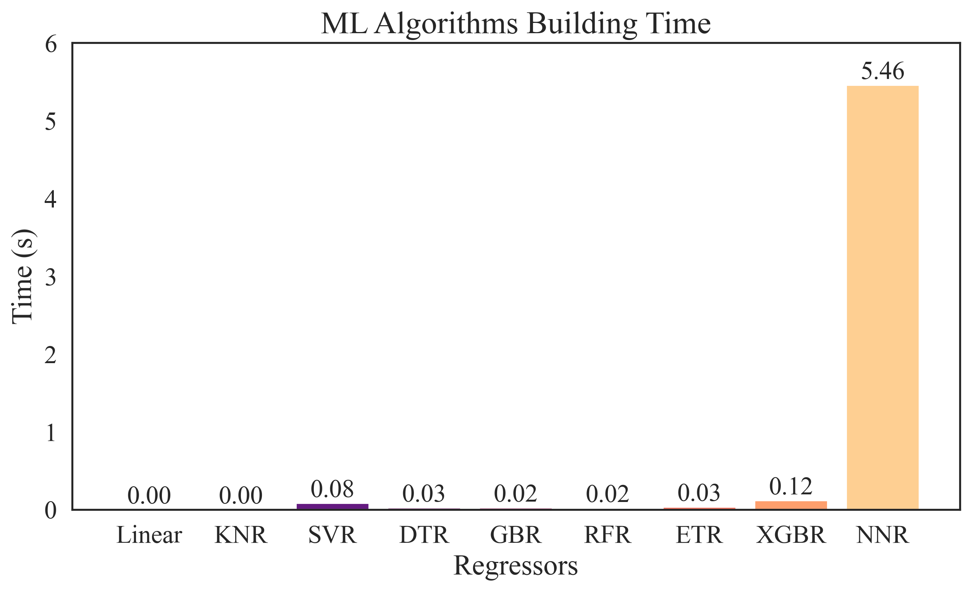
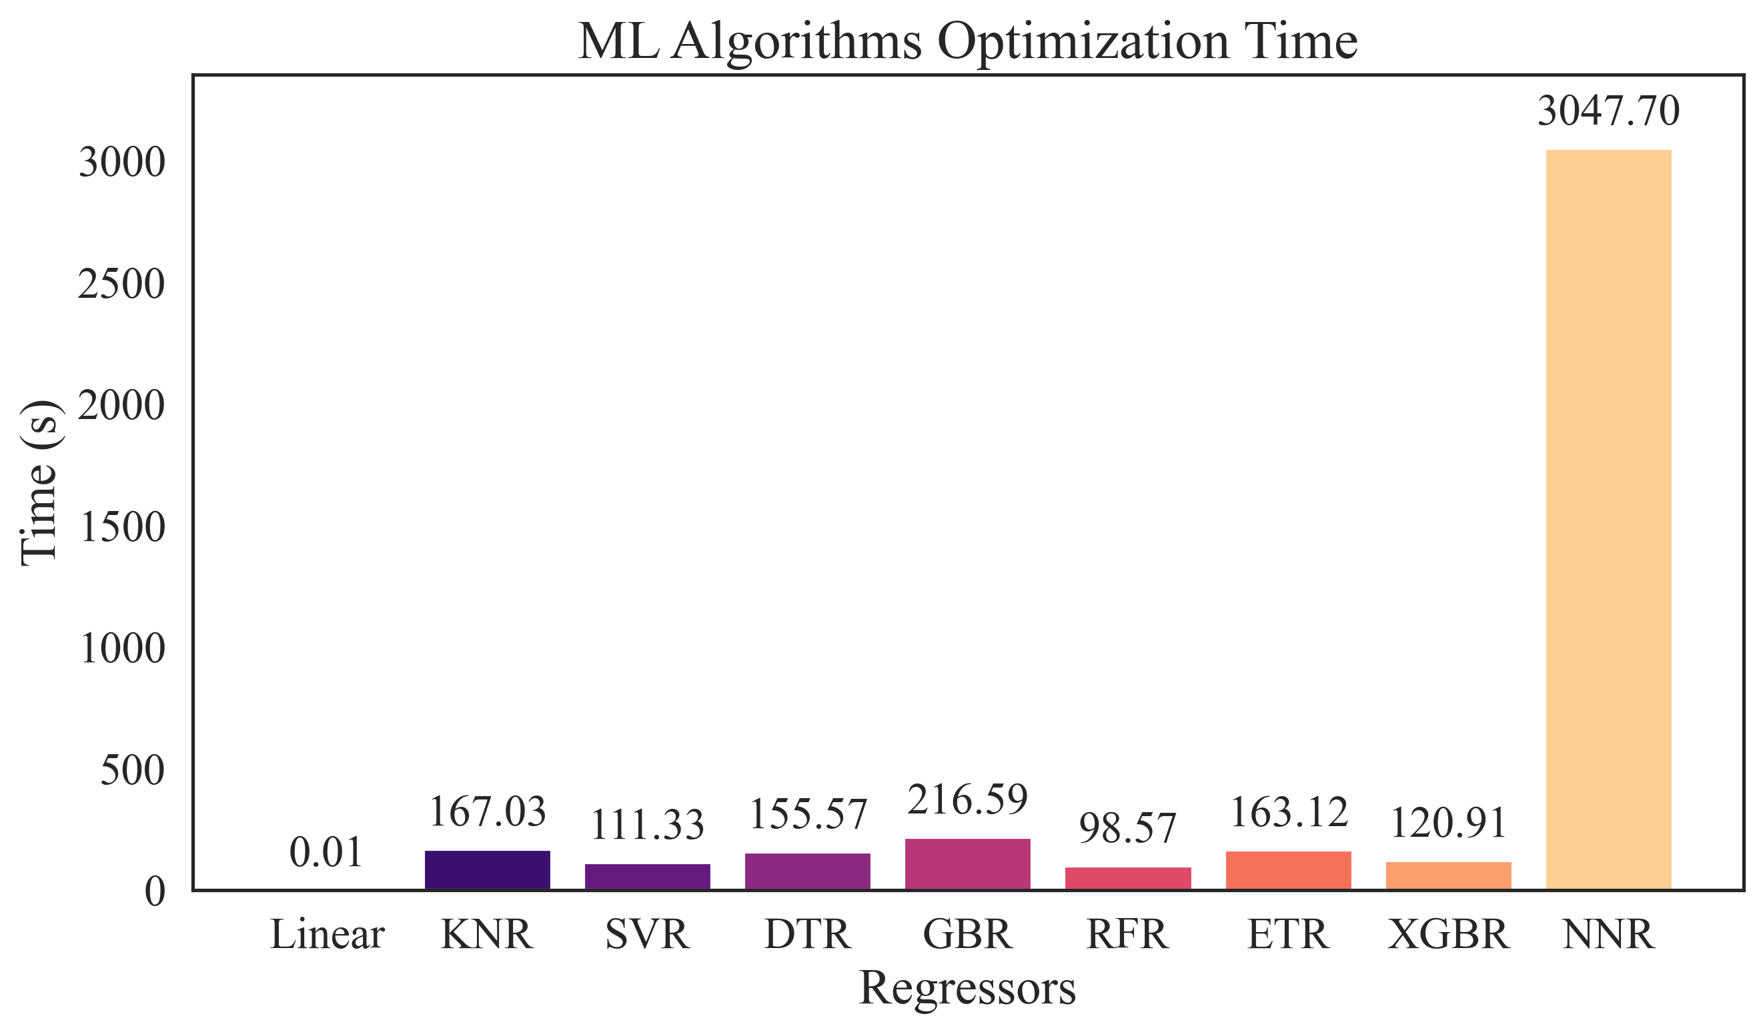
(a)
(b)

