Slide 1
DATA ENGINEERING
CAPSTONE PROJECT
By : Shakti Ranjan Mallick

Slide 2
Business Objective: To extract data from Semi- Structured files to Structured files and designing data model. Skills: Importing the CSVs into a SQL database, transferring SQL database to HDFS ,CREATING HIVE TABLES and Performing EDA analysis using Impala/Spark using the data and creating ML pipelines.

Slide 3
Data used:
Data set consists of 3 Lakhs of employees list data with employee ,salary, title ,dept-manager
department and designation.
description:
Exploratory data analysis to find out what datasets can reveal further beyond formal modeling of data.
This enables to gain in-depth knowledge of the variables in
datasets and their relationships.

Slide 4
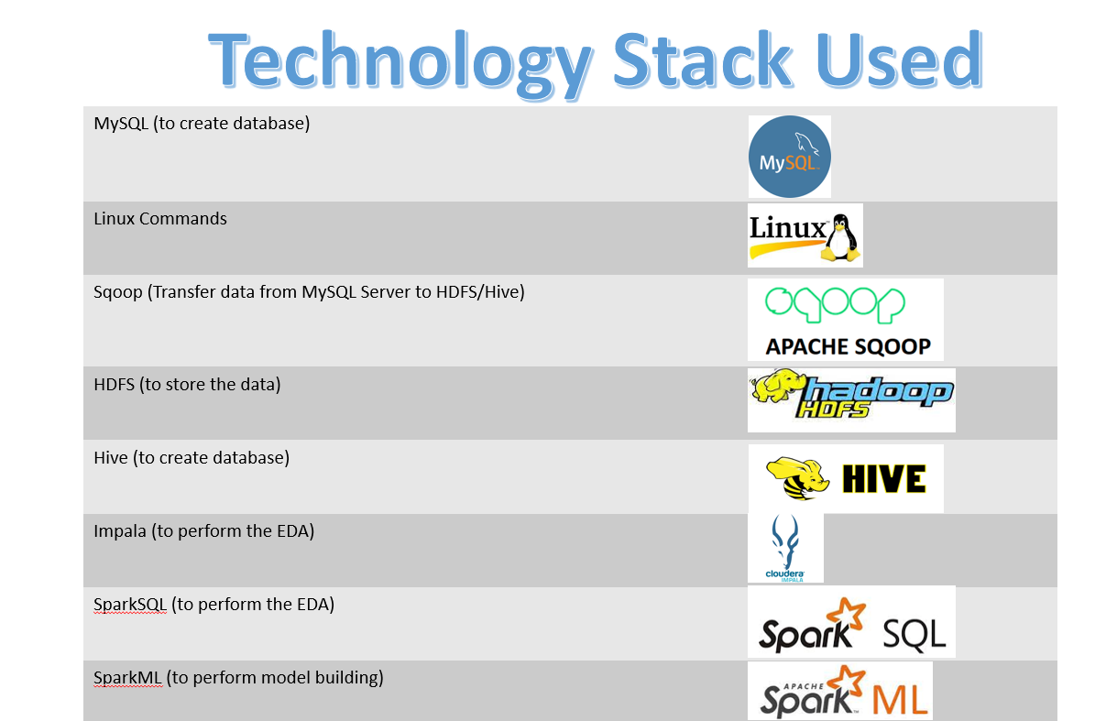

Slide 5
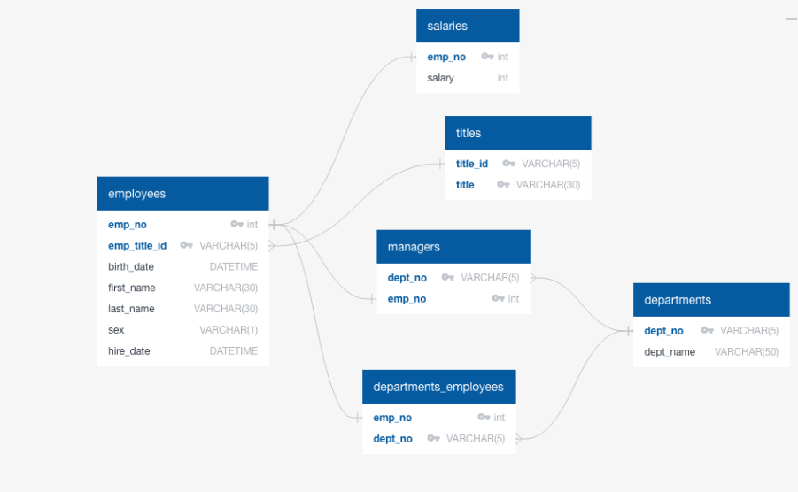

Slide 6
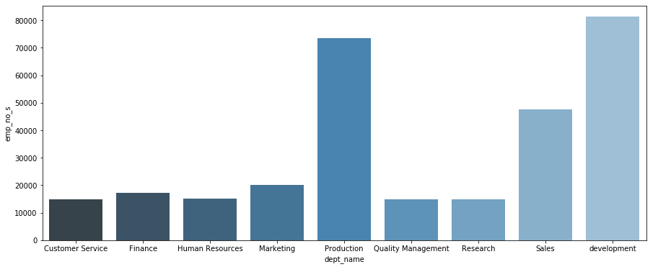
Count Department wise number of employees

Slide 7
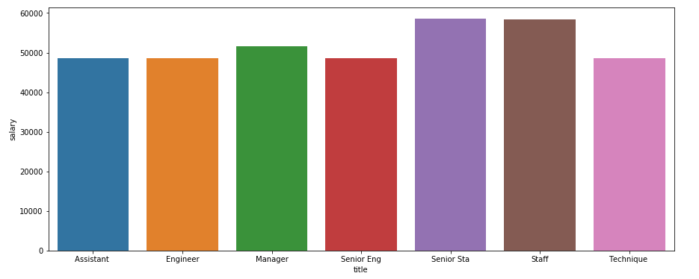
Bar graph to show the Average salary per title (designation)

Slide 8
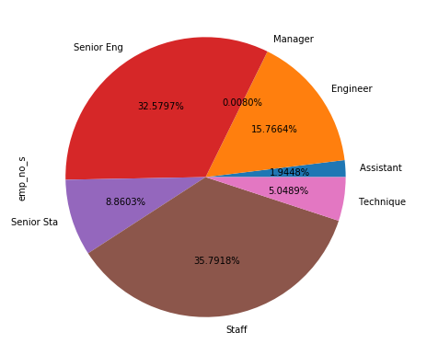
Percentage distribution of employees as per the Designation

Slide 9
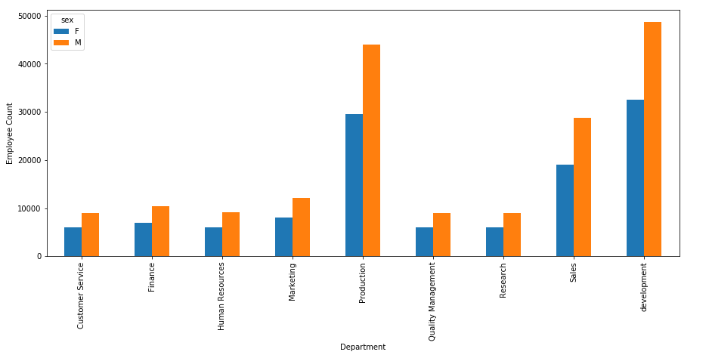
Gender wise employee count for different departments

Slide 10
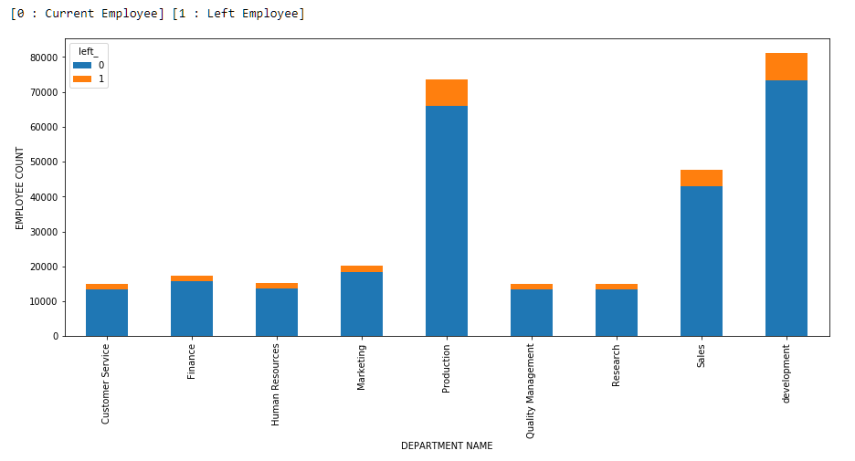
Department wise Left and working employee

Slide 11
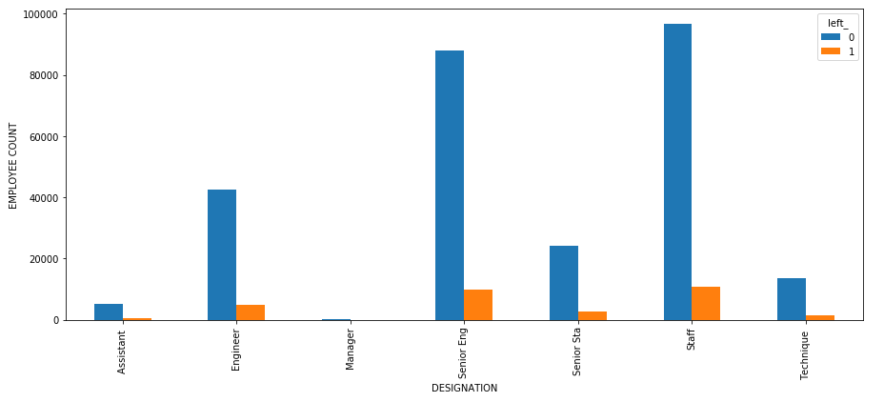
Analyse working vs left employes from different designations

Slide 12
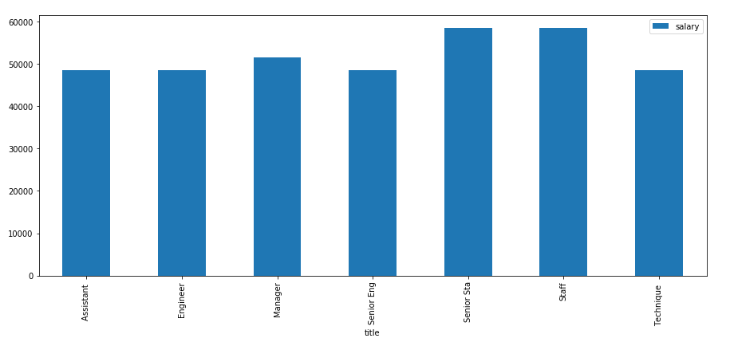
Average salary designation wise

Slide 13
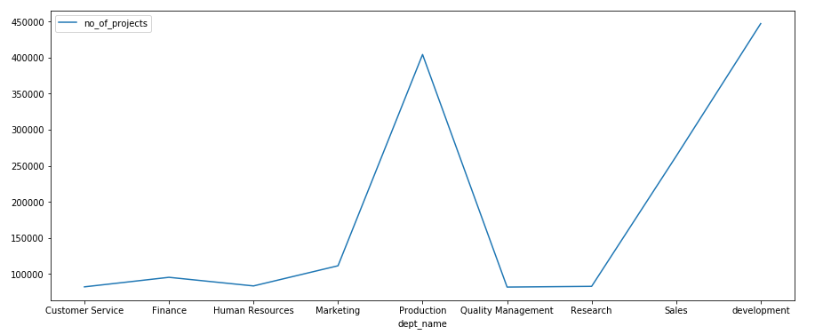
Department wise number of projects

Slide 14
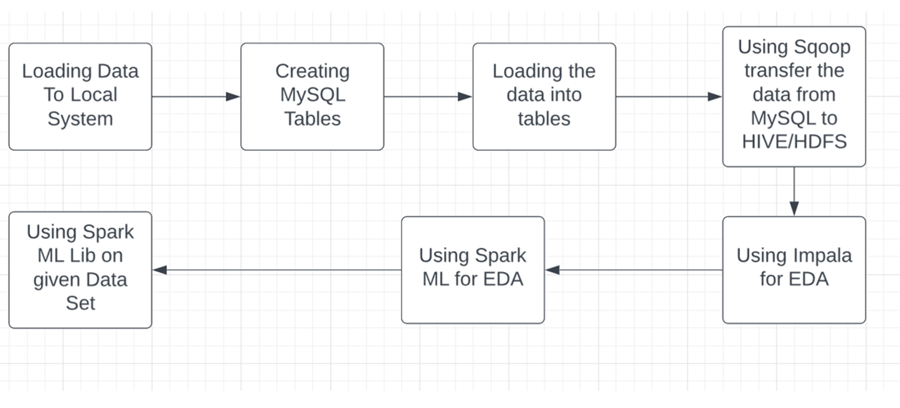
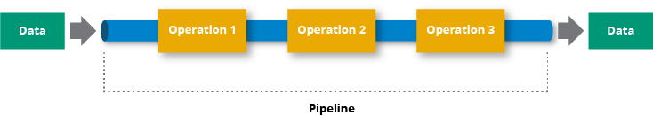
Pipeline Architecture
Pipeline Architecture

Slide 15
Challenges faced
Difficulty in understanding multiple data tables in a large scale.
Importing Data from Local to MySQL.
Data Transfer using SQOOP.
Analysing of data in spark by creating data frames
Creating of pipe lines
Using ML Lib for Machine Learning.

Slide 16
Future Scope
This analysis can be used to decide which department is generating more productivity and revenue
The company could pre-check and gives more information to manage employees in terms salary packages and employee growth.
The analysis can be used by the company to access its employee retention.
The analysis can be used to find out the reasons why employees are leaving the company.
The reasons found out may be used to rectify the problems.

Slide 17


