Slide 1
DATA ENGINEERING
CAPSTONE PROJECT
By : Shakti Ranjan Mallick

Slide 2
Business Objective: - Exploratory Data Analysis of provided Data Set. - Using the data set to come up with meaningful insights. - Using Machine Learning to come up with the various reasons for the employees leaving the company.

Slide 3
Data used:
Various CSV used:
Departments
Department Managers
Department Employees
Employees
Salaries
Titles
Description:
Exploratory data analysis to find out what datasets can reveal further beyond formal modeling of data.
This enables to gain in-depth knowledge of the variables in datasets and their relationships.

Slide 4








Technology Stack Used
MySQL (to create database)
Linux Commands
Sqoop (Transfer data from MySQL Server to HDFS/Hive)
HDFS (to store the data)
Hive (to create database)
Impala (to perform the EDA)
SparkSQL (to perform the EDA)
SparkML (to perform model building)

Slide 5
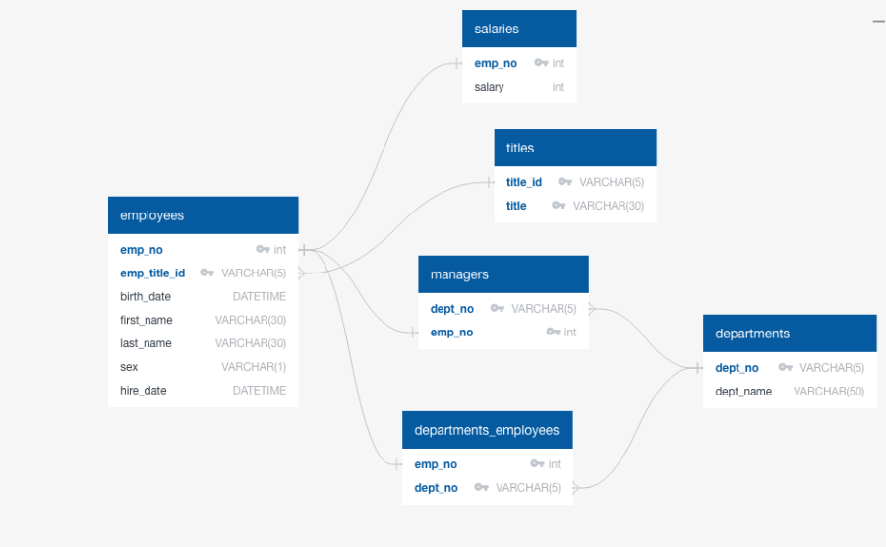

Slide 6
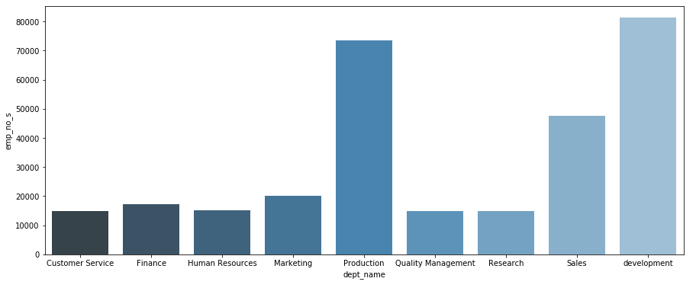
Count Department wise number of employees

Slide 7
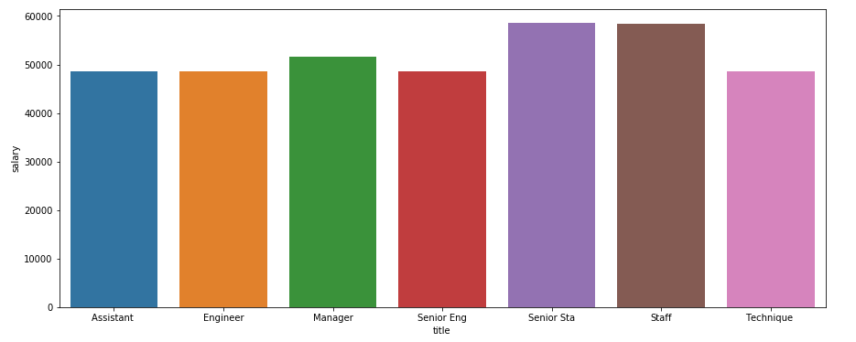
Bar graph to show the Average salary per title (designation)

Slide 8
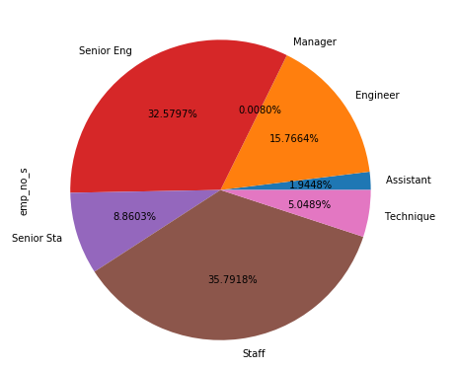
Percentage distribution of employees as per the Designation

Slide 9
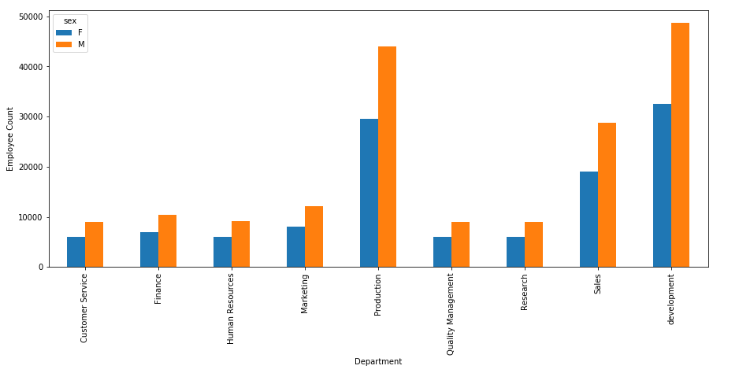
Gender wise employee count for different departments

Slide 10
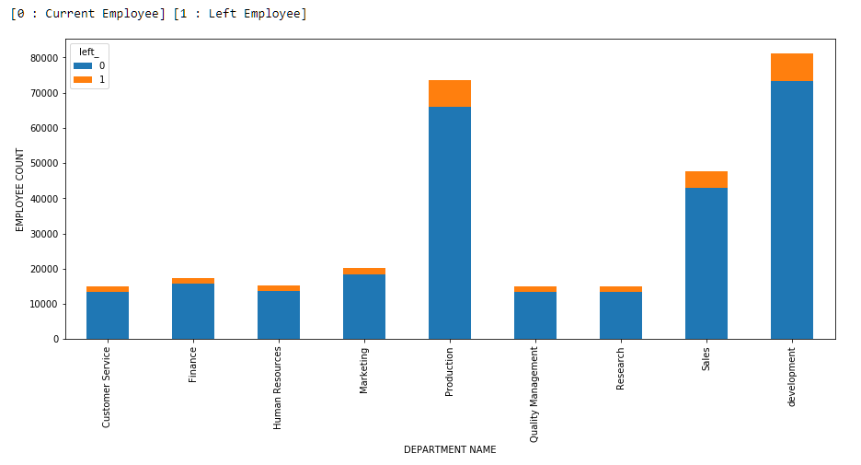
Department wise Left and working employee

Slide 11
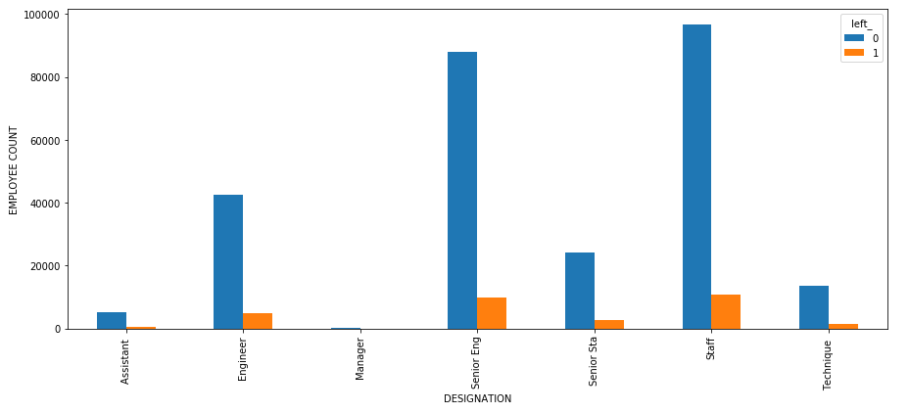
Analyze working vs left employees from different designations

Slide 12
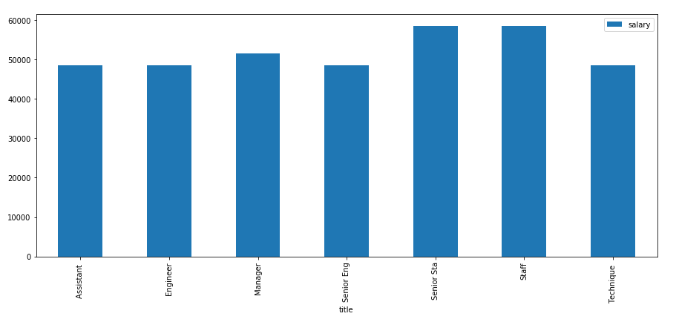
Average salary designation wise

Slide 13
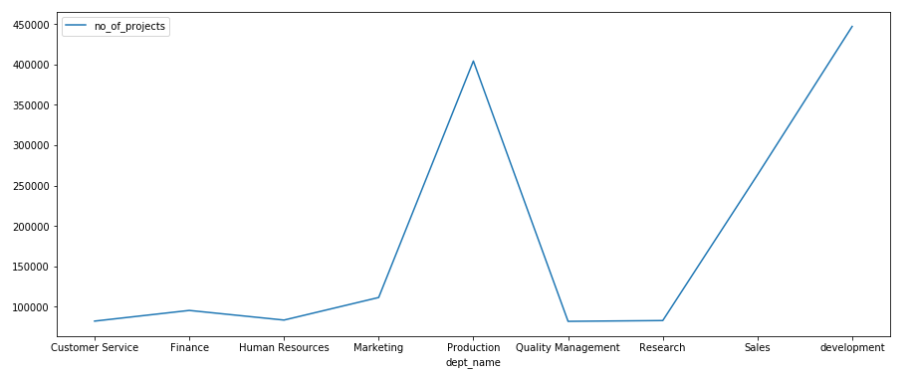
Department wise number of projects

Slide 14
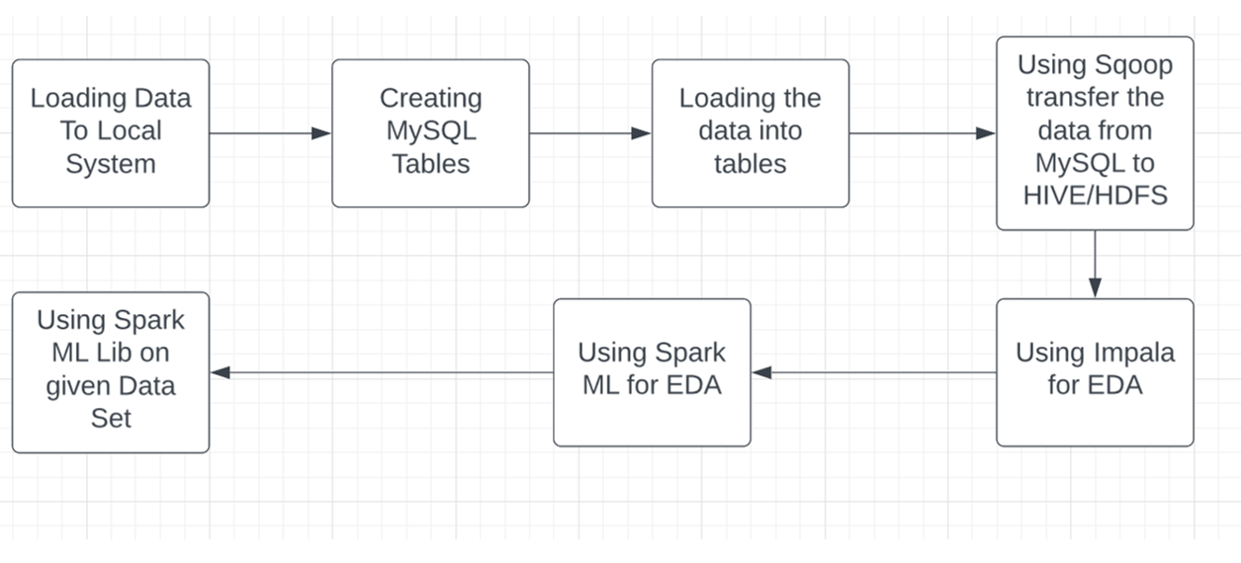
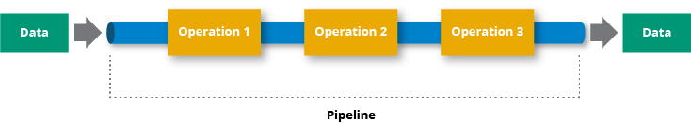
Pipeline Architecture
Pipeline Architecture

Slide 15
Challenges faced
Difficulty in understanding multiple data tables in a large scale.
Importing Data from Local to MySQL.
Creating of pipe lines
Using ML Lib for Machine Learning.

Slide 16
Future Scope
This analysis can be used to decide which department is generating more productivity
The company could pre-check and gives more information to manage employees in terms salary packages and employee growth.
The analysis can be used by the company to access its employee retention.
The analysis can be used to find out the reasons why employees are leaving the company.
The reasons found out may be used to rectify the problems.

Slide 17


