Slide 1
Bike-sharing Rental Demand Prediction
Data Science Project Report
Group No 06

Slide 2
Team Information
Mentor: [Abhishek Kavuri]
Team Member 1: [Roshan Zameer]
Team Member 2: [Prashant Bayye]
Team Member 3: [Payal Aher]
Team Member 4: [Sangram Deshmukh]
Team Member 5: [Rohan Kandhare]
Team Member 6: [Srishakti Awanti]
Team Member 7: [Chittuluru Naga Asrith Sai]

Slide 3
Objective
Predict hourly bike rental demand.
Optimize urban city bike supply.
Reduce customer waiting time.

Slide 4
Dataset Details
Source: UCI Bike Sharing Dataset
17,379 Hourly Records
17 Initial Features

Slide 5
Data Dictionary: Time
instant: Index
dteday: Date
season: Seasonality
yr: Year
mnth: Month

Slide 6
Data Dictionary: Weather
weathersit: Situation
temp: Temperature
hum: Humidity
windspeed: Speed

Slide 7
EDA: Missing Value Detection
Detected '?' in weather metrics
Imputed 11 entries in temp
Imputed 6 in humidity/atemp

Slide 8
EDA: Outlier Detection
Boxplots revealed high count outliers
Confirmed as rush-hour peaks
Kept outliers to maintain real-world signal

Slide 9
Data Cleaning Summary
Coerced numeric types
Parsed DD-MM-YYYY dates
Handled inconsistencies between casual/registered/cnt

Slide 10
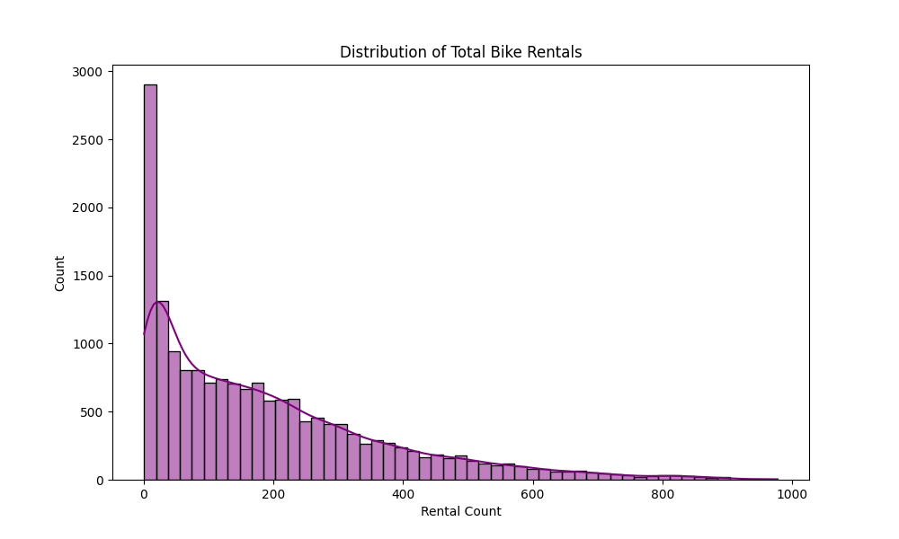
Inference: Demand Distribution
Right-skewed target variable
Majority of hours are low-demand
High peaks are rare but critical

Slide 11
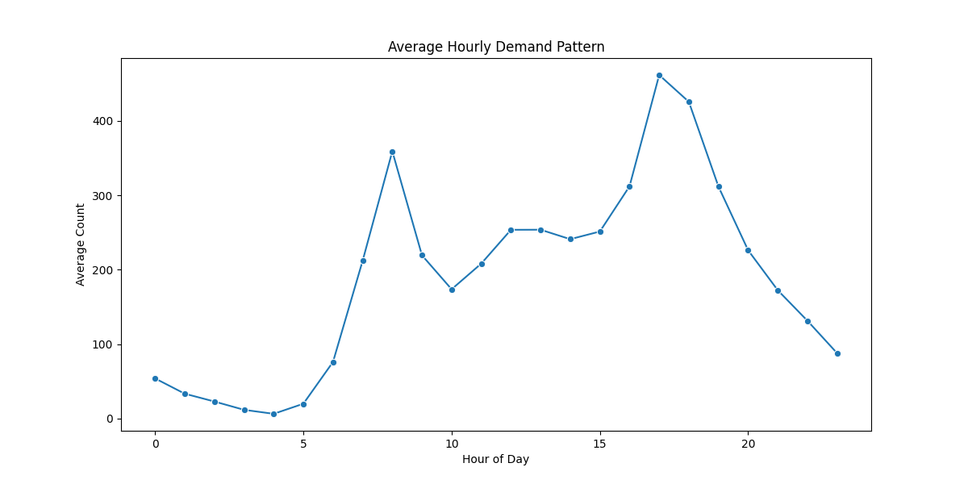
Inference: Hourly Trends
Peaks at 8 AM and 5-6 PM
Commuter-driven behavior dominates
Operations should focus on these slots

Slide 12
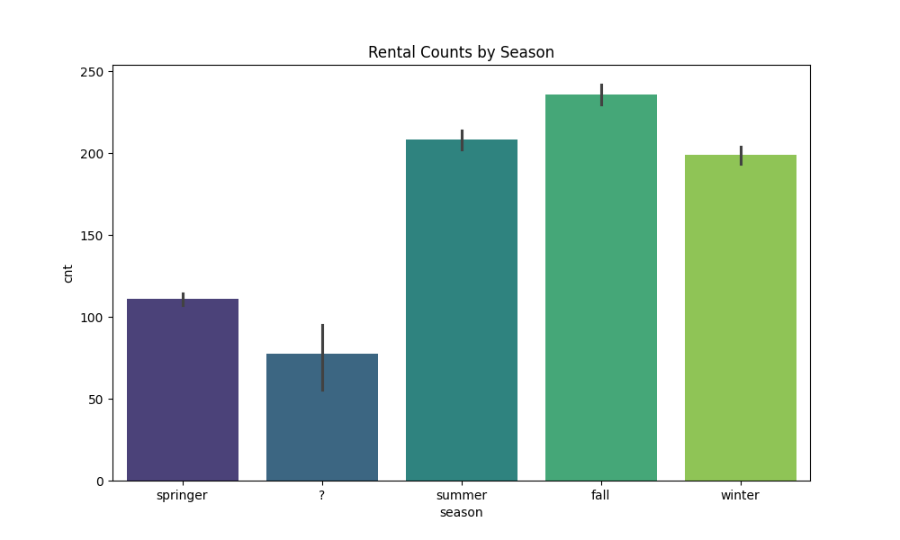
Inference: Seasonal Impact
Fall shows highest bike demand
Spring has significantly lower demand
Marketing should target transition seasons

Slide 13
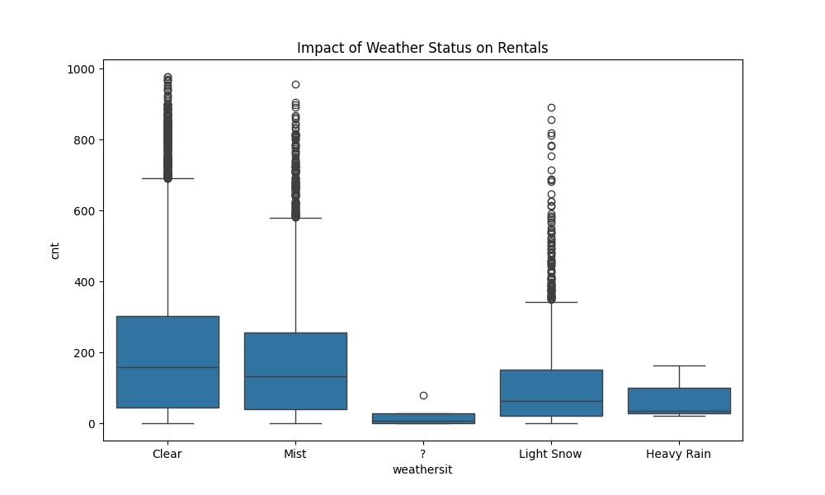
Inference: Weather Sit
Clear weather = Maximum rentals
Heavy rain = Minimal rentals
Demand is highly weather-elastic

Slide 14
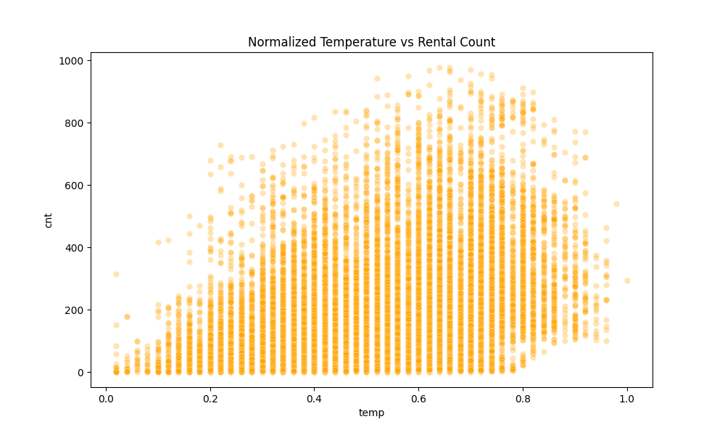
Inference: Temperature Influence
Positive correlation with rentals
Optimal riding temp: 0.6-0.8 range
Cold weather reduces casual ridership

Slide 15
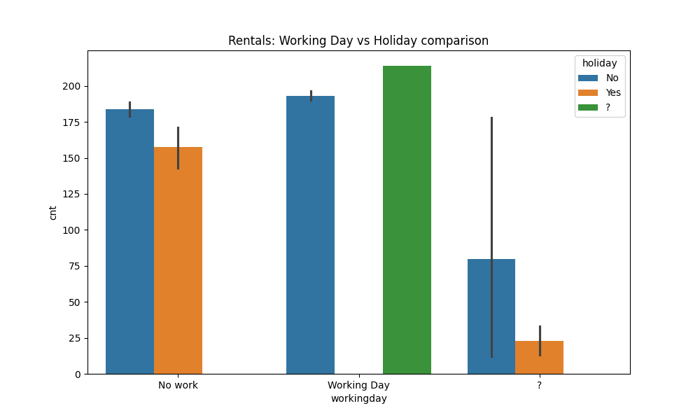
Inference: Working Days
Higher consistent demand on workdays
Different patterns for holidays vs workdays
Resource allocation must be dynamic

Slide 16
Feature Engineering: Cyclic
Hour mapped to Sin/Cos
Month mapped to Sin/Cos
Maintains circular time relationships

Slide 17
Feature Engineering: Encoding
One-Hot Encoding for Season
One-Hot Encoding for Weather
Ensured non-ordinal treatment

Slide 18
Feature Engineering: Scaling
Min-Max Scaler for weather data
Normalized range: 0 to 1
Ensured uniform feature contribution

Slide 19
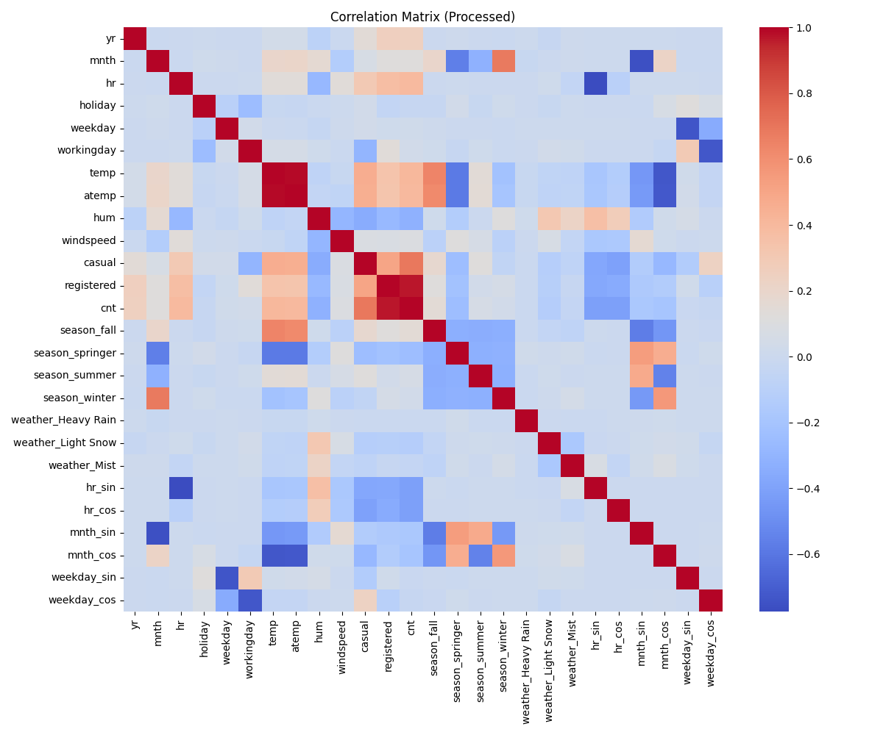
Correlation Insights
Temp & Atemp are highly correlated
Humidity negatively impacts demand
Hour is the strongest temporal feature

Slide 20
Model Selection Strategy
Evaluated three core algorithms: Decision Tree, Random Forest, and Gradient Boosting.
Goal: Identify the model with the highest generalization power.
Used a 80/20 train-test split with random state for reproducibility.
Metric Focus: R-squared (Accuracy) and MAE (Average Error).

Slide 21
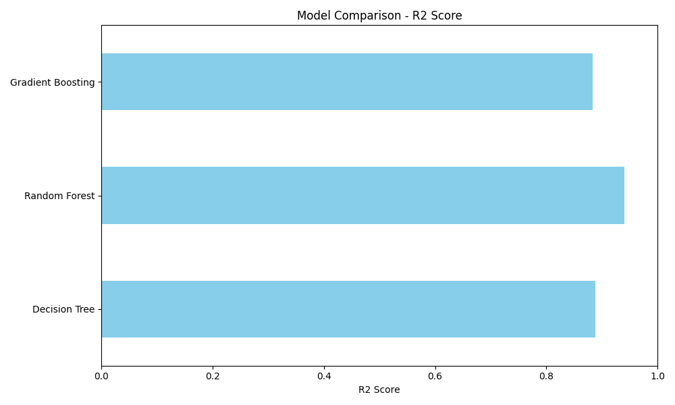
Analysis: Why Others Were Rejected
Decision Tree (R2: 0.88): Overfitted the training data too easily. High variance led to unreliable predictions for unseen peaks.
Gradient Boosting (R2: 0.88): Showed high sensitivity to noise in the dataset, resulting in the highest Average Error (MAE 42).
Both models failed to capture the complex, non-linear interactions as effectively as the ensemble method.

Slide 22
The Winner: Random Forest (R2: 0.94)
Ensemble Advantage: Combines multiple trees to cancel out individual prediction errors (Bagging).
Robustness: Handles skewed distributions and outliers (peak hours) without losing accuracy.
Performance: Achieved the lowest error and highest precision in demand forecasting.

Slide 23
Hyperparameter Tuning
Used Randomized Search CV
Optimized Depth and Estimators
Final model is robust to overfitting

Slide 24
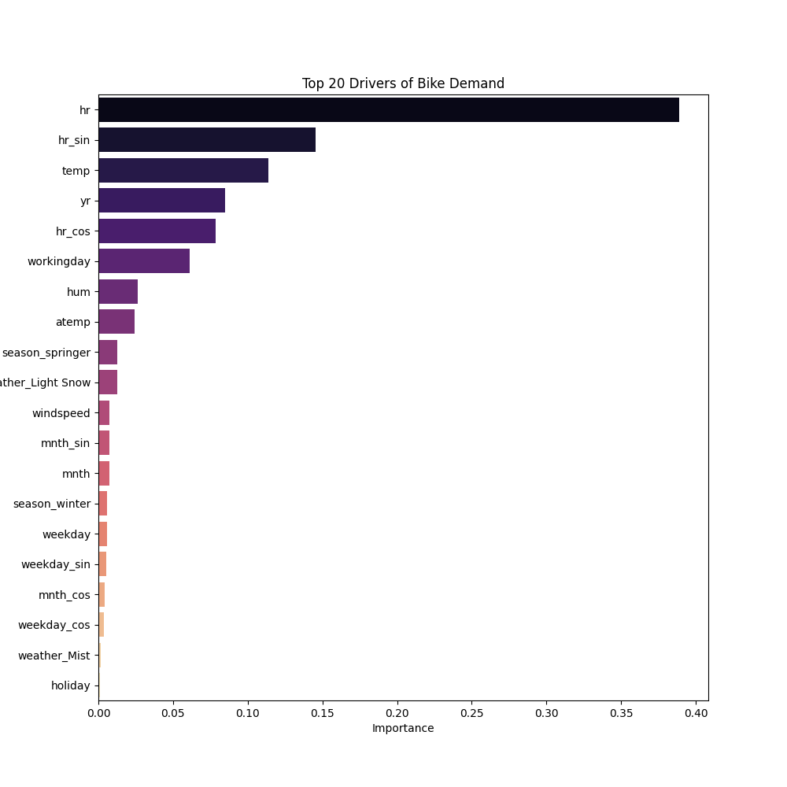
Feature Importance
Hour is the top driver (60%+)
Temp is the second major driver
Yearly growth is significant

Slide 25
Final Model Evaluation
MAE: ~25 rentals
RMSE: ~43 rentals
R-squared: 0.94 (Excellent fit)

Slide 26
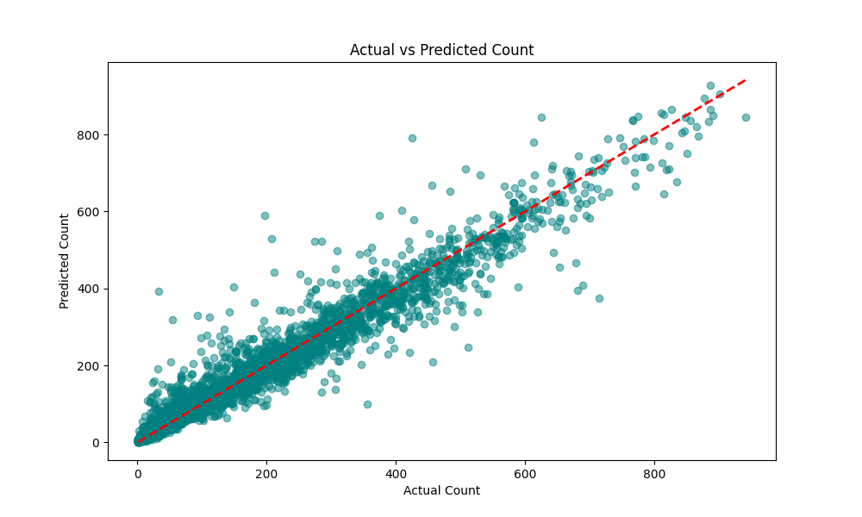
Prediction Performance
Predictions follow actual values closely
Stable across all demand levels
Minimal error for peak hours

Slide 27
Deployment: App Page
Streamlit Interface integrated
Real-time user inputs supported
Instant demand forecasting rendered

Slide 28
Challenges Faced
Data cleaning of hidden '?' values
Capturing cyclic nature of time
Tuning ensemble weights
Managing high-dimensional categorical data

Slide 29
Conclusion
High accuracy models enable better supply
Weather and Time are critical for city planning
Scalable approach for other cities

Slide 30
Thank You
Thank you for the opportunity!

