Slide 1


Orena Unified Platform
Connecting the Complete Talent Journey
Orena is building a unified platform that brings Hiring, Training and Culture Transformation into one connected ecosystem — connecting companies, candidates, students, employees and experts through a single experience.
FROM FINDING THE RIGHT TALENT TO DEVELOPING AND RETAINING IT
ORENA SOLUTIONS — UNIFIED PLATFORM ROADMAP

Slide 2





THE OBJECTIVE
What are we trying to achieve?
Today, different stages of the talent lifecycle involve different platforms, processes and stakeholders. Orena's objective is to bring these stages together into one connected platform, so that information and insights from each stage contribute to the next.
Hiring
Training
Mentoring & Expertise
Culture Transformation
Identify, assess and onboard the right talent.
Build skills through structured learning, assessment and certification.
Connect people with experts for targeted development.
Measure and improve engagement, leadership and organisational culture.
One platform. One talent journey. One connected view.
ORENA SOLUTIONS — UNIFIED PLATFORM ROADMAP

Slide 3

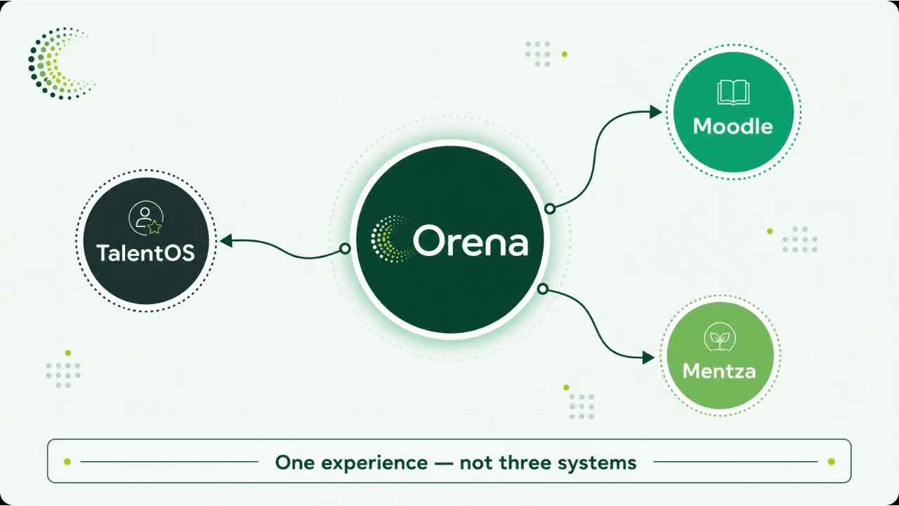
THE VISION
One Platform for Company, Candidate & Student
The vision is a common Orena experience that connects the different participants of the talent ecosystem — instead of separate experiences, Orena creates one connected journey.
A company can identify its requirements and talent needs.
A candidate can move through sourcing, assessment, evaluation and onboarding.
A student or employee can continue into learning, mentoring, assessment and certification.
Company → Candidate → Employee → Continuous Development
The platform integrates Moodle and Mentza into Orena across Hiring, Training and Culture Transformation.
ORENA SOLUTIONS — UNIFIED PLATFORM ROADMAP

Slide 4

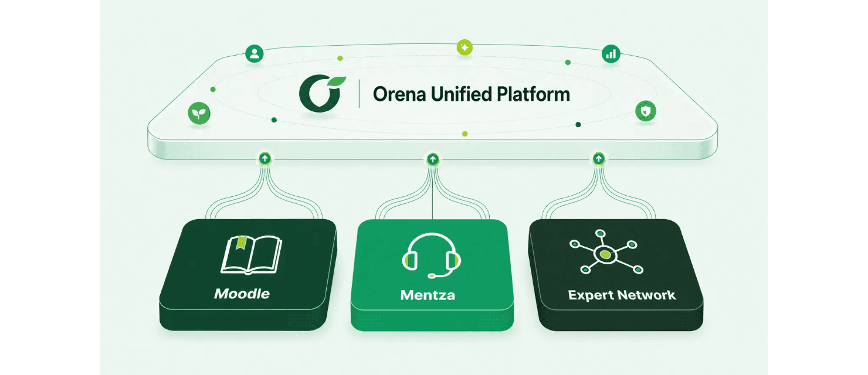
HOW THE PLATFORM WORKS
Connecting specialized capabilities through Orena
Moodle — learning management and structured training delivery.
Mentza — expert sessions, mentoring and skill development.
Expert Network — curated expertise, talent evaluation and expert interviews.
Orena — the connecting layer that brings these capabilities into one experience.
The goal is not to replace every existing system — it is to connect them into a common experience.
ORENA SOLUTIONS — UNIFIED PLATFORM ROADMAP

Slide 5

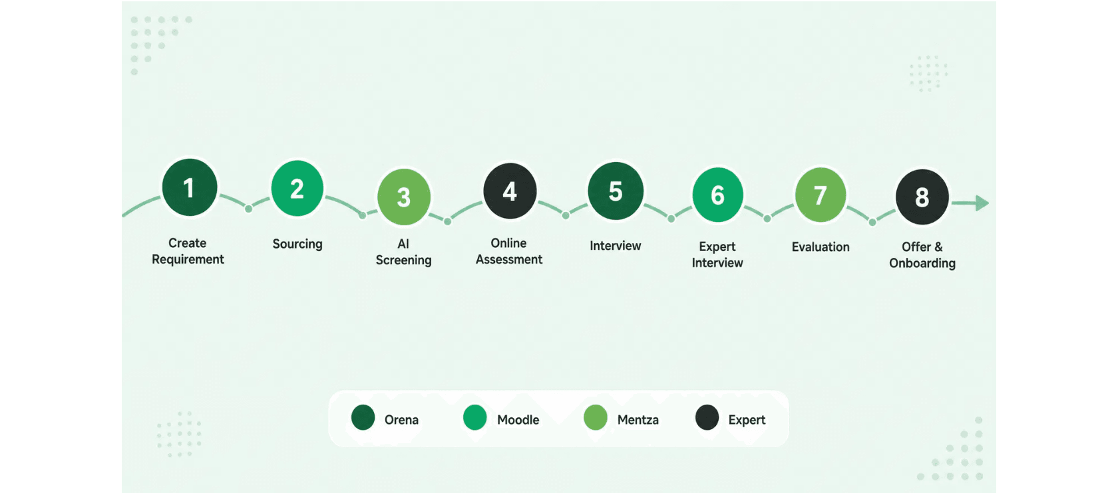
THE HIRING ENGINE
From requirement to onboarding — one connected recruitment journey
The process begins when a company creates a requirement and continues through sourcing, screening, assessment and interviews. Expert involvement then supports deeper evaluation before the final selection — every stage contributing to a more complete understanding of the candidate.
Eight stages, four systems — every stage builds a richer understanding of the candidate before and during onboarding.
ORENA SOLUTIONS — UNIFIED PLATFORM ROADMAP

Slide 6

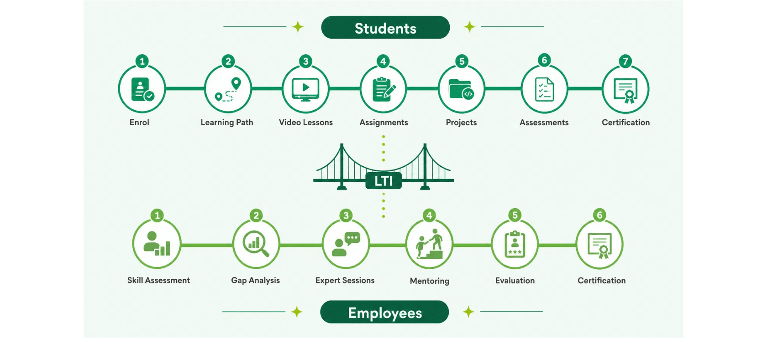
THE TRAINING ENGINE
Learning for students and employees on one platform
The Training Engine connects structured learning with practical skill development. For students, the journey moves from enrolment and learning paths to lessons, assignments, projects, assessments and certification. For employees, it begins with understanding current skills and gaps, followed by expert sessions, mentoring, evaluation and certification.
The LTI bridge carries Mentza's OSA Gap Analysis scoring into Orena — connecting learning outcomes back to the broader talent journey.
ORENA SOLUTIONS — UNIFIED PLATFORM ROADMAP

Slide 7
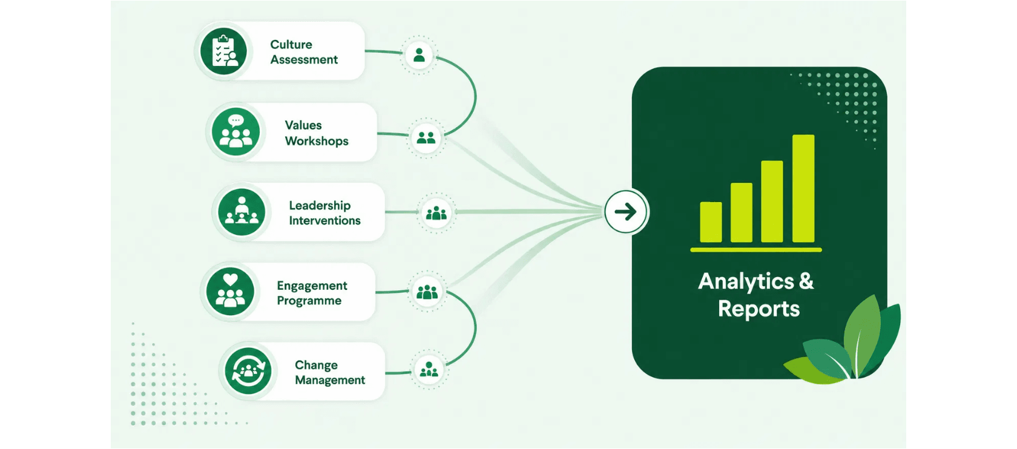
THE CULTURE ENGINE
From culture initiatives to measurable insight
The Culture Engine focuses on the human and organizational side of talent development. It brings together structured interventions that help organizations understand their culture, strengthen leadership and improve employee engagement — a fully human-led pillar where each stage feeds the next.
Move beyond individual initiatives — create measurable insight into organizational development.
ORENA SOLUTIONS — UNIFIED PLATFORM ROADMAP

Slide 8

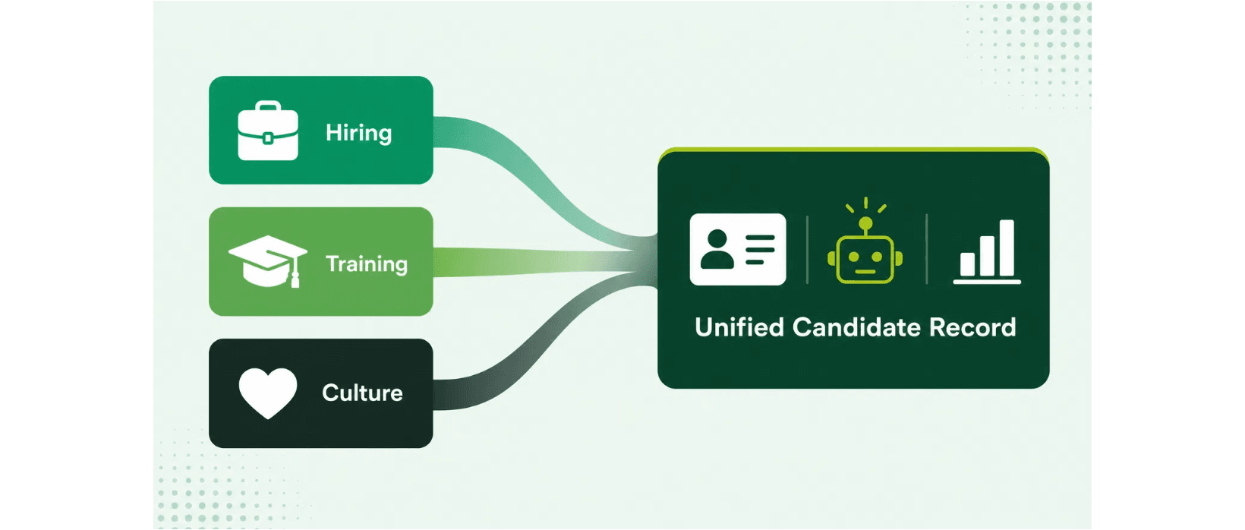
THE CONVERGENCE
One talent record across the entire journey
The key value of the unified platform is not simply connecting different systems. It is bringing the information generated across Hiring, Training and Culture into one connected talent view — a single record that supports a deeper understanding of each individual's journey and development.
Hiring contributes candidate information, assessments and evaluation.
Training contributes skills, learning progress and certifications.
Culture contributes engagement, leadership and organizational insights.
One dashboard. One record. Every pillar contributes to it.
ORENA SOLUTIONS — UNIFIED PLATFORM ROADMAP

Slide 9
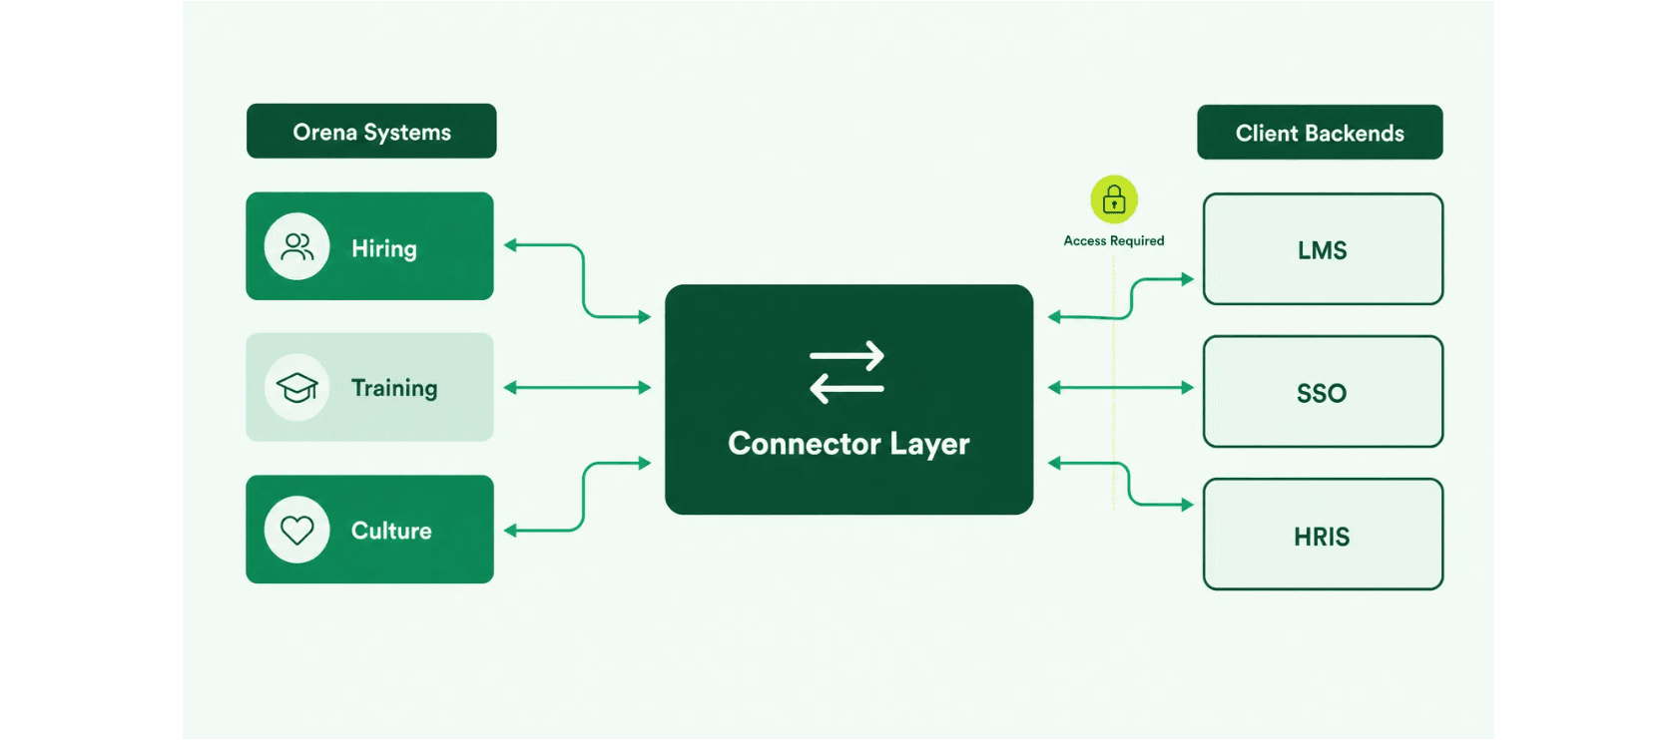
THE FOUNDATION
Connecting Orena with existing client systems
The unified platform needs to work with the systems organizations already use. Rather than requiring every client to replace its existing infrastructure, Orena introduces a connector layer between the platform and client backends — connecting Orena with different environments while keeping the unified experience at the platform level.
The connector layer links Orena's Hiring, Training and Culture systems to each client's LMS, SSO and HRIS backends.
ORENA SOLUTIONS — UNIFIED PLATFORM ROADMAP

Slide 10
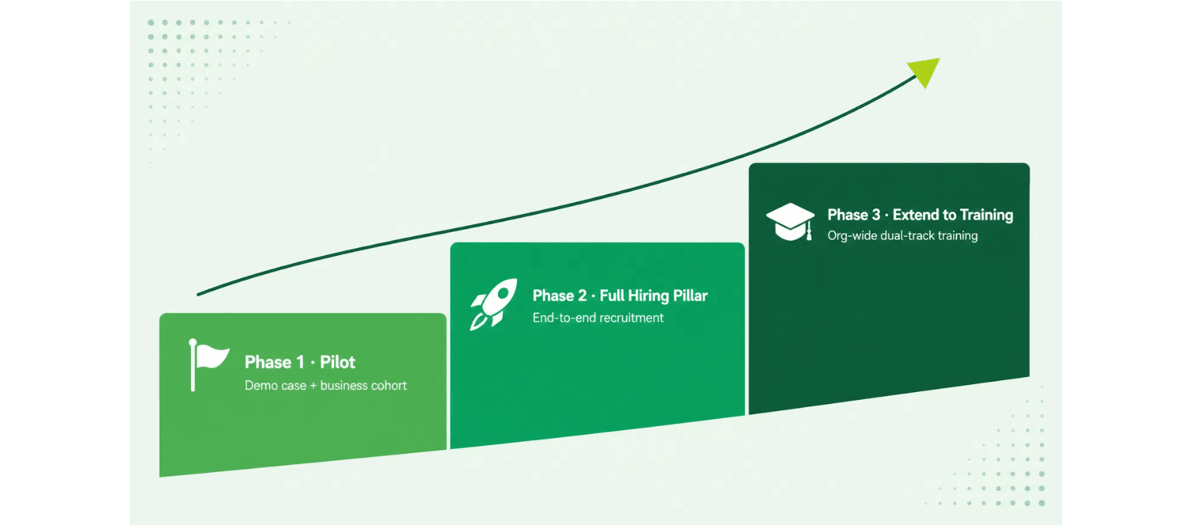
THE ROLLOUT
A phased approach to building the platform
The platform does not need to be built and deployed all at once. A phased approach allows each layer to be validated before expanding — Phase 1 validates the initial integration, Phase 2 establishes the complete Hiring Engine, and Phase 3 connects organization-wide learning and development.
Our approach: Validate → Learn → Improve → Scale.
ORENA SOLUTIONS — UNIFIED PLATFORM ROADMAP

Slide 11

NEXT STEPS
What do we need to start the pilot?
To begin Phase 1, three dependencies need to be addressed.
1
Moodle Backend Access
READY WHEN YOU ARE
Provide the required credentials and access so the team can conduct the technical audit and understand the existing environment.
Deploy Phase 1 Pilot
One demo case. One business cohort.
Validated, then scaled.
2
Mentza Scoping Conversation
Initiate a direct technical discussion with the Mentza development team to define the integration requirements and approach.
Launch the Pilot
3
Resourcing Sign-off
Confirm the timeline and allocate the engineering resources required for the pilot.
hello@orenasolutions.com
ORENA SOLUTIONS — UNIFIED PLATFORM ROADMAP

Slide 12

THE OUTCOME
One Connected Talent Journey
From separate systems to one connected talent ecosystem — where hiring, training, mentoring and culture grow together on a single platform.
Hiring — find the right talent
Training — build the right capabilities
Mentoring — connect people with expertise
Culture — develop stronger organizations
Pilot → Validate → Scale
ORENA SOLUTIONS — UNIFIED PLATFORM ROADMAP

