Slide 1

Bridging the Gap between Industry and Academia
The Workforce Growth Platform

Slide 2

Contents
Who we are, the platform we are building, and the track record behind it.
01
The Platform
The problem today, the idea and the workflow.
02
The Company
Vision, services, universities, clients and track record.

Slide 3



Orena Solutions
Orena Solutions builds the pipeline between raw engineering talent and the organizations who need it most — hiring, training and culture transformation, delivered as one connected system.
We have grown through hiring services, research-based training, industry collaboration and organizational transformation. We are part of the Shakti Ecosystem, engineering solutions that respect people and planet.
WHAT WE DO
Hiring
Lateral, fresher and contractual hiring for engineering teams.
Learning & Development
Research-based training for students and employees.
HEADQUARTERS
Culture Transformation
Vadodara, Gujarat
Expert-led, measurable organisational change.

Slide 4
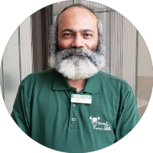
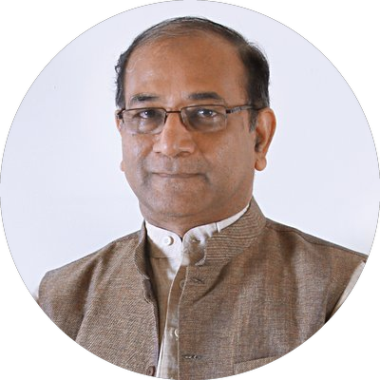
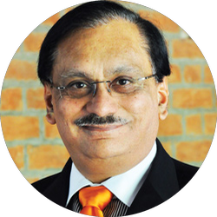
Advisory Board
Senior leaders from industry, academia and philanthropy who guide Orena's direction.
Dr. Bhuvan Unhelkar
Dr. Prabhat Ranjan
Mr. Pratul Shroff
Professor of Information Technology and consultant — Sarasota, Florida.
Vice Chancellor, D Y Patil International University, Akurdi, Pune. Former Director, TIFAC.
Founder of eInfochips. Founder, Dr. K. R. Shroff Foundation. Philanthropist, thinker & doer.

Slide 5






THE PROBLEM
Building engineering talent is scattered across disconnected tools.
When companies hire, train and grow engineering teams, the work runs on email, spreadsheets, chats and calls. No single system holds it together — so progress is invisible and outcomes cannot be measured from one place.
TODAY — THE FRAGMENTED FLOW
CORE PAIN POINTS
01
Manual coordination across stakeholders with no shared system of record
Email
Spreadsheets
WhatsApp
Calls
Files
02
Progress and outcomes are not measurable from a single place
03
Client visibility depends on consultant follow-up, not self-serve data
04
No structured way to consolidate hiring, learning and transformation history per client
NO SHARED SYSTEM OF RECORD
Progress lives in inboxes, sheets and chats — the consultant becomes the only source of truth.

Slide 6
THE IDEA
One platform that runs the entire talent journey.
Orena is building a Workforce Growth Platform — hiring, learning and culture transformation delivered inside one connected system, where experts and AI work together and every outcome is measurable.
HOW IT WORKS TODAY
WITH THE ORENA PLATFORM
Services delivered ad hoc
→
Services delivered through one connected platform
Email, spreadsheets and WhatsApp
→
A single system of record
Visibility that depends on a consultant
→
Client self-serve dashboards and analytics
Tools that dictate the experience
→
Technology abstracted behind the platform
Software orchestrates people, workflows and data. Experts keep delivering the judgment-driven work.

Slide 7
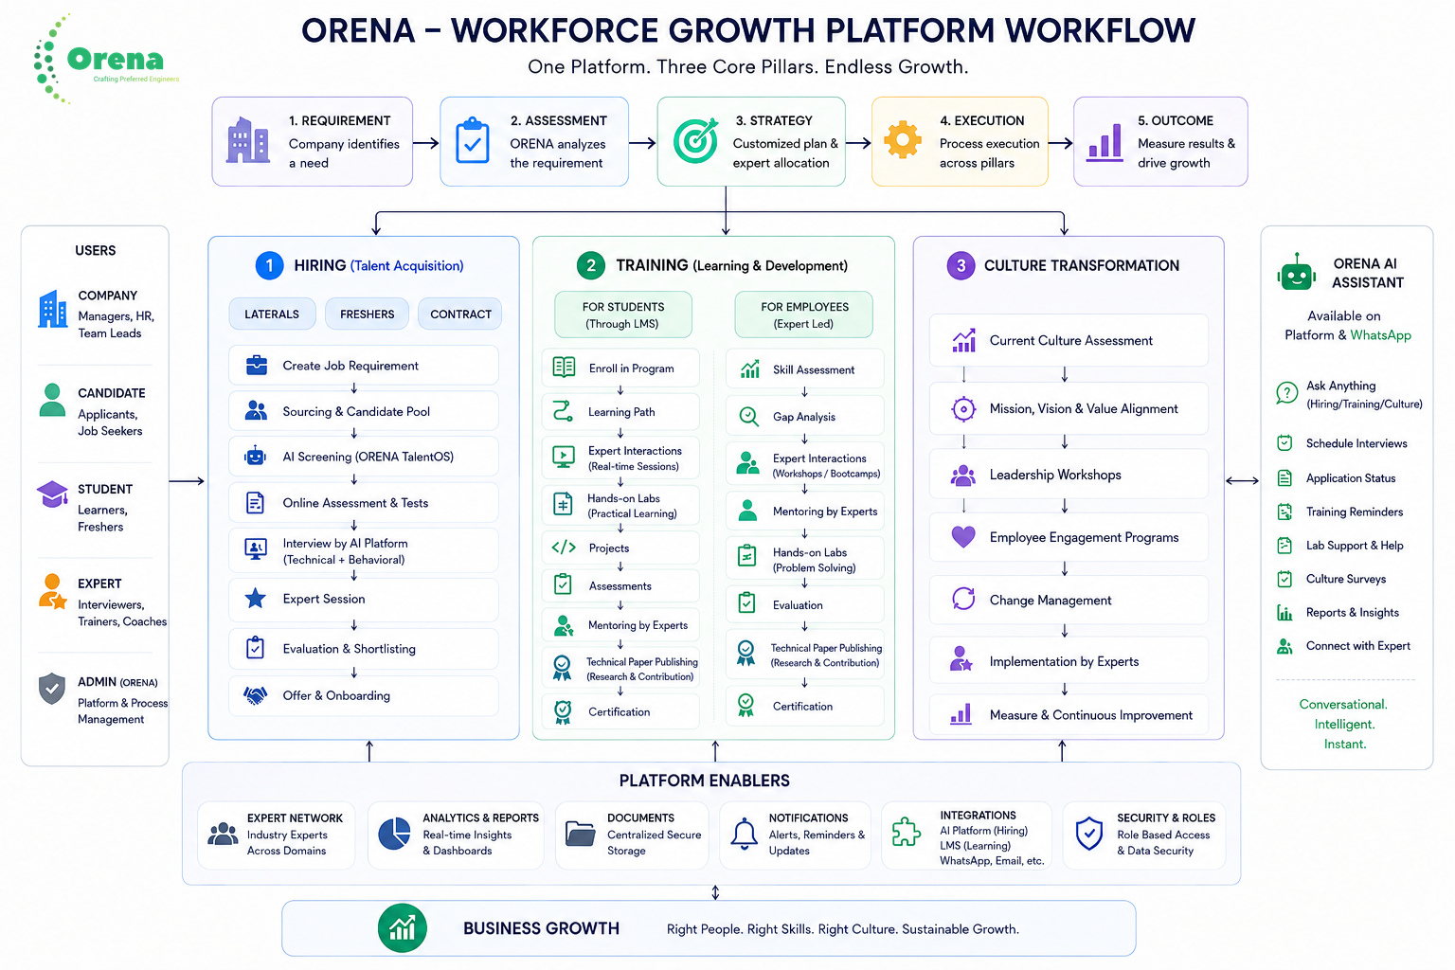

Slide 8



Power the pipeline of preferred engineers.
Our vision is to create an ecosystem that equips, empowers and encourages human talent — so companies grow through the right people, and people grow through relevant, research-based learning and mentoring.
Reliable
Forward-thinking
People-focused
Impact-driven
We deliver on our word. Every engagement is built on consistency organizations can plan around.
We anticipate where talent and industry are headed, not just where they are today.
Every solution starts with the humans it serves — engineers, teams and leaders alike.
We engineer solutions that create lasting value, not just short-term output.
One platform. One talent journey. One connected view.

Slide 9







Our Services
Seven services, three engines, one platform — industry-ready engineering talent and the organizations that keep it growing.
Talent Acquisition
Making Industry Ready
Expert Exchange
Corporate Workshops
Contract, permanent & freelance hiring, campus drives, mock interviews.
Research-based training that makes graduates deployable.
Named domain experts for interviews, reviews and mentoring.
Focused upskilling delivered inside client organizations.
Platform Services
Authentication & role-based access
Analytics & reporting
Document management
Notifications
AI assistant
IP, Patent & Development
Setting up Research Centres
Executing Industrial Projects
Intellectual-property creation, patents and product development.
Design-house and research-centre setup, team to infrastructure.
End-to-end delivery of industrial engineering projects.

Slide 10






University & Knowledge Partners
Research-based training runs in collaboration with universities — the engine behind industry-ready graduates and the campus hiring pipeline.
PROGRAMS TI University Program · Cypress University Alliance · Board of Studies participation across universities

Slide 11
























Domains & Clients
We operate across seven engineering domains, for a client base that spans product companies, design houses and enterprises.
DOMAINS WE SERVE
Embedded Systems
Automation
Industry 4.0
IT & ITES
E-Commerce
Digitalization
Consumer Durables
SELECTED CLIENTS — DEVELOPMENT & RECRUITMENT
…plus eInfochips, VVDN Technologies, and Fortune 500 delivery through our global partners.

Slide 12

Global clients through our partner network.
Through our global partner XCEL Solutions Corp, our talent and delivery reach Fortune 500 enterprises across the US, Europe and Latin America.
IBM · SAP · Oracle · Ericsson · Bayer · Ford · HP · Sun Microsystems · The Washington Post · Stanford University · Telcel · and more.

Slide 13
The numbers behind the name.
1,500+
98%
70,000+
20
1
3
Engineers trained
Placement rate
Students reached
Intellectual properties
IP patent
Entrepreneurs incubated
Star Companies of Orena
eInfochips
VVDN Technologies
Around 1,500 of 2,000 eInfochips engineers were trained by our team
Initiated the entire design house for VVDN in Gandhinagar
Long-running embedded-domain training partnership
Recruited a 500-strong team across all 8 design houses PAN India — including sales teams in the US, Canada, Japan and Germany; 450 joined

Slide 14
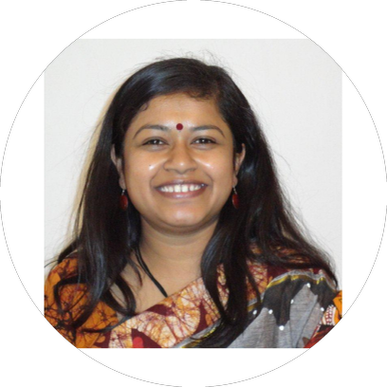
Meet the Director
Ekata Mehul Shah
PRINCIPAL DIRECTOR
Director & Chief Software Architect
25+ YEARS IN GLOBAL SOFTWARE ENGINEERING
28+ years across industry and academia; Ph.D. (contd.), M.Tech (ICT), B.E. (Computer)
B.Tech (Computer Science, 1995), NIT Rourkela; Executive MBA, Harvard Business School
Patent holder — digital metering using Zigbee; 25+ international publications, 3 book chapters
AI / Data Science & Quantum Computing, MIT Boston
Industry-Academia Anchor, KDEM, Government of Karnataka
NSDC Master Trainer & SME with NASSCOM / ESSCI; IVLP alumna (US, Women in STEAM)
Prior industry experience: IBM USA, AT&T NJ, CNR Corp, eVue
Women Entrepreneur Gujarat (GESIA, 2014); Director, Women in Big Data India
Serial entrepreneur, startup mentor and angel investor; board member for several companies
Trained 70,000+ students; built multiple Centres of Excellence and incubation centres
Visionary and catalyst for industry-academia collaboration — instrumental in setting up CoEs and incubation centres

Slide 15
Reach us at—
WEB
www.orena.solutions
EMAIL
contactus.orenasolutions@gmail.com
PHONE
+91 98243 47721
OFFICE
Let's build the platform.
4th Floor, Urban Complex, Near Panch-mukhi Hanuman,
Vasna-Bhayali Road, Vadodara – 390012

