Slide 1
IIT KANPUR
LOGO
Department of Materials Science and Engineering
Indian Institute of Technology Kanpur
Machine Learning Assisted Stress Prediction of
Gyroid TPMS Structures
MSE643: AI/ML Track Project
Presented by: Shakti
Notes:
Swap the logo box for the real IIT Kanpur logo before presenting (Insert > Picture). Link: https://www.iitk.ac.in/data/IITK.png.

Slide 2
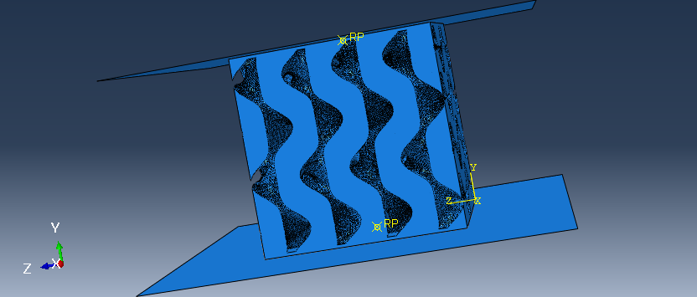
Introduction
A gyroid is a Triply Periodic Minimal Surface (TPMS): a smooth surface that repeats periodically in all three directions and divides space into two separate, interlocking regions, giving a continuous wavy lattice with no sharp edges or joints.
It is one of the most widely used TPMS lattices in engineering because it is self-supporting during 3D printing (its curves do not need extra support material), it has a fully open, connected pore network, and it spreads stress smoothly through the structure instead of concentrating it at sharp corners the way strut-based lattices do.
These properties make it useful in two very different fields: lightweight load-bearing parts for aerospace, where saving weight without losing strength matters, and bone-mimicking implants for biomedical use, where a porous structure needs to match the stiffness of real bone.
In this project, we look at how the stress a gyroid shape experiences depends on how much it is compressed (strain) and on its geometry: unit cell size, wall thickness, and how much of the volume is filled with material.
A gyroid shape (from our Abaqus model)
2
Notes:
Can run 45-60 seconds now with the extra detail. TPMS = Triply Periodic Minimal Surface, worth defining out loud since it's an acronym.

Slide 3
Problem Statement & Objective
Problem
Abaqus FEA gives very accurate predictions of how a gyroid structure deforms and carries stress under load, but setting up and running even one simulation, building the geometry, meshing it, defining boundary conditions, and solving the physics, takes real time.
Every time we want to test a new combination of unit cell length, wall thickness, or fill percentage, we have to repeat this whole process again, which makes exploring many designs slow.
Objective
Build a fast, data-driven model that learns the relationship between a gyroid's geometry and strain and its resulting stress directly from the FEA data we already have, so we get a prediction in milliseconds instead of running a new simulation.
Train and fairly compare two different approaches, Linear Regression (which assumes a mathematical relationship between inputs and output) and Decision Tree (which learns patterns by splitting the data), then identify which one predicts stress more accurately, and explain why.
3
Notes:
Main framing slide: FEA works fine but is slow, so we use ML instead once we already have enough simulation data.

Slide 4
From Simulation to Dataset
Methodology (1 of 5)
We simulated 5 gyroid shapes being compressed in Abaqus, a finite element simulation software, using Ti-6Al-4V as the material, with the bottom plate fully fixed and the top plate pushed down by a set displacement.
Each shape was compressed by 5 different amounts, all within the elastic region, so the shape returns to normal after the load is removed.
Abaqus recorded force, displacement, and energy at every time-step of every run, and saved all of it into one Excel file: gyroid_utkarsh_1_results.xlsx.
Geometry | Fill %
1 | 29.1
2 | 40.4
3 | 58.8
4 | 48.0
5 | 67.1
4
Notes:
Keep this reasonably fast, it's background. Next slide opens the actual Excel file.

Slide 5
The Dataset
Methodology (2 of 5)
gyroid_utkarsh_1_results.xlsx — Sheet1 — 2525 rows × 13 columns — each row is one time-step of one simulation run
Column (as in Excel) | What it means
Time | Simulation time, in seconds
ALLIE(N.mm) | Internal (strain) energy
RF2(N) | Reaction force at the loaded point
U2(mm) | Displacement of the loaded point
Engineering_Stress(MPA) | Stress — this is what we predict
Engineering_Strain | Strain (displacement ÷ height)
Applied_Displacement(mm) | Maximum displacement for that run
Cross_Sectional_Area + 4 more | The 5 shape settings: area, unit cell length, wall thickness, fill %, height
A column for kinetic energy (ALLKE) is also in the file but is not used as a model input. After cleaning (removing duplicate rows and the zero-load starting row of every run), 2525 rows become 2500 usable rows.
5
Notes:
This is the actual raw file. Good slide to open the Excel file live if asked, or show df.head() from the code.

Slide 6
Preprocessing the Data
Methodology (3 of 5)
1. One-Hot Encoding (Geometry_ID → 5 columns)
For every row, OneHotEncoder looks at which of the 5 geometries that row belongs to, and creates a 1 in that geometry's column and a 0 in the other four. This way the model sees “which shape is this” as five independent yes/no signals, instead of a single number that would wrongly suggest an order between shapes.
2. Standardization (StandardScaler)
For every numeric column, StandardScaler subtracts that column's mean and divides by its standard deviation: scaled value = (value − mean) ÷ standard deviation. Afterward, every numeric feature has a mean of 0 and a standard deviation of 1, so a feature like area (in the thousands) and strain (in the thousandths) are treated on equal footing.
3. Polynomial Features (degree 2, Linear Regression only)
PolynomialFeatures(degree=2) takes the 5 numeric features and adds every square (Strain², Fill_Percent², ...) and every pairwise product (Strain × Fill_Percent, ...) as new columns. This gives Linear Regression the curved building blocks it needs, even though the model itself only ever fits straight lines through whatever features it is given.
Result: Linear Regression ends up with 30 input columns per row (5 one-hot + 5 scaled + 20 polynomial). Decision Tree uses only 10 (5 one-hot + 5 scaled) — it builds non-linear patterns on its own.
6
Notes:
If asked why one-hot encoding: stops the model thinking one shape is 'bigger' than another. If asked why only Linear Regression gets polynomial features: trees create non-linearity through splits already, so it would just be redundant noise for them.

Slide 7
Model 1: Linear Regression
Methodology (4 of 5)
After preprocessing, Linear Regression receives 30 input columns for every row (5 one-hot geometry columns, 5 standardized numeric features, and 20 polynomial combinations of those features), and needs to learn one weight for each column plus one intercept: stress ≈ w₁x₁ + w₂x₂ + ... + b.
During training, scikit-learn's LinearRegression solves directly for the weights that minimize the total squared error between predicted and actual stress across all 1750 training rows, a method called Ordinary Least Squares. This is solved in a single step using linear algebra, not by trial and error.
To predict the stress of a new row, the model multiplies each of the 30 feature values by its learned weight, adds them all up along with the intercept, and that sum is the predicted stress.
This approach works well here because, within the elastic region we simulated, stress truly is a linear function of strain (Hooke's Law), and the polynomial terms let the model also capture how a shape's geometry changes its effective stiffness.
7
Notes:
If asked what 'weights' means: each input feature gets a number showing how much it pushes stress up or down. Ordinary Least Squares just means it picks the weights that make the total squared error as small as possible, solved directly rather than searched for.

Slide 8
Model 2: Decision Tree
Methodology (5 of 5)
After preprocessing, the Decision Tree receives 10 input columns for every row (5 one-hot geometry columns and 5 standardized numeric features) — it does not use the polynomial columns, because it can create non-linear patterns on its own through splitting.
During training, scikit-learn's DecisionTreeRegressor examines every feature and every possible threshold, and picks the single split that reduces prediction error the most across the training rows. It then repeats this process separately on each of the two resulting groups, and keeps going until it reaches the depth limit of 10.
To predict a new row's stress, the tree asks the same sequence of yes/no questions it learned (for example, “is Strain greater than 0.003?”, then another question, and so on) until it reaches a final leaf, and returns that leaf's stored average stress value as the prediction.
Limiting the depth to 10 avoids overfitting: an unlimited tree would keep splitting until almost every leaf held just one or two training rows, effectively memorizing the training data instead of learning the general trend.
8
Notes:
If asked what a 'leaf' is: the end point of a branch, once the tree stops asking questions. Overfitting means the model does great on training data but worse on new data.

Slide 9
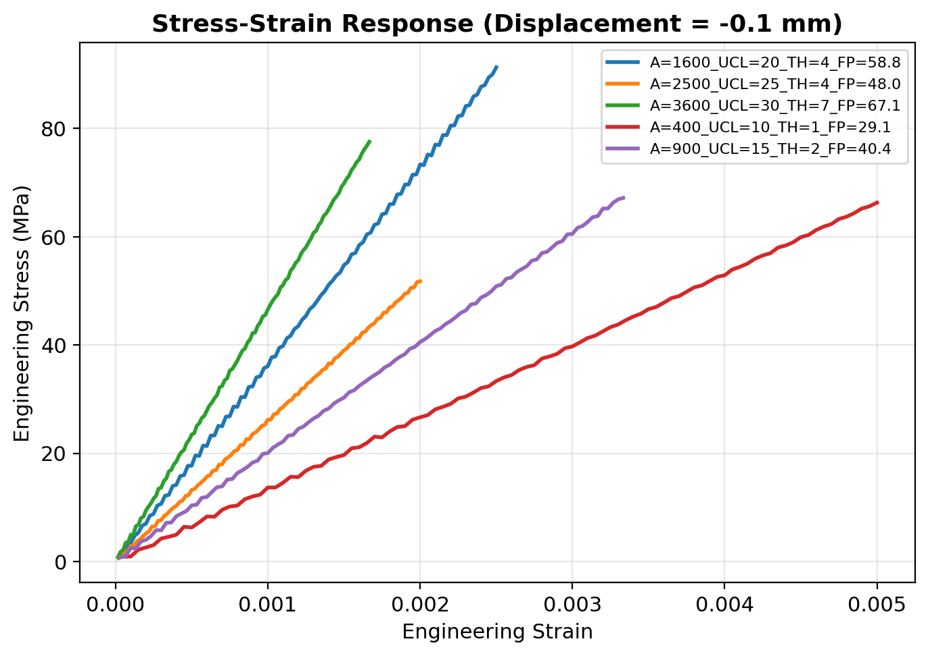
Looking at the Data First
Results (1 of 4)
Every shape gives a straight line starting from zero, which is exactly what basic physics predicts for elastic loading (Hooke's Law).
Shapes with more material (higher fill %) are stiffer, so their line is steeper, meaning they reach a higher stress for the same amount of strain.
This pattern, before we train any model, already hints at which factors will matter most for prediction.
9
Notes:
Quick slide, just point at the lines and note they fan out by fill percentage.

Slide 10
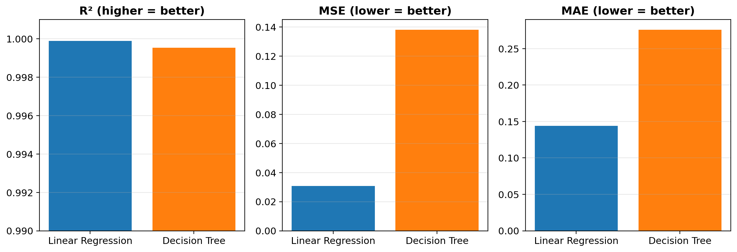
Which Model Predicts Better?
Results (2 of 4)
Model | R² | MSE | MAE
Linear Regression | 0.99990 | 0.031 | 0.144
Decision Tree | 0.99954 | 0.138 | 0.276
Linear Regression comes out ahead on every measure: R² closer to 1, and both MSE and MAE lower, meaning smaller average errors, in MPa, across the 750 test rows.
10
Notes:
Both models do well, but Linear Regression is a bit more accurate, because the real relationship here is close to a straight line once we added those extra features.

Slide 11
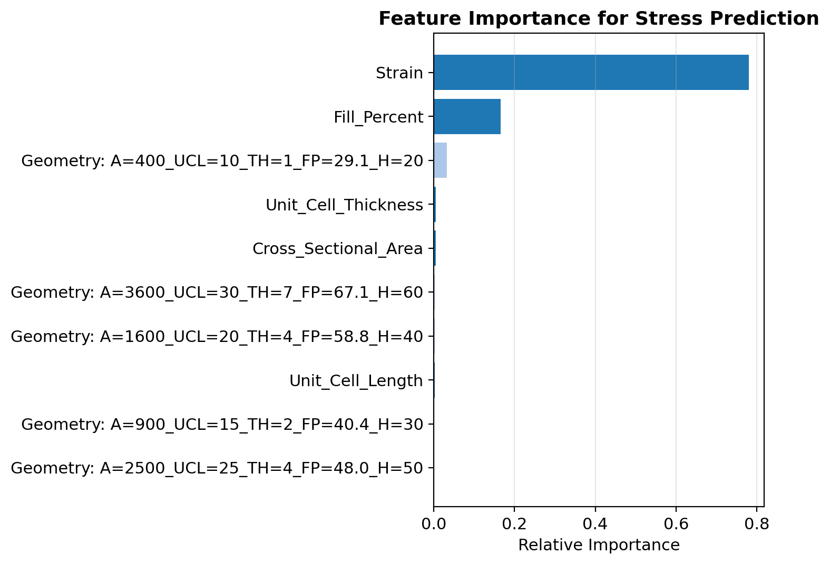
What Actually Drives Stress?
Results (3 of 4)
Strain matters the most: about 78% of the prediction, matching Hooke's Law directly.
Fill percentage comes next: about 17%, since it is the strongest geometric lever on how stiff a shape is.
Everything else, area, length, thickness, and the individual shape labels, barely matters once strain and fill percentage are known.
11
Notes:
This explains the earlier EDA slide: strain and fill percentage are what actually matter, matching simple physics (stress = stiffness times strain).

Slide 12
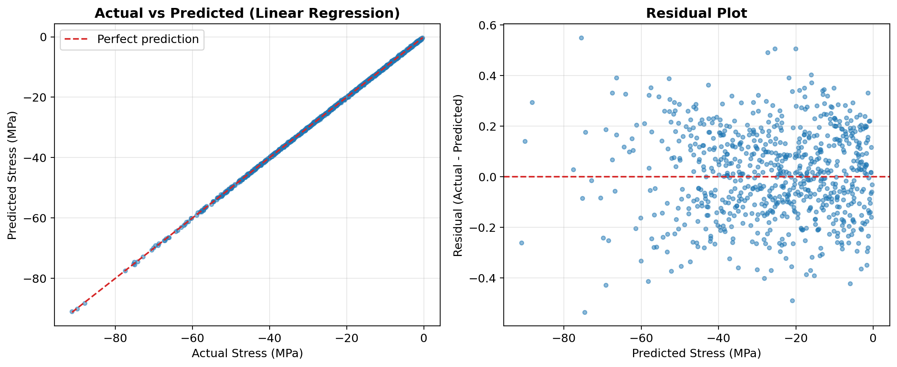
How Close Are the Predictions?
Results (4 of 4)
Left: predictions line up closely with the real values across the full stress range. Right: the errors (residuals) scatter randomly around zero with no funnel shape or trend, meaning the model is not systematically wrong at any particular stress level.
12
Notes:
The right-side plot matters more than it looks: no pattern in the errors means the mistakes are just small and random, not systematic.

Slide 13
Summary & Conclusion
Built on gyroid_utkarsh_1_results.xlsx: 2500 cleaned rows from 5 gyroid shapes, split 1750/750 for training and testing.
We built two models to predict gyroid stress instantly, instead of running a new Abaqus simulation every time.
Linear Regression (30 input columns, including polynomial terms) worked best: R² = 0.9999, staying very close to the real values.
Decision Tree (10 input columns, max depth 10) came in a close second: R² = 0.9995.
Strain and fill percentage are what matter most for predicting stress, matching basic physics.
This kind of model could save a lot of simulation time when exploring future gyroid designs.
Thank you
13
Notes:
Wrap up with the one-line takeaway: a simple model worked well because the underlying relationship here is genuinely simple.

