Slide 1
PROJECT REPORT
ON
BASIC CALCULATOR
Submitted By: Shaktimayee Dash
Branch : CS
RollNo.:25

Slide 2
TABLE CONTENTS
1.Introduction
2.Basic function
3.Flow Chart & Dataflow Diagram
4.Hardware & Software
5.Testing
6.Future scope of project
7.Conclusion
8.Extra Things

Slide 3
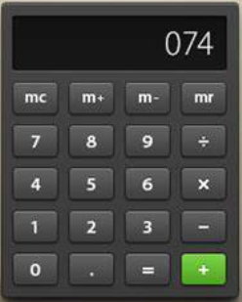
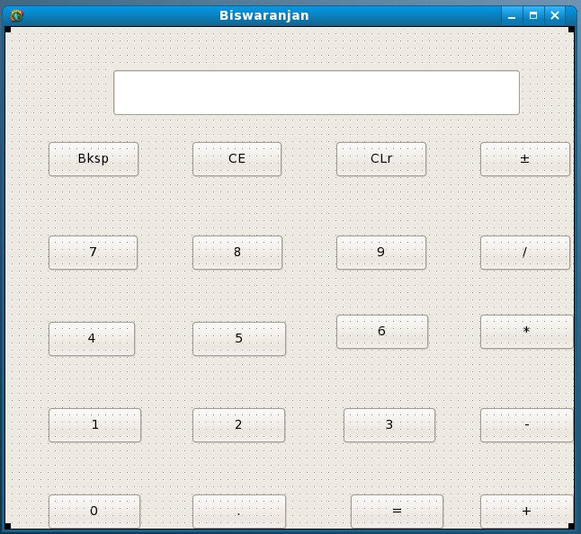
Image Of Basic Calculator:- Basic Calculator Using Glade Interface:-

Slide 4
INTRODUCTION
Basic Calculator :
The calculator was written by Rolf Howarth in early 1996. A fully featured scientific calculator with proper operator precedence is implemented, including trig functions and logarithms, factorials, 12 levels of parentheses, logs to base 2 (a handy function for information entropists!), bitwise logical operators, hex, octal, binary and ASCII display.
The calculator is written in JavaScript and you are welcome to view the JavaScript source (visible within the HTML page) for personal educational purposes as long as you recognize that it is copyrighted and not in the public domain. This calculator is now available as part of Hummingbird's Enterprise Information Portal. All enquiries regarding licensing the calculator should be directed to Hummingbird Ltd

Slide 5
BASIC FUNCTIONS
Addition:
The addition (sum function) is used by clicking on the "+" button or using the keyboard. The function results in a+b.
Subtraction:
The subtraction (minus function) is used by clicking on the "-" button or using the keyboard. The function results in a-b.
Multiplication:
The multiplication (times function) is used by clicking on the "x" button or using the keyboard "*" key. The function results in a*b.
Division:
The division (divide function) is used by clicking on the "/" button or using the keyboard "/" key. The function results in a/b.

Slide 6
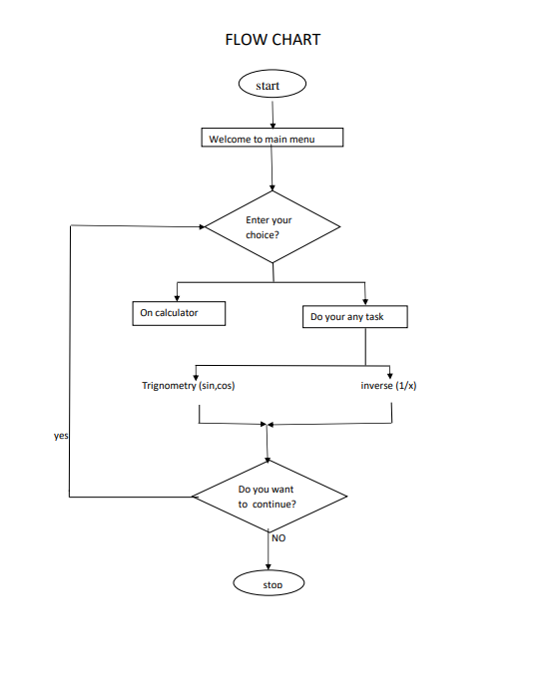
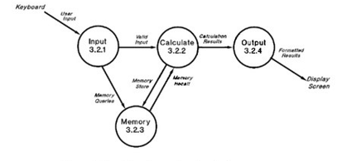
DATAFLOW DIAGRAM:-

Slide 7
HARDWARE AND SOFTWARE:
The program shall be written in standard C, in the interface created by GTK GLADE INTERFACE as compiled by the compiler (gcc). The program shall use only standard C library functions. The program shall be usable on any system which supports the gec compiler, and shall not require any particular hardware or software.

Slide 9
FUTURE SCOPE OF THE PROJECT:-
Our project will be able to implement in future after making some changes and modifications as we make our project at a very low level. So the modifications that can be done in our project are: To make it screen touch so no need to touch key buttons and one more change which can we made is to add snaps of the person who use it.
TESTING:-
Testing is the major control measure used during software development. Its basic function is to detect errors in the software. During requirement analysis and design, the output is a document that is usually textual and no executable. After the coding phase, computer programs are available that can be executed for testing purpose. This implies that testing not only, has to uncover errors introduced during coding, but also errors introduced during previous phase. Thus the goal of testing is to uncover the requirements, design and coding errors in the programs. TheSourcecode declared above for the program of Scientific Calculator has been tested and it has been found that the above source code is okay and correct.The program involves many type of conversions. These conversions has To done carefully

Slide 10
CONCLUSION:
After it's all said and done, making an instrument or a controller is a matter of putting together a series of components and segments of programs, each of which provides a specific function not unlike what we have done in almost all the projects in this calculator.In this calculator, we have covered the most basic techniques for doing this. Other more sophisticated techniques should not be any harder to investigate and assemble. Writing a short program to investigate what needs to be done for any part of your project should not be difficult with the expertise you now have.
EXTRA THINGS:
1.What is basic calculator?
→A basic calculator is sometimes referred to as a 4-function calculator. It's able to do simple arithmetic, which includes addition, subtraction, multiplication, and division. Use a basic calculator
2.Drawback of basic calculator?
>> This has to be handled carefully, as never explain too many drawbacks of your project.And use correct words to explain the drawback.
3. what is modules in a project?
My project can made by only one modules because of a module is a collection ofsource files and build settings that allow you to divide your project into discrete units offunctionality
4. what is your role in project? 5.challenge in project?
6. What is the tool technologies and Platform used in project?
→ This is also a very important aspect when explaining in my project in fronted is
7. What is the futures development of your project?
>>> Looking at the future value of your investments is important to determine what you want to invest in, as well as the potential wealth you'll accumulate over the long term

