Slide 1



AtliQ Data Services
MITRON BANK

Slide 2
AGENDA
Company Overview
Data
Insights & Visuals

Slide 3
Company Overview
Introduction :-
Mitron Bank, a legacy financial institution headquartered in Hyderabad, aims to broaden its product offerings by introducing a new line of credit cards to strengthen its market presence.
Problem Statement :-
Mitron Bank wants to launch credit cards to expand its reach. AtliQ Data Services approached the bank with a proposal to assist in this project. However, the bank’s Strategy Director, Mr. Bashnir Rover, requested a pilot project using sample data before proceeding. AtliQ was provided with a dataset of 4,000 customers from five cities, including details on their online spending behavior
Approach :-
Peter Pandey, a data analyst at AtliQ, is responsible for analyzing the sample data. His findings will help Mitron Bank tailor its credit card offerings to better meet customer needs and market trends.

Slide 4
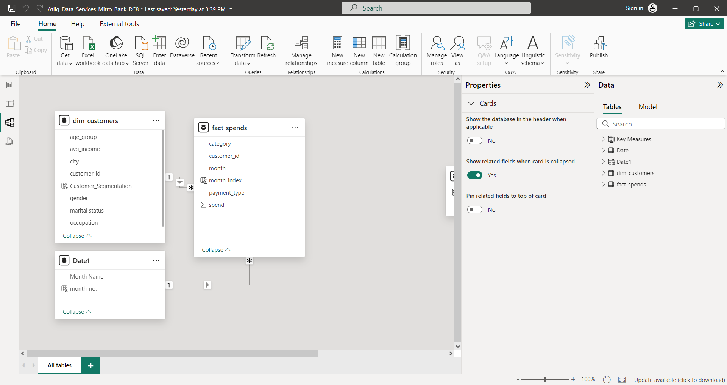

DATA :-
For Visualization :-
Power BI

Slide 5
Insights
&
Visuals

Slide 6
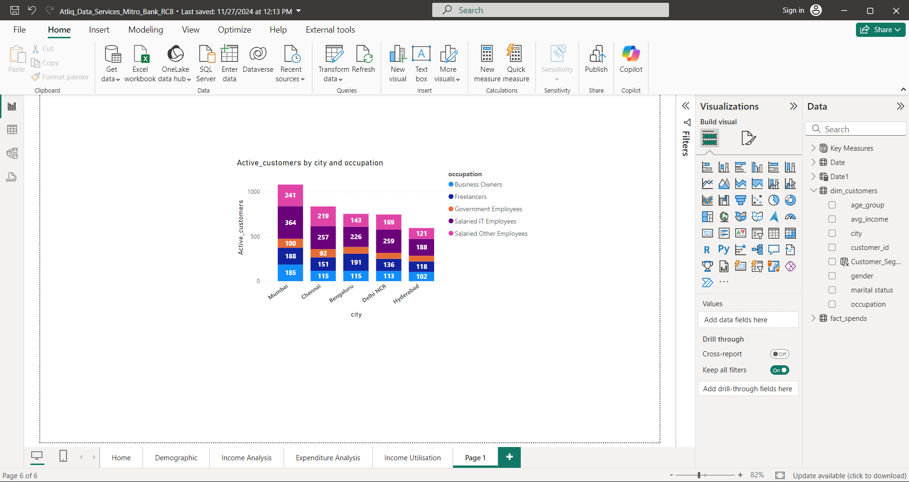
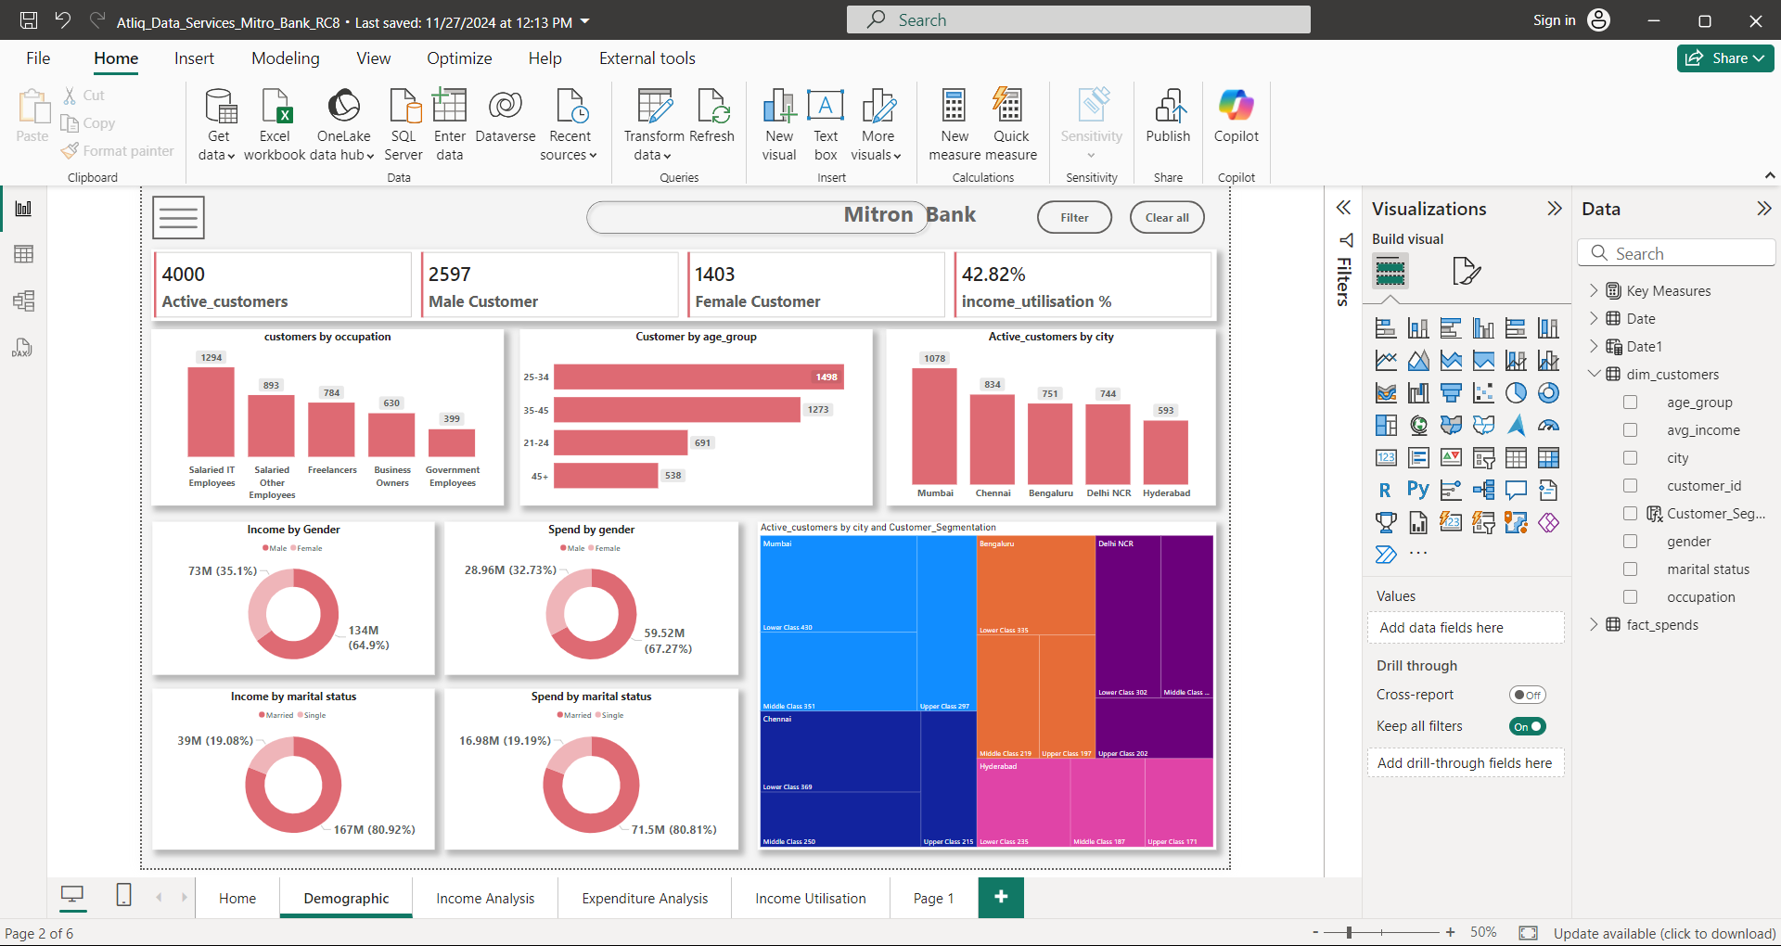
There are a total of 4,000 customers at Mitron Bank. Among them, 2,597 are male customers and 1,403 are female customers.
Mumbai (1,078) has the most customers, followed by Chennai (834). Hyderabad (593) has the least customers.
In Mumbai, salaried IT employees (364) make up the largest group of customers, followed by salaried other employees, government employees, and so on. The same pattern is observed in other cities as well.

Slide 7
Among Mitron Bank customers, salaried IT employees (1,294) have the most, followed by salaried other employees (893), freelancers (784), and government employees (399), who have the least.
In terms of age groups, Mitron Bank has the most customers in the 25-34 age group (1,498), followed by 35-45 (1,273), 21-24 (691), and the least in the 45+ age group (538).

Slide 8
In terms of customer segments, Mumbai has the most lower-class customers (430), followed by middle-class customers (351) and upper-class customers (297). Other cities like Chennai, Bengaluru, Delhi NCR, and Hyderabad follow.
At Mitron Bank, there are 3,136 married customers and 864 single customers. The income of married customers is higher than that of single customers, with married customers earning 167M and single customers earning 39M.
Mitron Bank's male customers have a higher income than female customers, with males earning 134M and females earning 73M.
Mitron Bank's male customers have higher spending than female customers, with males spending 59.52M and females spending 28.96M.
At Mitron Bank, married customers have higher spending than single customers, with married customers spending 71.5M and single customers spending 16.98M.

Slide 9
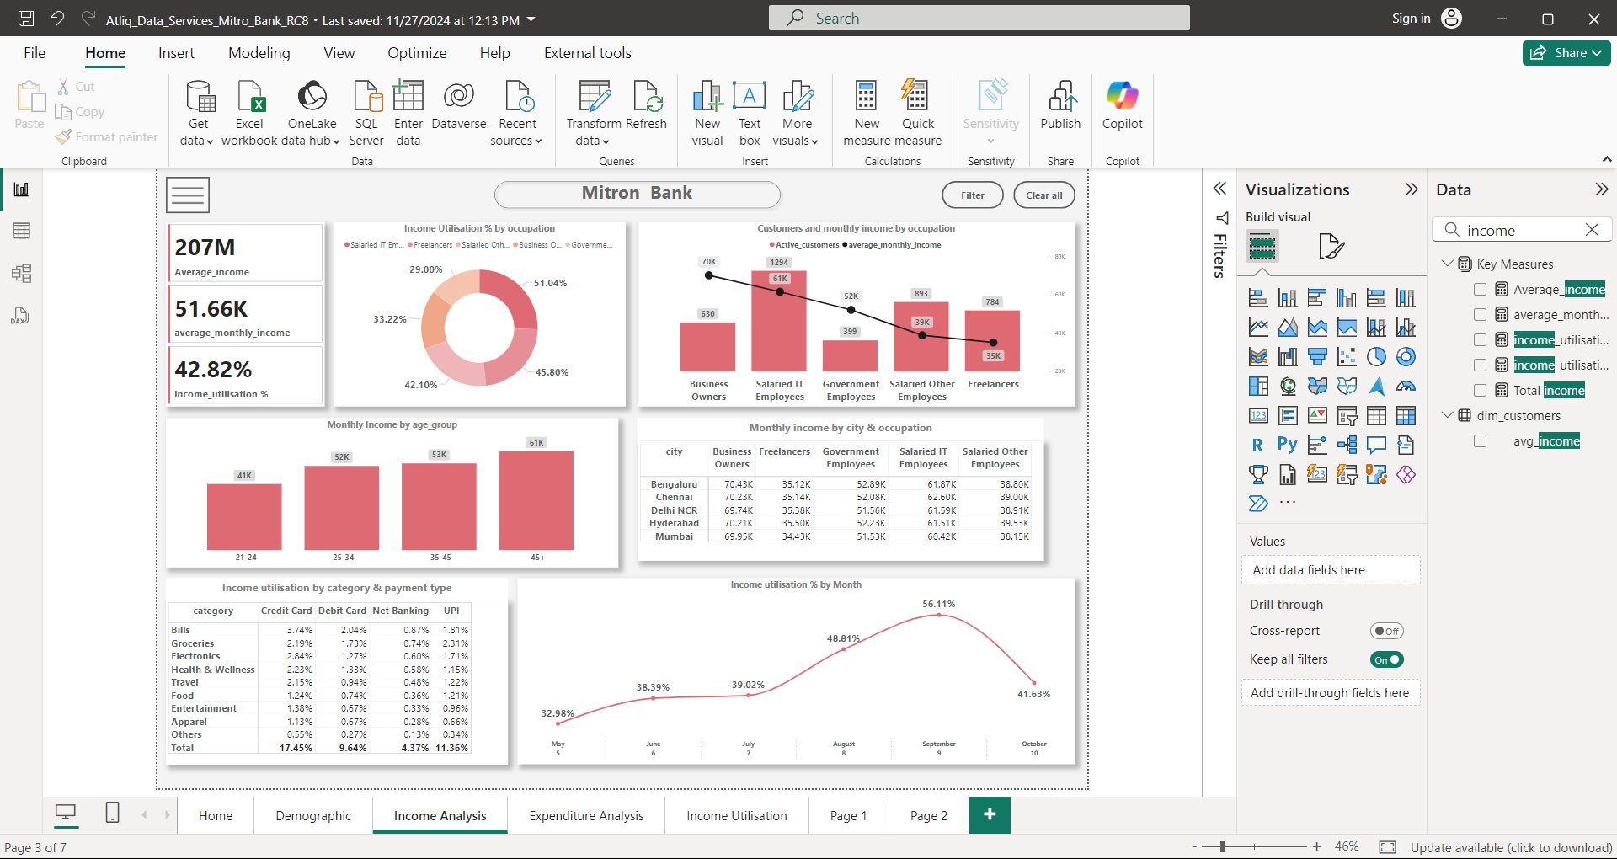
In Mitron Bank, the 45+ age group has the highest income (61K), followed by the 35-45 age group (53K), the 25-34 age group (52K), and the 21-24 age group, which has the least income (41K).
Business owners have the highest monthly income (70K) with only 630 customers, followed by salaried IT employees (61K). Freelancers have the least monthly income compared to others (35K).

Slide 10
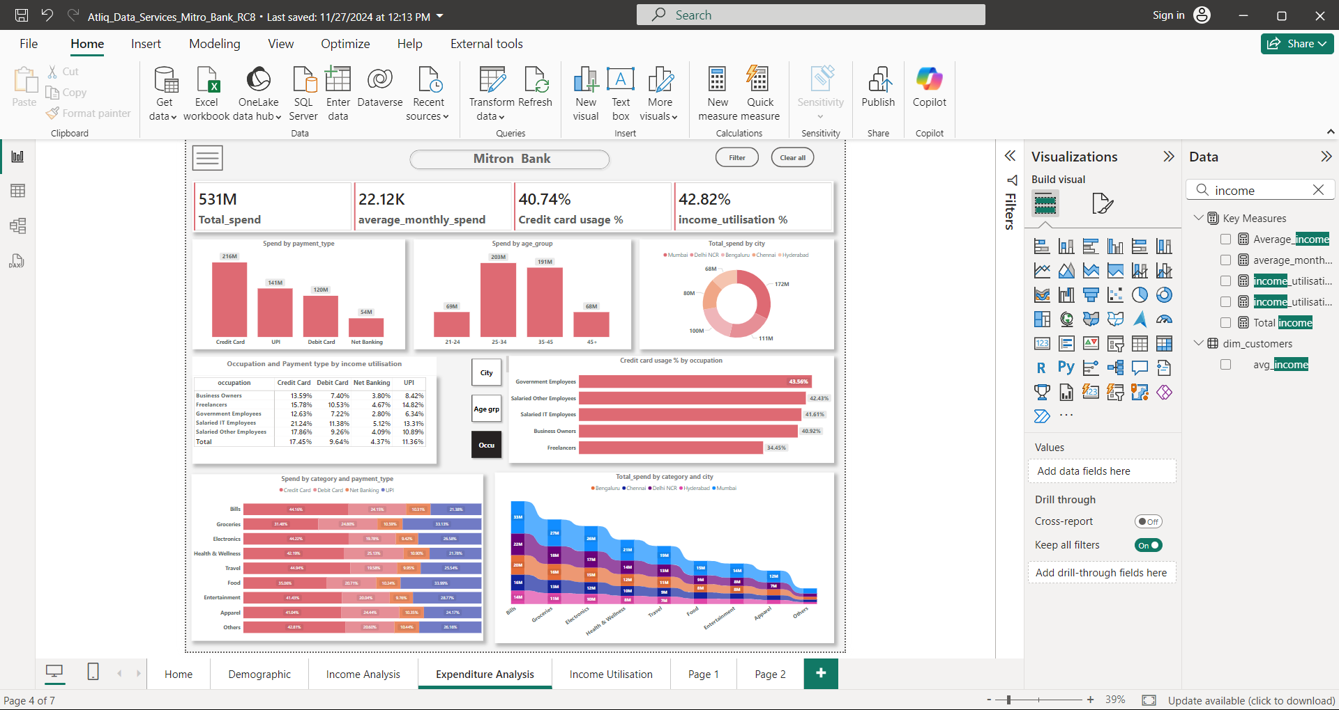
Mitron Bank customers prefer using credit cards (216M) to spend their earnings, with the highest spending among all payment types, followed by UPI, debit cards, and net banking, which has the least spending.
Mitron Bank customers in the 25-34 age group have the highest spending (203M), followed by the 35-45 age group (191M). The 21-24 age group and the 45+ age group have the least spending.
Mumbai has the highest spending (172M), followed by Delhi NCR (111M), with Hyderabad having the least spending (68M).
In terms of spending categories, Bills (105M) is the highest, followed by Groceries (86M), Electronics (80M), and the least spent category is Others (16M).
In terms of cities, Mumbai has the highest spending across all categories, followed by Delhi NCR, Bengaluru, with Chennai having the least spending across all categories.

Slide 11
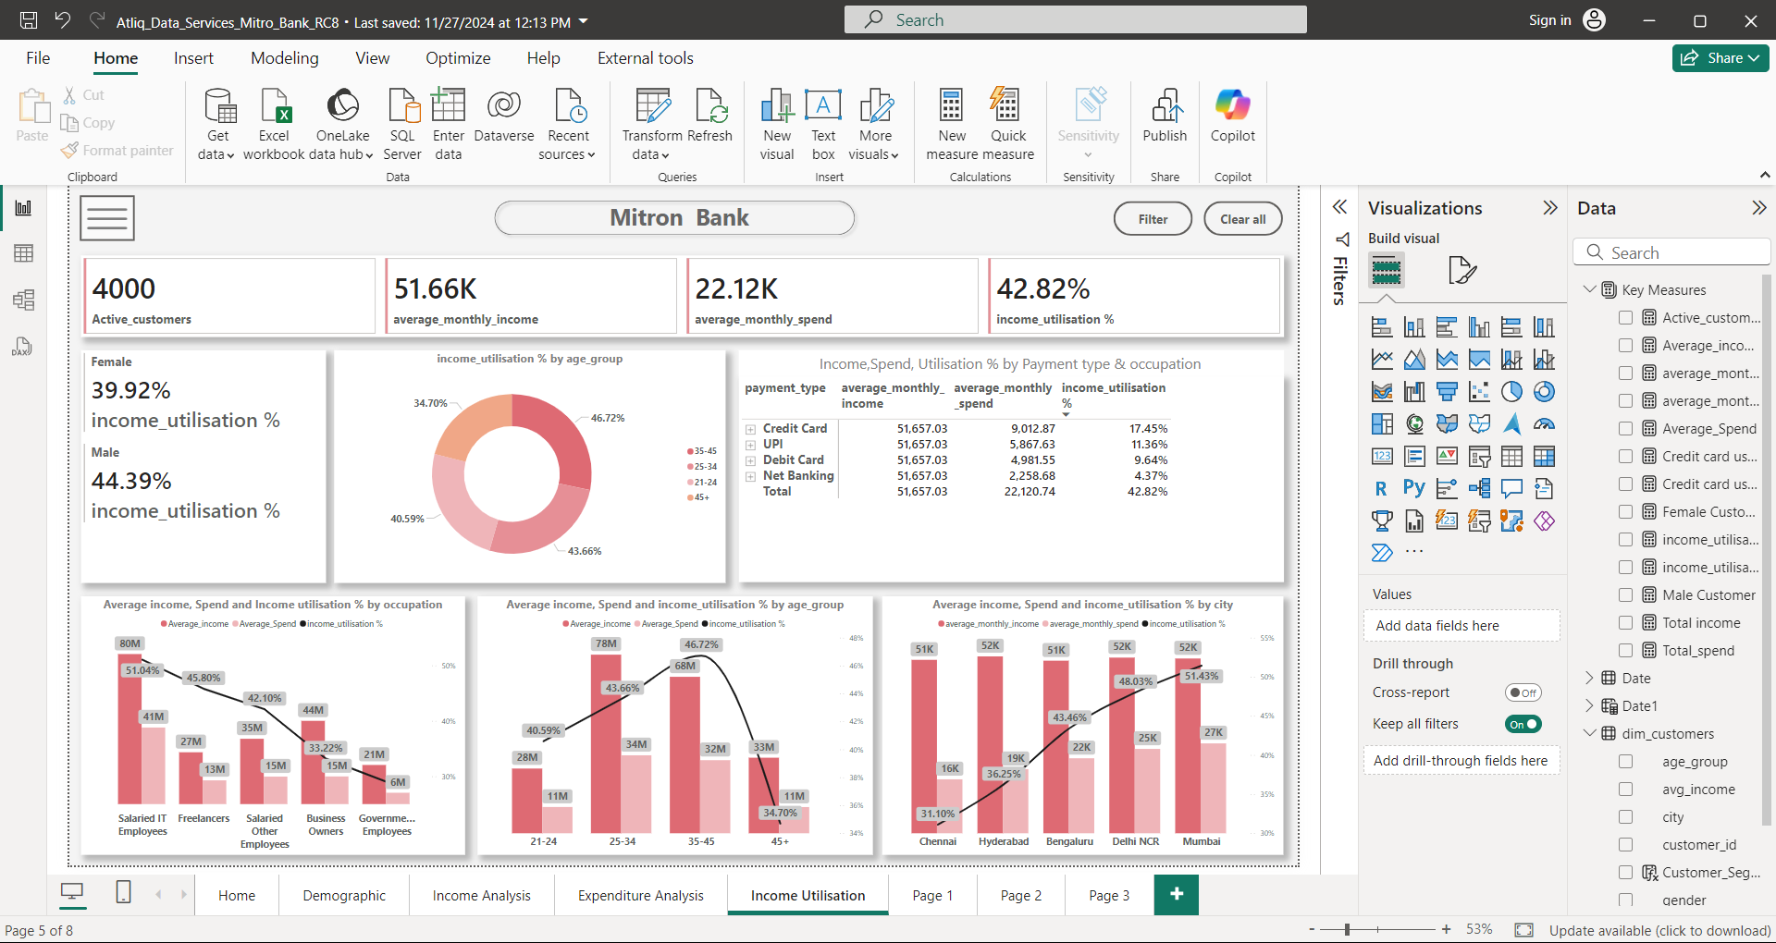
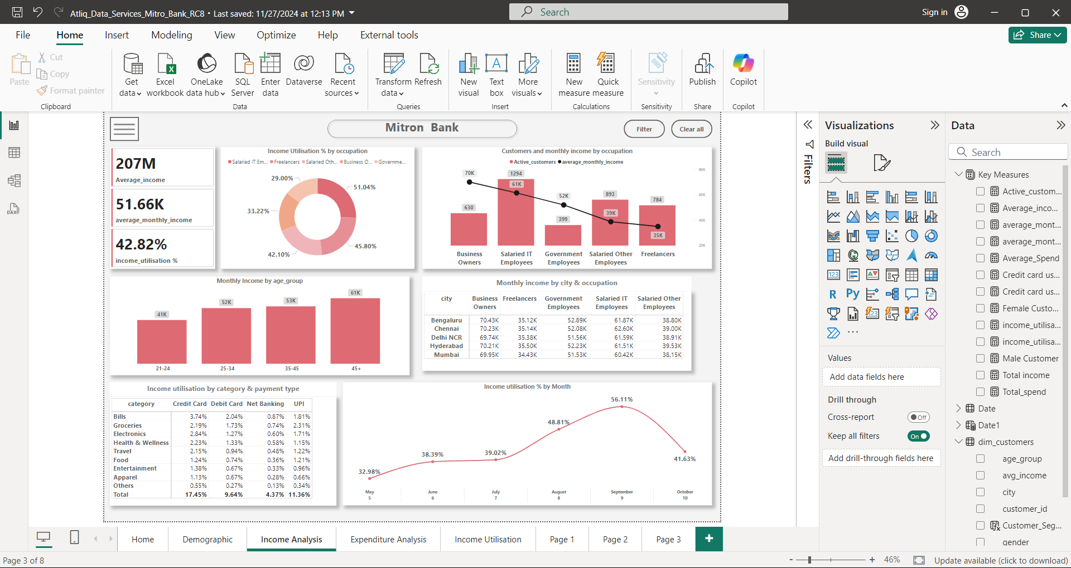
Key Matric is Average Income utilization %
Average Income Utilization % (IU %) = Avg Monthly Spend/Avg Monthly Income
Higher the IU% = Higher Possibility to Using Credit Cards.
There was a spike in income utilization in September (56.11%) May be due to festival sales on various e-commerce platforms. May Month had the least income utilization at 32.98%.

Slide 12
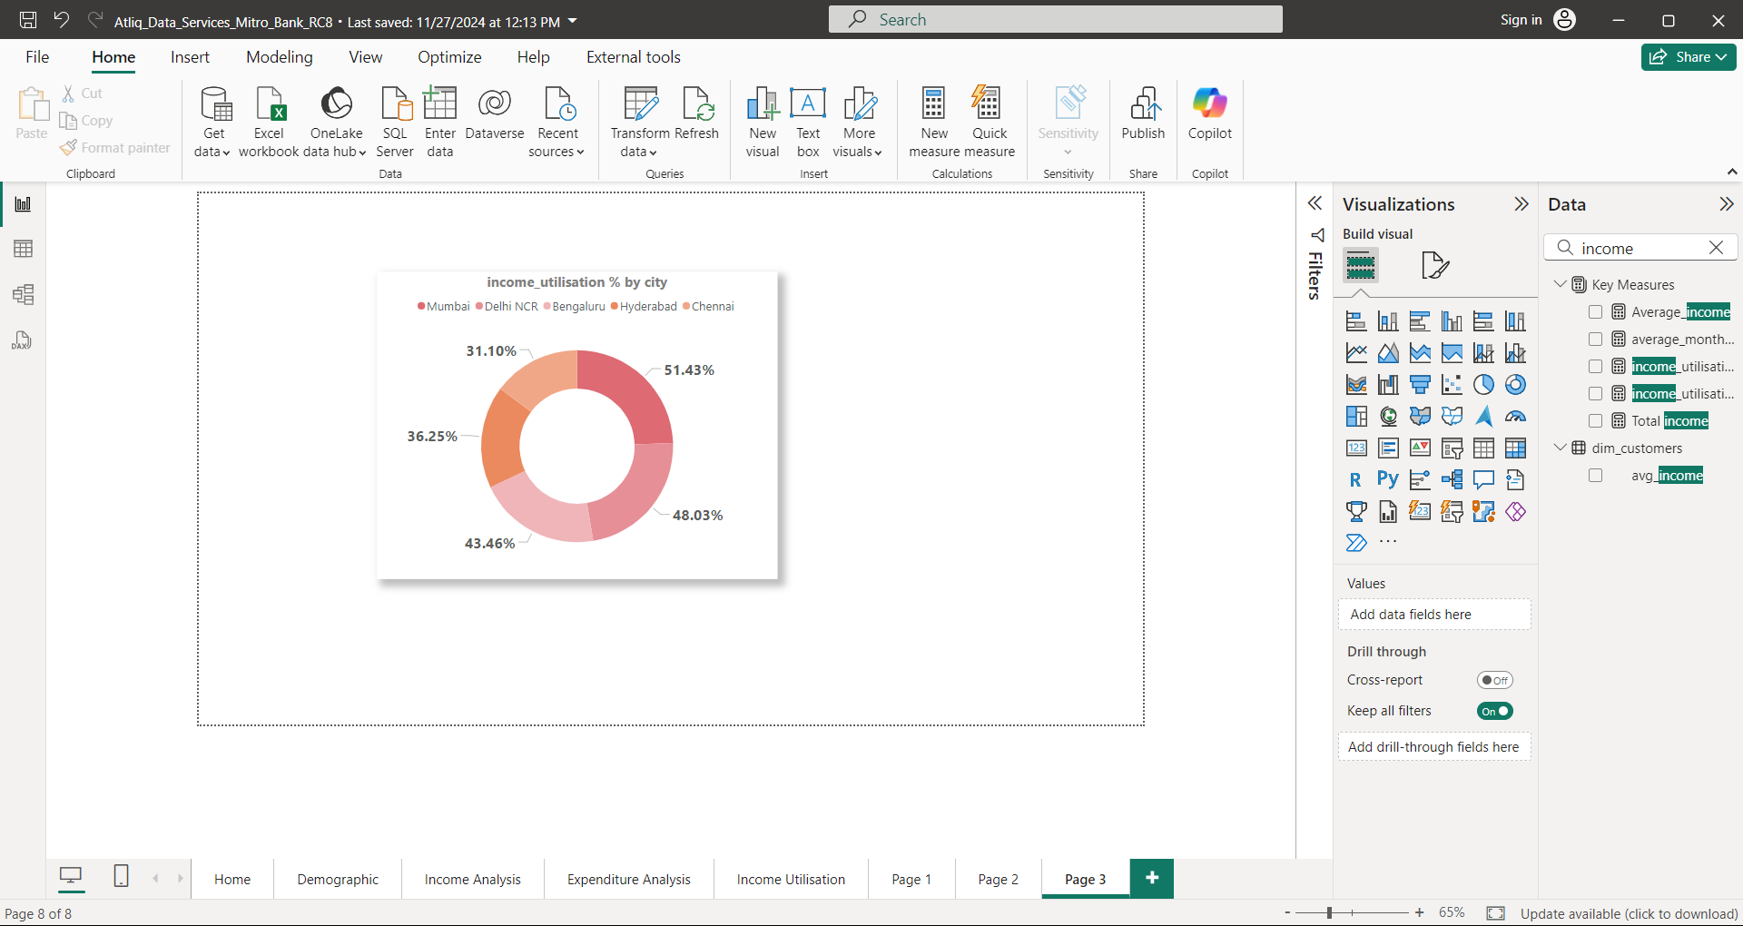
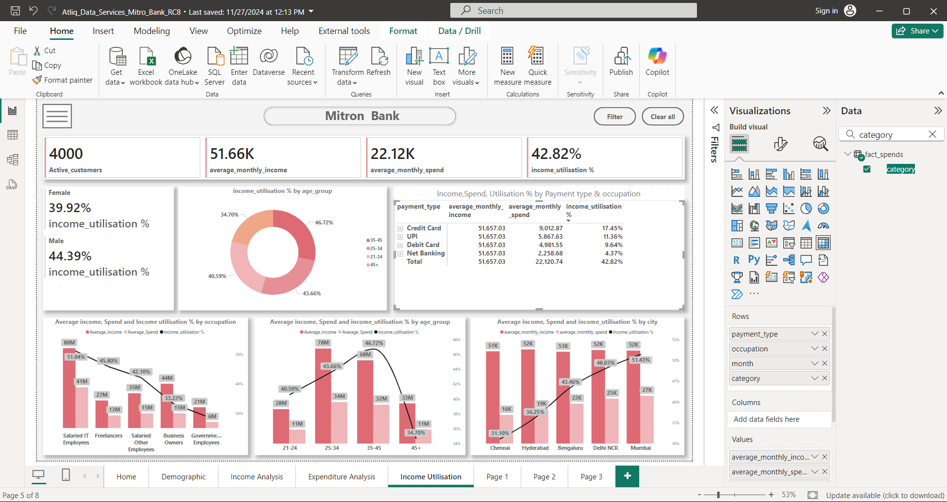
Salaried IT employees have the highest income utilization percentage (51.04%) and also lead in terms of income and spending, followed by freelancers and salaried other employees. Government employees have the lowest income utilization percentage, along with the lowest income and spending.
Mumbai has the highest income utilization percentage (IU%) along with the highest income and spending. It is followed by Delhi NCR, Bengaluru, and Hyderabad. Chennai has the least income utilization percentage at 31.10%.

Slide 13
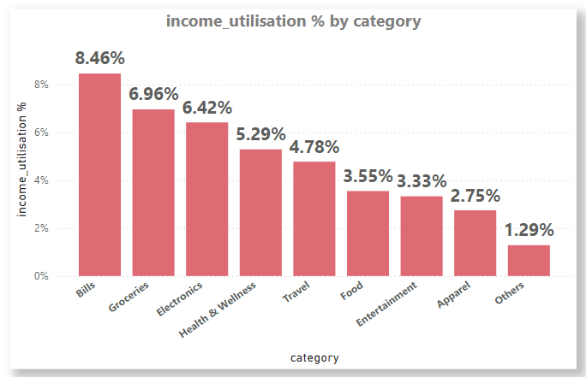
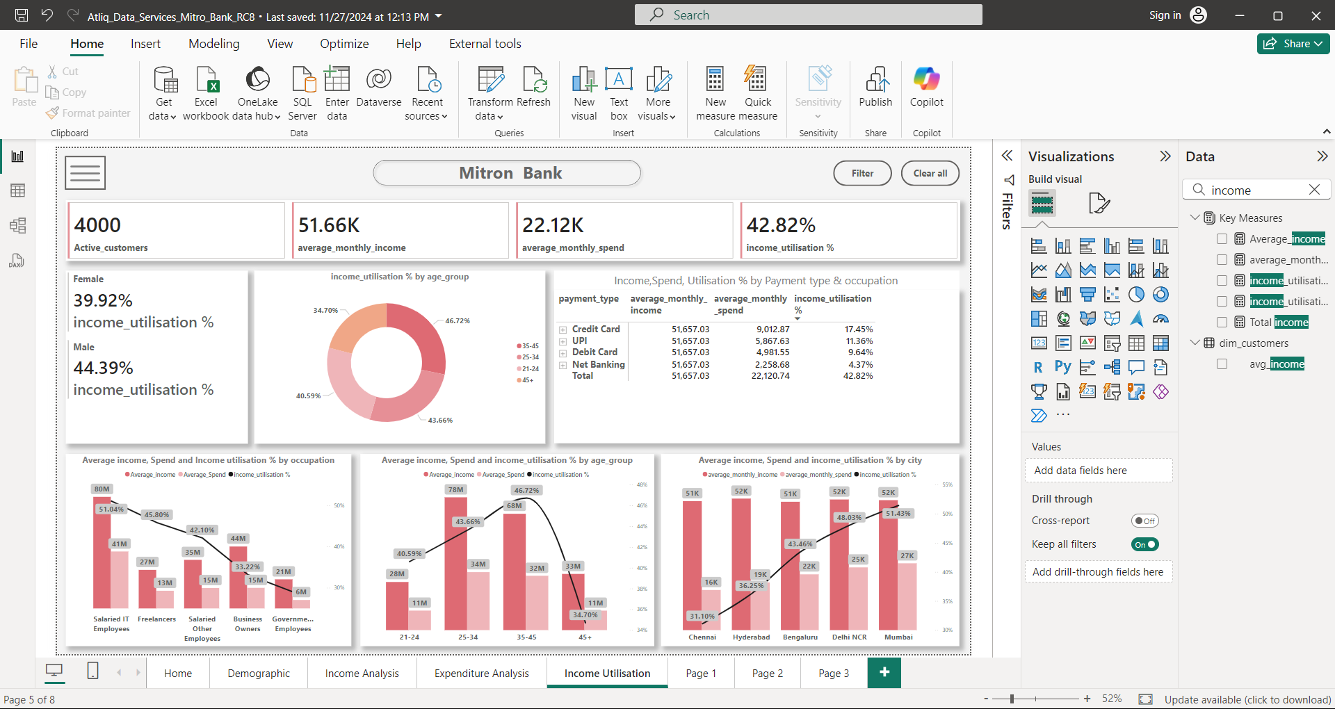

Customers in the 35-45 age group have the highest income utilization percentage (46.72%), followed by the 25-34 age group (43.66%) and the 21-24 age group (40.59%). The 45+ age group has the least income utilization percentage.
The Bills category has the highest income utilization percentage (8.46%), followed by Groceries (6.96%), Electronics (6.42%), and so on. The Others category has the least income utilization percentage at 1.29%.

Slide 14
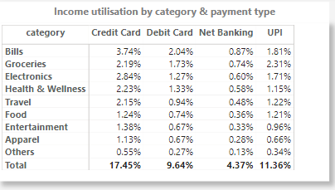
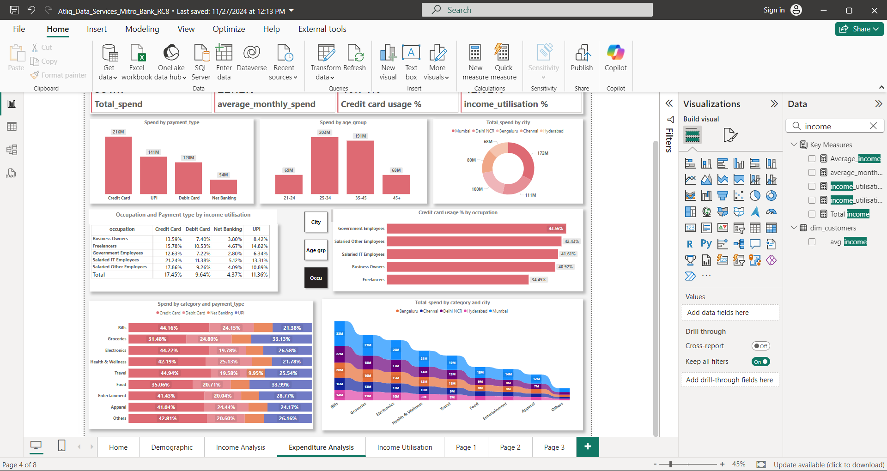
Bills have the highest income utilization percentage, with credit cards being the most commonly used payment type, followed by Groceries, Electronics. Apparel has the least income utilization percentage when using credit card payment.

Slide 15
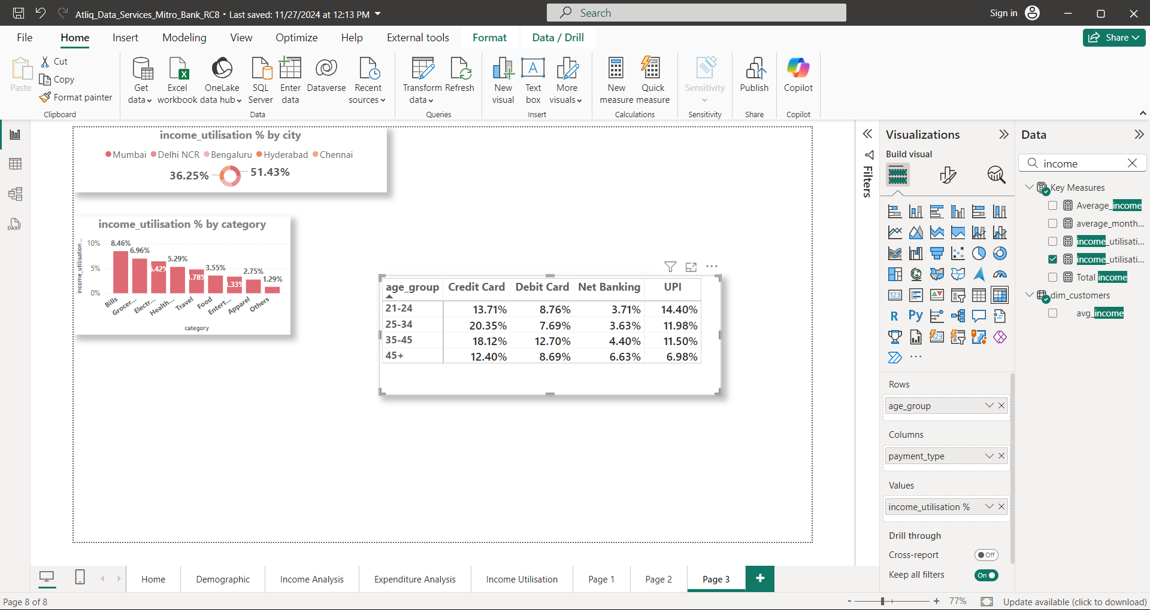
Salaried IT employees (21.24%) have the highest credit card in terms of income utilization, followed by salaried other employees (17.45%).
Government employees (12.63%) have the least credit card usage in terms of income utilization.
The age group 25-34 (20.35%) has the highest credit card usage in terms of income utilization, while the 45+ age group has the least credit card usage for income utilization.
The 35-45 age group (12.70%) has the highest debit card usage in terms of income utilization, while the 45+ age group (6.63%) has the highest net banking usage for income utilization.
The 21-24 age group (14.40%) has the highest UPI usage in terms of income utilization.

Slide 16
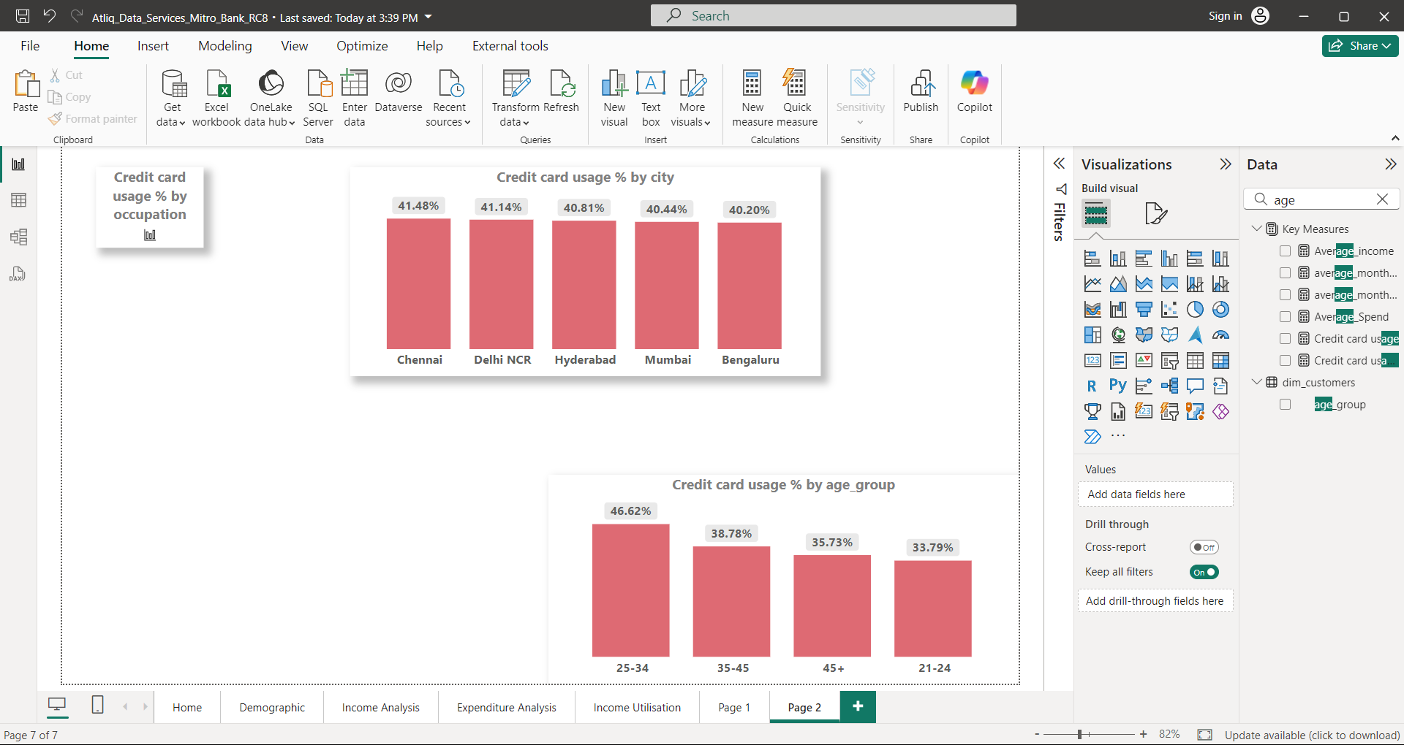
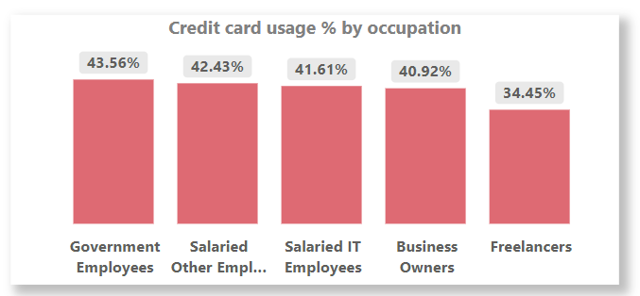
In terms of credit card usage, Chennai has the highest usage percentage (41.48%), followed by Delhi NCR (41.14%).
Bengaluru has the least percentage of credit card usage at 40.20%.
In terms of credit card usage, government employees have the highest usage percentage (43.56%), followed by salaried other employees (42.43%).
Freelancers have the least credit card usage at 34.45%.
In terms of age groups, the 25-34 age group has the highest credit card usage percentage (46.62%), followed by the 35-45 age group (38.78%).
The 21-24 age group has the least credit card usage percentage (33.79%).

Slide 17
Key findings
City :-
Mumbai has the highest number of customers in spending & they also have high income utilization percentage.
Based on Credit Card Usage %, Chennai city has the highest Credit Card Utilization % (41.48%). Delhi Stands at 2nd Position with 41.14%.
Gender :-
Number of Male Customers is more than female customers in Mitron Bank.
Female Customers , They have less Average Income Utilization percentage than male but they have high Credit Card Usage % (41.50%) for male (40.38%).

Slide 18
Age Group :-
Mitron Bank has more customers in the age group 25-34 (1498) .
Customers of Age Group 35-45 have more Income Utilization percentage (46.72%) , Customers of age group 25-34 is at 2nd Position with (43.66%).
Age group 21-24 spent most of their income on categories like Entertainment, Food, Apparel and mostly use UPI as payment type . Where as Customers of other age group spent most on Bills, Electronics, Groceries, Health, Wellness & Travel.
In terms of Credit Card Usage , Age Group 25-34 (46.62%) have used Credit card for purchase as there payment type, Customers age group 21-24 (33.79%) have least usage of credit card.

Slide 19
Occupation :-
Most of the customers in Mitron Bank are Salaried IT Employees, Freelancers and Salaried Other Employees , Government Employees are the least customers.
Salaried IT Employees , Freelancers and Salaried Other Employees are have high Income Utilization percentage.
In case of credit card usage Government Employees have the high Credit Usage % as compare to other occupation.
Customer of all occupation have used Credit Card the most of there purchase in categories like Travel, Electronics and Bills

Slide 20
Recommendation :-
Age group of 21-24 the customers mostly spend there income on Entertainment , Travel , Food. Mostly use UPI payment type for there purchase so to attract these young customers bank can come up with offers with friendly credit card like low or no annual fee, Gamefi rewards, Flexible Payment plans etc.
Age group of 25-34 the customers have credit card usage % and mainly spend on categories like Electronics & Travel. So Cashback offers on these categories.
Chennai has the Highest Credit Card Usage % but Chennai city have less income Utilisation %, by taking feedback from customers it can help bank to understand there preferences.
Most of the customers are salaried IT employees who are likely spend on travel , electronics , Health and wellness so reward points , discounts , Brand promotional offers/discounts can be given for purchase on those categories.
Government customers have high Credit Card Usage % made mostly purchase on travel and electronics so the discounts and reward points can be considered.

Slide 21
Thank You

