Slide 1
汇编语言
第十三讲 代码优化（二）
——微结构相关的优化

Slide 2
第十三讲 代码优化
处理器微结构与程序性能
挖掘指令并行性
转移的开销
访存的优化

Slide 3
处理器微结构
PC
IC
Fetch
Decode1
Decodek
Regmap
Dispatch
Dispatch Queue
…
BrP
ReadRF
Reg File
Reorder queue
Memory
LL Cache
DC
TLB
Ldstn
…
Ldst1
Execute
WtBack
Commit
Falum
…
Falu1
Alul
…
Alu1

Slide 4
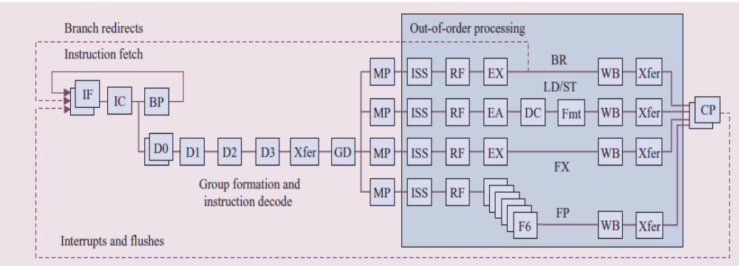
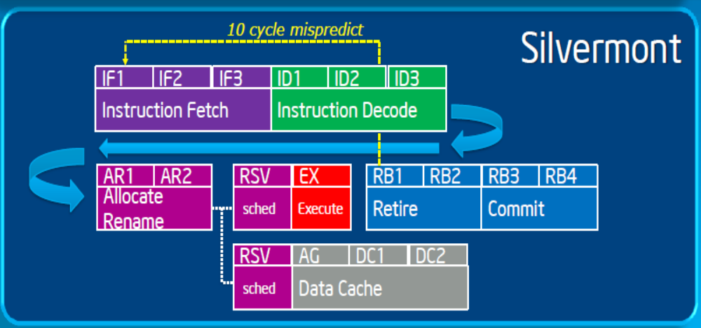
POWER5

Slide 5
（一）Pipeline
Pipeline目的是提高处理器部件的利用率
Fetch
Decode
ReadRF
Execute
WtBack
单条指令CPI =5
理想CPI接近1
 | 周期k-4 | 周期k-3 | 周期k-2 | 周期k-1 | 周期k | 周期k+1
Fetch | 指令i | 指令i+1 | 指令i+2 | 指令i+3 | 指令i+4 | 指令i+5
Decode |  | 指令i | 指令i+1 | 指令i+2 | 指令i+3 | 指令i+4
ReadRF |  |  | 指令i | 指令i+1 | 指令i+2 | 指令i+3
Execute |  |  |  | 指令i | 指令i+1 | 指令i+2
WtBack |  |  |  |  | 指令i | 指令i+1

Slide 6
Deep pipeline
Deep pipeline ：Basic pipeline ≥ 9
  主流处理器都是Deep pipeline
Deep pipeline目的是提高处理器的主频
  理想性能是1条pipeline1个Cycle执行1条指令
  主频越高，Cycle值越小，指令吞吐率越高
  目前主流处理器主频都在2.0~5.0GHz之间，Power系列超过4.0GHz，Power6达到6GHz，Intel、AMD处理器睿频超过4.0GHz

Slide 7
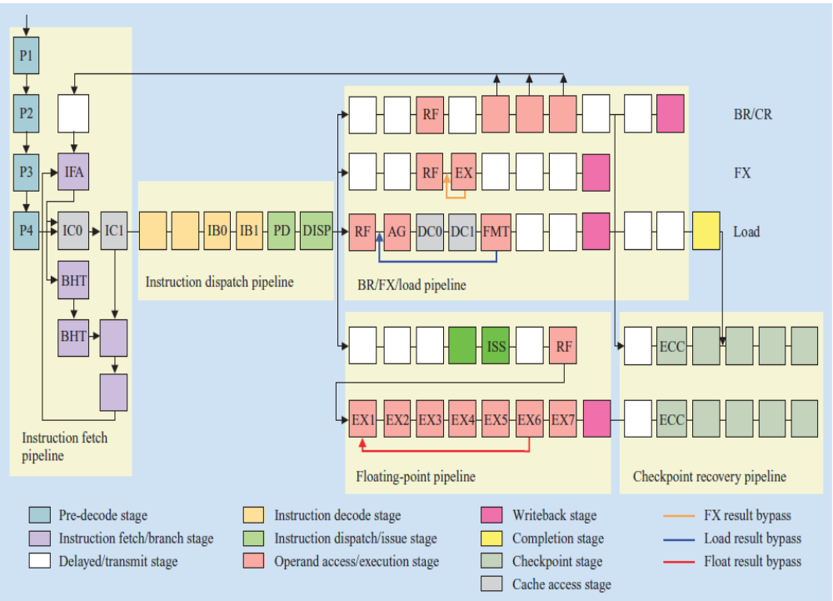
Power6 Pipeline

Slide 8
（二）Superscalar
多条Pipeline，1个Cycle发射和执行多条指令
Fetch
Decode
ReadRF
Execute
WtBack
 | 周期k-4 | 周期k-3 | 周期k-2 | 周期k-1 | 周期k | 周期k+1
Fetch | 指令i+1 指令i | 指令i+3 指令I+2 | 指令i+5 指令i+4 | 指令i+7 指令i+6 | 指令i+9 指令i+8 | 指令i+11 指令i+10
Decode |  | 指令i+1 指令i | 指令i+3 指令I+2 | 指令i+5 指令i+4 | 指令i+7 指令i+6 | 指令i+9 指令i+8
ReadRF |  |  | 指令i+1 指令i | 指令i+3 指令I+2 | 指令i+5 指令i+4 | 指令i+7 指令i+6
Execute |  |  |  | 指令i+1 指令i | 指令i+3 指令i+2 | 指令i+5 指令i+4
WtBack |  |  |  |  | 指令i+1 指令i | 指令i+3 指令i+2

Slide 9
Superscalar
Most modern CPUs are superscalar.
  Intel: since Pentium (1993)
超标量处理器通常都是动态调度和乱序执行，最后顺序提交。
Benefit: 处理器自动调度，利用程序所具有的指令级并行性

Slide 10
动态调度与顺序提交
动态调度
PC
IC
Fetch
Decode1
Decodek
Regmap
Dispatch
Dispatch Queue
顺序提交
…
BrP
ReadRF
Reg File
Reorder queue
Memory
LL Cache
DC
TLB
Ldstn
…
Ldst1
Execute
WtBack
Commit
Falum
…
Falu1
Alul
…
Alu1

Slide 11
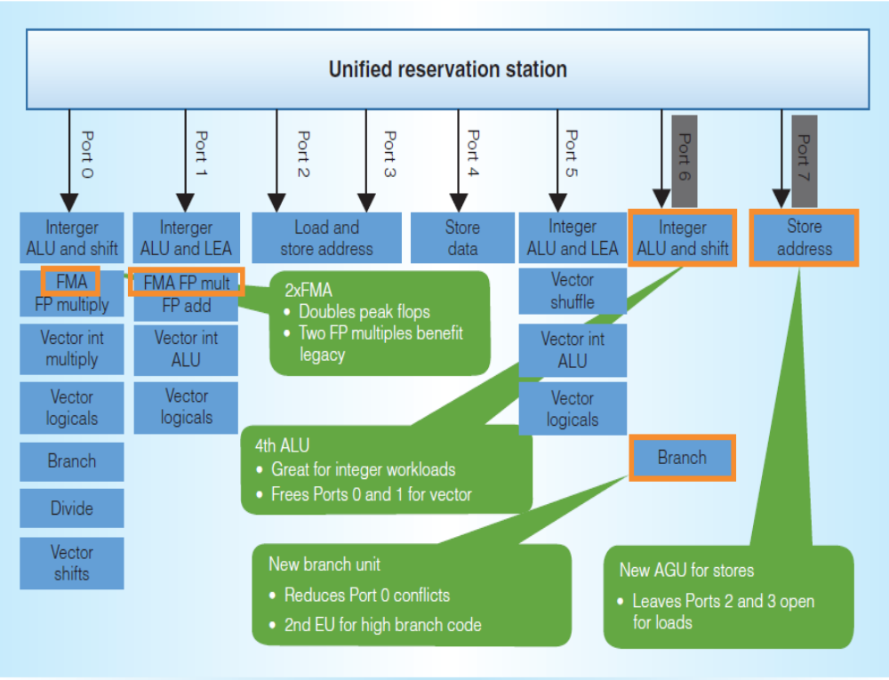
Multi-issue, multi-function-unit
Intel Haswell

Slide 12
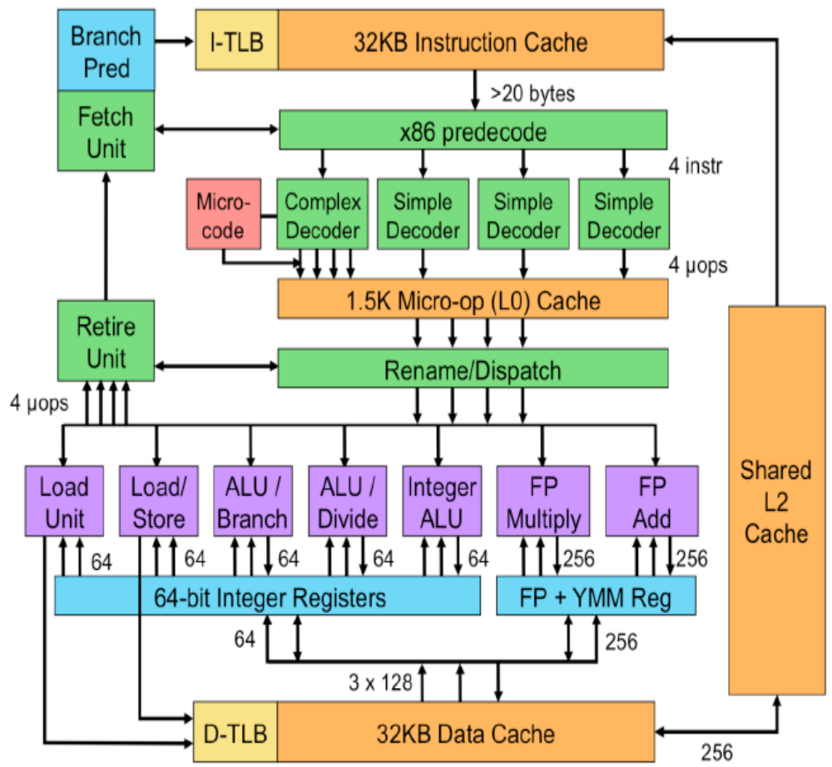
Intel SandyBridge

Slide 13
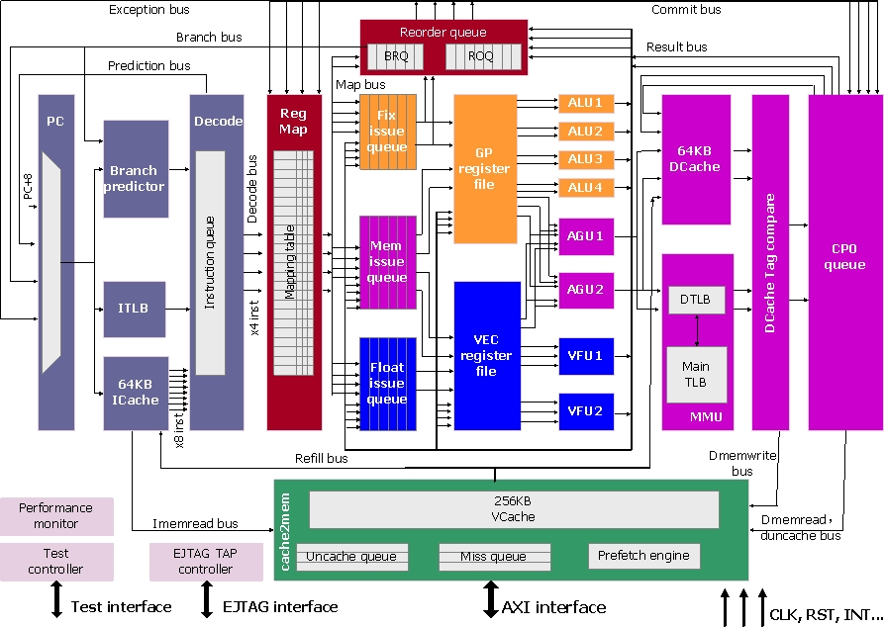
Loongson 3A4000

Slide 14
（三） Memory Hierarchy
L0:
CPU registers hold words retrieved from L1 cache
Registers
L1:
L1 cache
(SRAM)
Smaller,
faster,
costlier
per byte
L1 cache holds cache lines retrieved from L2 cache
L2:
L2 cache
(SRAM)
L2 cache holds cache lines retrieved from main memory
L3:
Larger,
slower,
cheaper
per byte
Main memory
(DRAM)
Main memory holds disk blocks retrieved from local disks
L4:
Local secondary storage
(local disks)
Local disks hold files retrieved from disks on remote network servers
Remote secondary storage
(tapes, distributed file systems, Web servers)
L5:

Slide 15
Intel Core i7 Cache Hierarchy
Processor package
L1 i-cache and d-cache:
  32 KB, 8-way,
  Access: 4 cycles
L2 unified cache:
  256 KB, 8-way,
  Access: 11 cycles
L3 unified cache:
  8 MB, 16-way,
  Access: 30-40 cycles
Block size: 64 bytes for all caches.
Memory:
Acess: >100 cycles
Core 0
Core 3
Regs
Regs
L1
d-cache
L1
i-cache
L1
d-cache
L1
i-cache
…
L2 unified cache
L2 unified cache
L3 unified cache
(shared by all cores)
Main memory

Slide 16
存储层次对访存性能的改善
Average access time =
Hitrate_{L1}× Lat_{L1} +
(1- Hitrate_{L1})×(Hitrate_{L2} × Lat_{L2} +
(1-Hitrate_{L2}) ×(Hitrate_{L3} × Lat_{L3} +(1-Hitrate_{L3}) × Lat_{m}))
Average access time1 =
0.95×4+0.05×(0.9×11 + 0.1×(0.9×40 + 0.1× 100))
=3.8 + 0.05×(9.9 + 0.1 × (36 +10)) = 4.525
Average access time2 =
0.99×4+0.01×(0.9×11 + 0.1×(0.9×40 + 0.1× 100))
=3.96 + 0.01×(9.9 + 0.1 × (36 +10)) = 4.105

Slide 17
程序理想性能与实际性能
程序的理想性能就是处理器流水线利用率100%，IPC = Pipeline number
  但实际利用率平均在50%左右
指令存在三类相关
  数据相关
  控制相关
  资源相关

Slide 18
数据相关
Inst 1: mov data, %eax
Need 3~100 cycles
数据相关
Inst 2: add $10, %eax
After 3~100 cycles
今天我去办护照
需要 9~11天
数据相关
出国旅游要护照
至少 9~11天后

Slide 19
控制相关
Inst 1: test %eax, %eax
Inst 2: jz L1
Need M cycles
控制相关
控制相关
Inst 3: mov $1, %ebx
……
L1:
Inst n: add %ecx, %ebx
1
2
3
4
5
6
7
8
9
PC
Fetch
Decode
Regmap
Dispatch
ReadRF
Execute
WtBack
Commit
M = 7

Slide 20
资源相关
……
Inst i : add $1, %eax
Inst i+1: add $1, %ebx
Inst i+2: add $4, %ecx
Inst i+3: add $4, %edx
……
Fetch
Decode
ReadRF
Execute
Alu1
WtBack
Alu2
周期k | Inst i : add $1, %eax | Inst i+1: add $1, %ebx
周期k+1 | Inst i+2: add $4, %ecx | Inst i+3: add $4, %edx

Slide 21
面向微结构的程序优化
挖掘指令并行性
  superscalar/vector
尽可能消除相关，或者将相关的依赖距离拉长
  提高pipeline的利用率
提高高层次存储的命中率
  L1 Cache，L2/LL Cache

Slide 22
第十三讲 代码优化
处理器微结构与程序性能
挖掘指令并行性
转移的开销
访存的优化

Slide 23
挖掘指令并行性
Superscalar能够同时执行多条指令
  不同处理器有所不同，需要了解处理器的手册
  Haswell：4 dispatch ，8 issue
  SandyBridge：4 dispatch， 6 issue
指令并行性主要受限于指令间的相关性
简单的变换可以产生显著的性能提升
  但编译器很难做这些变换
  需要程序员自己来优化

Slide 24
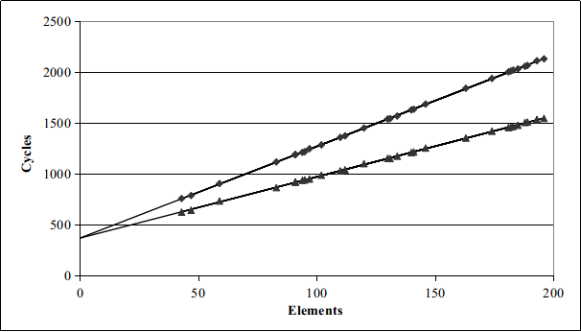
Cycles Per Element (CPE)
用于评价向量或链表的性能
  Length = n
  CPE = cycles per OP
  T = CPE*n + Overhead
    CPE is slope of line
psum1
Slope = 9.0
psum2
Slope = 6.0

Slide 25
Example: Data Type for Vectors
/* data structure for vectors */
typedef struct{
size_t len;
data_t *data;
} vec;
len
0
1
len-1
data
Data Types
  Use different declarations for data_t
  int
  long
  float
  double
/* retrieve vector element
and store at val */
int get_vec_element
(vec *v, size_t idx, data_t *val)
{
if (idx >= v->len)
return 0;
*val = v->data[idx];
return 1;
}

Slide 26
测试的benchmark
void combine1(vec *v, data_t *dest)
{
long int i;
*dest = IDENT;
for (i = 0; i < vec_length(v); i++) {
data_t val;
get_vec_element(v, i, &val);
*dest = *dest OP val;
}
}
Compute sum or product of vector elements
Data Types
  Use different declarations for data_t
  int
  long
  float
  double
Operations
  Use different definitions of OP and IDENT
  + / 0
  * / 1

Slide 27
测试程序
#include <stdio.h>
#include <stdlib.h>
#include <string.h>
#include <sys/time.h>
#define data_t long
#define OP +
#define IDENT 0
#define ELE_SIZE 20000
/* data structure for vectors */
typedef struct{
size_t len;
data_t *data;
} vec;
long vec_length(vec *v)
{
return v->len;
}

Slide 28
/* retrieve vector element and store at val */
int get_vec_element
(vec *v, size_t idx, data_t *val)
{
if (idx >= v->len)
return 0;
*val = v->data[idx];
return 1;
}
void combine1(vec *v, data_t *dest)
{
long int i;
*dest = IDENT;
for (i = 0; i < vec_length(v); i++) {
data_t val;
get_vec_element(v, i, &val);
*dest = *dest OP val;
}
}

Slide 29
static inline unsigned long long rdtsc(void)
{
unsigned long long tick;
asm volatile ("rdtsc":"=A"(tick));
return tick;
}
int main(void)
{
data_t *str;
data_t dest;
vec vc;
unsigned long long tick1, tick2;
long i;
str = malloc(ELE_SIZE*4);
vc.len = ELE_SIZE;
vc.data = str;
for(i = 0; i< ELE_SIZE; i++) vc.data[i] = 1;
tick1 = rdtsc();
combine1(&vc, &dest);
tick2 = rdtsc();
printf("CPE = %lf\n", (tick2 - tick1)*1.0/ELE_SIZE);
printf("dest = %ld \n", dest);
return 0;
}

Slide 30
Benchmark Performance
void combine1(vec *v, data_t *dest)
{
long int i;
*dest = IDENT;
for (i = 0; i < vec_length(v); i++) {
data_t val;
get_vec_element(v, i, &val);
*dest = *dest OP val;
}
}
Compute sum or product of vector elements
Method | Integer
Operation | Add | Mult
Combine1 unoptimized | 22.68 | 20.02
Combine1 –O1 | 10.12 | 10.12
Results in CPE (cycles per element)

Slide 31
Basic Optimizations
void combine4(vec *v, data_t *dest)
{
long i;
long length = vec_length(v);
data_t *d = get_vec_start(v);
data_t t = IDENT;
for (i = 0; i < length; i++)
t = t OP d[i];
*dest = t;
}
vec_length外提
消除了每次循环get_vec_element的调用
引入临时的累加/积变量

Slide 32
Effect of Basic Optimizations
void combine4(vec_ptr v, data_t *dest)
{
long i;
long length = vec_length(v);
data_t *d = get_vec_start(v);
data_t t = IDENT;
for (i = 0; i < length; i++)
t = t OP d[i];
*dest = t;
}
Method | Integer
Operation | Add | Mult
Combine1 –O1 | 10.12 | 10.12
Combine4 | 1.27 | 3.01
消除了循环中原有的一些开销

Slide 33
Pipelined Functional Units
Stage 1
long mult_eg(long a, long b, long c) {
long p1 = a*b;
long p2 = a*c;
long p3 = p1 * p2;
return p3;
}
Stage 2
Stage 3
 | Time
 | 1 | 2 | 3 | 4 | 5 | 6 | 7
Stage 1 | a*b | a*c |  |  | p1*p2
Stage 2 |  | a*b | a*c |  |  | p1*p2
Stage 3 |  |  | a*b | a*c |  |  | p1*p2
  计算分解为多个流水级，流水级之间传递中间结果
  Stage i 把中间结果传递给Stage i+1后可以开始新的计算
  例，尽管1个乘法需要3拍，但3级流水后3个乘法只要7拍

Slide 34
Haswell CPU
  8 Total Functional Units
Multiple instructions can execute in parallel
  2 load, with address computation
  1 store, with address computation
  4 integer
  2 FP multiply
  1 FP add
  1 FP divide
Some instructions take > 1 cycle, but can be pipelined
  Instruction Latency Cycles/Issue
  Load / Store 4 1
  Integer Multiply 3 1
  Integer/Long Divide 3-30 3-30
  Single/Double FP Multiply 5 1
  Single/Double FP Add 3 1
  Single/Double FP Divide 3-15 3-15

Slide 35
x86 Compilation of Combine4
Inner Loop (Case: Integer Multiply)
.L8: # loop:
imull (%ebx,%eax,4), %edx # t = t* d[i]
addl $1, %eax # i++
cmpl %ecx, %eax # cmp length, i
jne .L8 # if >, goto loop
Method | Integer
Operation | Add | Mult
Combine4 | 1.27 | 3.01
Latency Bound | 1.00 | 3.00

Slide 36
Combine4 仍是串行计算(OP = *)
1
d₀
Computation (length=8)
  ((((((((1 * d[0]) * d[1]) * d[2]) * d[3])
  * d[4]) * d[5]) * d[6]) * d[7])
Sequential dependence
  Performance: determined by latency of OP
*
d₁
*
d₂
*
d₃
*
d₄
*
d₅
data_t t = IDENT;
for (i = 0; i < length; i++)
t = t OP d[i];
*dest = t;
*
d₆
*
d₇
*

Slide 37
Loop Unrolling (2x1)
void unroll2a_combine(vec_ptr v, data_t *dest)
{
long length = vec_length(v);
long limit = length-1;
data_t *d = get_vec_start(v);
data_t x = IDENT;
long i;
/* Combine 2 elements at a time */
for (i = 0; i < limit; i+=2) {
x = (x OP d[i]) OP d[i+1];
}
/* Finish any remaining elements */
for (; i < length; i++) {
x = x OP d[i];
}
*dest = x;
}
Perform 2x more useful work per iteration

Slide 38
Effect of Loop Unrolling
Method | Integer
Operation | Add | Mult
Combine4 | 1.27 | 3.01
Unroll 2x1 | 1.01 | 3.01
Latency Bound | 1.00 | 3.00
Integer add提高了
  接近 latency bound
Integer Mult没有改进?
  Still sequential dependency
x = (x OP d[i]) OP d[i+1];

Slide 39
Loop Unrolling with Reassociation (2x1a)
void unroll2aa_combine(vec_ptr v, data_t *dest)
{
long length = vec_length(v);
long limit = length-1;
data_t *d = get_vec_start(v);
data_t x = IDENT;
long i;
/* Combine 2 elements at a time */
for (i = 0; i < limit; i+=2) {
x = x OP (d[i] OP d[i+1]);
}
/* Finish any remaining elements */
for (; i < length; i++) {
x = x OP d[i];
}
*dest = x;
}
Compare to before
x = (x OP d[i]) OP d[i+1];
改善了mult的性能，但add没有变化?

Slide 40
Effect of Reassociation
Method | Integer
Operation | Add | Mult
Combine4 | 1.27 | 3.01
Unroll 2x1 | 1.01 | 3.01
Unroll 2x1a | 1.01 | 1.51
Latency Bound | 1.00 | 3.00
乘法提高了近2倍？
  消除了顺序依赖
x = x OP (d[i] OP d[i+1]);

Slide 41
Reassociated Computation
x = x OP (d[i] OP d[i+1]);
What changed:
  Ops in the next iteration can be started early (no dependency)
Overall Performance
  N elements, D cycles latency/op
  (N/2+1)*D cycles:
  CPE = D/2
d₀
d₁
*
d₂
d₃
1
*
d₄
d₅
*
*
d₆
d₇
*
*
*
*

Slide 42
ADD的调度
Combine4:
.L8:
addl (%ebx,%eax,4), %edx #1 add, 1 load
addl $1, %eax #1 add
cmpl %ecx, %eax #1 cmp
jne .L8 #1 jne
1 iteration
Func unit | LD1 | LD2 | ALU1 | ALU2 | ALU3 | ALU4/Br
Cycle i | load |  | add | add | cmp | jne
Cycle i+1

Slide 43
ADD的调度
unroll21:
.L8:
addl (%ecx,%edx,4), %eax #1add, 1load
addl 4(%ecx,%edx,4), %eax #1add, 1load
addl $2, %edx #1add
cmpl %edx, %edi #1cmp
jg .L8 #1jg
2 iteration
Func unit | LD1 | LD2 | ALU1 | ALU2 | ALU3 | ALU4/Br
Cycle i | load | load | add | add | cmp | jg
Cycle i+1 |  |  | add
Cycle i+2 |  |  | add | add | cmp | jg
Cycle i+3 |  |  | add

Slide 44
ADD的调度
unroll21a:
.L8:
movl 4(%ebx,%eax,4), %ecx #1load
addl (%ebx,%eax,4), %ecx #1load, 1add
addl %ecx, %edx #1add
addl $2, %eax #1add
cmpl %eax, %ebp #1cmp
jg .L8 #1jg
2 iteration
动态调度要等指令流
Func unit | LD1 | LD2 | ALU1 | ALU2 | ALU3 | ALU4/Br
Cycle i | load | load | add |  | add
Cycle i+1 |  |  | add |  | cmp | jg
Cycle i+2 |  |  | add
Cycle i+3 |  |  | add

Slide 45
MUL的调度
Combine4:
.L8:
imull (%ebx,%eax,4), %edx #1load, 1mul
addl $1, %eax #1add
cmpl %ecx, %eax #1cmp
jne .L8 #1jne
1 iteration
Mul: 3 cycles
Func unit | LD1 | LD2 | ALU1 | ALU2 | ALU3 | ALU4/Br
Cycle i | load |  | add | mul | cmp | jne
Cycle i+1
Cycle i+2
Cycle i+3 |  |  |  | mul

Slide 46
MUL的调度
unroll21a:
.L8:
movl (%ebx,%eax,4), %ecx #1load
imull 4(%ebx,%eax,4), %ecx #1load, 1mul
imull %ecx, %edx #1mul
addl $2, %eax #1add
cmpl %eax, %ebp #1cmp
jg .L8 #jg
2 iteration
Func unit | LD1 | LD2 | ALU1 | ALU2 | ALU3 | ALU4/Br
Cycle i | load | load | add | mul | cmp | jne
Cycle i+1 |  |  |  | mul
Cycle i+2
Cycle i+3 |  |  |  | mul
Cycle i+4 |  |  |  | mul

Slide 47
Loop Unrolling with Separate Accumulators (2x2)
void unroll2a_combine(vec_ptr v, data_t *dest)
{
long length = vec_length(v);
long limit = length-1;
data_t *d = get_vec_start(v);
data_t x0 = IDENT;
data_t x1 = IDENT;
long i;
/* Combine 2 elements at a time */
for (i = 0; i < limit; i+=2) {
x0 = x0 OP d[i];
x1 = x1 OP d[i+1];
}
/* Finish any remaining elements */
for (; i < length; i++) {
x0 = x0 OP d[i];
}
*dest = x0 OP x1;
}
Different form of reassociation

Slide 48
Effect of Separate Accumulators
Method | Integer
Operation | Add | Mult
Combine4 | 1.27 | 3.01
Unroll 2x1 | 1.01 | 3.01
Unroll 2x1a | 1.01 | 1.51
Unroll 2x2 | 0.81 | 1.51
Latency Bound | 1.00 | 3.00
Int + 形成2条独立的计算流水线
x0 = x0 OP d[i];
x1 = x1 OP d[i+1];

Slide 49
Separate Accumulators
x0 = x0 OP d[i];
x1 = x1 OP d[i+1];
What changed:
  Two independent “streams” of operations
Overall Performance
  N elements, D cycles latency/op
  Should be (N/2+1)*D cycles:
  CPE = D/2
1
d₀
1
d₁
*
d₂
*
d₃
*
d₄
*
d₅
*
d₆
*
d₇
*
*
*

Slide 50
Unrolling & Accumulating
理想结果
  Can unroll to any degree L
  Can accumulate K results in parallel
  L must be multiple of K
限制
  不能超越功能部件的限制
Method | Integer |  | Double FP
Operation | Add | Mult | Add | Mult
Latency Bound | 1.00 | 3.00 | 3.00 | 5.00
Throughput Bound | 0.50 | 1.00 | 1.00 | 0.50
4 func. units for int +
2 func. units for load
2 func. units for FP *
2 func. units for load

Slide 51
Unrolling & Accumulating: Double *
Case
  Intel Haswell，x86-64
  Double FP Multiplication
  Latency bound: 5.00.
FP * | Unrolling Factor L
K | 1 | 2 | 3 | 4 | 6 | 8 | 10 | 12
1 | 5.01 | 5.01 | 5.01 | 5.01 | 5.01 | 5.01 | 5.01
2 |  | 2.51 |  | 2.51 |  | 2.51
3 |  |  | 1.67
4 |  |  |  | 1.25 |  | 1.26
6 |  |  |  |  | 0.84 |  |  | 0.88
8 |  |  |  |  |  | 0.63
10 |  |  |  |  |  |  | 0.51
12 |  |  |  |  |  |  |  | 0.52
Accumulators

Slide 52
Unrolling & Accumulating: Int +
Case
  Intel Haswell
  Integer addition
  Latency bound: 1.00.
Int + | Unrolling Factor L
K | 1 | 2 | 3 | 4 | 6 | 8 | 10 | 12
1 | 1.27 | 1.01 | 1.01 | 1.01 | 1.01 | 1.01 | 1.01
2 |  | 0.81 |  | 0.69 |  | 0.54
3 |  |  | 0.74
4 |  |  |  | 0.69 |  | 1.24
6 |  |  |  |  | 0.56 |  |  | 0.56
8 |  |  |  |  |  | 0.54
10 |  |  |  |  |  |  | 0.54
12 |  |  |  |  |  |  |  | 0.56
Accumulators

Slide 53
Achievable Performance
Method | Integer |  | Double FP
Operation | Add | Mult | Add | Mult
Best | 0.54 | 1.01 | 1.01 | 0.52
Latency Bound | 1.00 | 3.00 | 3.00 | 5.00
Throughput Bound | 0.50 | 1.00 | 1.00 | 0.50
Limited only by throughput of functional units
Up to 42X improvement over original, unoptimized code

Slide 54
Programming with AVX2
YMM Registers
  16 total, each 32 bytes
  32 single-byte integers
  16 16-bit integers
  8 32-bit integers
  8 single-precision floats
  4 double-precision floats
  1 single-precision float
  1 double-precision float

Slide 55
SIMD Operations
  SIMD Operations: Single Precision
  SIMD Operations: Double Precision
vaddps %ymm0, %ymm1, %ymm1
%ymm0
+
+
+
+
+
+
+
+
%ymm1
vaddpd %ymm0, %ymm1, %ymm1
%ymm0
+
+
+
+
%ymm1

Slide 56
Using Vector Instructions(X86-64)
Method | Integer |  | Double FP
Operation | Add | Mult | Add | Mult
Scalar Best | 0.54 | 1.01 | 1.01 | 0.52
Vector Best | 0.06 | 0.24 | 0.25 | 0.16
Make use of AVX Instructions
  Parallel operations on multiple data elements

Slide 57
第十三讲 代码优化
处理器微结构与程序性能
挖掘指令并行性
转移的开销
访存的优化

Slide 58
分支指令的影响
  不能及时确定分支的方向，需要等到分支指令在 branch/ integer 单元中执行完毕，导致计算单元出现空闲
404663: mov $0x0,%eax
404668: cmp (%rdi),%rsi
40466b: jge 404685
40466d: mov 0x8(%rdi),%rax
. . .
404685: repz retq
Branch Not-Taken
Branch Taken
1
2
3
4
5
6
7
8
9
PC
Fetch
Decode
Regmap
Dispatch
ReadRF
Execute
WtBack
Commit
7 cycles

Slide 59
分支预测
Branch Prediction Idea
  Guess which way branch will go，
  Begin executing instructions at predicted position
    But don’t actually modify register or memory data
404663: mov $0x0,%eax
404668: cmp (%rdi),%rsi
40466b: jge 404685
40466d: mov 0x8(%rdi),%rax
. . .
404685: repz retq
Predict Taken
Begin
Execution

Slide 60
循环中的分支预测
401029: vmulsd (%rdx),%xmm0,%xmm0
40102d: add $0x8,%rdx
401031: cmp %rax,%rdx
401034: jne 401029
Assume
vector length = 100
i = 98
Predict Taken (OK)
401029: vmulsd (%rdx),%xmm0,%xmm0
40102d: add $0x8,%rdx
401031: cmp %rax,%rdx
401034: jne 401029
i = 99
Predict Taken
(err)
401029: vmulsd (%rdx),%xmm0,%xmm0
40102d: add $0x8,%rdx
401031: cmp %rax,%rdx
401034: jne 401029
Read invalid location
Executed
i = 100
401029: vmulsd (%rdx),%xmm0,%xmm0
40102d: add $0x8,%rdx
401031: cmp %rax,%rdx
401034: jne 401029
Fetched
i = 101

Slide 61
分支误预测取消
401029: vmulsd (%rdx),%xmm0,%xmm0
40102d: add $0x8,%rdx
401031: cmp %rax,%rdx
401034: jne 401029
Assume
vector length = 100
i = 98
Predict Taken (OK)
401029: vmulsd (%rdx),%xmm0,%xmm0
40102d: add $0x8,%rdx
401031: cmp %rax,%rdx
401034: jne 401029
i = 99
Predict Taken
(err)
401029: vmulsd (%rdx),%xmm0,%xmm0
40102d: add $0x8,%rdx
401031: cmp %rax,%rdx
401034: jne 401029
i = 100
Invalidate
401029: vmulsd (%rdx),%xmm0,%xmm0
40102d: add $0x8,%rdx
401031: cmp %rax,%rdx
401034: jne 401029
i = 101

Slide 62
分支误预测恢复
401029: vmulsd (%rdx),%xmm0,%xmm0
40102d: add $0x8,%rdx
401031: cmp %rax,%rdx
401034: jne 401029
401036: jmp 401040
. . .
401040: vmovsd %xmm0,(%r12)
i = 99
Definitely not taken
Reload
Pipeline
Performance Cost
  Multiple clock cycles on modern processor
  Can be a major performance limiter

Slide 63
分支预测机制
2-bit BHT
4096-item
PC 32-bit
0 | 1
1 | 1
1 | 0
…
1 | 1
0 | 0
0 | 1
1 | 0
0 | 0 | 1 | …… | 1 | 0 | 0
1 | 1 | 0 | 0 | 1 | 0 | 1 | 0
GHR 8-bit

Slide 64
分支预测的例子
for(i = 0; i < SIZE; i++)
{
if(pbrflag[i] < 0) data -= 1;
else if(pbrflag[i] > 0) data +=pbrflag[i];
else data+=1;
}
Pbrflag[]是一个数组，指示分支转移的方向
  如果pbrflag[]的值没有规律，分支预测很困难
  如果pbrflag[]的值有规律，分支预测有作用

Slide 65
无规律分支
#include <stdio.h>
#include <stdlib.h>
static inline unsigned long long rdtsc(void){……}
#define SIZE 3*1024*1024
int main(void)
{
char *pbrflag;
long data = 0，i, negi=0, posi=0,zeroi = 0;
unsigned long long tick1, tick2;
pbrflag = malloc(SIZE);
for(i = 0; i<SIZE; i++)
{
pbrflag[i] = (char)((random()%3)*2 -2);
negi += (pbrflag[i] < 0);
zeroi += (pbrflag[i] == 0);
posi += (pbrflag[i] >0);
}
tick1 = rdtsc();
{ 被测代码}
tick2 = rdtsc();
printf("tick elasped %lld\n", tick2 - tick1);
printf("data = %ld negi = %ld zeroi = %ld posi = %ld\n",data, negi, zeroi, posi);
free(pbrflag);
return 0;
}

Slide 66
无规律分支
$ gcc -O2 -S branch.c
$ gcc -O2 -o branch branch.c
$ ./branch
tick elasped 53979858
data = 2098007 negi = 1048317 zeroi = 1048498 posi = 1048913
$ ./branch
tick elasped 55859490
data = 2098007 negi = 1048317 zeroi = 1048498 posi = 1048913

Slide 67
有规律分支
#include <stdio.h>
#include <stdlib.h>
static inline unsigned long long rdtsc(void){……}
#define SIZE 3*1024*1024
int main(void)
{
char *pbrflag;
long data = 0,i,j;
unsigned long long tick1, tick2;
pbrflag = malloc(SIZE);
for(i = 0,j = 0; j<1048317; j++,i+=3)
pbrflag[i] = -2, pbrflag[i+1] = 0, pbrflag[i+2] = 2;
for(j=0; j< 181; j++,i+=2)
pbrflag[i] = 0, pbrflag[i+1] = 2;
for(j=0; j< 415; j++,i++)
pbrflag[i] = 2;
tick1 = rdtsc();
{被测代码}
tick2 = rdtsc();
printf("tick elasped %lld\n", tick2 - tick1);
free(pbrflag);
return 0;
}

Slide 68
被测代码汇编
无规律分支
有规律分支
rdtsc
xorl %edi, %edi
movl %edx, -44(%ebp)
movl %eax, -48(%ebp)
movl -32(%ebp), %edx
jmp .L6
.L3: je .L5
addl %eax, %edi
.L4: addl $1, %ebx
cmpl %edx, %ebx
je .L11
.L6: movsbl (%ebx), %eax
testb %al, %al
jns .L3
addl $1, %ebx
subl $1, %edi
cmpl %edx, %ebx
jne .L6
.L11:
rdtsc
……
.L5: addl $1, %edi
jmp .L4
rdtsc
xorl %ebx, %ebx
movl %eax, -32(%ebp)
movl %edx, -28(%ebp)
jmp .L8
.L5: je .L7
addl %eax, %ebx
.L6: addl $1, %ecx
cmpl %ecx, %esi
je .L15
.L8: movsbl (%ecx), %eax
testb %al, %al
jns .L5
addl $1, %ecx
subl $1, %ebx
cmpl %ecx, %esi
jne .L8
.L15:
rdtsc
……
.L7: addl $1, %ebx
jmp .L6

Slide 69
有规律分支结果
$ gcc -O2 -o branch1 branch1.c
$ gcc -O2 -S branch1.c
$ ./branch1
tick elasped 13727268
data = 2098007
$ ./branch1
tick elasped 13694877
data = 2098007
$ ./branch
tick elasped 53979858
data = 2098007 negi = 1048317 zeroi = 1048498 posi = 1048913
有规律分支运行时间 ：无规律分支运行时间
=
1 ： 4

Slide 70
第十三讲 代码优化
处理器微结构与程序性能
挖掘指令并行性
转移的开销
访存的优化

Slide 71
Memory Hierarchy
L0:
CPU registers hold words retrieved from L1 cache
Registers
L1:
L1 cache
(SRAM)
Smaller,
faster,
costlier
per byte
L1 cache holds cache lines retrieved from L2 cache
L2:
L2 cache
(SRAM)
L2 cache holds cache lines retrieved from main memory
L3:
Larger,
slower,
cheaper
per byte
Main memory
(DRAM)
Main memory holds disk blocks retrieved from local disks
L4:
Local secondary storage
(local disks)
Local disks hold files retrieved from disks on remote network servers
Remote secondary storage
(tapes, distributed file systems, Web servers)
L5:

Slide 72
Intel Core i7 Cache Hierarchy
Processor package
L1 i-cache and d-cache:
  32 KB, 8-way,
  Access: 4 cycles
L2 unified cache:
  256 KB, 8-way,
  Access: 11 cycles
L3 unified cache:
  8 MB, 16-way,
  Access: 30-40 cycles
Block size: 64 bytes for all caches.
Memory:
Acess: >100 cycles
Core 0
Core 3
Regs
Regs
L1
d-cache
L1
i-cache
L1
d-cache
L1
i-cache
…
L2 unified cache
L2 unified cache
L3 unified cache
(shared by all cores)
Main memory

Slide 73
Cache结构
v | tag | Data block (32B~64B)
v | tag | Data block (32B~64B)
 | … | …
v | tag | Data block (32B~64B)
v | tag | Data block (32B~64B)
v | tag | Data block (32B~64B)
v | tag | Data block (32B~64B)

Slide 74
通过数据局部性提高 cache命中率
Temporal locality:
  2nd through N^{th} accesses to same
  location will be hits
Spatial locality:
  Cache blocks contains multiple words,
  so 2nd to N^{th} word accesses can be hits
  on cache block loaded for 1st word
替换算法

Slide 75
矩阵乘法
C = A ×B
c_{ij} = ∑a_{ik}×b_{kj}
n
k=1
j
=
k
x
j
i
i
k
C
A
B

Slide 76
矩阵乘法特征
计算复杂度：O(N³)
访存复杂度：O(N²)
计算访存比： N：1
void matrix(double *a, double *b, double *c, long n)
{
long i, j, k;
double tmp;
for(i = 0; i < n; i++)
for(j = 0; j < n; j++)
for(k= 0; k < n; k++)
c[i*n+j] += a[i*n+k]*b[k*n+j];
}

Slide 77
#include <stdio.h>
#include <stdlib.h>
#include <string.h>
#include <sys/time.h>
int main(void)
{
double *ptr_a; double *ptr_b; double *ptr_c;
struct timeval tv1, tv2; long i,j,n;
printf("Input matrix size :"); scanf("%ld",&n);
ptr_a = malloc(n*n*8); ptr_b = malloc(n*n*8); ptr_c = malloc(n*n*8);
for(i = 0; i< n; i++)
for(j =0; j < n; j++)
{ ptr_a[i*n+j] = 2.0; ptr_b[i*n+j] = -2.0; ptr_c[i*n+j] = 0.0; }
gettimeofday(&tv1, NULL);
matrix(ptr_a, ptr_b, ptr_c, n);
gettimeofday(&tv2, NULL);
printf("time elapse %ld s: %ld us\n", (unsigned)tv2.tv_sec - tv1.tv_sec, (unsigned)tv2.tv_usec - tv1.tv_usec);
return 0;
}
测试主程序

Slide 78
编译选项
gcc -o matrix -O2 -mfpmath=sse -march=pentium4 matrix.c
输入参数n：128、256、512、1024、2048

Slide 79
不同规模的矩阵对比
矩阵规模（DP） | 运行时间 | 占用空间
128×128 | 0.008s | 3×128KB
256×256 | 0.05s | 3×512KB
512×512 | 0.6s | 3×2MB
1024×1024 | 16s | 3×8MB
2048×2048 | 128s | 3×32MB

Slide 80
优化一
void matrix(double *a, double *b, double *c, long n)
{
long i, j, k;
double tmp;
for(i = 0; i < n; i++)
for(j = 0; j < n; j++)
{
tmp = 0.0;
for(k= 0; k < n; k++)
tmp += a[i*n+k]*b[k*n+j];
c[i*n+j] = tmp;
}
}
提高寄存器的使用
改进到13~15s左右

Slide 81
最内层循环差别
… （初始的）
.L7:
movsd (%ecx), %xmm1
movl %ebp, %edx
xorl %eax, %eax
.L6:
movsd (%esi,%eax,8), %xmm0
mulsd (%edx), %xmm0
addsd %xmm0, %xmm1
movsd %xmm1, (%ecx)
addl $1, %eax
addl %edi, %edx
cmpl %ebx, %eax
jne .L6
addl $1, (%esp)
addl $8, %ecx
addl $8, %ebp
cmpl %ebx, (%esp)
jne .L7
… （优化的）
.L7:
movl %edi, %edx
movapd %xmm2, %xmm1
xorl %eax, %eax
.L6:
movsd (%ebx,%eax,8), %xmm0
mulsd (%edx), %xmm0
addsd %xmm0, %xmm1
addl $1, %eax
addl %ebp, %edx
cmpl %ecx, %eax
jne .L6
movl (%esp), %eax
movsd %xmm1, (%eax,%esi,8)
addl $1, %esi
addl $8, %edi
cmpl %ecx, %esi
jne .L7

Slide 82
优化二
void matrix(double *a, double *b, double *c, long n)
{
long i, j, k;
double tmp,tmp1;
for(i = 0; i < n; i++)
for(j = 0; j < n; j+=2)
{
tmp = tmp1 = 0.0;
for(k= 0; k < n; k++)
{
tmp += a[i*n+k]*b[k*n+j];
tmp1 += a[i*n+k]*b[k*n+j+1];
}
c[i*n+j] = tmp;
c[i*n+j+1] = tmp1;
}
}
循环展开+局部性
改进至10s左右

Slide 83
循环展开提高A矩阵局部性
void matrix(double *a, double *b, double *c, long n)
{
long i, j, k;
double tmp,tmp1;
for(i = 0; i < n; i++)
for(j = 0; j < n; j+=2)
{
tmp = tmp1 = 0.0;
for(k= 0; k < n; k++)
{
tmp += a[i*n+k]*b[k*n+j];
tmp1 += a[i*n+k]*b[k*n+j+1];
}
c[i*n+j] = tmp;
c[i*n+j+1] = tmp1;
}
}
Inner loop:
(*,j)
(i,j)
(i,*)
A
B
C
Row-wise
Column-
wise
Fixed

Slide 84
优化三
void matrix(double *a, double *b, double *c, long n)
{
long i, j, k;
double tmp,tmp1,tmp2,tmp3;
for(i = 0; i < n; i++)
for(j = 0; j < n; j+=4)
{
tmp = tmp1 = tmp2 = tmp3 = 0.0;
for(k= 0; k < n; k++)
{
tmp += a[i*n+k]*b[k*n+j];
tmp1 += a[i*n+k]*b[k*n+j+1];
tmp2 += a[i*n+k]*b[k*n+j+2];
tmp3 += a[i*n+k]*b[k*n+j+3];
}
c[i*n+j] = tmp;
c[i*n+j+1] = tmp1;
c[i*n+j+2] = tmp2;
c[i*n+j+3] = tmp3;
}
}
可用寄存器的上限
改善至8s左右

Slide 85
.L6:
movsd (%ebx,%edx,8), %xmm0
movsd -8(%eax), %xmm5
mulsd %xmm0, %xmm5
addsd %xmm5, %xmm1
movsd (%eax), %xmm5
mulsd %xmm0, %xmm5
addsd %xmm5, %xmm2
movsd 8(%eax), %xmm5
mulsd %xmm0, %xmm5
addsd %xmm5, %xmm3
mulsd 16(%eax), %xmm0
addsd %xmm0, %xmm4
addl $1, %edx
addl %edi, %eax
cmpl %ecx, %edx
jne .L6
movsd %xmm1, -8(%esi)
movsd %xmm2, (%esi)
movsd %xmm3, 8(%esi)
movsd %xmm4, 16(%esi)
…
最内层循环

Slide 86
矩阵分块
j
=
k
x
j
i
i
k
C
A
B
j
=
k
x
j
i
11
12
i
11
12
k
11
12
21
22
21
22
21
22
C
A
B
C₁₁ = A₁₁ ×B₁₁ ＋ A₁₂ ×B₂₁

Slide 87
优化四
void matrix(double *a, double *b, double *c, long n)
{
long i, j, k, l, m = n >>5;
double tmp,tmp1,tmp2,tmp3;
for(l = 0; l<m; l++)
for(i = 0; i < n; i++)
for(j = 0; j < n; j+=4)
{
tmp = c[i*n+j]; tmp1 = c[i*n+j+1];
tmp2 = c[i*n+j+2]; tmp3 = c[i*n+j+3];
for(k= l*32; k < (l+1)*32; k++)
{
tmp += a[i*n+k]*b[k*n+j];
tmp1 += a[i*n+k]*b[k*n+j+1];
tmp2 += a[i*n+k]*b[k*n+j+2];
tmp3 += a[i*n+k]*b[k*n+j+3];
}
c[i*n+j] = tmp; c[i*n+j+1] = tmp1;
c[i*n+j+2] = tmp2; c[i*n+j+3] = tmp3;
}
}
分块，提高一级Cache命中率
0.8s

Slide 88
调整计算顺序 (ikj)
Inner loop:
/* ikj */
for (i=0; i<n; i++) {
for (k=0; k<n; k++) {
r = a[i][k];
for (j=0; j<n; j++)
c[i][j] += r * b[k][j];
}
}
(i,k)
(k,*)
(i,*)
A
B
C
Fixed
Row-wise
Row-wise
Misses per inner loop iteration:
  A B C
  0.0 0.25 0.25
1~2s

Slide 89
调整计算顺序 (kij)
/* kij */
for (k=0; k<n; k++) {
for (i=0; i<n; i++) {
r = a[i][k];
for (j=0; j<n; j++)
c[i][j] += r * b[k][j];
}
}
Inner loop:
(i,k)
(k,*)
(i,*)
A
B
C
Fixed
Row-wise
Row-wise
Misses per inner loop iteration:
  A B C
  0.0 0.25 0.25
1~2s

Slide 90
调整计算顺序 (kji)
/* kji */
for (k=0; k<n; k++) {
for (j=0; j<n; j++) {
r = b[k][j];
for (i=0; i<n; i++)
c[i][j] += a[i][k] * r;
}
}
Inner loop:
(*,k)
(*,j)
(k,j)
A
B
C
Column-
wise
Fixed
Column-
wise
Misses per inner loop iteration:
  A B C
  1.0 0.0 1.0
~50s

Slide 91
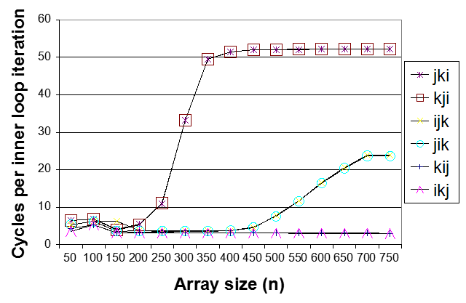
Core i7 Matrix Multiply Performance
jki / kji
ijk / jik
kij / ikj

Slide 92
总结：如何获得更高的性能？
好的编译器和选项
程序员
  找出算法中效率低下的部分
  编写编译器更易优化的代码
    procedure calls & memory references
  仔细优化内部循环 (where most work is done)
根据处理器调整代码
  挖掘指令并行性
  避免分支预测失败
  利用好Cache

