Slide 1

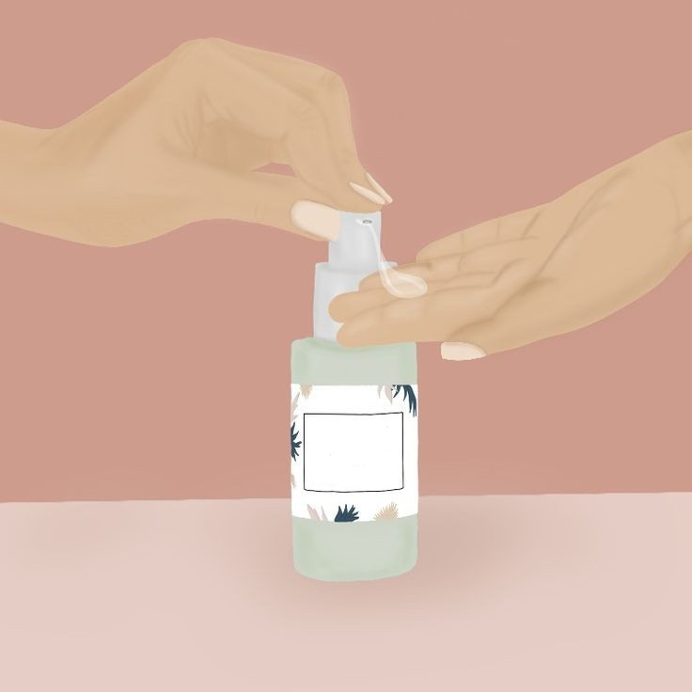
Machine Learning Approaches For Personalized Skincare Product Recommendation
Shalaka Praveen Waikar

Slide 2

Introduction
In this presentation, our focus converges on skincare recommendations, propelled by the power of a Hybrid Recommendation System—a synthesis that merges collaborative filtering and content-based filtering and uses constraints in the form of skin type and the skin concerns of the user in order to recommend suitable products.
Through this we'll dissect the intricate workings of our Hybrid Recommendation System, dissecting the interplay of algorithms, preferences, and product attributes. So let's discuss how the hybrid recommendation systems can be used to recommend skincare products to various skin types and concerns.

Slide 3
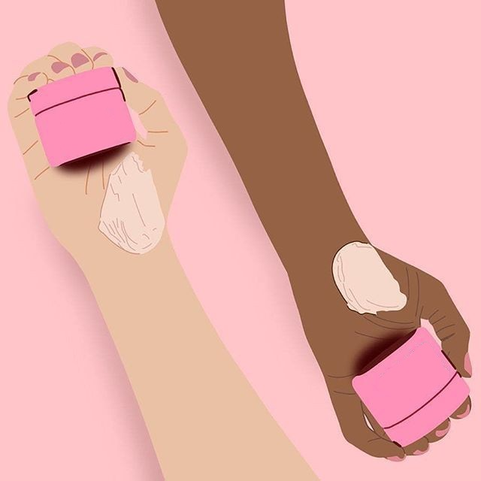
Research Goals
Objective 1: Develop a Hybrid Recommendation System | To view this template correctly in PowerPoint, download and install the fonts we used
1 | Synthesize collaborative filtering and content-based filtering techniques.
2 | Craft a synergistic solution that leverages strengths from both approaches.
Objective 2: Enhance Personalized Skincare Recommendations | All the colors used in this presentation
1 | Tailor recommendations to individual user preferences.
2 | Elevate the user experience by catering to unique skincare needs.
Through these goals, we aim to revolutionize the skincare recommendation landscape, marrying technological innovation with individualized beauty routines.

Slide 4

Background Study
Types of Skin
Role of Ingredients
Recommendation System
Our journey commences with a diverse spectrum of skin types—Dry, Oily, and Combination. Each type unfurls its own narrative, presenting unique challenges and opportunities. From the parched realms of Dry skin to the intriguing balancing act of Combination skin, and the oil-laden adventures of Oily skin, we immerse ourselves in the anatomy of each type.
Ingredients serve as the palette of skincare formulations. They contribute to efficacy and texture, and, most importantly, align with the aspirations of different skin types. Delve into the world of active agents, moisturizers, antioxidants, and more. Witness how ingredients dance together, choreographing routines of rejuvenation.
The recommendation system is the collaboration of technology and artistry. Algorithms weave insights from user preferences, product attributes, and skin concerns to curate personalized suggestions. We navigate the pathways of content-based and collaborative filtering, observing them as they amplify user satisfaction.

Slide 5

Methodology
01
02
03
04
Web Scrapping
Data Cleaning
Unearthing valuable insights from diverse sources through systematic extraction of skincare-related data.
Purifying the collected data to ensure accuracy and reliability, setting the foundation for meaningful analysis.
Data Integration
Data Preprocessing
Harmonizing data from various origins to create a comprehensive and unified dataset for robust analysis.
Transforming raw data into a refined format, ready for analysis, by handling missing values, outliers, and normalization.

Slide 6
Methodology
05
06
07
08
Content based Filtering
Collaborative Filtering
Tailoring skincare recommendations based on the inherent attributes of products, ensuring personalized alignment with user preferences.
Leveraging collective user behavior to suggest skincare products, fostering community-driven recommendations.
User Interface
Hybrid Recommendation System
Creating a symbiotic blend of content-based and collaborative filtering techniques to elevate the accuracy and personalization.
Crafting an intuitive and user-centric interface that facilitates seamless interactions, making personalized skincare recommendations accessible and engaging.

Slide 7

Content-Based Filtering
Crafting Personalized Recommendations with Content-Based Filtering:
In our pursuit of data-driven precision within skincare recommendations, the technique of content-based filtering assumes a pivotal role. This approach leverages the inherent attributes and characteristics of skincare products to create personalized recommendations that resonate with individual user preferences.
Mathematics:
For a given product, let's denote its attributes and characteristics as a vector A, where each element corresponds to a distinct feature. The user's preferences can also be represented as a vector P. Content-based filtering aims to quantify the similarity between the product's attributes and the user's preferences using a similarity measure, such as the cosine similarity:
Similarity(Product, User)=cos(θ)=Product.User/||Product||⋅||User|​|
Where:
⋅ represents the dot product between the product attributes vector and the user preferences vector.
∥Product∥∥Product∥ and ∥User∥∥User∥ denote the Euclidean norms of the respective vectors.
θ represents the angle between the vectors in the feature space.
By calculating this similarity, we can identify products that align closely with a user's preferences, enabling the creation of recommendations that align with their skincare goals and aspirations.

Slide 8
Collaborative-Based Filtering
Crafting Personalized Recommendations with Collaborative-Based Filtering:
In our quest to uncover the intricate relationships between skincare products and user preferences, we introduce Collaborative Filtering—a technique that draws from the collective wisdom of user experiences to shape personalized recommendations.
Mathematics :
At the heart of Collaborative Filtering lies a mathematical dance that illuminates connections. Let U denote the set of users, P represents the set of products, and R signifies the matrix of user-product ratings. Collaborative Filtering seeks to fill the void in this matrix, predicting missing ratings with precision.
Ru,p ​= Predict(u,p) = μ+Bias(u)+Bias(p)+∑f = 1F​User_Featureu, f​⋅Product_Featurep,f​
Where:
Ru,p​ is the predicted rating for user u and product p.
μ is the mean rating across all known ratings.
Bias(u) represents the user bias, accounting for their overall rating tendency.
Bias(p) captures the product bias, reflecting its general popularity.
F indicates the number of latent features.
User_Feature, User_Featureu, f​ and Product_Feature, Product_Featurep,f​ are the latent feature vectors for user u and product p, respectively.
By calculating this, we can identify products that align closely with a user's preferences, enabling the creation of recommendations that align with their skincare goals and aspirations.

Slide 9
Hybrid Recommnedation System
Uniting Algorithms: The Hybrid Recommendation System:
In our quest for skincare recommendation excellence, we've merged the prowess of content-based filtering and collaborative filtering into a singular, powerful solution—the Hybrid Recommendation System. This harmonious fusion combines the precision of data-driven insights with the personalization artistry that the skincare journey demands.
Mathematics :
In the Hybrid Recommendation System, the magic unfolds by combining the strengths of content-based filtering and collaborative filtering using weighted summation. Given a user's preferences vector PP and a product's attributes vector AA, the recommendation score RR is calculated as:
R(Product,User)=Weight1​×Similarity(Product,User)Content​+Weight2​×Similarity(Product,User)Collaborative​+Weight3​×Similarity(Product,User)Concern​ Where:
Similarity(Product, User)ContentSimilarity(Product, User)Content​ represents the content-based similarity between the product and the user.
Similarity(Product,User)CollaborativeSimilarity(Product,User)Collaborative​ signifies the collaborative filtering similarity.
Similarity(Product, User)ConcernSimilarity(Product, User)Concern​ captures the similarity based on the user's skin concerns.
The weights Weight1Weight1​, Weight2Weight2​, and Weight3Weight3​ allow us to fine-tune the influence of each filtering technique, culminating in a recommendation that strikes the perfect balance between product attributes, user preferences, and skincare aspirations.

Slide 10

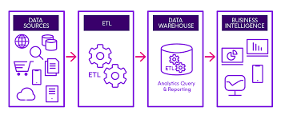
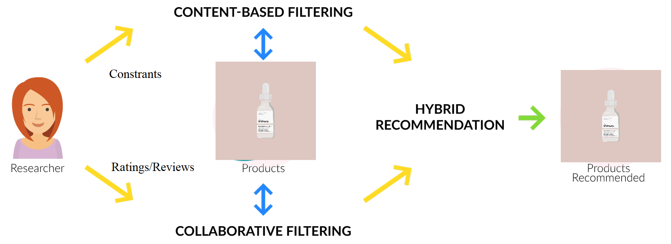
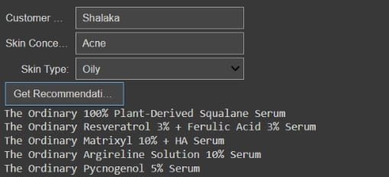
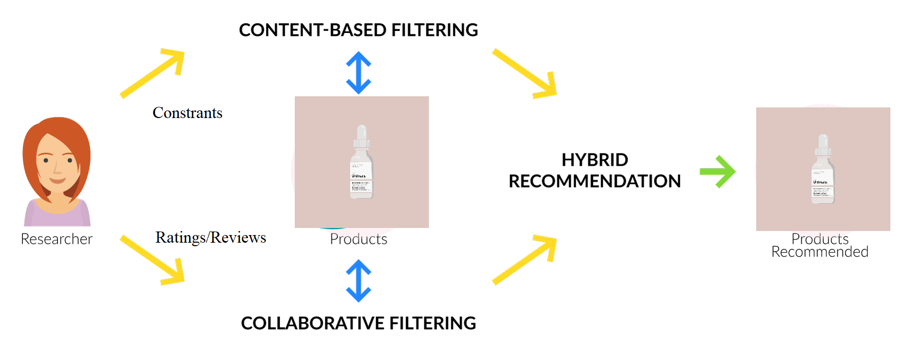
Implementation
Data Integration
Algorithmic Deployment
User Interface Design
Our first step involves gathering data from diverse sources: customer reviews, product attributes, and user preferences. Followed by data preprocessing, cleaning, and integration, ensuring a solid foundation for actionable insights.
The heart of our system lies in the application of machine learning algorithms. Collaborative filtering uncovers patterns in user behaviours, while content-based filtering dissects product attributes. The amalgamation of these approaches forms the Hybrid Recommendation System
While algorithms fuel the machinery, the user interface is the window through which users interact with the system. Our design philosophy revolves around user-centricity

Slide 11

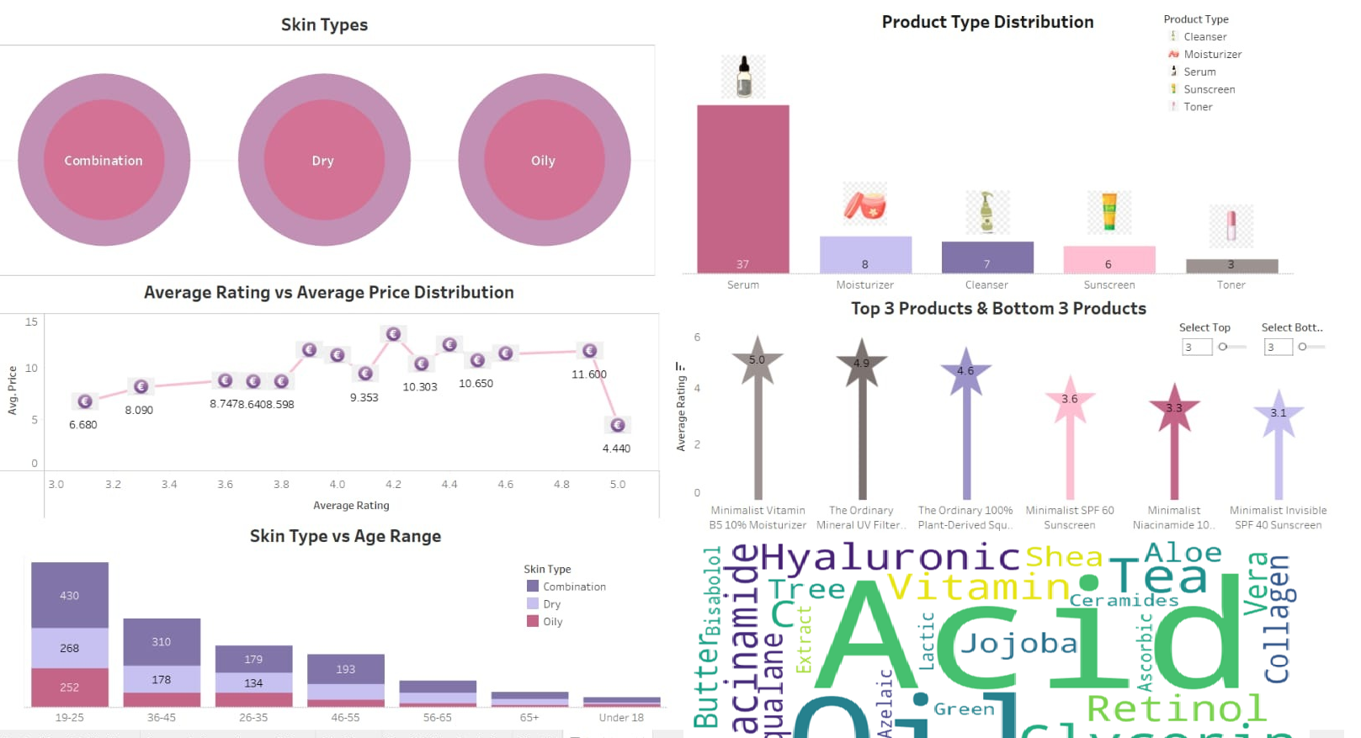
Visualization

Slide 12

Results
Quantifying Precision and Performance:
Collaborative Filtering Metrics:
Mean Absolute Error (MAE): The MAE measures the average absolute difference between predicted and actual ratings. In our context, it signifies the degree of closeness between the recommendations made by our collaborative filtering model and the actual user ratings.
MAE = 0.4569 (Aurora), 0.4482 (Madhumetha R.), 1.2638 (Babul B.)
Root Mean Squared Error (RMSE): The RMSE quantifies the root mean square of the differences between predicted and actual ratings. This metric provides insight into the overall accuracy of our collaborative filtering recommendations.
RMSE = 0.5399 (Aurora), 0.5934 (Madhumetha R.), 1.5757 (Babul B.)
Hybrid Recommendation Metrics:
Coverage: The coverage metric reveals the proportion of the entire product catalog that our recommendations encompass. It signifies the breadth of options our system offers.
Coverage = 0.082
User Satisfaction: User satisfaction captures the percentage of users for whom our recommendations achieved a user rating of 4 or higher. It showcases the alignment between our suggestions and users' preferences.
User Satisfaction = 100% (Aurora), 100% (Madhumetha R.), 60% (Babul B.)

Slide 13
Conclusions
Key Takeaways
Personalization Unveiled
Data-Driven Insights
In this journey through the realm of skincare recommendations, we've ventured into the convergence of data science and personal care. The results of our efforts bring forth a plethora of insights that redefine the way we approach skincare choices.
Our Hybrid Recommendation System stands as a testament to the potential of merging content-based and collaborative filtering techniques. By fusing user preferences, product attributes, and collaborative insights, we've unveiled a personalized realm of skincare choices that cater to diverse needs.
Exploring our system has uncovered intriguing insights into user behavior, product affinities, and the symbiotic relationship between user feedback and data-driven recommendations. These insights pave the way for future refinements and innovations in the realm of personalized skincare solutions.
User-Centric Harmony
Beyond the Horizon
Concluding
In the pursuit of elevating skincare, our system has achieved remarkable user satisfaction rates. This not only reaffirms the power of personalization but also underscores the importance of aligning technological advancements with individual preferences.
Our journey does not end here. The fusion of data-driven precision with the art of skincare is an ever-evolving process. As we look ahead, the door is open to further enhancements, collaborations, and the integration of emerging technologies to create an even more refined and tailored skincare experience.
In conclusion, we've embarked on a path that seamlessly marries the world of data-driven precision with the artistry of skincare. This journey has shed light on the immense potential of personalized recommendations, shaping the future of skincare in ways that empower, delight, and revolutionize the way we care for ourselves.

Slide 14
Future Scope
01
Harnessing AI and Machine Learning
The fusion of AI and machine learning continues to offer untapped potential. Exploring advanced algorithms and models can enhance the accuracy and sophistication of our recommendation system, unraveling deeper insights into user preferences and product synergies.
02
Incorporating Natural Language Processing (NLP)
Integrating NLP techniques can unlock the power of user-generated content, reviews, and feedback. By deciphering the nuances of language, we can enrich our understanding of user sentiment, thereby refining our recommendations to cater to emotional as well as functional needs.
03
Sensor Technology and Real-Time Feedback
As technology advances, the integration of sensor devices and wearables could usher in an era of real-time skin health monitoring. These insights can be woven into our recommendation system, creating a dynamic and responsive skincare experience that adapts to users' changing needs.
04
Global Collaboration and Expertise
Collaboration with skincare experts, dermatologists, and researchers can inject a wealth of specialized knowledge into our system. Integrating medical insights, cutting-edge formulations, and cultural perspectives can amplify the precision and depth of our recommendations.

Slide 15
Thanks!
Thank you for accompanying us on this transformative journey. Together, we aspire to create a skincare experience that transcends expectations and sets new standards of excellence. The future of personalized skincare beckons. Let's step forward, united by the aspiration to elevate skincare into an extraordinary, deeply personalized, and empowering experience.
Do you have any questions?

