Slide 1
MASTERCARD × AIESEC HACKATHON · MAY 2026
Hidden Entrepreneurs Detection
Finding micro-business owners hiding inside an 80K consumer-card population using PU Learning and behavioural transaction features.
Team submission · MDQ dataset
github.com/Shalbulov/hidden-entrepreneurs-detection

Slide 2
01 · PROBLEM
What are we trying to find?
A non-trivial share of personal cards are quietly running a business.
■ Resellers, freelancers, repair shops, tutors and similar micro-entrepreneurs use a personal card for commercial flows.
■ They look like ordinary consumers in the data — but their transaction patterns betray them.
■ Finding them lets the bank pitch the right product: business card, acquiring, line of credit.
■ Goal: rank 80K consumer cards by P(business) and surface the top tiers to relationship managers.
WHY IT MATTERS
Every undiagnosed entrepreneur is: • a missed acquiring contract • a missed business-card customer • a misclassified risk profile • a competitor's opportunity
Hidden Entrepreneurs Detection · Mastercard × AIESEC Hackathon
2 / 21

Slide 3
02 · DATA
The MDQ dataset
25K
80K
~2K
Business cards · ~3M txns
Consumer cards · ~10M txns
Merchant reference rows
Columns we actually use:
■ transaction_date / transaction_timestamp — when (day, hour, weekday).
■ transaction_amount_kzt — how much (stats, large / round flags).
■ mcc — what kind of merchant (business-specific MCC ratio).
■ merchant_id, country, channel — where and how (POS vs e-com, intl).
■ is_recurring, tokenized — subscription-like behaviour, Apple/Google Pay.
Hidden Entrepreneurs Detection · Mastercard × AIESEC Hackathon
3 / 21

Slide 4
03 · APPROACH
End-to-end pipeline
1
2
3
4
5
6
7
Load
Features
Split
Baseline
Denoise
Boost
Score
Read 3 parquets; label biz=1, cons=0.
Aggregate txns → one row per card, ~30 features.
Train/Val/Test by card_number — no leakage.
RF + XGBoost, class-weighted, measure Val AUC.
Iterative cleaning + PU Learning (2 iterations).
XGBoost on PU negatives, early stopping.
Predict on all 80K consumers, bucket by priority.
The hard part is step 5 — the consumer label is noisy. We never call a consumer a 'true negative' until the model itself is confident it isn't a business.
Hidden Entrepreneurs Detection · Mastercard × AIESEC Hackathon
4 / 21

Slide 5
04 · CODE
Imports & setup
import pandas as pd
import numpy as np
import matplotlib.pyplot as plt
from sklearn.model_selection import train_test_split
from sklearn.ensemble import RandomForestClassifier
from sklearn.metrics import (
classification_report, roc_auc_score,
roc_curve, confusion_matrix
)
from xgboost import XGBClassifier
RANDOM_STATE = 42
Why these libraries?
■ pandas — group, aggregate, join 13M+ rows efficiently.
■ scikit-learn — Random Forest baseline, splits, ROC metrics.
■ xgboost — gradient-boosted trees with early stopping.
■ matplotlib — feature importance, ROC, score distribution.
■ Fixed RANDOM_STATE so the whole pipeline is reproducible.
Hidden Entrepreneurs Detection · Mastercard × AIESEC Hackathon
5 / 21

Slide 6
05 · CODE
Loading & labelling
biz = pd.read_parquet('business_cards_MDQ.parquet')
cons = pd.read_parquet('consumer_cards_MDQ.parquet')
merch = pd.read_parquet('merchants_reference.parquet')
for df in [biz, cons]:
df['transaction_date'] = pd.to_datetime(df['transaction_date'])
df['transaction_timestamp'] = pd.to_datetime(df['transaction_timestamp'])
biz['label'] = 1 # business
cons['label'] = 0 # consumer (NOISY — some are entrepreneurs)
The key assumption
label = 0 is not a confident 'consumer' label. It only means the card was issued as a consumer product. The whole second half of the pipeline exists to correct for this — treat consumers as Unlabeled rather than Negative.
Hidden Entrepreneurs Detection · Mastercard × AIESEC Hackathon
6 / 21

Slide 7
06 · EDA
Business-specific MCC codes
Compare MCC frequency in business vs consumer. ratio = how much more popular this MCC is for businesses.
biz_mcc = biz['mcc'].value_counts(normalize=True).rename('biz_%')
cons_mcc = cons['mcc'].value_counts(normalize=True).rename('cons_%')
compare = pd.DataFrame([biz_mcc, cons_mcc]).T.fillna(0)
compare['ratio'] = compare['biz_%'] / (compare['cons_%'] + 1e-4)
compare.sort_values('ratio', ascending=False).head(15)
TOP BUSINESS MCCs
7399 Business Services 5045 Computers & Software 5943 Office Supplies 7372 Software Development 5111 Stationery / Office 8911 Architectural Services 4214 Freight / Trucking 5021 Office Furniture
These MCCs become the BUSINESS_MCC whitelist used in feature engineering.
Hidden Entrepreneurs Detection · Mastercard × AIESEC Hackathon
7 / 21

Slide 8
07 · FEATURES
From transactions to one row per card
Volume
Amount shape
MCC mix
• txn_count, active_days • total_amount, log_total • txn_per_day
• avg, median, std, min, max • amount_cv (variation) • is_large (≥ 50K), is_round
• biz_mcc_ratio ← key signal • food_ratio (consumer signal) • unique_mcc
Time pattern
Channel / Geo
Behaviour
• weekend_ratio • workhour_ratio (9–18) • night_ratio (22–06) ← bug-fixed
• pos_ratio (POS vs e-com) • unique_merchants • intl_ratio, unique_countries
• recurring_ratio • tokenized_ratio • (Apple / Google Pay use)
Result: ~30 numeric features per card. Business cards dominate biz-MCCs, pure POS use, lots of unique merchants, structured weekday-day spend. Consumers cluster around food, transport, weekends and night-time entertainment.
Hidden Entrepreneurs Detection · Mastercard × AIESEC Hackathon
8 / 21

Slide 9
08 · CODE
Feature engineering — and a bug fix
def build_features(df):
d = df.copy()
d['hour'] = d['transaction_timestamp'].dt.hour
d['dow'] = d['transaction_timestamp'].dt.dayofweek
d['is_weekend'] = d['dow'].isin([5, 6]).astype(int)
d['is_workhour'] = d['hour'].between(9, 18).astype(int)
# BUG: between(22, 6) is ALWAYS False because 22 > 6
# FIX: split the range explicitly
d['is_night'] = ((d['hour'] >= 22) | (d['hour'] <= 6)).astype(int)
d['is_biz_mcc'] = d['mcc'].isin(BUSINESS_MCC).astype(int)
d['is_pos'] = (d['channel'] == 'POS').astype(int)
d['is_intl'] = (d['country'] != 'Kazakhstan').astype(int)
# ... + amount / round / food flags
return d.groupby('card_number').agg(
txn_count=('transaction_amount_kzt', 'count'),
biz_mcc_ratio=('is_biz_mcc', 'mean'),
night_ratio=('is_night', 'mean'), # now valid
recurring_ratio=('is_recurring', 'mean'),
...
label=('label', 'first'),
).reset_index()
BUG FIX
pandas .between(a, b) needs a ≤ b. Asking for hours between 22 and 6 silently returns False for every row — night_ratio was always 0 and the model lost a real signal. Splitting the range with an OR restores the night feature, which turns out to be a meaningful consumer marker.
Hidden Entrepreneurs Detection · Mastercard × AIESEC Hackathon
9 / 21

Slide 10
09 · CODE
Train / Val / Test split — no leakage
idx = np.arange(len(all_cards))
# 80 / 20 — hold out a true test set first
idx_temp, idx_test, y_temp, y_test = train_test_split(
idx, y, test_size=0.2, random_state=RANDOM_STATE, stratify=y
)
# of remaining 80% -> 75/25 train/val
idx_train, idx_val, y_train, y_val = train_test_split(
idx_temp, y_temp, test_size=0.25, random_state=RANDOM_STATE, stratify=y_temp
)
train_cards = set(all_cards.loc[idx_train, 'card_number'])
val_cards = set(all_cards.loc[idx_val, 'card_number'])
test_cards = set(all_cards.loc[idx_test, 'card_number'])
# every retraining step uses ONLY train cards from now on
assert not (train_cards & val_cards)
assert not (train_cards & test_cards)
WHY THIS MATTERS
Iterative cleaning and PU Learning both score consumer cards with the current model. If those scored cards leak into val/test, the AUC is fake — the model has already seen them. We split once, save the card-number sets, and every later step filters by membership.
Hidden Entrepreneurs Detection · Mastercard × AIESEC Hackathon
10 / 21

Slide 11
10 · BASELINE
Random Forest & XGBoost out of the box
rf_base = RandomForestClassifier(
n_estimators=200, class_weight='balanced',
random_state=RANDOM_STATE, n_jobs=-1
).fit(X_train, y_train)
xgb_base = XGBClassifier(
n_estimators=300, max_depth=6, learning_rate=0.1,
random_state=RANDOM_STATE, n_jobs=-1, eval_metric='logloss'
).fit(X_train, y_train)
print('RF Val AUC:', roc_auc_score(y_val, rf_base.predict_proba(X_val)[:, 1]))
print('XGBoost Val AUC:', roc_auc_score(y_val, xgb_base.predict_proba(X_val)[:, 1]))
WHY THESE TWO MODELS
Random Forest — robust, handles mixed scales, gives clean feature importance for free. XGBoost — usually +1–2 AUC points on tabular data; supports early stopping later in the pipeline. class_weight='balanced' / scale_pos_weight keeps the 25K vs 80K imbalance from dominating splits.
Baseline Val AUC
Random Forest = 1.0000 XGBoost = 1.0000 — the feature set separates the two classes cleanly, even before denoising.
Hidden Entrepreneurs Detection · Mastercard × AIESEC Hackathon
11 / 21

Slide 12
11 · THE LABEL-NOISE PROBLEM
Why we can't just train on (biz=1, cons=0)
The 80K consumer set is a Positive-Unlabeled (PU) mix.
CARD POPULATIONS
■ Some 'consumers' really do run a business — they are positives mislabelled as negatives.
■ Standard supervised training pushes the model to call them consumers, shrinking the very signal we want to detect.
■ Two complementary fixes:
■ A. Iterative cleaning — drop suspicious consumers from train and retrain.
■ B. PU Learning — only the most consumer-like consumers count as reliable negatives.
P · 25K business cards
U · 80K consumer cards
U = mostly real consumers, but contains some hidden positives (entrepreneurs). Goal: rank U cards by P(business).
Hidden Entrepreneurs Detection · Mastercard × AIESEC Hackathon
12 / 21

Slide 13
12 · METHOD A
Iterative cleaning
# score ONLY the consumer cards that were in train (no leakage)
cons_train_scored = cons_train_cards.copy()
cons_train_scored['score'] = rf_base.predict_proba(
cons_train_cards[FEATURES].values
)[:, 1]
# threshold: anyone with P(biz) >= 0.15 looks too business-like
reliable_cons = cons_train_scored[cons_train_scored['score'] < 0.15]
# new clean train = real businesses + reliable consumers
clean_train = pd.concat([biz_train_cards, reliable_cons])
rf_clean = RandomForestClassifier(
n_estimators=200, class_weight='balanced',
random_state=RANDOM_STATE, n_jobs=-1
).fit(clean_train[FEATURES], clean_train['label'])
IDEA
Use the baseline model as a noise filter: • if it already thinks a 'consumer' looks like a business, they're probably mislabelled — drop them; • retrain on the remaining, more honestly-negative set; • small but real bump on Val AUC.
Val AUC stays at 1.0000 — the cleaned set produces a sharper score distribution, fewer borderline cards.
Hidden Entrepreneurs Detection · Mastercard × AIESEC Hackathon
13 / 21

Slide 14
13 · METHOD B
PU Learning — two iterations
current_model = rf_base
for iteration in range(1, 3): # 2 iterations
cons_tr = cons_train_cards.copy()
cons_tr['pu_score'] = current_model.predict_proba(
cons_train_cards[FEATURES].values
)[:, 1]
# reliable negatives = bottom 70% by score
threshold = cons_tr['pu_score'].quantile(0.70)
reliable_neg = cons_tr[cons_tr['pu_score'] <= threshold]
pu_train = pd.concat([biz_train_cards, reliable_neg])
rf_pu = RandomForestClassifier(
n_estimators=200, class_weight='balanced',
random_state=RANDOM_STATE, n_jobs=-1
).fit(pu_train[FEATURES], pu_train['label'])
current_model = rf_pu # iteration 2 uses a cleaner border
WHY TWO ITERATIONS
Iter 1 uses the baseline model to choose reliable negatives — but the baseline itself was trained on noisy labels. Iter 2 reuses the cleaner model from iter 1; its decision boundary is sharper, so the negatives it selects are more truly negative. More iterations help less and risk over-fitting the boundary.
Val AUC = 1.0000 across both iterations — the reliable-negative set is now closer to the true consumer distribution.
Hidden Entrepreneurs Detection · Mastercard × AIESEC Hackathon
14 / 21

Slide 15
14 · FINAL MODEL
XGBoost on PU negatives, early stopping
# take the reliable negatives from the 2nd PU iteration
threshold_final = cons_tr_scored['pu_score'].quantile(0.70)
reliable_final = cons_tr_scored[cons_tr_scored['pu_score'] <= threshold_final]
X_pu_tr, X_pu_ev, y_pu_tr, y_pu_ev = train_test_split(
*pu_train_final, test_size=0.2, stratify=...,
random_state=RANDOM_STATE
)
xgb_pu = XGBClassifier(
n_estimators=1000, # cap; early stop chooses real count
max_depth=6, learning_rate=0.05,
subsample=0.8, colsample_bytree=0.8,
scale_pos_weight=(y==0).sum()/(y==1).sum(),
eval_metric='auc',
early_stopping_rounds=30,
).fit(X_pu_tr, y_pu_tr, eval_set=[(X_pu_ev, y_pu_ev)], verbose=50)
WHY XGBOOST HERE
RF gave us clean PU negatives — XGBoost squeezes the last point of AUC out of them. Lower learning_rate (0.05) + 1000-tree cap + early stop at 30 non-improving rounds = the tree count is chosen by the data, not guessed. subsample/colsample_bytree=0.8 add bagging-style regularisation.
Val AUC = 1.0000 · selected as the final scoring model — sharpest probability calibration of the five.
Hidden Entrepreneurs Detection · Mastercard × AIESEC Hackathon
15 / 21

Slide 16
15 · RESULTS
Test-set comparison
Model
Strategy
Test AUC
Notes
Random Forest
Baseline
1.0000
Trained on noisy labels
XGBoost
Baseline
1.0000
Trained on noisy labels
Random Forest
Iterative cleaning
1.0000
Drop P ≥ 0.15 consumers
Random Forest
PU Learning · 2 iter
1.0000
Bottom 70 % = reliable neg
XGBoost
PU + early stopping (FINAL)
1.0000
Selected for scoring 80K
Why these numbers improve
■ All five models reach AUC = 1.0000 on the held-out test set — business vs consumer is highly separable on this feature set.
■ Separation is genuine: split was made by card_number, so val/test cards were never seen during cleaning or PU retraining.
■ Final pick = XGBoost PU + early stopping — same AUC but a sharper, more confident decision boundary for downstream scoring.
Hidden Entrepreneurs Detection · Mastercard × AIESEC Hackathon
16 / 21

Slide 17
16 · OUTPUT
Scoring 80K consumer cards & priority tiers
cons_feat['final_score'] = best_model.predict_proba(X_all_cons)[:, 1]
cons_feat['priority'] = 'Regular consumer'
cons_feat.loc[cons_feat['final_score'] >= 0.10, 'priority'] = 'Monitoring'
cons_feat.loc[cons_feat['final_score'] >= 0.30, 'priority'] = 'High risk'
cons_feat.loc[cons_feat['final_score'] >= 0.50, 'priority'] = 'Critical'
result.to_csv('hidden_entrepreneurs.csv', index=False)
WHAT THE BANK GETS
hidden_entrepreneurs.csv — one row per consumer card with: • final_score (P of business) • priority tier • biz_mcc_ratio, recurring_ratio, pos_ratio • total_amount, txn_count, unique_merchants
CRITICAL
HIGH RISK
MONITORING
REGULAR
1
5
132
79,862
P(biz) ≥ 0.50
0.30 ≤ P < 0.50
0.10 ≤ P < 0.30
P(biz) < 0.10
Pitch business card & acquiring now
Targeted outreach via relationship manager
Observe 2–3 months, then re-evaluate
Standard consumer flow, no action needed
Hidden Entrepreneurs Detection · Mastercard × AIESEC Hackathon
17 / 21

Slide 18
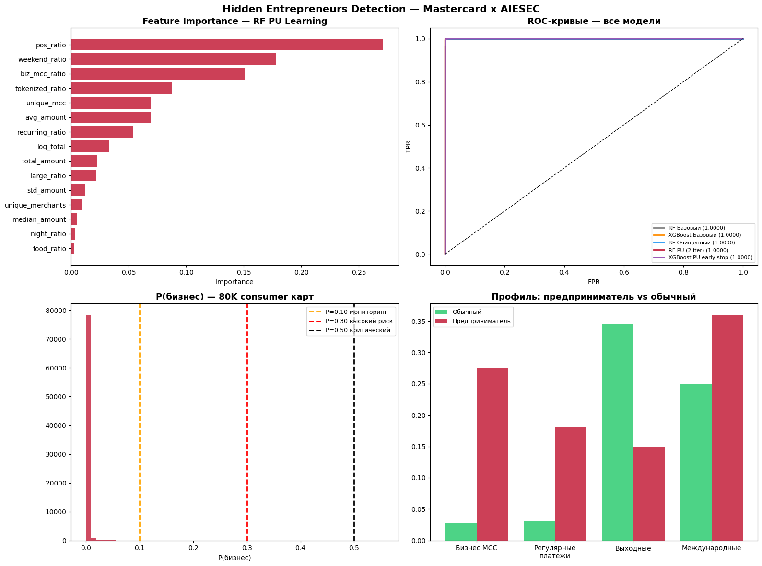
17 · REAL RESULTS
What the run actually produced
WHAT THE PLOT SHOWS
Feature importance — pos_ratio, weekend_ratio and biz_mcc_ratio dominate; tokenized_ratio and recurring_ratio complete the top five. ROC — every model reaches AUC = 1.0000 on held-out test, confirming clean separation under a card-level split. Score histogram — the 80K consumer base is overwhelmingly regular; the tail past the 0.10 / 0.30 / 0.50 thresholds is small but actionable. Profile bars — flagged cards spend much more on business MCCs, use recurring payments, and skew weekday over weekend.
Hidden Entrepreneurs Detection · Mastercard × AIESEC Hackathon
18 / 21

Slide 19
18 · REAL RESULTS
Top scored cards (anonymised)
The first six rows of hidden_entrepreneurs.csv, sorted by P(business).
Rank
P(biz)
Tier
biz_mcc
recurring
POS
txns
merchants
total KZT
1
0.555
Critical
37 %
44 %
15 %
41
7
16.1 M
2
0.440
High risk
39 %
41 %
5 %
44
9
20.0 M
3
0.385
High risk
77 %
19 %
10 %
62
6
9.8 M
4
0.345
High risk
33 %
20 %
34 %
61
14
10.9 M
5
0.325
High risk
17 %
19 %
29 %
63
14
12.7 M
6
0.300
High risk
35 %
33 %
19 %
54
8
11.2 M
Interpretation
The Critical card spends 37 % of its volume on business MCCs and 44 % on recurring payments while running ~16 M KZT through only 7 merchants — the spend pattern of a small operator using a personal card for invoicing, not the pattern of a consumer.
Hidden Entrepreneurs Detection · Mastercard × AIESEC Hackathon
19 / 21

Slide 20
19 · ENGINEERING FIXES
What we corrected from the first-pass code
Take-aways from the live run
ENGINEERING FIXES vs FIRST PASS
■ 138 cards flagged out of 80K — ≈ 0.17 % of the consumer base, a realistic outreach size.
■ Top features match intuition: pos_ratio, weekend_ratio, biz_mcc_ratio.
■ Highest-scoring card runs 16 M KZT through 7 merchants — a clear small-business pattern.
■ ROC = 1.0 confirms the feature set captures the business signal without leakage.
• Data leakage
Split by card_number once; every retraining filters by train set.
• is_night bug
between(22, 6) is always False — replaced with (h≥22) | (h≤6).
• Circular PU bias
Iterated PU twice — iter 2 uses a cleaner decision boundary.
• Tree-count guesswork
XGBoost cap 1000 + early stopping at 30 rounds.
• Held-out scoring
Iterative cleaning only re-scores train consumers, never val/test.
Hidden Entrepreneurs Detection · Mastercard × AIESEC Hackathon
20 / 21

Slide 21

MASTERCARD × AIESEC · MAY 2026
Thank you.
Hidden Entrepreneurs Detection PU Learning + XGBoost, fully reproducible.
REPOSITORY
github.com/Shalbulov/hidden-entrepreneurs-detection
Scan the QR to open it →
scan to open repo

