Slide 1
NETWORK INTRUSION DETECTION SYSTEM
IBM SKILLSBUILD VIRTUAL INTERNSHIP PROJECT
Presented By:
-Shaleen Bapna
-Techno India NJR Institute of Technology
-Computer Science & Engineering - Cybersecurity

Slide 2
OUTLINE
Problem Statement
Proposed System/Solution
Technology Used
Algorithm & Deployment
Result
Conclusion
Future Scope
References

Slide 3
Problem Statement
Create a robust network intrusion detection system (NIDS) using machine learning. The system should be capable of analyzing network traffic data to identify and classify various types of cyber-attacks (e.g., DoS, Probe, R2L, U2R) and distinguish them from normal network activity. The goal is to build a model that can effectively secure communication networks by providing an early warning of malicious activities.

Slide 4
Proposed Solution
The proposed solution is to develop a Network Intrusion Detection System (NIDS) using machine learning techniques to detect and classify malicious network traffic. The solution uses a labeled dataset containing instances of both normal and attack traffic, trains a classification model to distinguish between them, and integrates the solution into a cloud-based environment for scalable deployment. The system aims to provide early warnings of cyber-attacks like DoS, Probe, R2L, and U2R, enhancing the security of communication networks.
Key components of the solution include:
Data Preprocessing: Cleaning, encoding, and normalizing network traffic data.
Model Training: Using classification algorithms to learn attack patterns.
Evaluation: Validating the model’s performance using accuracy, F1-score, and confusion matrix.
Cloud Deployment: Hosting the model on IBM Cloud Lite using watsonx.ai Runtime for prediction APIs.

Slide 5
System Approach
The system is built on a modular approach using IBM Cloud Lite services to ensure accessibility and scalability. The key aspects include:
System Requirements:
Python 3.x environment
Jupyter Notebook via watsonx.ai Studio
IBM Cloud Object Storage for dataset handling
IBM watsonx.ai Runtime for model deployment
Cloud Services:
IBM Cloud Object Storage
watsonx.ai Studio
watsonx.ai Runtime (Machine Learning)

Slide 6
Algorithm & Deployment
Algorithm Selection:
A Random Forest Classifier was selected due to its high accuracy and robustness in handling tabular classification problems with mixed feature types (numerical + categorical).
Data Input:
Features such as protocol type, source/destination bytes, connection flags, and host behavior metrics were used.
The output label is either 'normal' or 'anomaly'.
Training Process:
The dataset was cleaned and label-encoded.
80/20 train-validation split was used.
The model was trained using RandomForestClassifier from scikit-learn with 100 estimators.
Prediction Process:
The trained model was used to classify unseen traffic in the test dataset.
Predictions were exported and visualized to evaluate anomaly detection.
Deployment:
The model was saved and can be deployed via IBM watsonx.ai Runtime to expose an API for real-time traffic classification.
IBM Cloud provides a seamless environment to integrate the model with external systems or dashboards.

Slide 7
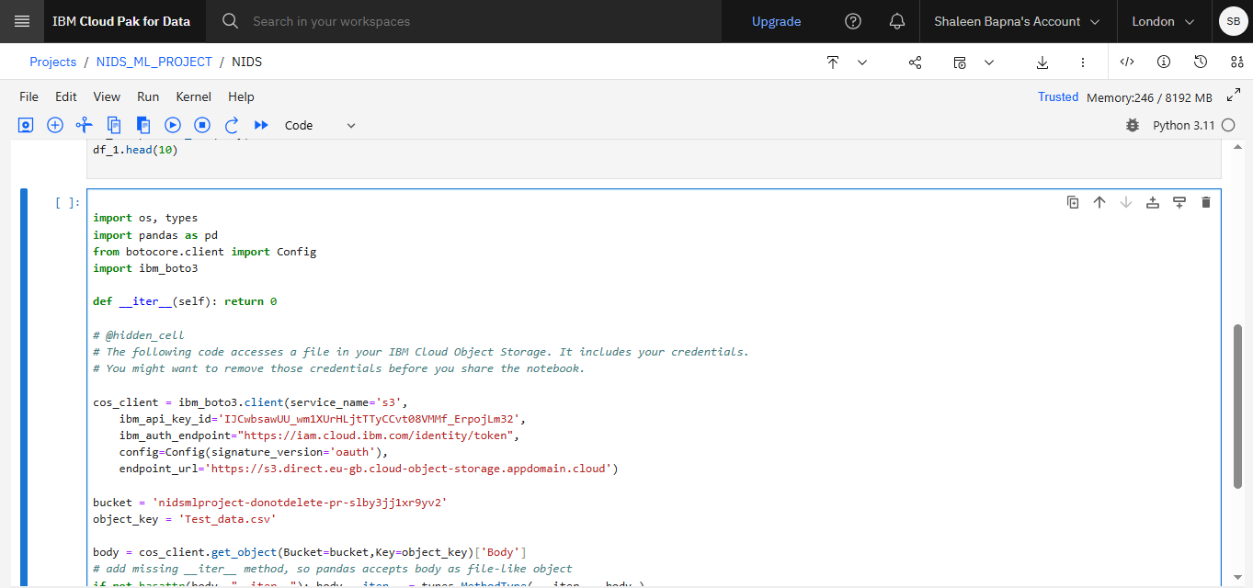
Result

Slide 8
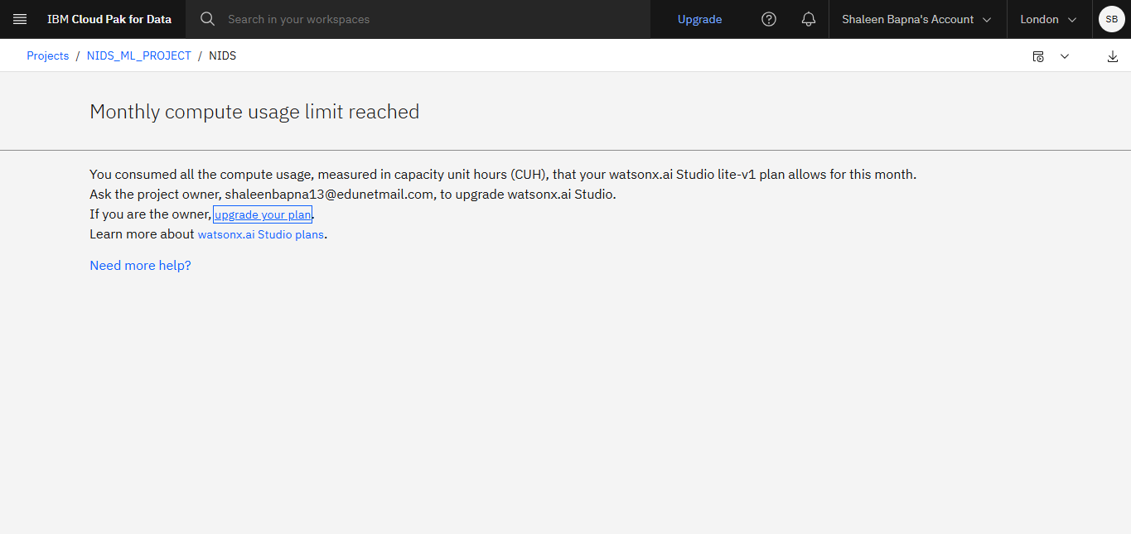
Result
Sir the rest of the screenshots are from vs code as I was not able to take the remaining ones from the IBM platform due to this issue, I kindly request you to consider them as I completed the same on IBM platform too.

Slide 9
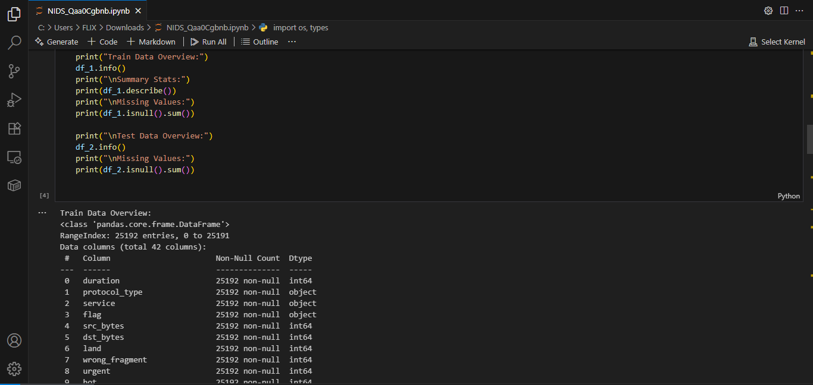
Result

Slide 10
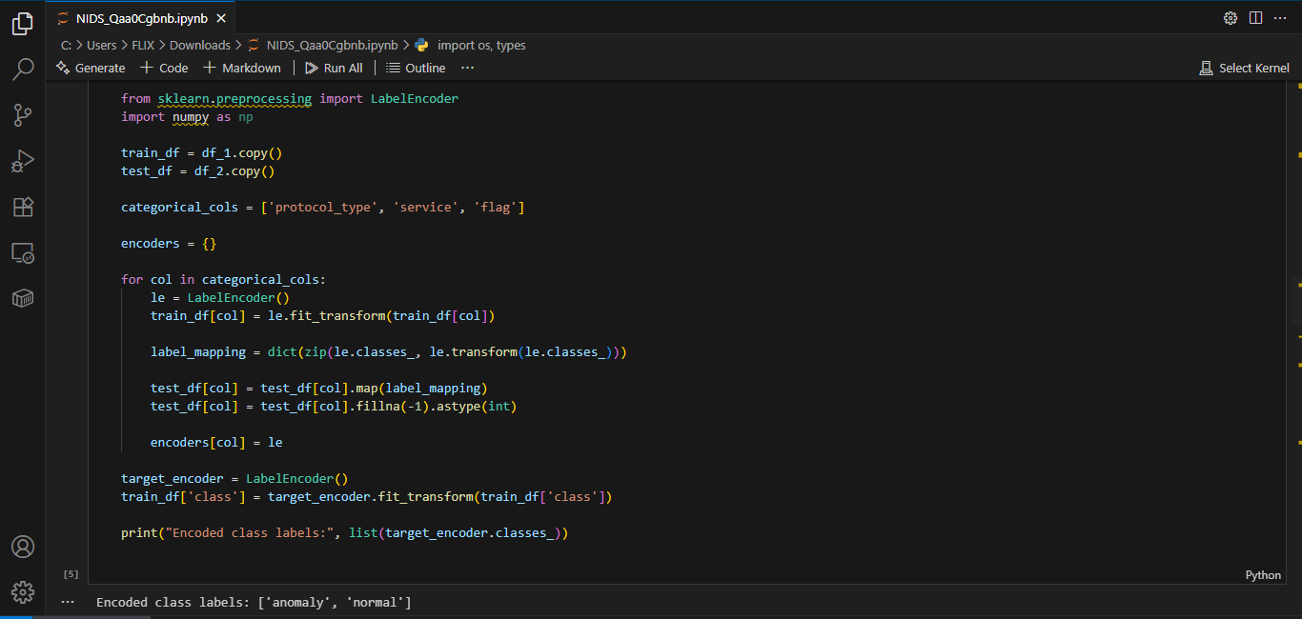
Result

Slide 11
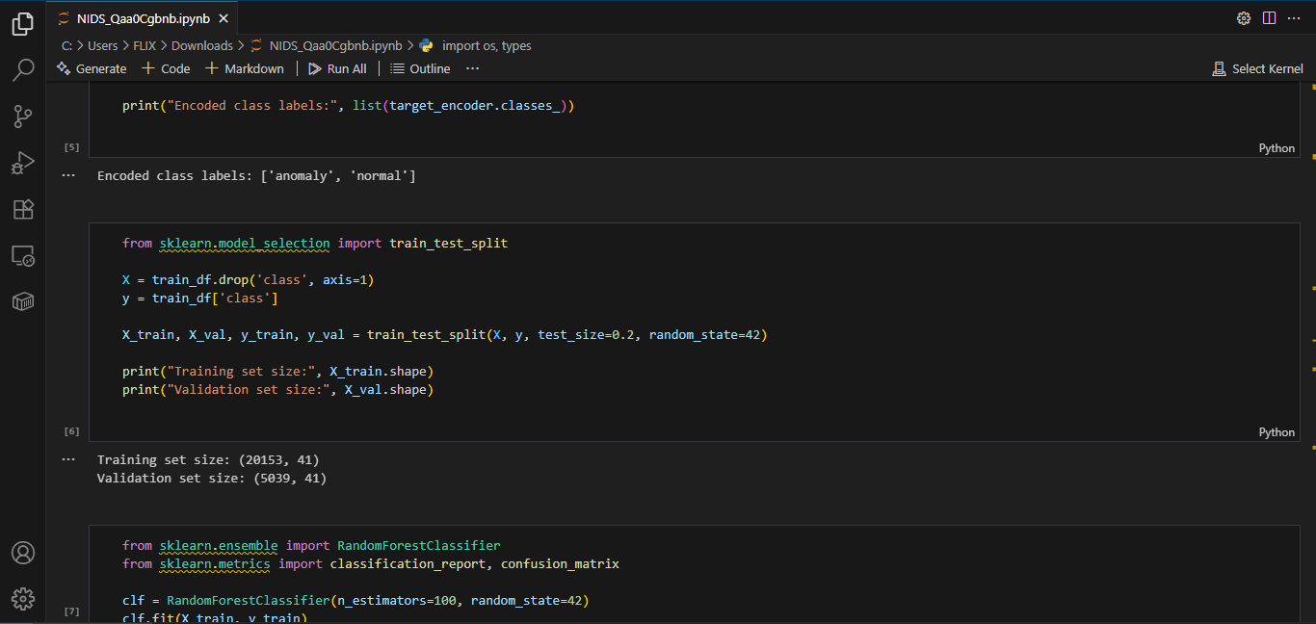
Result

Slide 12
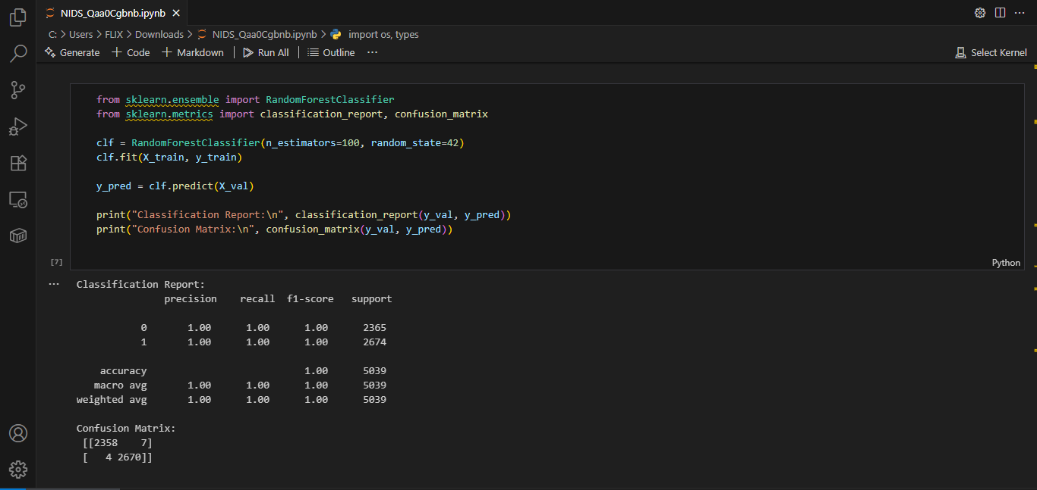
Result

Slide 13
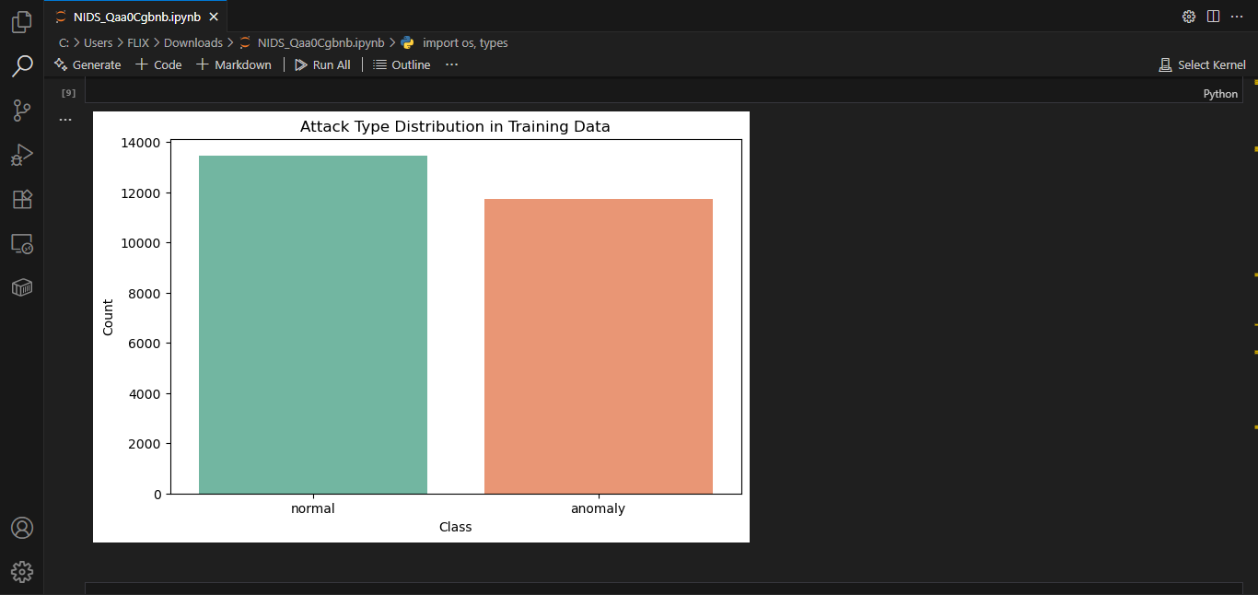
Result

Slide 14
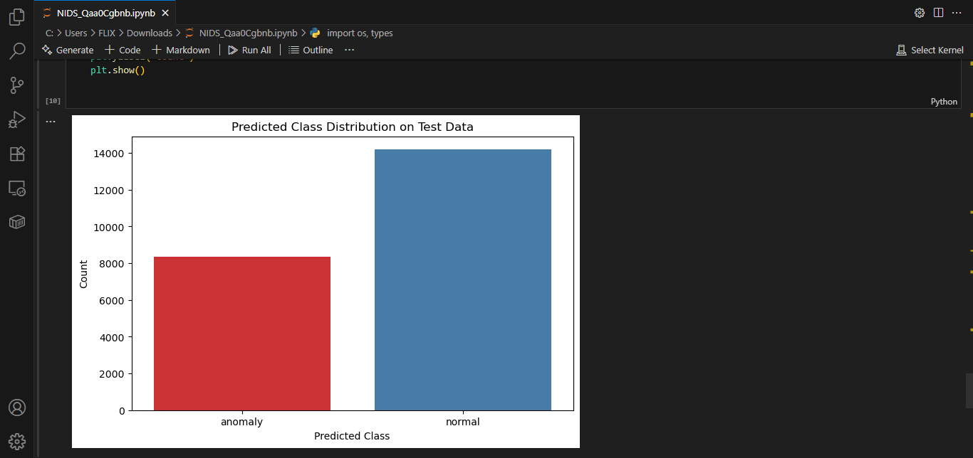
Result

Slide 15
Conclusion
The developed Network Intrusion Detection System (NIDS) using machine learning successfully demonstrates how cyber threats can be identified and mitigated in real-time through data-driven approaches. By training a Random Forest classifier on labeled network traffic data, the system achieved high accuracy in detecting and classifying intrusions such as DoS, R2L, U2R, and Probe attacks. The integration with IBM Cloud Lite services enabled scalable, cloud-based development and deployment using watsonx.ai Studio and Runtime. This solution highlights the effectiveness of machine learning in strengthening network security infrastructure and providing early alerts for potential cyber threats

Slide 16
Future scope
Real-Time Traffic Integration
Multi-Class Classification
Ensemble & Deep Learning Models
Dashboard/Visualization Tool
Edge Computing & IoT Security
Cross-Dataset Evaluation

Slide 17
References
GitHub Link: https://github.com/Shaleen-flix/NIDS

Slide 18
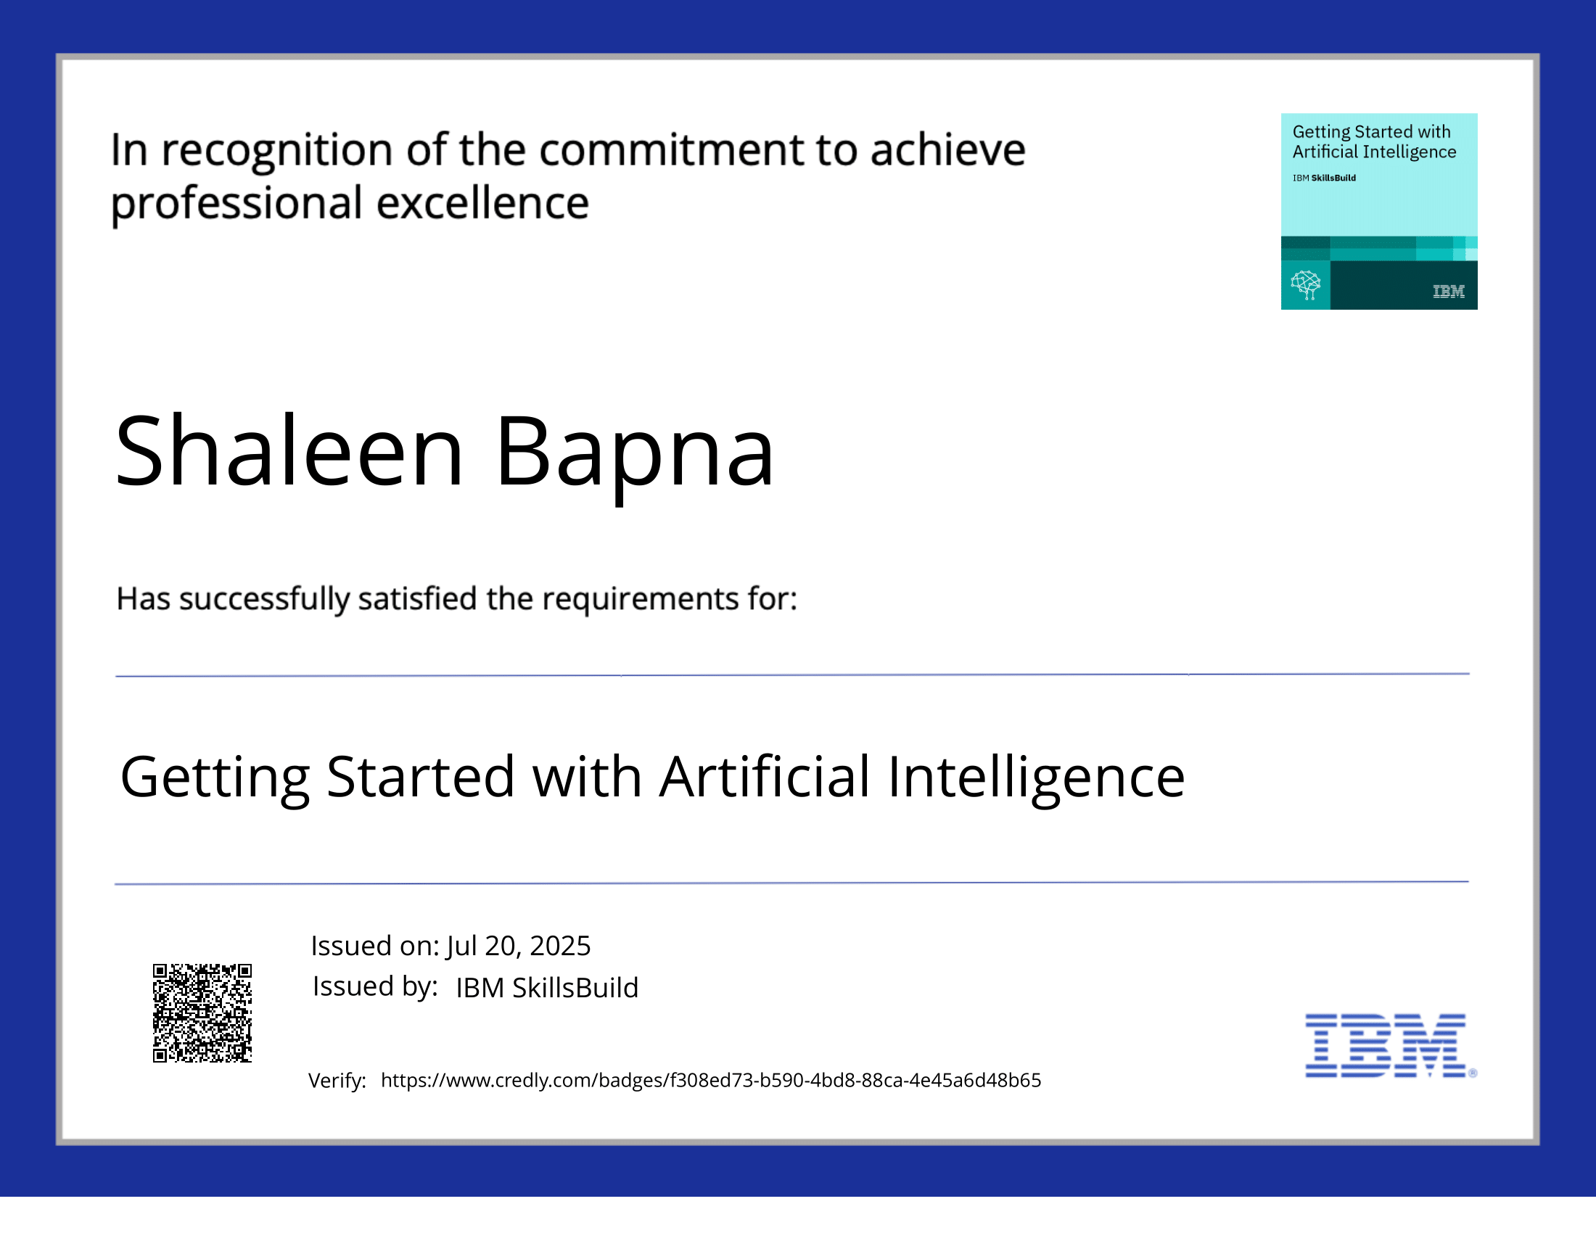
IBM Certifications

Slide 19

IBM Certifications

Slide 20
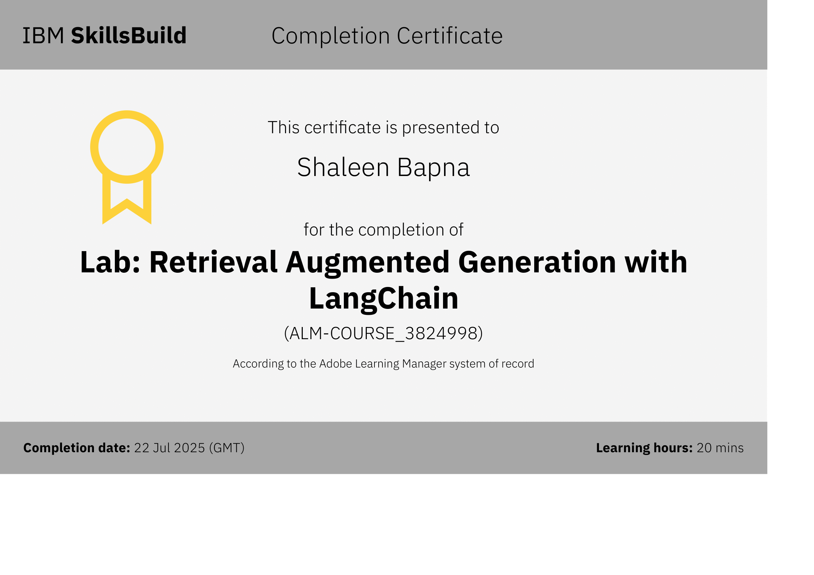
IBM Certifications

Slide 21
THANK YOU

