Slide 1
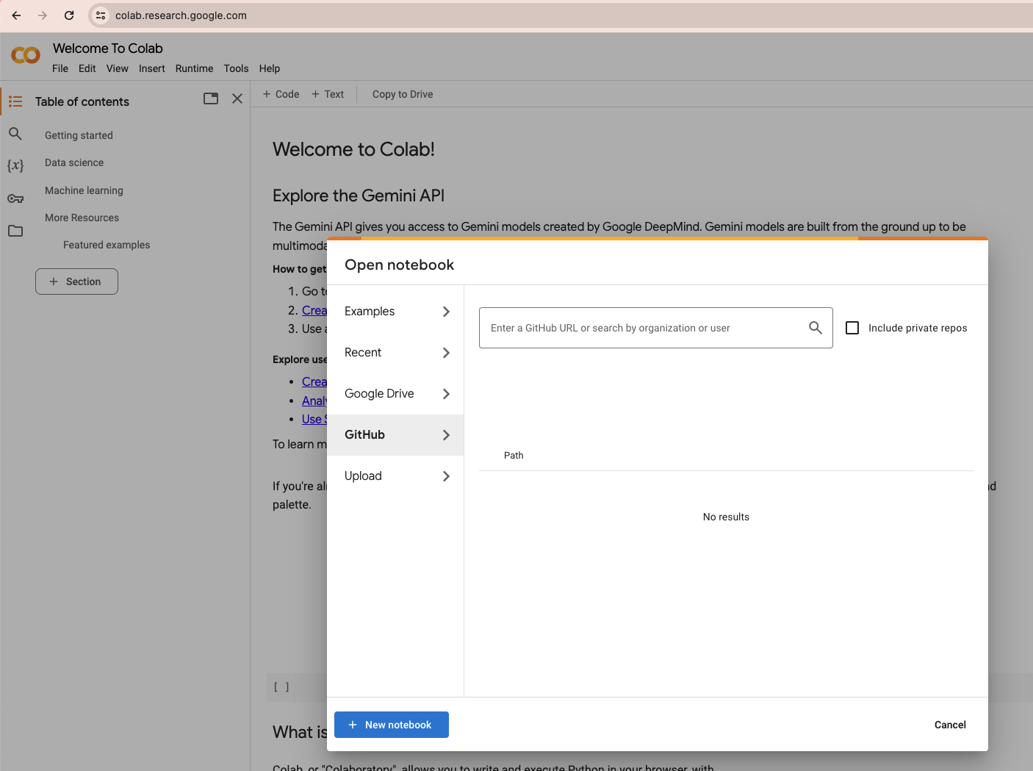
Log into your google account on your browser.
Open website “colab.research.google.com” in your browser.
The window on the right opens automatically, titled “Open notebook”.
Click on “Github” on the left panel in the open window.
Click into the text field “Enter a GitHub URL..”

Slide 2
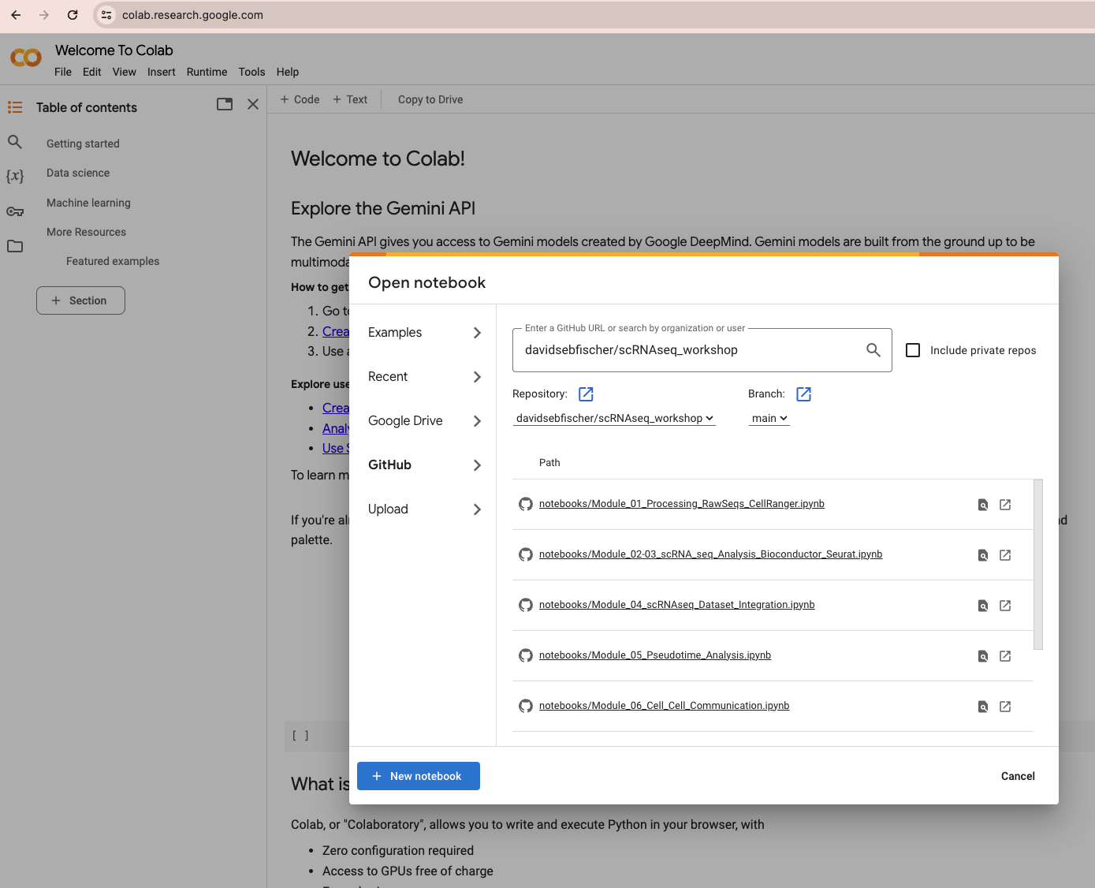
Type into the text field: “davidsebfischer/scRNAseq_workshop”
Click below the text field to load the selection from Github.
Click on the notebook that you want to open and run.

Slide 3
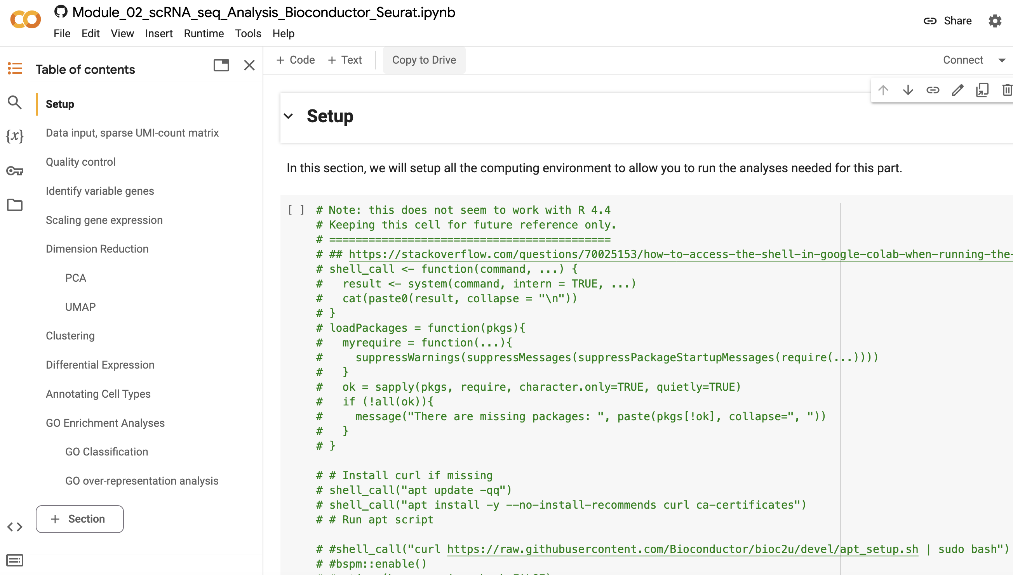
This notebook opens in colab in a new window. To modify and save it, copy it into your own colab account.

Slide 4
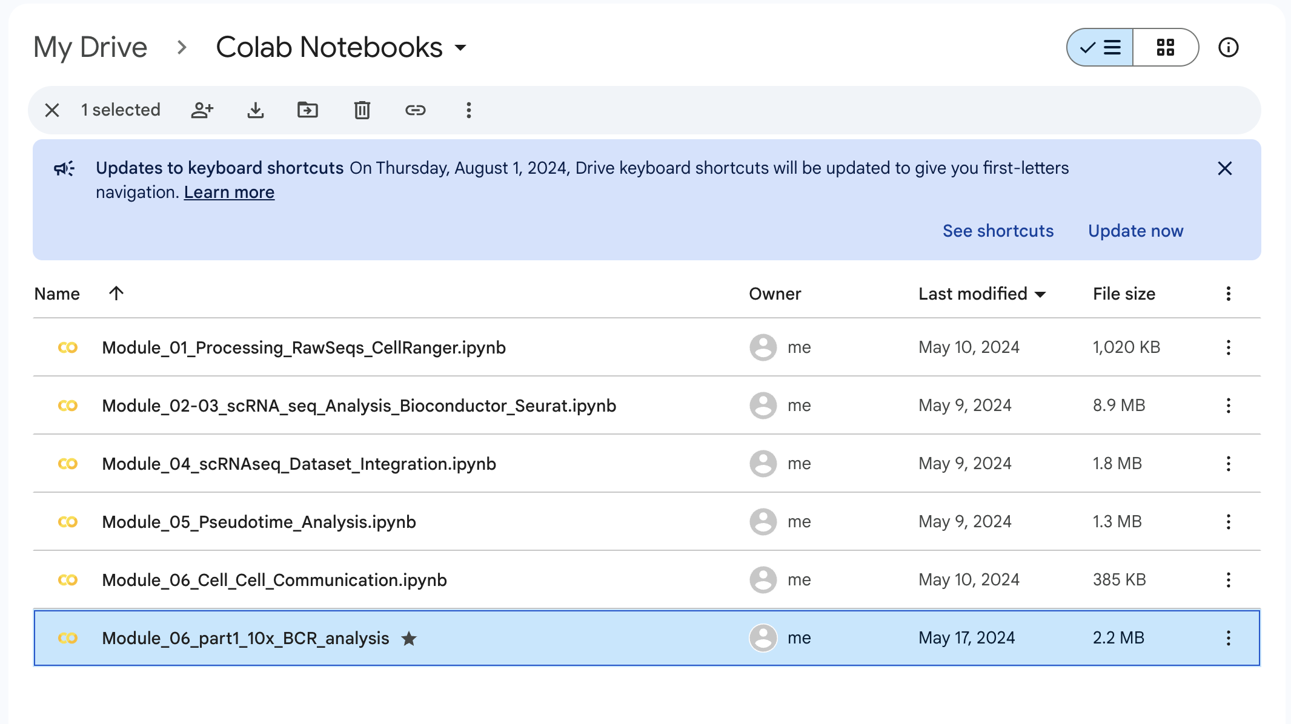
Later, you will be able to retrieve this personal copy of the notebook via your colab account: all changes and comments that you make and save will be saved.
You can find this page under on https://drive.google.com/drive/my-drive under the yellow folder “Colab Notebooks”.
We use colab for teaching because it allows us to control the software environment in which you execute code, this helps us avoid installation issues in workshops. If you use snippets of these tutorials in your own work, you might want to do that in other environments, for example locally on your laptop.

