Slide 1



2024 Single Cell Workship Colombia: Day 3 Honeycomb Library Prep and 10X Cell Loading
July 15-19, 2024
Bogota, Colombia

Slide 2
Objectives for Today
Honeycomb CLX
10X Genomics
Perform Library clean-up steps
Quality control (QC) our libraries
Load fixed nuclei and RNA into the 10X chip
Retrieve 10X

Slide 3

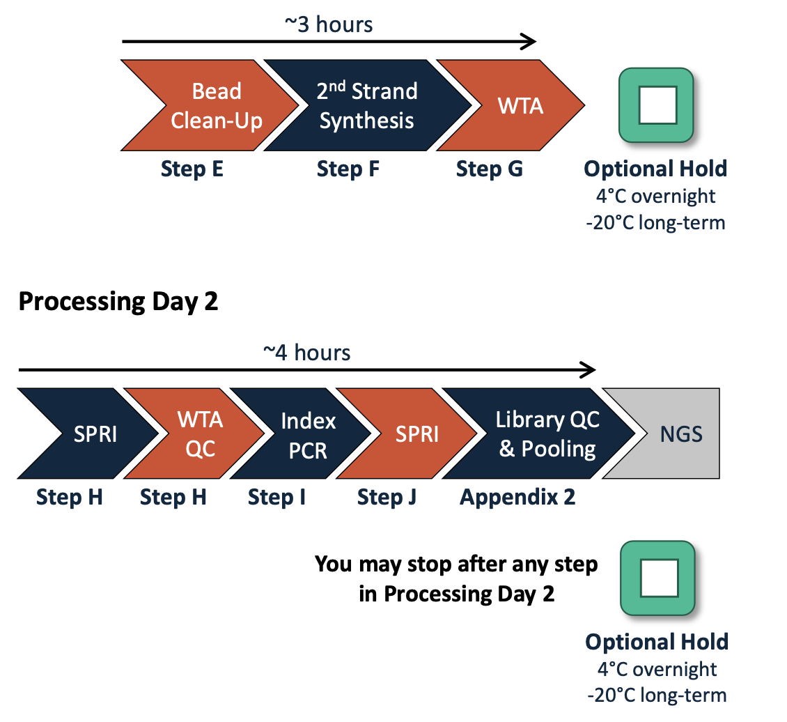
Honeycomb CLX Recap + Next Steps
Notes:
Recap: We did sample capture, transcriptome recovery, and 1st strand synthesis.

Slide 4
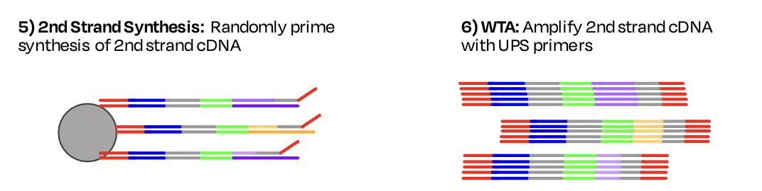
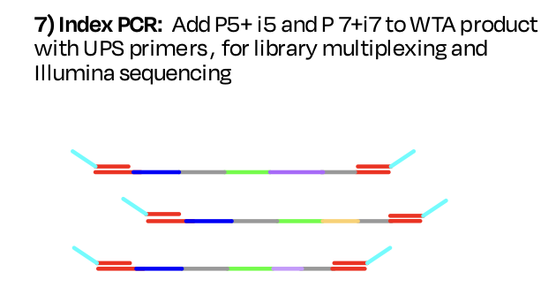
Honeycomb CLX Relevant Chemistry
Recap:
Today:

