Slide 1


Minterate
Payment App
REVOLUTIONIZING MOBILE PAYMENTS
Payment App
[24A10357] Natali Dahary 205871049
[24A10357] Shalev Sharabi 313287823

Slide 2
Introduction
Our project's goal is to develop an advanced client-server architecture for lending. With the increasing costs and interest rates imposed by financial institutions, there is a need for a more accessible and cost-effective lending platform. This system will serve as a leading solution for direct money lending between individuals, providing significant advantages for both borrowers and lenders.
Minterate
Payment App

Slide 3
Market
Research
Upstart
Prosper
Blender
Client-Server Model: where borrowers and investors connect to Upstart's servers to participate in peer-to-peer lending activities.
A client-server lending platform that facilitates loans between individuals
A peer-to-peer lending platform connecting borrowers and investors.
Keywords: lending marketplace, online lending, borrower investor platform.
Keywords: lending, personal loans, investor lending platform.
Keywords: lending, personal loans, investor lending platform.

Slide 4
Apps Main
Features
1
Authentication and Authorization
2
Loan Management
User Registration and Login: Allow users to register the system and login securely via email, password and OTP (mobile).
JWT Authentication: Secure user authentication using JSON Web Tokens (JWT).
Loan Application: Enable users to apply for loans by providing necessary details such as loan amount, interest rate, and period.
Loan Approval: Allow authorized personnel to review and approve loan applications.
Loan Repayment: Provide options for users to repay their loans in installments or full amount.
Automatic Loan Processing: Implement automation for processing loan transactions and updating balances.
3
Transaction Recording
Transaction Logging: Record all financial transactions related to loans, including repayments and disbursements.
Balance Update: Update user balances automatically after each transaction to reflect accurate financial status.
Error Handling: Implement error handling mechanisms to manage exceptions during transaction processing.
User Management
4
Profile Management: Allow users to view and update their profile information, including personal details and contact information.
Password Reset: Provide functionality for users to reset their passwords in case they forget or need to change them.
Account Deactivation: Allow users to deactivate or delete their accounts if needed.
5
Reporting and Analytics
Loan Status Tracking: Provide users with insights into the status of their loans, including pending, active, and completed loans.
Transaction History: Enable users to view their transaction history, including details such as date, amount, and transaction type.
Financial Analytics: Generate reports and analytics to help users track their financial activities and make informed decisions.
6
Security and Compliance
Data Encryption: Ensure sensitive user data is encrypted both at rest and in transit to maintain confidentiality.

Slide 5
External API Integration:
Integrate the CurrencyLayer API for seamless currency exchange, enabling users to convert between currencies effortlessly with real-time exchange rates.
The Server’s
Retrofit
uses
Retrofit offers a streamlined approach to handling HTTP requests in Android, providing a clean, type-safe interface for defining API endpoints.
Express.js for Server-Side Routing
Utilize Express.js to define server routes, ensuring efficient handling of incoming HTTP requests and facilitating smooth communication between client and server components.
Authentication and Authorization
Implement user authentication using Firebase Authentication or custom authentication solutions.
Verify user identity and manage user sessions to restrict access to certain features or resources.
Real-Time Communication
Data Processing and Storage
Using Firestore's real-time capabilities (Firestore listeners) to enable real-time updates to data.
Using Firestore SDK to interact with Firestore database for storing and retrieving data.
Implement CRUD operations (Create, Read, Update, Delete) to manage user data, application settings, transaction records, etc.
Minterate
Error Handling and Logging
Payment App
Implement error handling middleware to catch and handle errors gracefully.
Log relevant information about requests, responses, and system events for troubleshooting and monitoring purposes.

Slide 6
Application Screens

Slide 7
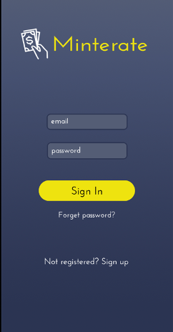
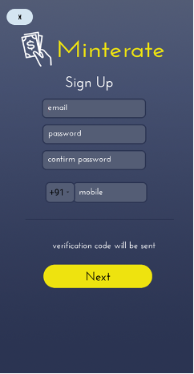
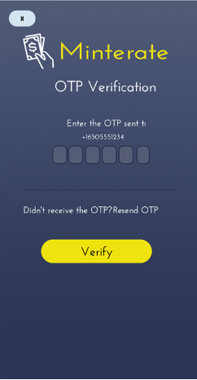
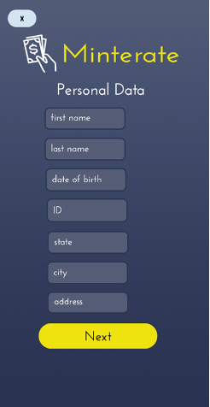
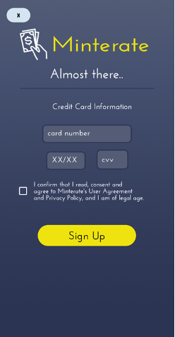
User registration process

Slide 8
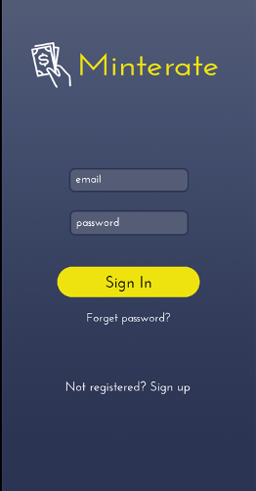
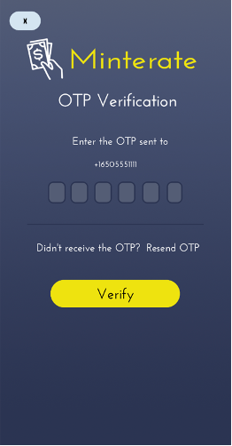
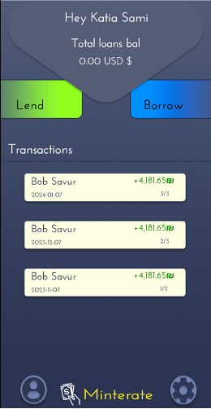
Login of the user and reaching the main screen

Slide 9
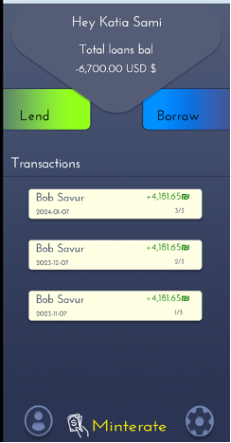
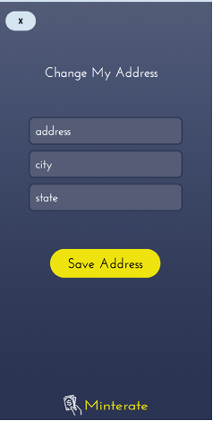
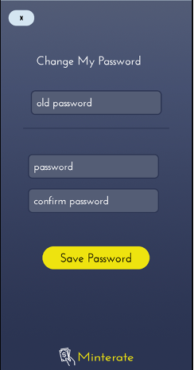
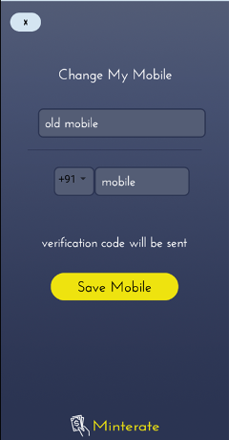
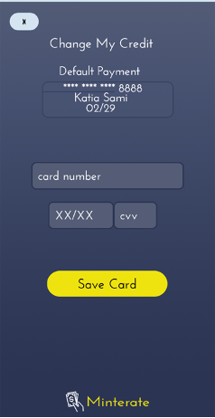
User's personal menu

Slide 10
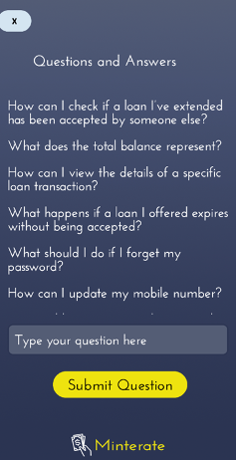
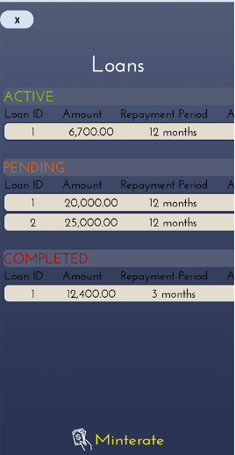
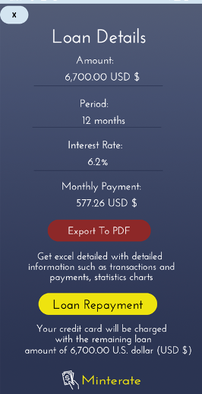
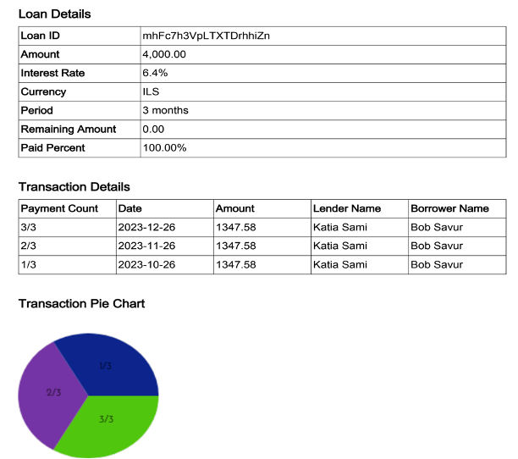
User's personal menu

Slide 11
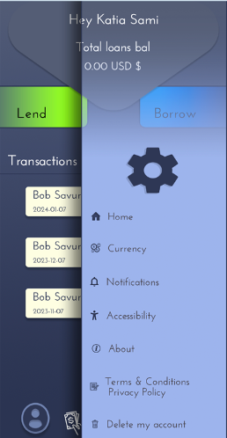
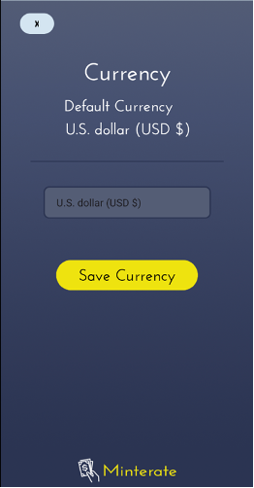
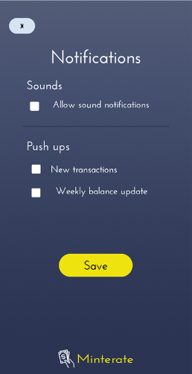
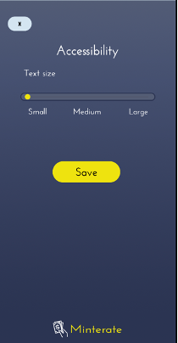
User settings menu

Slide 12
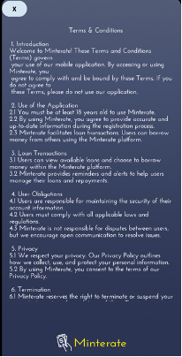
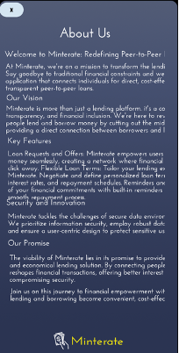
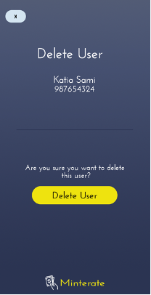
User settings menu

Slide 13
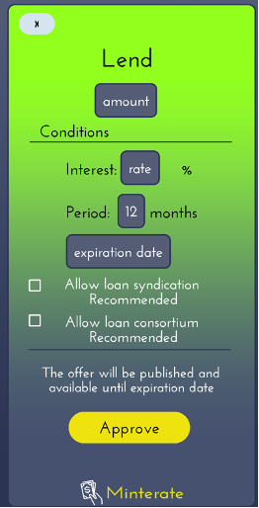
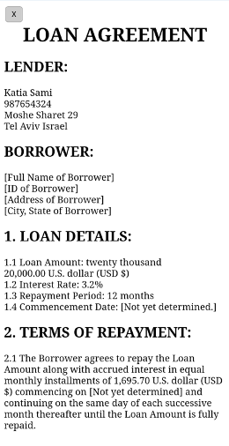
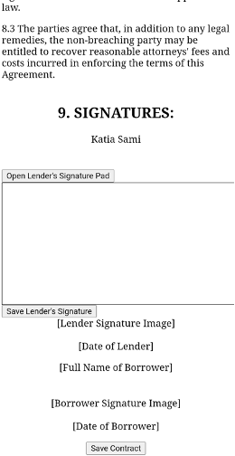
Application Screens
Option to give a loan

Slide 14
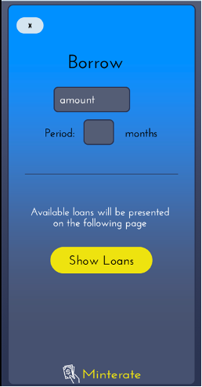
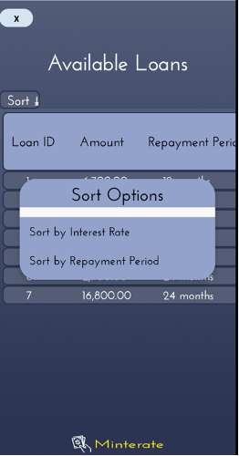
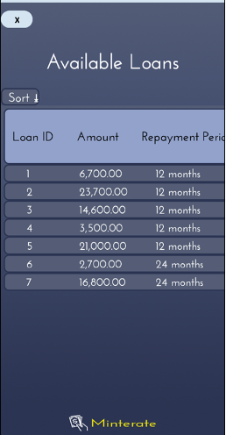
Option to get a loan

Slide 15
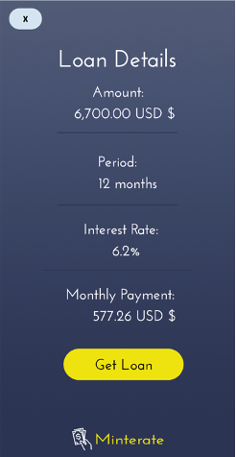
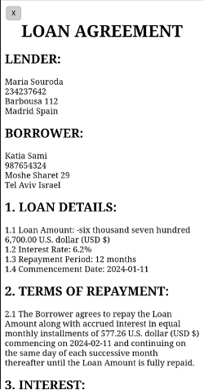
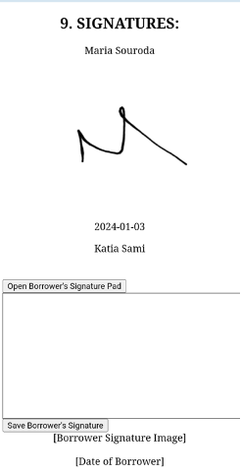
Option to get a loan

Slide 16
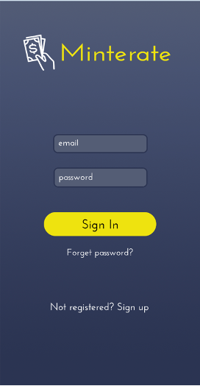
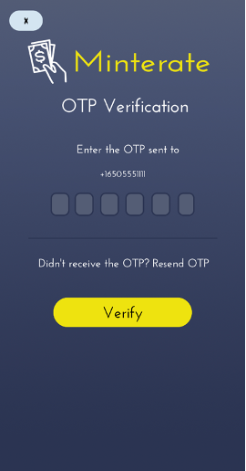
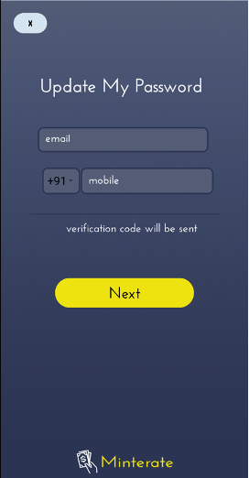
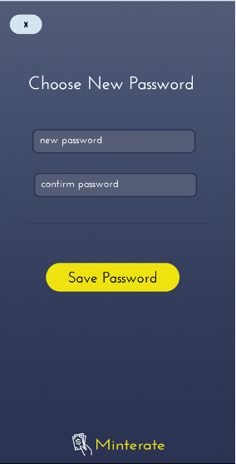
password reset

Slide 17
Thanks for listening !
Payment App

