Slide 1
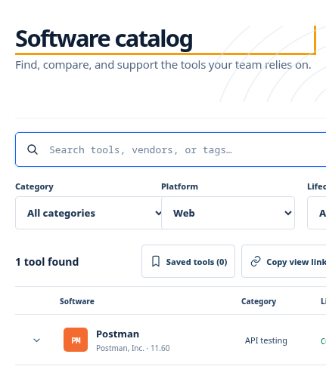
OPERATING MODEL WORKSHOP
Tool Atlas
User journeys, administration, software delivery, maintenance, and storage
Meeting deck and decision guide
4 September 2026
Notes:
Purpose: agree how Tool Atlas should serve users and how the organization should operate it.
The deck separates current capabilities from proposed extensions.
Target decisions: delivery modes, contribution routes, token-page boundary, maintenance ownership, and storage policy.

Slide 2
WHAT WE NEED TO DECIDE
02
Meeting outcomes
By the end of the meeting, the team should have one agreed operating model and named owners for the open design work.
The employee journey from discovery to a successful installation
The administrative journey from submission through approval and publication
Rules for local packages, repository links, and contact or guide requests
Maintenance ownership, review frequency, monitoring, backup, and recovery
The safest role for a hidden developer page and its access token
Decision lens
Every path must answer:
1
Who can request?
2
Who approves?
3
Where is the binary?
4
How do we recover?
Notes:
Use these five outcomes as the agenda.
Keep product decisions separate from implementation details until the ownership and trust boundaries are agreed.
Record decisions and owners directly in the meeting-notes document.

Slide 3
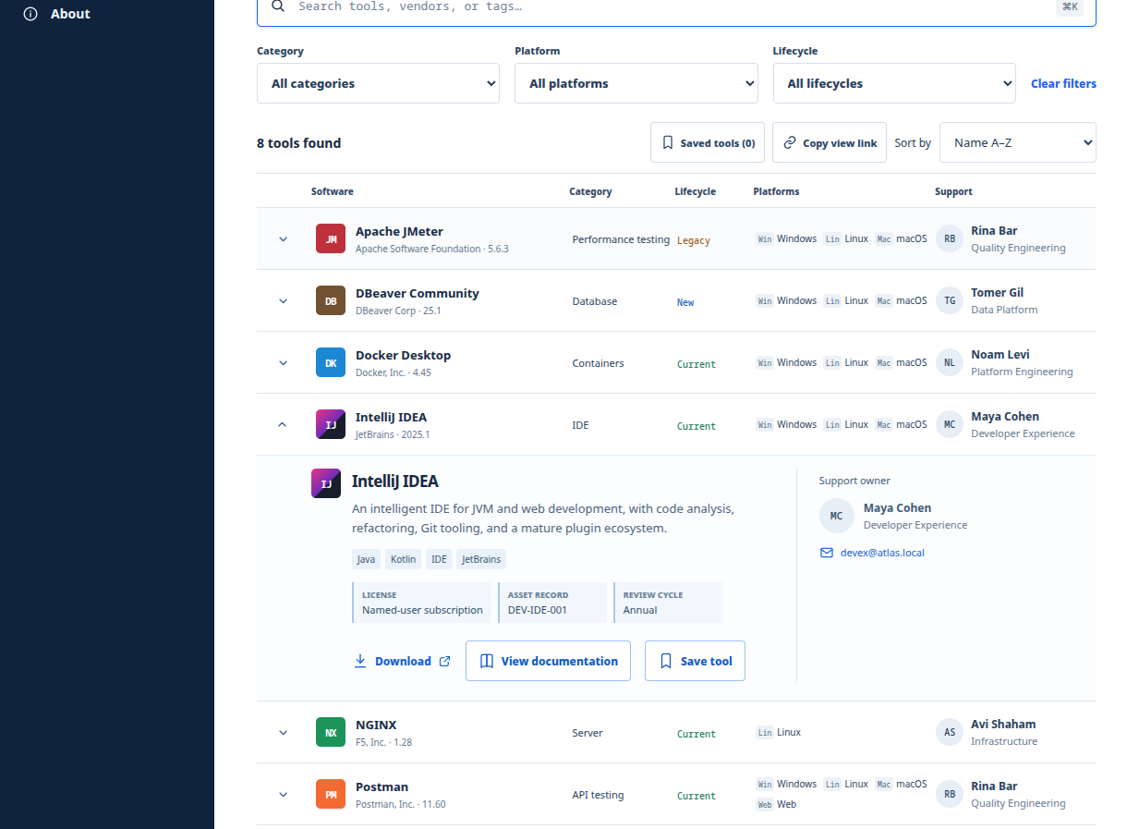
CURRENT STATE
03
How Tool Atlas works today
PUBLIC, STATIC, BACKEND FREE
The browser reads a reviewed catalog built into the site. Users search, filter, compare versions, open guides, save tools locally, and follow an approved HTTPS path.
Source
Build
Catalog files and guides
Validate and generate
Deploy
Use
Static bundle behind Caddy
Browser only, no login
Notes:
Current state is confirmed by the repository: React and Vite frontend, generated catalog data, no backend, no login, and no application secrets.
Saved tools remain in each visitor's browser. They do not create a shared administrative record.
The deployment design exposes Caddy on HTTPS and keeps the NGINX app container on an internal network.
This current-state slide does not include the proposed hidden developer page or contact workflow.

Slide 4
TARGET EXPERIENCE
04
Employee user flow
1 Find
2 Compare
3 Choose
4 Install
5 Get help
Search by tool, vendor, category, platform, or lifecycle.
Check approved version, ownership, status, and documentation.
Select the delivery path assigned to that release.
Download, open the repository link, or request help.
Use the guide or owner contact.
What the user should always see
The approved version and platform before any action
A clear action label: Download, Open repository, or Contact support
Installation guidance and a named support owner
A visible warning when a release is legacy, retired, or temporarily unavailable
Notes:
The release record should determine the action, so the user does not need to understand storage architecture.
Use explicit verbs on buttons. Avoid one generic Download button for all three modes.
A contact path should still provide expectations, such as who receives the request and what information the user must supply.

Slide 5
STORAGE AND FULFILLMENT
05
Three software delivery modes
Approved release record
Version + delivery mode + destination
Local package
External repository
Contact or guide
The website server or a dedicated internal package volume serves the approved file. Best for controlled internal distribution when the team owns patching and capacity.
The release points to an approved HTTPS address such as Artifactory. The repository owns binary storage, access policy, checksums, and retention.
The action opens support contact instructions or an installation guide. Use this for licensed, restricted, assisted, or manually provisioned software.
Recommended schema: each release declares exactly one delivery mode.
Notes:
The current schema stores a version and one HTTPS download URL. Supporting all three modes requires an explicit delivery-mode field and mode-specific validation.
Local package is a proposal. It introduces binary lifecycle, capacity, integrity, malware scanning, and recovery responsibilities.
External repository is usually the strongest default when Artifactory or an equivalent service already exists.
Contact or guide is a fulfillment path, not binary storage. The catalog should track the public instructions, owner, and service expectation.

Slide 6
DECISION RULES
06
Delivery-mode policy
Local package
External repository
Contact or guide
CHOOSE WHEN
PREFERRED DEFAULT
CHOOSE WHEN
The organization owns redistribution and needs a controlled internal file.
An approved repository already manages binaries and access.
Licensing or installation requires human approval or assisted setup.
Primary owner
Primary owner
Primary owner
Platform team
Repository owner
Support owner
Required controls
Required controls
Required controls
Checksum, malware scan, capacity, backup, retention
HTTPS allowlist, immutable version, checksum, availability
Contact route, guide review, response target, fallback
Notes:
Agree one default and two exception paths. The proposed default is the managed external repository.
For local files, decide whether the binary belongs inside the web container, on a mounted volume, or behind a separate package service. A separate package service or repository gives cleaner deployment and recovery boundaries.
Contact and guide entries need operational ownership even though they do not consume binary storage.

Slide 7
REVIEW AND PUBLICATION
07
Administration flow
1 Submit
2 Triage
3 Validate
4 Approve
5 Publish
New software, release, correction, or retirement
Confirm scope, owner, category, and delivery mode
Check URLs, guide, metadata, safety, and generated output
Authorized maintainer records the publication decision
Merge reviewed content, deploy, and verify the live result
Approval boundary
A submission never changes production directly. Approval creates a reviewable branch or change request. A second reviewer confirms the generated catalog, destination, and guide before merge.
Notes:
The current GitHub and GitLab paths already use approval-gated branches and pull or merge requests.
Treat software additions, version changes, corrections, and retirement as the same controlled publication process.
The maintainer approval and the merge review should be distinct decisions where practical.
After deployment, verify the live action for the selected release. CI success alone does not confirm the external destination works.

Slide 8
HOW CHANGES ENTER REVIEW
08
Three contribution channels
Developer page
Interactive CLI
GitHub or GitLab issue
A hidden internal form submits structured content through a server-side endpoint. The browser must never contain a repository token.
The existing pnpm catalog:add command asks questions, writes source files, regenerates data, and leaves the contributor with a normal Git review.
A non-code contributor completes a form. A maintainer approves it, automation validates it, and then opens a pull or merge request.
One validation and approval pipeline
All channels produce the same catalog source and pass the same checks.
Current: CLI and issue-based automation
Proposed: hidden developer page with server-side credential handling
Notes:
Current: the CLI and issue-based paths exist in the repository.
Proposed: a hidden developer page. Hidden routing alone provides no authorization.
The clean design is to make every channel an adapter into one shared schema, validator, generator, and review workflow.
No channel should bypass the normal pull or merge request review.

Slide 9
PROPOSED SECURITY MODEL
09
Hidden developer page and token boundary
Internal browser
Submission service
Git provider
Authenticated user completes the structured form. The page receives no Git or repository token.
Validates identity, rate limits requests, records audit context, and queues a change.
A narrowly scoped service credential creates a branch and pull or merge request.
Do not ship a reusable token in JavaScript, localStorage, a URL, or a hidden field
If the website remains fully static, route the form to the issue workflow or remove the token-based page. A true token-backed form requires a private server-side component, authentication, secret storage, rotation, logging, and incident response.
Notes:
This is the main architectural decision in the meeting.
A hidden URL is discoverable and does not protect a token. Any Vite browser variable becomes public JavaScript.
Option A: keep the site static and have the page generate an issue or copy a validated payload.
Option B: add a private authenticated submission service that owns the service credential and creates a review request.
Prefer short-lived provider credentials or a GitHub App style integration over a long-lived personal token.

Slide 10
OWNERSHIP AND CADENCE
10
Maintenance operating model
Weekly
Content operations
Review submissions, failed automation, broken links, support-owner changes, and urgent notices.
Monthly
Catalog quality
Check stale versions, contact routes, taxonomy consistency, download destinations, and storage growth.
Quarterly
Platform and access
Patch images and dependencies, test restore procedures, review approvers, and rotate expiring credentials.
Annually
Policy review
Review retention, licensing and redistribution rules, supported delivery modes, owners, and disaster-recovery targets.
Suggested accountability: Product owner for catalog policy, content maintainers for approvals, platform owner for hosting and storage, and tool owners for release accuracy.
Notes:
Replace role names with actual people or teams during the meeting.
Maintenance should cover both the static website and every external dependency that a release points to.
Track live verification separately from CI checks. A valid URL can still lead to the wrong package or require unavailable access.
Record the restore test result and access review as evidence, not only as recurring intentions.

Slide 11
OPERATIONAL DESIGN
11
Storage, backup, and recovery
Catalog source
Git stores metadata, guides, configuration, and review history.
Backup policy
Restore test
Define retention, encryption, access, off-host copies, and immutable recovery points for each store.
Rebuild the site from Git, restore local packages and TLS state, then verify a sample user journey.
Software binaries
Local package volume or external repository. Do not put large binaries in normal Git history.
TLS state
Recommended boundary
Back up Caddy data and configuration volumes to avoid avoidable certificate reissuance.
Keep the web container replaceable. Put persistent binary and certificate data in managed volumes or dedicated services with tested recovery.
Notes:
The current website can be rebuilt from Git and a locked dependency set. Persistent data enters the design only through local binary storage and Caddy certificate volumes.
If local storage is selected, define capacity thresholds, checksum records, scan results, access logs, and retirement rules before launch.
For Artifactory, document which team backs it up and what Tool Atlas should display during an outage.
A contact route still needs continuity: current owner, backup owner, guide availability, and escalation instructions.

Slide 12
Decisions and next steps
1
Delivery default
Choose the default mode and the exception criteria for local and contact fulfillment.
2
Developer page
Choose static issue handoff or approve a private authenticated submission service.
3
Ownership
Name catalog, platform, repository, support, and security owners.
4
Recovery targets
Set retention, backup frequency, restore target, and evidence expectations.
Immediate follow-up
Update the schema and contributor adapters only after these decisions have owners and acceptance criteria.
Notes:
Capture each decision, owner, and due date in the meeting notes.
Suggested sequence after agreement: schema design, validator changes, UI labels, contributor adapters, storage integration, operational documentation, and acceptance testing.
Do not enable local binary hosting or a token-backed form until their operational controls and recovery paths are tested.

