Slide 1
SRAM Memory design

Slide 2
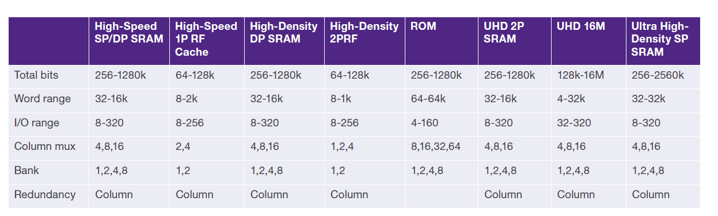
Overview
Synopsys provides designers with a broad portfolio of high-speed, high-density and low-power memory compilers. Optimized for TSMC’s 28-nm high-performance (HP) process technology, the DesignWare® Duet Package of Embedded Memories includes SRAMs, register files, ROMs.
Options for High density SRAMs, and memory built-in self test (BIST) and repair are also available, enabling designers to achieve the best combination of performance, power and area in their designs.
The DesignWare Memory Compiler for the TSMC 28HP process provides advanced, built-in power management features that enable system-on-chip (SoC) designers to explore tradeoffs between performance, area and power to generate optimal memory configurations. This dashboard control capability is critical at 28-nm where
design and process complexities require sophisticated management of the various tradeoffs to effectively meet stringent end-product requirements and increasingly narrow time-to-market windows. In addition, the integrated STAR Memory System enables highspeed test and repair of embedded memories, delivering higher test quality and yield. The DesignWare Memory Compiler and Logic Library IP solutions have been silicon-proven with billions of units shipping in volume production, enabling designers to lower risk and speed time-to-market. These high-density embedded SRAMs
are optimized to generate memories with the absolute minimum area and power, enabling designers to achieve aggressive critical path requirements. These compilers minimize both static and dynamic power consumption, while the high-speed embedded memory compilers provide a much higher level of performance. The logic libraries include yield optimized standard cells for a wide variety of design applications at 28-nm with multiple threshold process variants and multiple channel lengths.

Slide 3
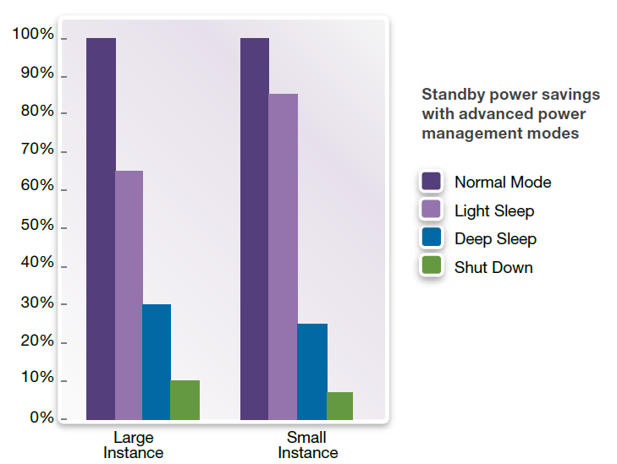
Memory Compiler Features
DesignWare Memory Compilers offer advanced power management features such as light sleep, deep sleep, shut down and dual power rails, allowing designers to meet the stringent low-power requirements of today's system-on-chips (SoCs).
The configurable memory compilers deliver high speed and high density while consuming minimal power through the use of:
Source biasing
Power gating
Multiple threshold voltages
These SRAMs include high-speed (HS),
high-density (HD) and
ultra-high-density(UHD) architectures.

Slide 4
Agenda
Memory structure
Types of bitcells
Types of SRAM memories
Memory design flow
Leaf cell design principles

Slide 5
Memory cell intersection
Row/word decoder, buffers
Memory Array
Control blocks
column/bit decoders, sense amplifiers, output buffers/IO cells
We will discuss static random access memory (SRAM)
These type of memories are termed random access since any bit of data can be accessed at any time. External to the memory array are the row and column logic. The row lines are called word lines and the column lines - bit lines. Referring to the row lines the row address is latched, decoded and then buffered. A particular line will go high when the line is selected. This selects the entire row of the array. Since the row line is long and loaded periodically with the capacitive memory cells, a buffer is needed to drive the line. The address is latched with signals from the control logic. After a particular line is selected, the column is used to decode which of the bits from the row are the addressed information. At this point data can be read into or out of the array through the column decoder.

Slide 6
1p RAM cell
vdd
When word line is low, then both pass transistors are off, and datum in the cell is latched as long as power is applied to the cell.
When the row word goes high, then the pass transistors turn on and datas on the bit lines are written to the cell.
vss
Word line
bit
bit
2p RAM cell
vdd
vss
Word line0
Word line1
bit1
bit0
bit1
bit0

Slide 7
Types of memories
ASAP (LT - light)
BIST (IT- integrated test(built in self test )
STAR (ST - BIST+REPAIR)(self test and repair)

Slide 8
ASAP (LT) Memory structure
Timer
column
cap
column
Center column
buffer column
array column
Ref row
RW
RWBUF
WTIMER
RAR
RAR
PWEDGE
X4DEC
X4BUF
l4ref
array
array
edge
array row
X4DEC
X4BUF
l4ref
array
array
edge
LCEN
LCENBUF
refmux
CMUX
CMUX
capmux
centers row
SACTRL
SACBUF
rio
sac
sac
capsac
GCEN
GCENBUF
rmctrl
gio
gio
giocap
pin row
Cen pin
buf pin
timer pin
io pin
timer pin
Cap pin
Every square is called leafcell.

Slide 9
BIST (IT) structure
Timer
column
cap
column
Center column
buffer column
array column
Ref row
RW
RWBUF
WTIMER
RAR
RAR
PWEDGE
X4DEC
X4BUF
l4ref
array
array
edge
array row
X4DEC
X4BUF
l4ref
array
array
edge
LCEN
LCENBUF
refmux
CMUX
CMUX
capmux
centers row
SACTRL
SACBUF
rio
sac
sac
capsac
GCEN
GCENBUF
rmctrl
gio
gio
giocap
pin row
Cen pin
buf pin
timer pin
io pin
timer pin
Cap pin
TEST ROW
BCENBUF
fillbio
bio
bio
biocap
BCEN

Slide 10
STAR (ST) structure
Center column
buffer column
Timer
column
cap
column
array column
REPAIR ROW
Ref row
RW
RWBUF
WTIMER
RAR
RAR
RAR
PWEDGE
X4DEC
X4BUF
l4ref
array
array
array
edge
array row
X4DEC
X4BUF
l4ref
array
array
array
edge
LCEN
LCENBUF
refmux
CMUX
CMUX
CMUX
capmux
SACTRL
SACBUF
rio
sac
sac
sac
capsac
REDSACTRL
GCEN
REDBUF
GCENBUF
redfill
rmctrl
redm
gio
redio
gio
giocap
REPAIR ROW
redio
redcap
centers row
BCEN
BCENBUF
fillbio
redfillgio
TEST ROW
bio
bio
biocap
pin row
Cen pin
buf pin
timer pin
redbiofill
io pin
io pin
Cap pin
io pin

Slide 11
Center column
buffer column
Timer
column
REPAIR ROW
array column
cap
column
DR col
Ref row
lshfrwl
RW
RWBUF
WTIMER
RAR
RAR
RAR
PWEDGE
wlshift
X4DEC
X4BUF
l4ref
array
array
array
edge
array row
wlshift
X4DEC
X4BUF
l4ref
array
array
array
edge
lshflc
LCEN
LCENBUF
refmux
CMUX
CMUX
CMUX
capmux
lsfilllpg
PG row
SACTRL
SACBUF
rio
sac
sac
sac
capsac
LPGCTRL
LPGBUF
lpgrio
lpgred
lpgsm
lpgsm
lpgcap
lsfillsc
REPAIR ROW
REDSACTRL
REDBUF
redfill
redm
redio
redio
redcap
redlsfill
GCEN
GCENBUF
rmctrl
redfillgio
gio
gio
giocap
centers row
lshfrm
TEST ROW
BCEN
BCENBUF
fillbio
redbiofill
bio
bio
biocap
PG row
lsfillgpg
pin row
GPGCTRL
GPGBUF
gpgrio
gpgred
gpgsm
gpgsm
gpgcap
Cen pin
buf pin
timer pin
io pin
io pin
io pin
Cap pin
lsfillbcen
lsh pin

Slide 12
CD1 option
RED (Y)
IO (Y)
IO (Y)
Buffer (MY)
Level shifter(MY)
center
Level shifter (Y)
Buffer (Y)
timer
CAP (MY)
RED (Y)
CAP (Y)
IO (Y)
Buffer (MY)
center
Buffer (Y)
timer
IO (Y)
IO (Y)
Buffer (MY)
center
Buffer (Y)
timer
CAP (MY)
CAP (Y)
CAP (MY)
IO (Y)
CAP (Y)

Slide 13
BK2 option
REF
REF
XDEC
XDEC
LOCAL
LOCAL
LPG
LPG
SAC
SAC
LOCAL
LOCAL
XDEC
XDEC
REF
REF
REDUNTANCY
GLOBAL
GLOBAL
LPG
LPG
BCEN
BCEN

Slide 14
Leafcell design principles
Leaf cells should be designed so that in multiple contexts they don’t create DRC errors
Pay attention on the notes mentioned by DE in the schematic designs
Pay attention on specific signals/couplings during leaf cell layout design (the docs will be provided during design)
Pay attention on programming requirements mentioned in the schematic design
Pay attention on perfect power mesh in every leafcell
Add contacts/vias on cross sections as much as possible

Slide 16
What is the programming
A
C
A should connect to C when LT
B should connect to C when ST
B
VIA
C_A_V12
C_B_V12
C
TEXT
TEXT
A
B

Slide 17
Edge matching (EMG)
New manufacturing consideration such as device DFM effects and Lithography effects force us to reexamine our layout methodology so we can account for these effects during the physical design process as opposed to reacting with post layout activity.
By designing in rigid design structures we can limit a leafcell’s context variability while using existing area in a beneficial way. The key is to consider a leafcell’s master interface and mimic this interface in all other contexts. An example of a master interface is the horizontal abutment of IO to IO. This interface is easily mimicked by enforcing a partial dummy cell placement at the breaks in an IO row. The dummy cell will contain Edge Matching Geometries which mimic the leafcells left or right interface. In most cases this EMG can be incorporated into the abutting leafcell and require no extra area .. for example in a buffer, rebuffer, or fill section . In other cases the EMG’s can be real devices of an abutting cell, only placed to mimic the master interface geometries ... For example the devices in the cap cells or the ref timer column cells .
The new golden rule:
All leafcell layouts will be mindful of their multiple contexts and will be designed to include geometries which guarantee a consistent surrounding environment when placed in different contexts. These geometries will be referred to as Edge Matching Geometries or EMG’s .

