Slide 1
Offline-First, Scalable, and Monitored MLOps Pipeline
for Wearable Human Activity Recognition
Master's Thesis Defense
Shalin Vachheta - Matriculation 1701359
University of Siegen - Faculty of Engineering - Chair of Embedded Systems
First Supervisor: Prof. Dr.-Ing. Roman Obermaisser - Second Examiner: M.Sc. Ugonna Oleh
15 June 2026
Notes:
This thesis is about what happens after a wearable HAR model is trained. Not the model itself - the lifecycle around it: how you run it reliably, how you detect when something is wrong, and how you decide whether to change anything.

Slide 2
The Gap: What HAR Papers Skip
Published HAR papers stop at offline accuracy. This thesis starts there.
Standard wearable HAR paper
This thesis
Train -> Evaluate -> Report accuracy
(model development, once, offline)
Train -> Execute -> Monitor
-> Govern -> Decide
offline-first - single-machine - reproducible
- 7-stage operational assessment path
- 3-stage gated mutation path
- Multi-signal monitoring without labels
- Retraining as a deliberate act, not automatic
What happens next?
- Different user
- Different sensor session
- Weeks or months later
- No ground-truth labels at runtime
Notes:
Most wearable HAR papers train a model, measure accuracy on a held-out test, and publish. That is necessary. But when the same model runs on data from a different user, with slightly different preprocessing, or months later - how does it behave? Who decides whether to retrain? That is the question this thesis addresses.

Slide 3
Application Domain: Why Repetitive Wrist Behaviors?
Anxiety-relevant repetitive behaviors can be studied as wrist-IMU activity patterns.
Repetitive hand- and wrist-centered behaviors:
hand tapping - hand scratching - nail biting
hair pulling - skin picking - hand rubbing
Expressed as short, repeated wrist movements -> observable from accelerometer + gyroscope
Passive sensing: no clinician present, no recall bias.
"This thesis does not diagnose mental health conditions.
It treats these behaviors as observable behavioral proxies."
Engineering target: build a reproducible, monitored, offline-first MLOps pipeline
around a wrist-IMU HAR classifier - not a clinical diagnostic instrument.
Notes:
The application domain is repetitive hand- and wrist-centered behavior relevant to anxiety or distress contexts. A wrist-worn IMU can observe these movement patterns passively, without a clinician present, without recall bias. This thesis does not claim a clinical diagnostic system or a clinical taxonomy. It treats these behaviors as an engineering target that motivates building a governed pipeline.

Slide 4
The contribution is not a new classifier.
It is a reproducible, monitored, and governed
offline-first MLOps lifecycle for wearable HAR
7-stage operational assessment path
(observe, infer, evaluate, monitor, govern)
3-stage gated mutation path
(retrain, register, promote - explicit flag only)
MLOps Level 1 - by design, not by limitation
Notes:
Here is the claim. Not: I built the most accurate HAR model. Not: I built a clinical system. The claim is: the lifecycle can be designed so that preprocessing decisions are traceable, monitoring signals are multi-dimensional, and retraining is a deliberate act - not an automatic reflex.

Slide 5
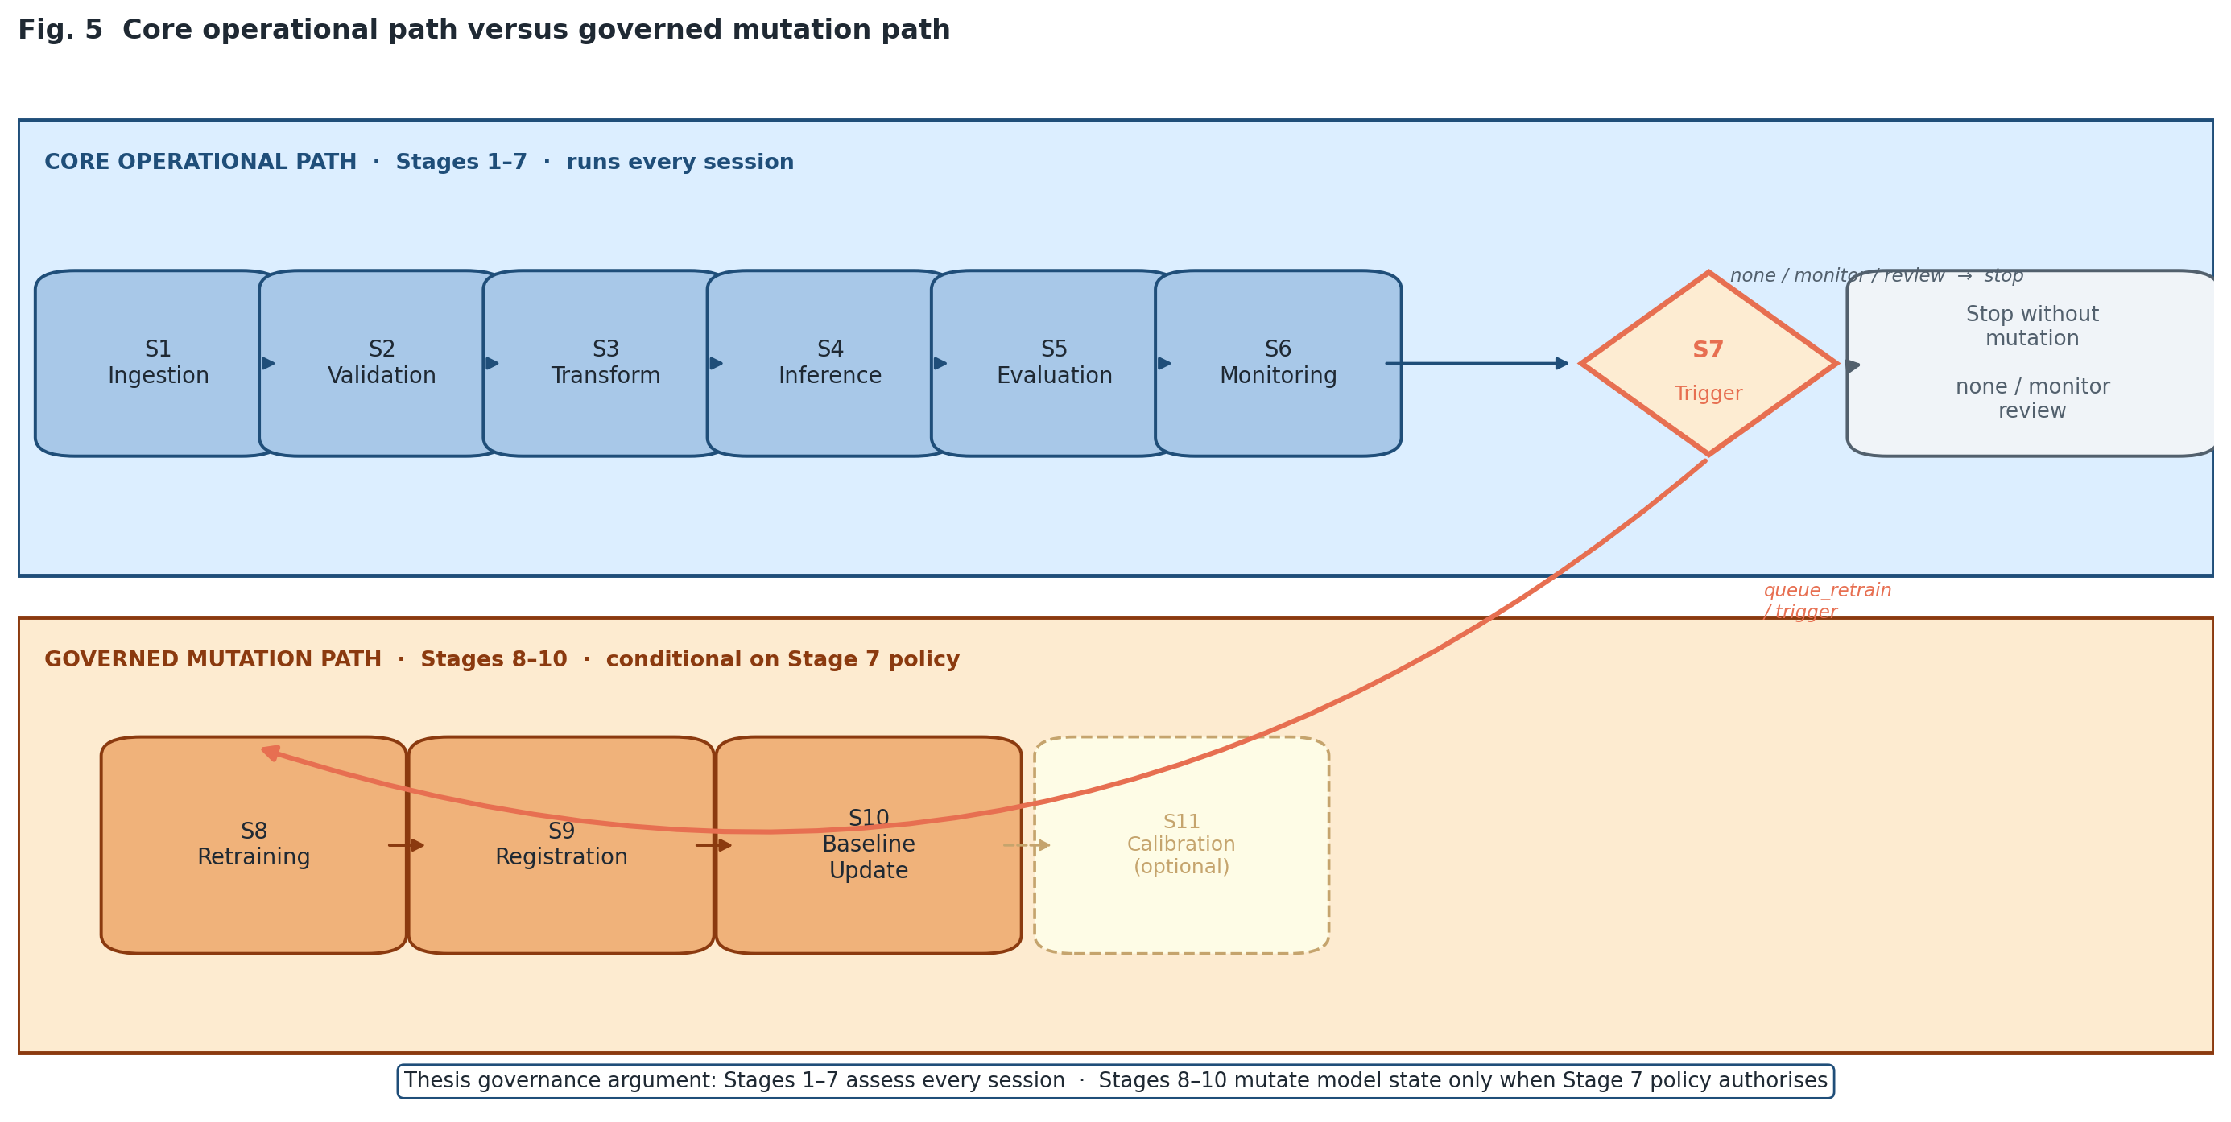
Architecture: Two Explicit Paths
Stage 1-7 observes and governs. Stage 8-10 mutates. Explicitly separated.
Stage 1-7
Operational
assessment path
(observe, infer,
evaluate, monitor,
govern)
Stage 8-10
Governed
mutation path
(retrain, register,
promote baseline)
- explicit flag only -
Notes:
The architecture has two linked but distinct flows. The blue band - Stages 1 to 7 - runs every session. It ingests data, validates the preprocessing contract, runs inference, evaluates, monitors, and makes a governance decision. The orange band - Stages 8 to 10 - only runs when explicitly activated. Retraining changes operational state, so it must be gated. That separation is not cosmetic. It is the core governance design.

Slide 6
What "Scalable" Actually Means
Modular, reproducible, configurable, artifact-tracked, extensible - not cloud-scale.
NOT this:
THIS:
x Cloud-scale deployment
x Multi-tenant streaming
x Automated continuous retraining
x Production-grade clinical system
OK Each stage is independently replaceable
OK YAML config layer - no code edits for thresholds
OK All artifacts run-scoped and versioned
OK Mutation stages activated by flag, not default
OK Stage 8-10 extensible without redesigning 1-7
Notes:
The word 'scalable' in the thesis title does not mean cloud infrastructure. It means the pipeline can absorb a new model checkpoint, a changed dataset, or an updated threshold without dismantling and rebuilding. Each stage has one responsibility, one component file. The configuration layer controls behavior without touching code. That is what scalable means here.

Slide 7
Data and Model A Contract
Model A is the defended proof-of-concept runtime candidate. Its contract is fully persisted and verified.
Garmin Venu 3 - all_users training split - 11 classes (ADAMSense taxonomy)
User 7 excluded from training, scaler fit, and model selection; external evaluation only
Training data
87,083 params - 1D-CNN + BiLSTM - Row-wise time-major - (batch, 200, 6)
Garmin train-only StandardScaler (persisted JSON + joblib, 0.0 parity verified)
SHA-256 label order fingerprint persisted and checked
Model A
unit conversion (milliG -> m/s^2 when needed) -> scaler -> windowing -> Model A
Preprocessing contract
Proof-of-concept runtime candidate
NOT: production-grade - NOT: clinical device - NOT: population-level proof
Status
Notes:
Model A is the defended runtime candidate. 87,000 parameters. The scaler is fitted only on Garmin training data - not on the external evaluation set. That scaler is persisted in two redundant forms and verified to agree to 0.0 absolute difference at evaluation time. The label order of 11 classes has a persisted SHA-256 fingerprint. Every parameter that matters is frozen and checked. That is what a runtime contract means.

Slide 8
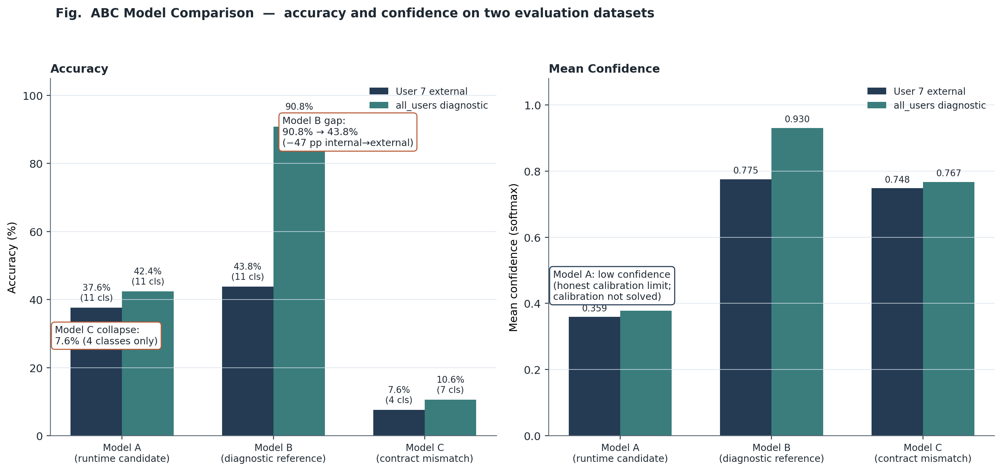
ABC Comparison: Three Models, One Lesson
Same tensor shape. Different contracts. Wildly different behavior.
Model A
reproducible contract - modest but honest - all 11 classes
Model B
non-persisted full-evaluation scaler -> not a fixed runtime contract
Model C
same checkpoint as B, wrong contract -> 7.6% accuracy, 4/11 classes
Same tensor shape (batch, 200, 6) is necessary but NOT sufficient.
Contract = shape + scaler + layout + label order.
Notes:
Three models, all with the same nominal input shape. Completely different behavior. Model A is the honest candidate: modest external accuracy, reproducible, all 11 classes. Model B uses a non-persisted scaler recomputed from the full evaluation dataframe - its native diagnostic result is not a fixed reproducible runtime contract. That is why the 47-point internal-to-external gap exists. Model C is the contract-mismatch lesson: the same checkpoint as B, run without its scaler, collapses to 7.6 percent and uses only 4 of 11 classes. Same shape is not enough. The contract matters.

Slide 9
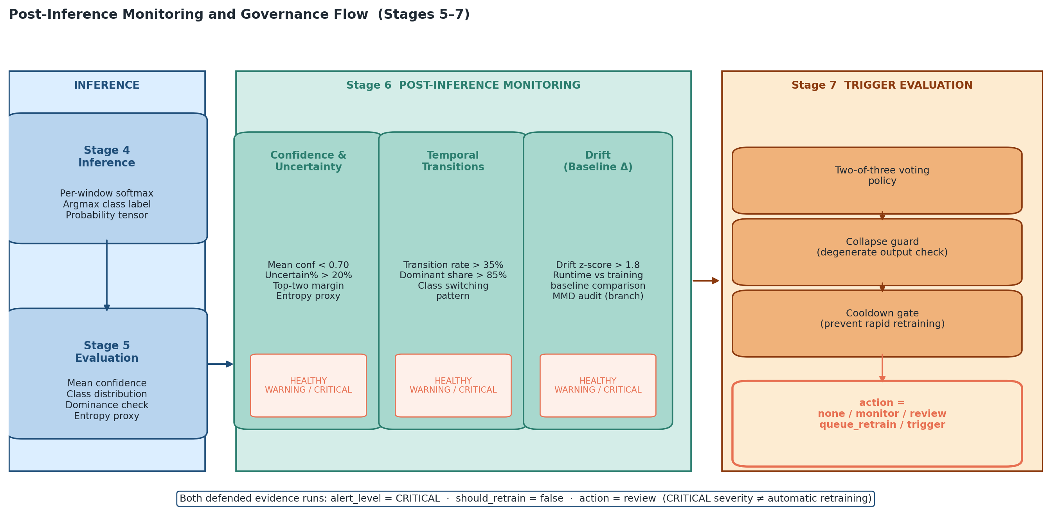
Monitoring: Three Signals, One Governance Decision
No single signal decides. CRITICAL = severity. REVIEW = governance action. Different fields.
Notes:
Stage 6 computes three independent monitoring assessments: one on confidence and uncertainty, one on prediction stability over time, one on distribution drift. Each gets its own rating. Stage 7 combines them with a two-of-three voting rule, a collapse guard, and a cooldown gate. CRITICAL is a severity rating. REVIEW is the action. They are two separate fields. On both defended evidence runs, CRITICAL signals fired on confidence/uncertainty, drift and temporal remained HEALTHY, and the action was REVIEW - not RETRAIN.

Slide 10
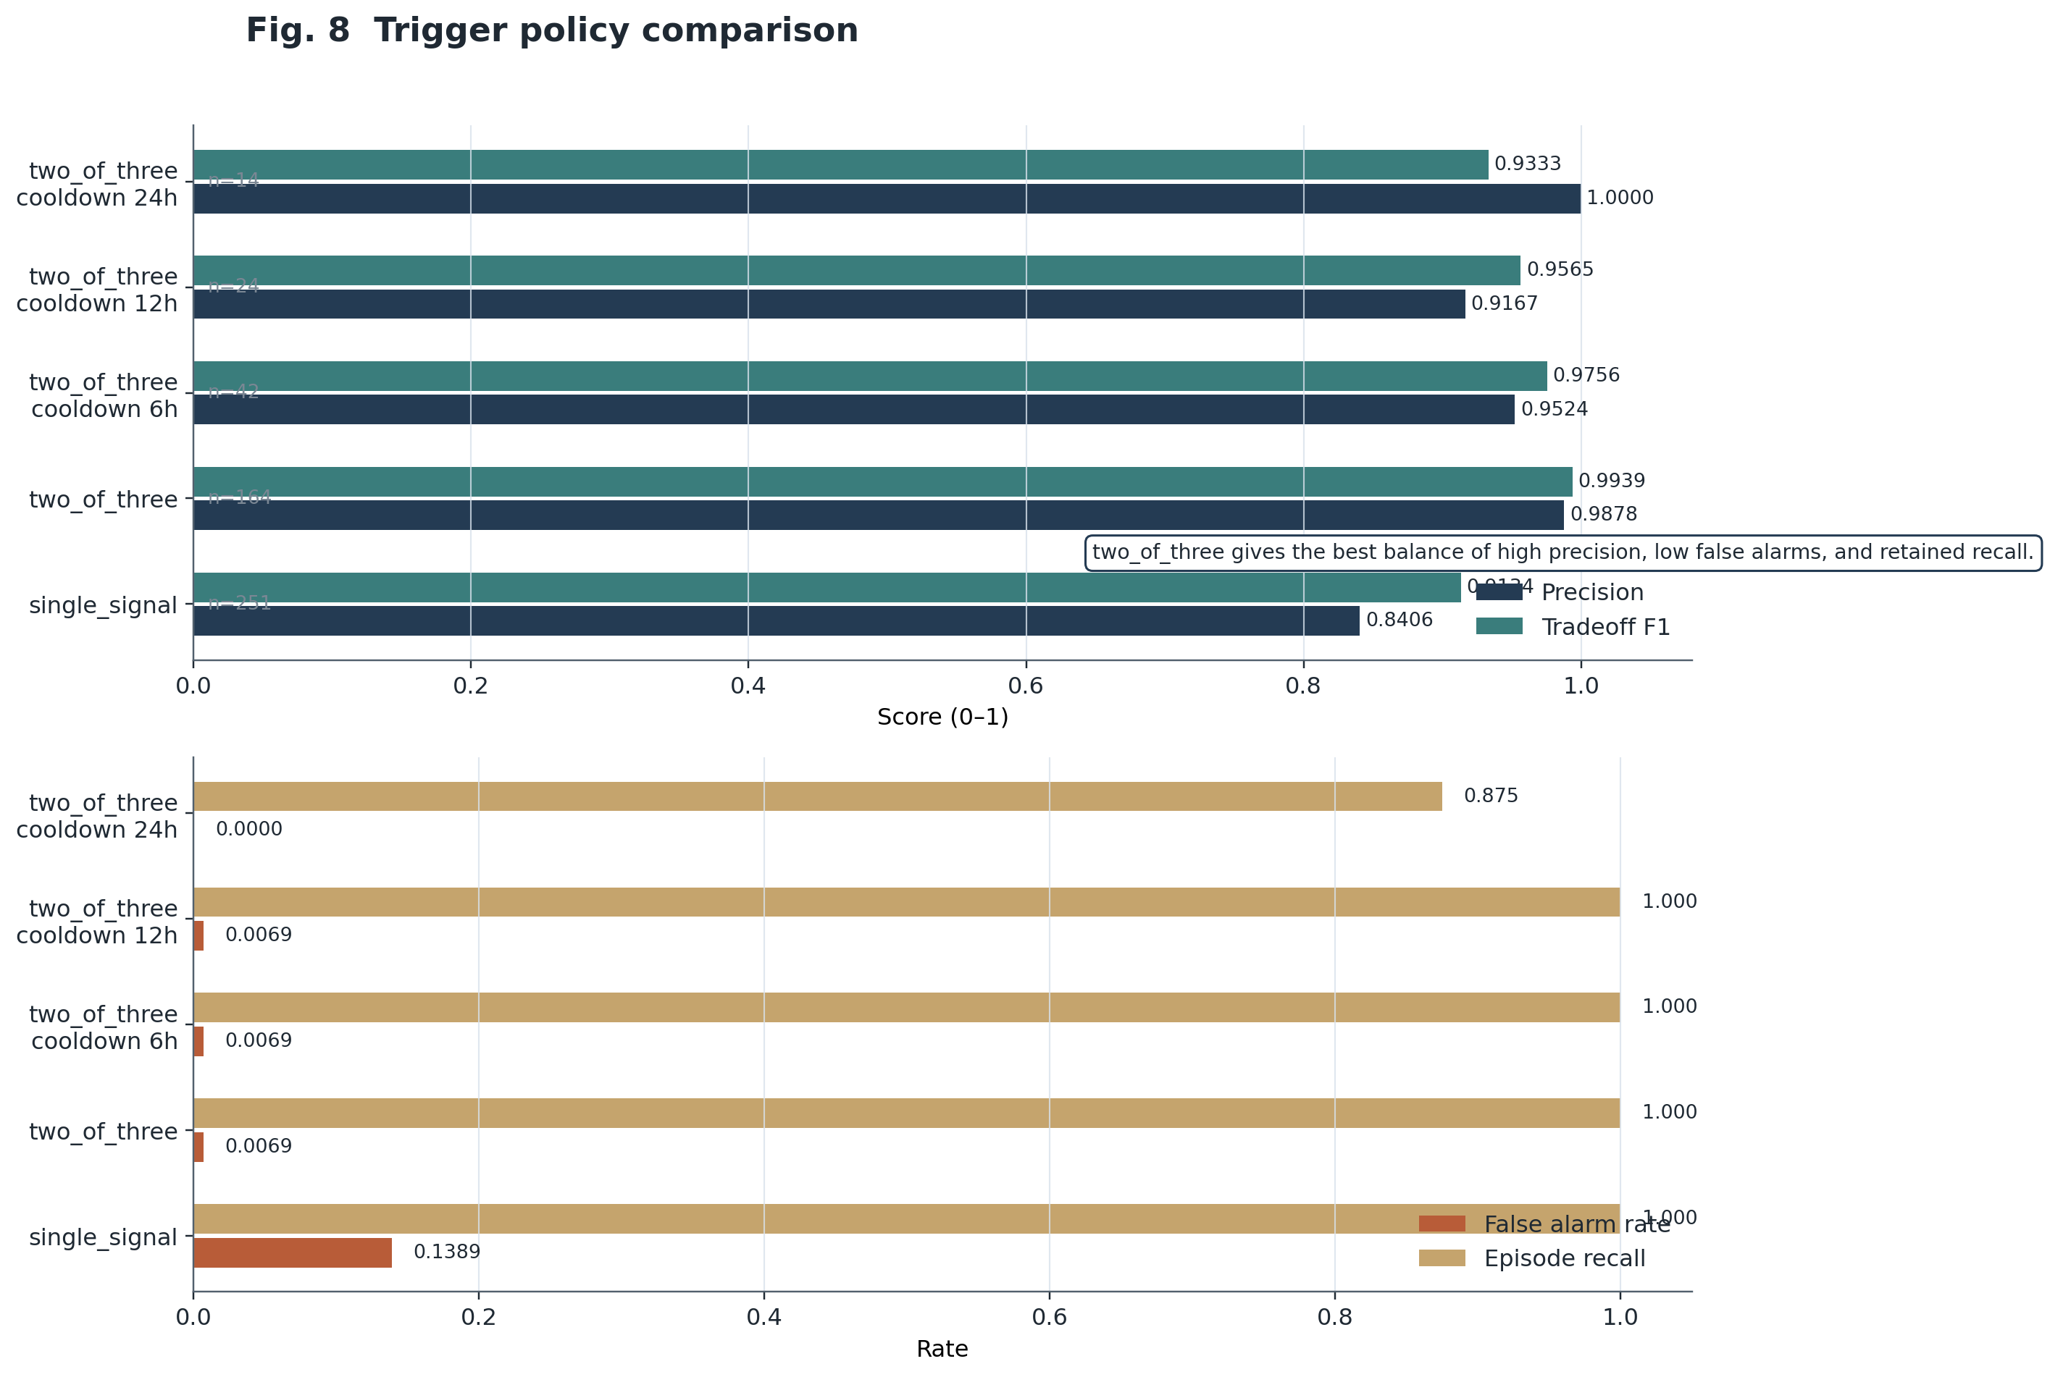
Trigger Policy: Why Two-of-Three Voting?
Single-signal: 13.9% false alarm rate. Two-of-three: 0.7% FAR, full episode recall.
Policy
Precision
FAR
Episode recall
single_signal
0.8406
13.9 %
100 %
two_of_three OK
0.9878
0.7 %
100 %
+cooldown 24 h
1.0000
0.0 %
87.5 %
-> Two-of-three: full recall, 20x fewer false alarms than single-signal.
-> 24h cooldown: zero false alarms but misses 2 of 16 episodes.
-> Governance trade-off is explicit and documented.
Notes:
The trigger policy comparison replays 16 monitored episodes. Single-signal triggering fires too easily - 1 in 7 alerts is spurious. The two-of-three policy requires two of the three signal groups to be in a concerning state before firing. That gives precision 0.99 and a false alarm rate under 1 percent while still catching every genuine episode. The 24-hour cooldown eliminates false alarms entirely but misses 2 episodes. The trade-off is documented. Two-of-three without cooldown is the defended choice.

Slide 11
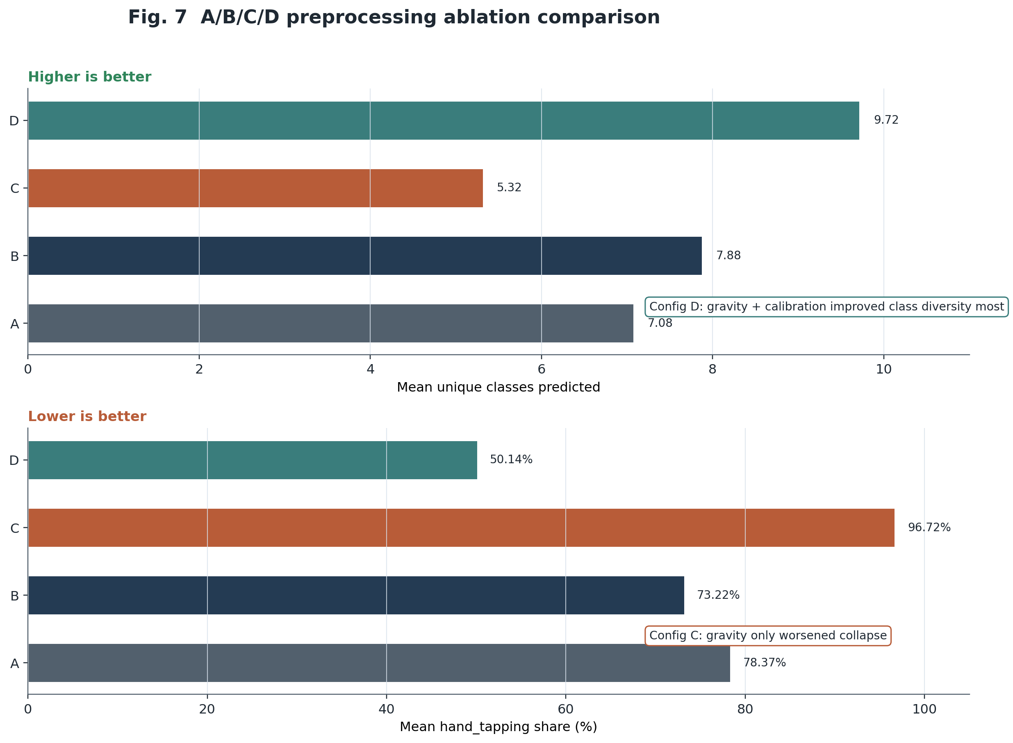
Preprocessing Sensitivity: Gravity Removal Made It Worse
Intuitively reasonable signal cleaning worsened collapse. Train-serve parity is empirically real.
Config
Unique classes
Hand-tapping %
A baseline
7.08
78.4 %
B +calibration
7.88
73.2 %
C +gravity removal
5.32
96.7 % high
D +calibration + gravity
9.72
50.1 % lower
-> Gravity removal alone (C) worsened collapse dramatically.
-> Preprocessing is part of the model contract.
-> "Intuitively reasonable" != "operationally safe."
Notes:
We ran 25 session pairs under four preprocessing configurations, holding the model constant. Gravity removal alone - configuration C - made class collapse dramatically worse: only 5 classes predicted on average, and 97 percent of predictions concentrated on hand-tapping. Adding calibration on top recovered diversity. The lesson: preprocessing is not neutral preamble - it is part of the operational contract. Changing it at inference time without retraining is the exact train-serve mismatch the thesis is built around.

Slide 12
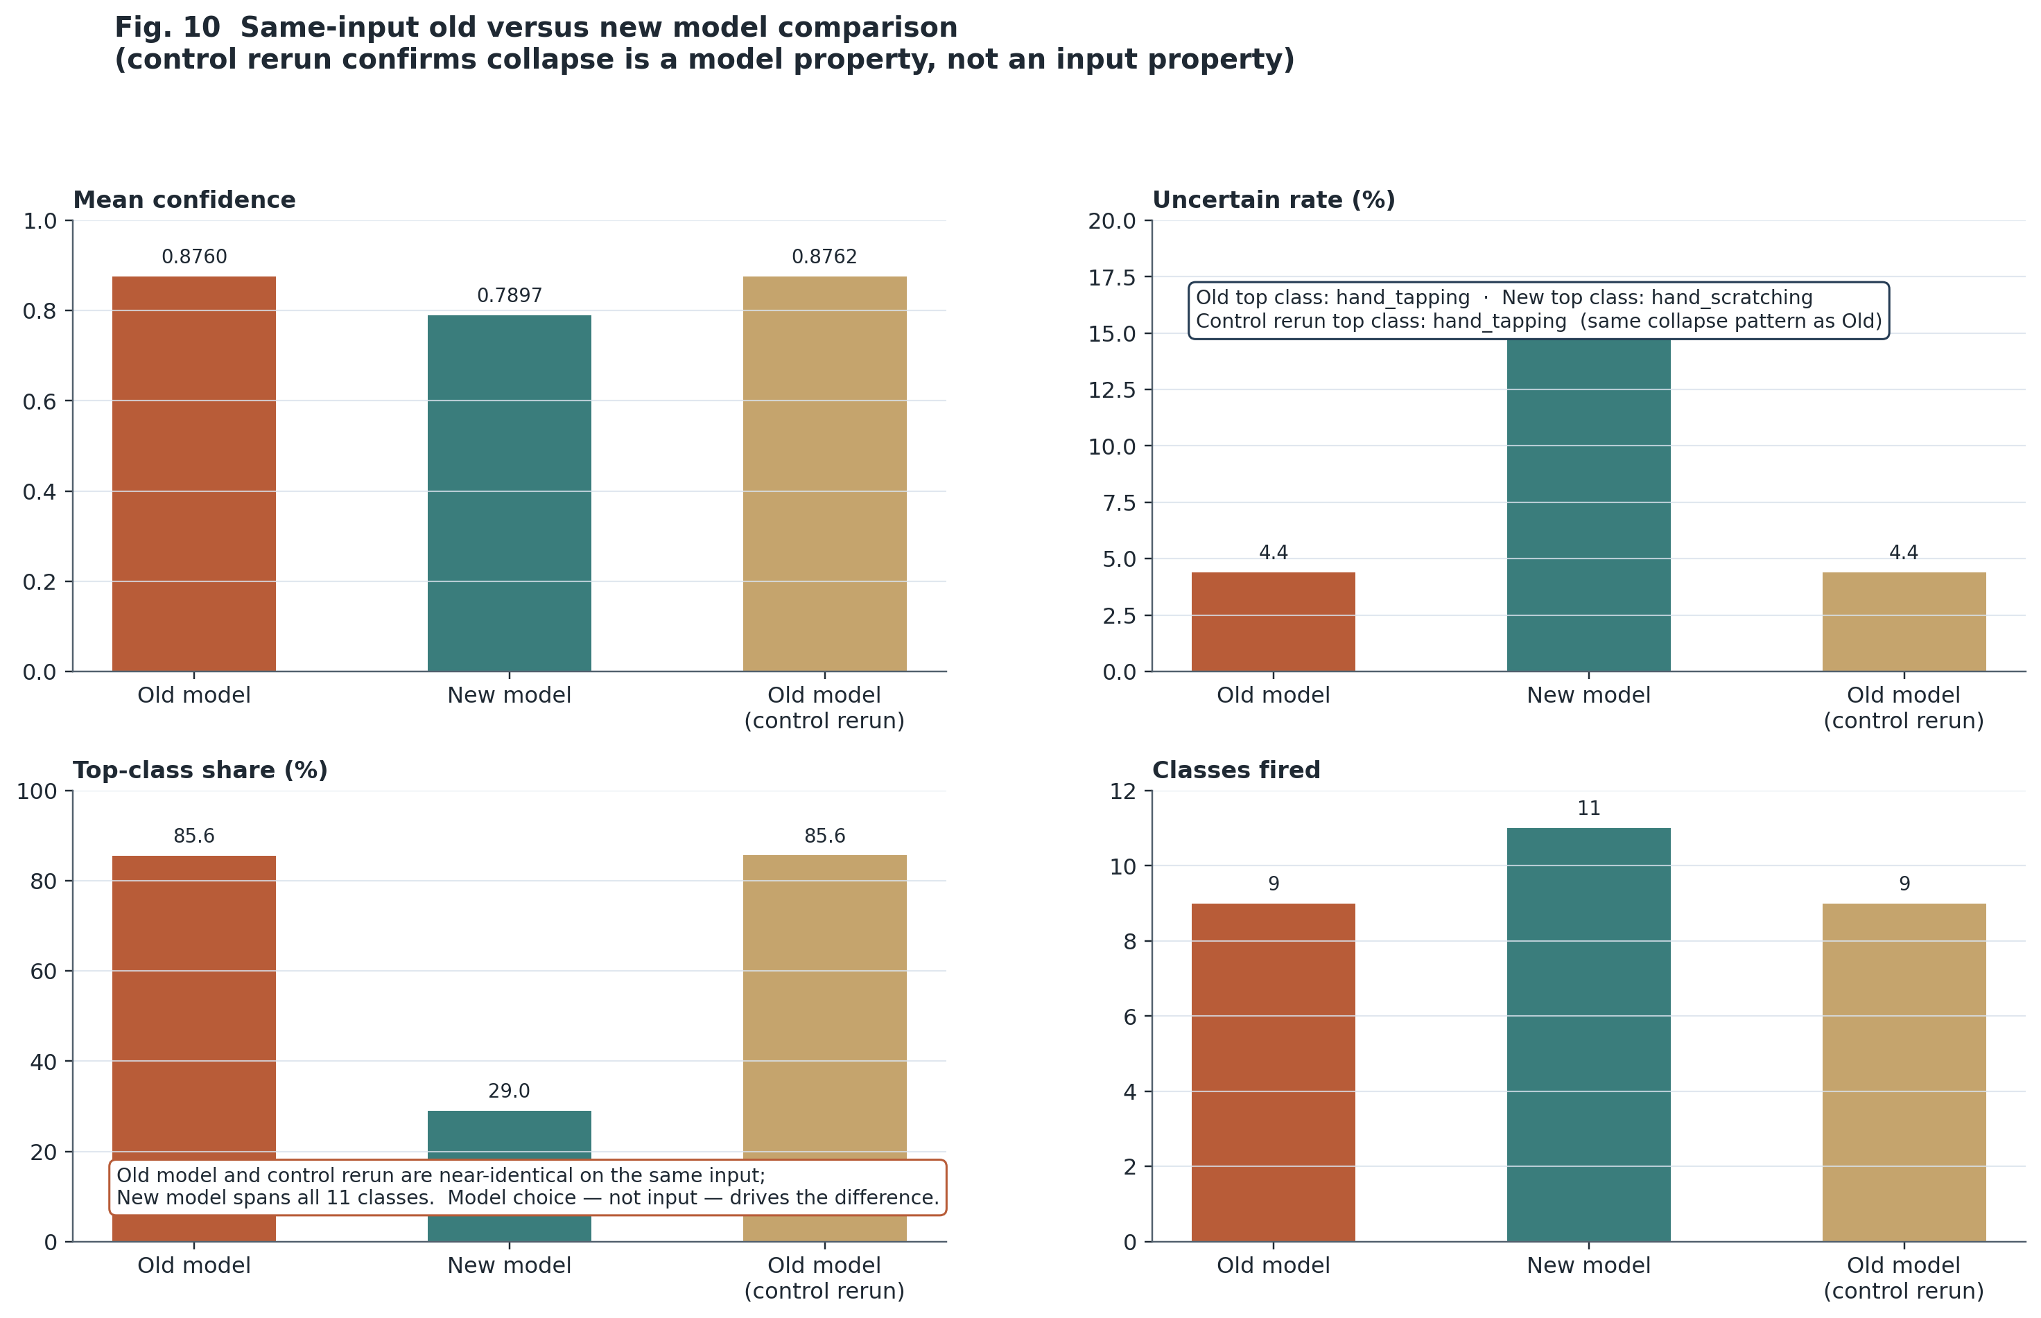
Model Choice Drives Collapse: Same Input, Different Behavior
Old model collapse was reproduced on a controlled rerun - it is a model property, not an input property.
Same raw session
all three runs
Old model:
85.6% top-class
9/11 classes
New model:
29.0% top-class
11/11 classes
Old model (rerun):
85.6% top-class
9/11 classes
<- reproduced
-> Collapse is a
model property,
not an input property.
Notes:
We ran the same raw sensor file through the old model, the new retrained model, and the old model a second time as a control. The old model reproduced the same collapse pattern exactly - 85 percent hand-tapping, 9 classes, both times. The new model used all 11 classes with 29 percent dominance. The input was identical. The collapse was model-specific. That is why Stage 7 includes a collapse guard.

Slide 13
Negative Result: Routing Change != Quality Improvement
Mean confidence unchanged at 0.8578 before and after a plausible intervention bundle.
Metric
Before
After
Mean confidence
0.8578
0.8578
<- unchanged
Mean dominant-class share
81.2 %
67.3 %
<- appears better
Mean REVIEW-routed share
0.0 %
66.1 %
<- explains the drop
-> Lower dominance = windows routed to REVIEW, not better classification.
-> The quality signal (mean confidence) did not move.
-> This is a deliberate negative result - governance must track quality, not routing.
Notes:
One of the most academically important results in this thesis is a negative one. We applied a plausible bundle of interventions to 26 sessions. Dominant-class share dropped from 81 to 67 percent, which looks like an improvement. But mean confidence was unchanged at 0.8578 before and after. The apparent improvement was entirely explained by routing windows into REVIEW. The underlying quality signal did not move. This is the empirical argument for why governance must track quality signals, not routing distributions.

Slide 14
Defended Evidence Runs: The Honest External Ceiling
37.6% external accuracy + REVIEW routing + auto_retrain=false is correct governed behavior.
Garmin unlabeled run
User 7 external labeled run
1,304 windows - 50 Hz - no labels
989 windows - 50 Hz - labeled
Mean confidence: 0.393
Accuracy: 37.6% Macro F1: 34.1%
Drift status: HEALTHY
Mean confidence: 0.359
Monitoring: CRITICAL (low confidence)
Classes used: 11 / 11
Temporal status: HEALTHY
Monitoring: CRITICAL (low confidence)
Trigger action: REVIEW
Drift/temporal: HEALTHY
auto_retrain: false
Trigger action: REVIEW auto_retrain: false
-> Both runs: Stage 1-7 all SUCCESS - Risk flagged - Routed to human review - No model mutation
Notes:
The two defended evidence runs. User 7: an external participant not in the training set. 37 percent accuracy - low, honest, expected for cross-user transfer. The monitoring layer correctly identified low confidence and high uncertainty, while drift and temporal status remained healthy. Stage 7 routed the run to REVIEW. The Garmin unlabeled run: 1,304 windows of real wrist sensor data, no labels. Drift status HEALTHY, but confidence low enough to trigger REVIEW. Both runs: auto_retrain=false. That is not a missing feature. That is the governance policy working.

Slide 15
What the Pipeline Does NOT Claim
Scope limits are explicit non-claims - documented, not hidden.
x Not claimed:
OK What IS contributed:
- Clinical diagnosis or population-level generalisation
- Reproducible offline-first lifecycle
- Model A is production-grade or deployable at scale
- Honest external accuracy ceiling reported
- Subject-independent generalisation beyond User 7
- Risk detectable without ground-truth labels
- Confidence calibration solved (mean conf 0.359 on User 7)
- Auto-retraining as a live feature (auto_retrain=false by design)
- Retraining gated by auditable policy
- CRITICAL monitoring severity means automatic retraining
- Stages 8-10/11 are live automatic runtime features
Notes:
These are the explicit non-claims. They are not weaknesses the examiner found. They are scope boundaries the thesis documents. A system that reports its limitations clearly is a stronger contribution than one that overstates.

Slide 16
Research Questions: Bounded Answers
All four RQs answered - each with explicit evidence and explicit bounds.
Can the pipeline detect risk without labels?
Yes, partially. Monitoring signals respond directionally.
(Not: recover label-level accuracy)
RQ1
How strongly do preprocessing decisions affect behavior?
Strongly and non-monotonically.
(Gravity removal alone worsened collapse - Config C)
RQ2
Can governed trigger policy improve safety?
Yes. Two-of-three: precision 0.9878, FAR 0.7%, full episode recall.
(Bounded to one replay set)
RQ3
How much collapse is from model choice vs input?
Materially from model choice.
(Controlled rerun reproduced old-model collapse pattern exactly)
RQ4
Notes:
Four bounded answers. Partial on RQ1 - the signals move in the right direction but they are proxies, not ground truth. Strong on RQ2 - preprocessing matters more than expected, and in a non-obvious direction. Strong on RQ3 - the voting policy is a clear improvement over single-signal. Clear on RQ4 - the controlled rerun shows the collapse is model-specific. Each answer is tied to archived run artifacts. None of them is a claim beyond the available evidence.

Slide 17
Contribution
A reproducible, auditable, and governance-aware
offline-first MLOps lifecycle for wearable HAR
Model A - frozen proof-of-concept runtime candidate (87,083 params)
Model B - diagnostic reference only (non-persisted scaler, not a fixed runtime contract)
Model C - checkpoint-contract mismatch evidence (7.6% on User 7)
Review-first trigger policy - CRITICAL severity routes to human review, not automatic retraining
The pipeline is not broken. It executes end-to-end, detects uncertainty, and routes risk to REVIEW.
The remaining limitation is model confidence, calibration, and external generalisation.
Those limitations are documented - not hidden.
Notes:
That is the contribution. Not a new architecture. Not a clinical tool. A lifecycle in which the distinctions that matter - between observation and mutation, between monitoring severity and governance action, between internal accuracy and deployment transferability - are all observable from archived artifacts.

Slide 18
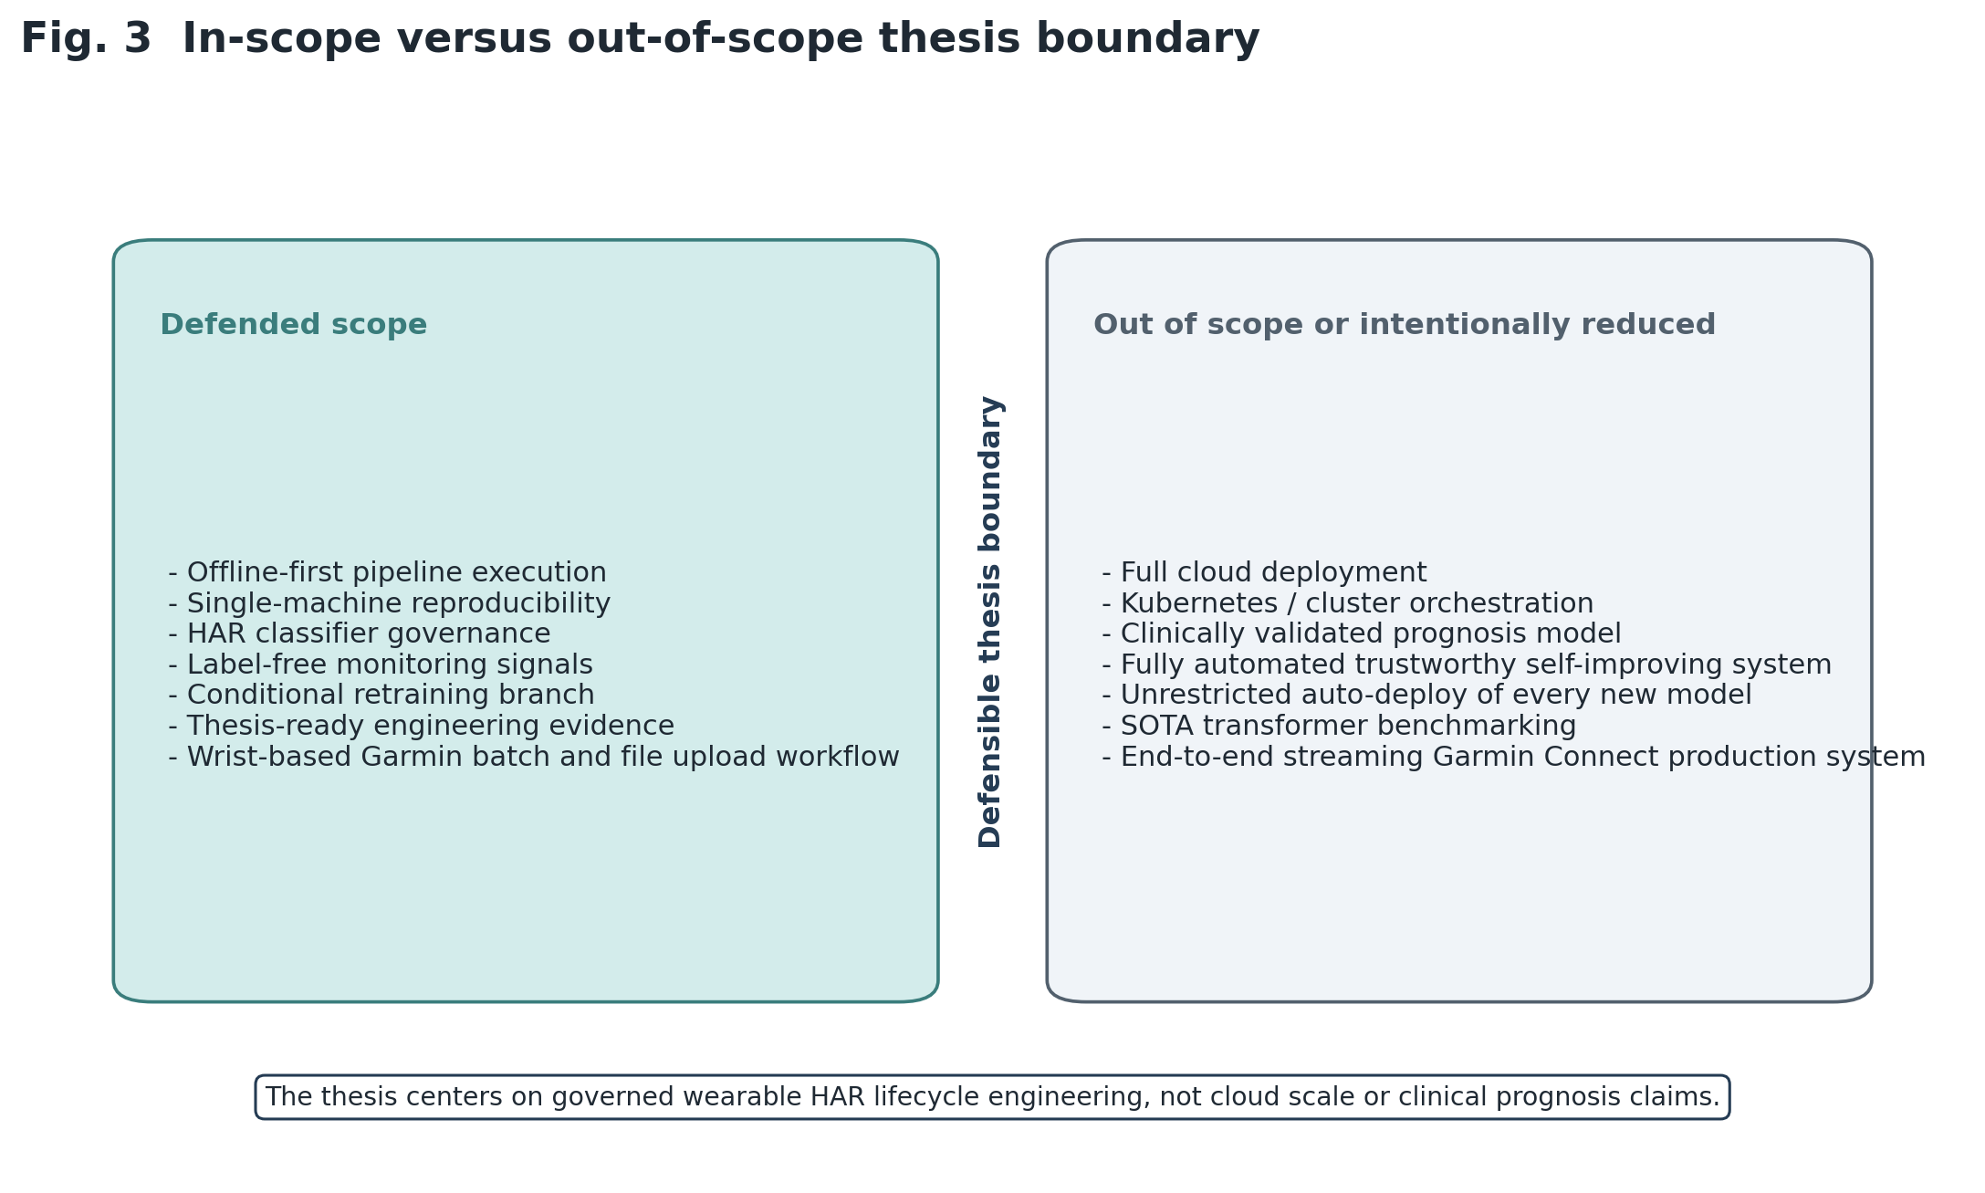
Thank you.
Offline-first - Reproducible - Governed
MLOps Level 1 - by design, not by limitation
Questions?
Notes:
Thank you. The system is not Level 2 MLOps because Level 2 is not safe here - unlabeled data, label-scarce monitoring, health-adjacent context. Level 1 with explicit governance is the correct target. I am happy to go into any of the model decision, monitoring signals, trigger policy, or preprocessing ablation in more detail.

