Slide 1
SQL Day 6: ER Model & Database Design
SQL
Structured Query Language · B.Tech SQL Training
Shalinee Priya
Data Analyst | SQL Trainer
1/10

Slide 2
TODAY'S AGENDA
What We'll Cover Today
01
06
Why Database Design?
Cardinality (1:1, 1:M, M:N)
02
07
Problems with Poor Design
ER Diagram
03
08
What is an ER Model?
Convert ER Model into Tables
04
09
Entity & Attribute
Business Case Study
05
10
Relationship
Mini Interview Challenge
Shalinee Priya
Data Analyst | SQL Trainer
2/10

Slide 3
DAY 5 → DAY 6
From Protected Tables to Connected Tables
Before writing JOINS, we first design how tables relate.
Keys & Constraints
Reliable Tables
ER Model
Database Blueprint
SQL Tables
Shalinee Priya
Data Analyst | SQL Trainer
3/10

Slide 4
CLASSROOM WARM-UP
Why Database Design?
Should 5,000 students, 300 faculty and 200 courses be stored in one table?
POOR DESIGN — one big table
GOOD DESIGN — linked tables
Student
Dept
Course
Departments
Courses
S101
CS
DBMS
S101
CS
DBMS
!
S102
IT
OS
Students
S101
CS
DBMS
!
THE THREE ANOMALIES
Update Anomaly · Insert Anomaly · Delete Anomaly
THE TAKEAWAY
Good design isn't optional — it prevents the exact anomalies above before they happen. (Full detail in Normalization, next module.)
Shalinee Priya
Data Analyst | SQL Trainer
4/10

Slide 5
CONCEPTUAL BLUEPRINT
What is an ER Model?
DEFINITION
A conceptual blueprint representing business requirements before creating database tables.
Requirement Gathering
Identify Entities
Identify Attributes
Identify Relationships
Decide Cardinality
Draw ER Diagram
Convert into Tables
Write SQL
Business Requirement → ER Diagram → SQL Database
Shalinee Priya
Data Analyst | SQL Trainer
5/10

Slide 6
BUILDING BLOCKS
Entity & Attribute
Every ER Model starts with one entity and its describing attributes.
Student_ID
Simple
Name
Cannot be divided further — e.g. Phone.
STUDENT
Email
Composite
Phone
Made of sub-parts — e.g. Name (First + Last).
DOB
MySQL Workbench — college_db
Single-valued
Holds exactly one value — e.g. DOB.
-- Entity: Student
CREATE TABLE Student (
Student_ID INT PRIMARY KEY,
Name VARCHAR(50),
Email VARCHAR(100),
Phone VARCHAR(15),
DOB DATE
);
Multi-valued
Can hold many values — e.g. Phone Numbers.
Derived
Computed from another attribute — e.g. Age from DOB.
Key Attribute
Uniquely identifies the entity — Student_ID.
Shalinee Priya
Data Analyst | SQL Trainer
6/10

Slide 7
MAPPING BUSINESS RULES
Relationship & Cardinality
How many records on one side can connect to how many on the other.
1 : 1
1 : M
Person
1
1
Passport
Department
1
N
Students
M : 1
M : N
Students
N
1
Department
Students
N
M
Courses
THE BIG IDEA
M:N is resolved using a junction table — Enrollment — that breaks the many-to-many link into two clean one-to-many links.
Shalinee Priya
Data Analyst | SQL Trainer
7/10

Slide 8
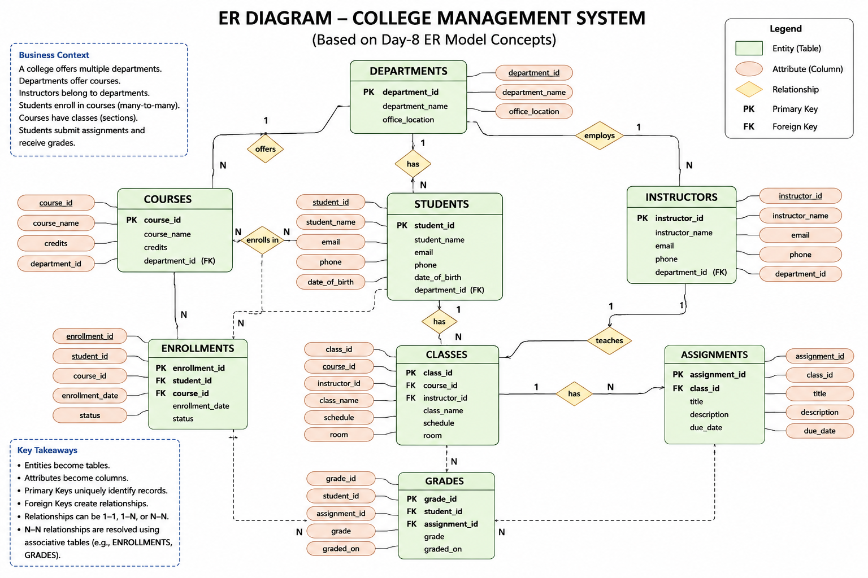
THE FULL PICTURE
College ER Diagram
Every entity, key, and relationship — this is the blueprint behind every table we build.
INTERVIEW INSIGHT
Many-to-Many relationships are implemented using a Junction Table (ENROLLMENTS).
Entity = Table
Attribute = Column
PK / FK = Relationship Key
Primary Keys uniquely identify records, while Foreign Keys create relationships between entities.
Shalinee Priya
Data Analyst | SQL Trainer
8/10

Slide 9
ER → SQL
Convert ER Model into Tables
Every ER concept has a direct, predictable SQL equivalent.
ER CONCEPT
SQL
Entity
Table
Attribute
Column
Key Attribute
PRIMARY KEY
Relationship
FOREIGN KEY
M:N Relationship
Junction Table
EXAMPLE — THE ENROLLMENT JUNCTION TABLE
CREATE TABLE Enrollment (Student_ID INT, Course_ID INT, PRIMARY KEY(Student_ID, Course_ID));
Shalinee Priya
Data Analyst | SQL Trainer
9/10

Slide 10
HANDS-ON
Mini Interview Challenge
Five questions using everything from today — no answers here!
1
Entity vs Attribute — what's the difference?
2
Strong vs Weak Entity — what sets them apart?
3
What is Cardinality?
4
Why is an Enrollment (junction) table required?
5
Convert a Library ER model into tables.
ER Model → Tables → Normalization (Next Module)
Shalinee Priya
Data Analyst | SQL Trainer
10/10

