Slide 1
Text-To-Image using Stack-Generative Adversarial Networks (GAN)
Presented By : Shalini B
Register No. : 711721243096
Department : B.Tech Artificial Intelligence and Data Science

Slide 2
PROJECT TITLE
Text-To-Image using Stack-GAN

Slide 3


AGENDA
Problem Statement
Project overview
End Users
Solution and Its value proposition
Special in Solution
Modelling
Result
Conclusion
3/21/2024 Annual Review

Slide 4

PROBLEM STATEMENT
In recent years, the field of computer vision has seen remarkable advancements, particularly in the domain of image generation. One of the most intriguing challenges within this realm is the creation of a system capable of generating realistic images from textual descriptions. This task, commonly known as text-to-image synthesis, has numerous real-world applications ranging from artistic creativity to aiding the visually impaired.

Slide 5

PROJECT OVERVIEW
The project aims to address several challenges prevalent in existing text-to-image synthesis methods, including generating high-quality images, optimizing training and inference efficiency, and enabling user control and interactivity.
To achieve these objectives, the project will leverage the hierarchical structure of the Stack-GAN model, which comprises multiple stages for progressively refining generated images based on input text.

Slide 6
WHO ARE THE END USERS?
Creative Professionals
E-commerce Platform Developers
Game Developers
AR/VR Developers
Educational Institutions

Slide 7

OUR SOLUTION AND ITS VALUE PROPOSITION
SOLUTION :
The proposed solution addresses the challenge of text-to-image synthesis by developing a sophisticated system capable of generating realistic images from textual descriptions. Leveraging advancements in computer vision, the system employs state-of-the-art techniques, such as the Stack-GAN architecture, to bridge the gap between text and visual content. By training on large datasets of textual descriptions paired with corresponding images, the system learns to map semantic information from text to visual features, enabling the generation of high-fidelity images that accurately reflect the input descriptions.

Slide 8
VALUE PROPOSITION :
Enhances creativity and productivity in content creation processes.
Enables customers to better visualize products before purchase.
Aids in conveying complex concepts visually, improving the learning experience for students.

Slide 9

THE WOW IN OUR SOLUTION
Improved image quality and coherence
Practical applications across various industries and domains (E-Commerce, Education, etc.)
Customize the generated images according to their needs
3/21/2024 Annual Review

Slide 10
MODELLING
Data Collection and Preprocessing :
Gather a dataset containing pairs of textual descriptions and corresponding images. This dataset can be sourced from publicly available datasets or curated manually.
Preprocess the images by resizing them to a uniform size and normalizing pixel values to a standard range.
2. Training Setup:
Split the dataset into training, validation, and test sets.
Select appropriate optimization algorithms, such as Adam or RMSprop, and tune hyperparameters like learning rate and batch size.
Set up a mechanism for monitoring training progress and visualizing generated images during training.
3. Model Training:
Train the Stack-GAN model using the preprocessed dataset and the defined training setup.
Monitor training metrics such as generator and discriminator losses, image quality scores, and semantic alignment scores on the validation set.
4. Inference and Image Generation:
Once trained, deploy the trained model for generating images from textual descriptions.
Implement an inference pipeline that takes a textual description as input, preprocesses it, feeds it to the generator network, and produces a corresponding image output.

Slide 11
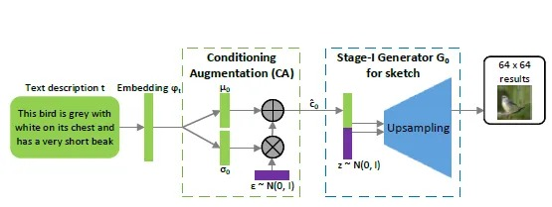
5. Evaluation and Validation:
Evaluate the quality of generated images using both quantitative metrics and qualitative human evaluation.
Validate the system's performance on diverse textual descriptions and assess its ability to capture semantic consistency and visual realism.
6. Optimization and Fine-Tuning:
Iterate on the model architecture, training setup, and preprocessing techniques based on feedback from evaluation results.
Fine-tune the model on additional data or adjust hyperparameters to further improve performance and address any shortcomings identified during evaluation.

Slide 12
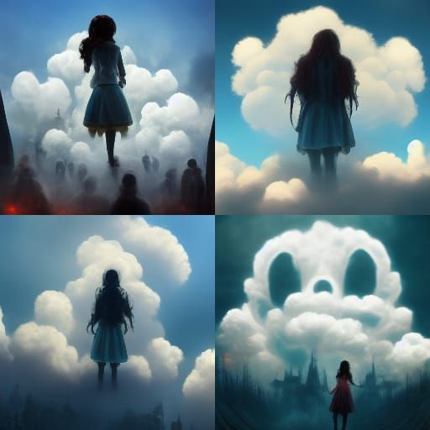
RESULT
“A girl standing on a cloud with horrific effect”
Textual Content
Image Generated

Slide 13
CONCLUSION
In conclusion, this project has addressed the challenge of generating realistic images from textual descriptions by leveraging state-of-the-art techniques and methodologies.
Moving forward, exploring new applications and use cases for text-to-image synthesis and integrating emerging technologies such as natural language processing and generative adversarial networks (GANs) can open up new frontiers for innovation and discovery.
Overall, this project represents a significant step forward in advancing text-to-image synthesis technology, offering tangible benefits and opportunities for a wide range of stakeholders. The developed system serves as a testament to the power of interdisciplinary collaboration, innovation, and ingenuity in driving positive change in the world.

