Slide 1


Model Evaluation based on Machine Learning Algorithms ( IRIS FLOWER DATASET )
- SHALINI bARDHAN

Slide 2
The Iris flower data set is a multivariate data set introduced by the British statistician and biologist Ronald Fisher in his 1936 paper – “The use of multiple measurements in taxonomic problems as an example of linear discriminant analysis” . The data set consists of 50 samples from each of the three species of Iris: Iris Setosa , Iris virginica , Iris versicolor .
Story

Slide 3

The dataset contains a set of 150 records under five attributes:
Petal Length
petal WIDTH
Sepal Length
Sepal Width
Species

Slide 4
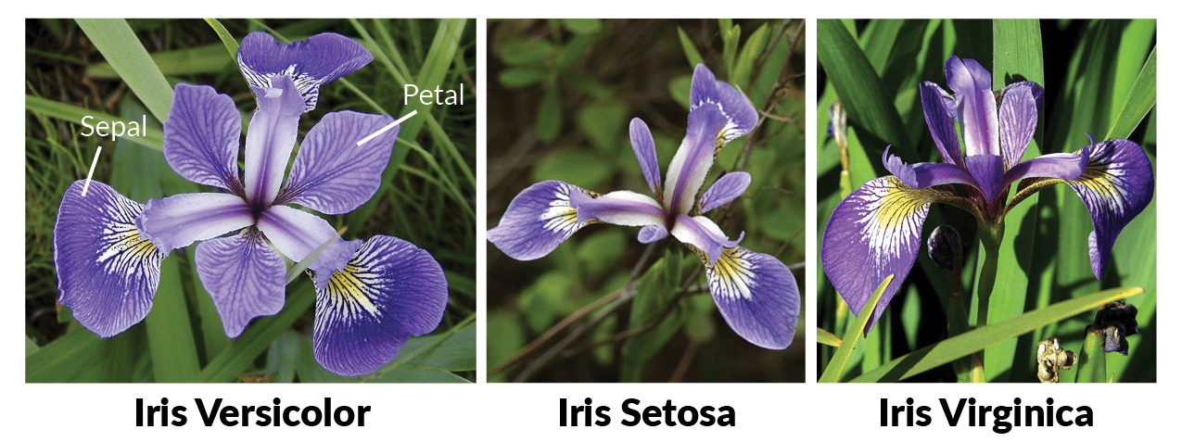
Problem statement
Given sepal and Petal length and width , we are predicting the class of iris , i.e whether it belongs to class of iris – setosa / virginica / versicolor.

Slide 5
analysis of the Data
The dataset provided has 150 rows.
Dependent variables : Sepal length , sepal width , petal length , petal width
Independent / target variable : species
Missing values : None ( no missing values found )
The ID column was dropped ( not required )

Slide 6
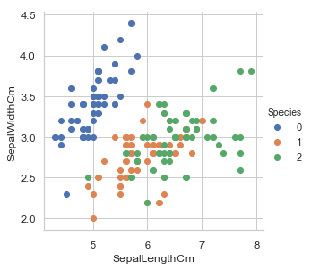
Exploratory Data analysis
As stated, our dataset has three iris-species , namely :
iris-setosa , iris-versicolor, iris-virginica with 50 samples of each.
Using sepal length ( in Cm ) and sepal width ( in cm ) attribute correlation,
Setosa flowers can be distinguished from other two
It is difficult to differentiate versicolor and virginica since they have considerable overlap.

Slide 7
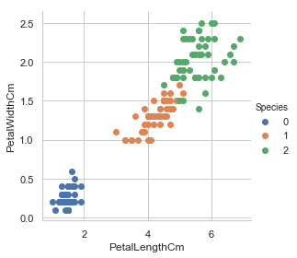
(as plotted in fig.)
using correlation between petal length ( in cm ) and petal width ( in CM ) features,
All the three flower species can be differentiated now.

Slide 8
Machine learning models used
1. ) Random forest regressor
- without PCA
- After PCA
2. ) K-Nearest Neighbours ( KNN )
3. ) SVM
- SVR
- Linear SVC
- SVC

Slide 9
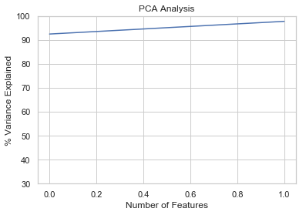
Model evaluation using PCA
Random forest regressor
i. ) Without pca:
MAE is 0.13333333333333333
RMSE is 0.32557641192199416
ii. ) After PCA :
2 components explain 95% of variation in the data
Mae is 0.14666666666666667
Rmse is 0.35023801430836526

Slide 10
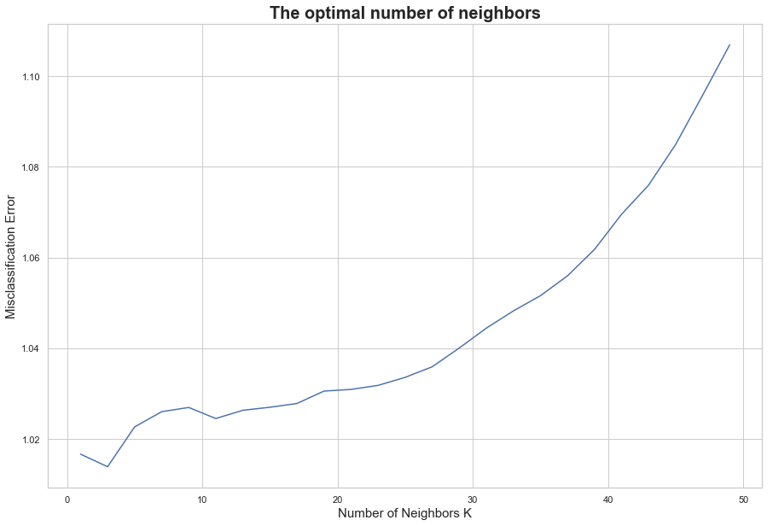
Model Evaluation using KNN
Accuracy = 93.33%
MAE Is 0.14666666666666667
RMSE is 0.35023801430836526
Optimal number of neighbors found = 3

Slide 11
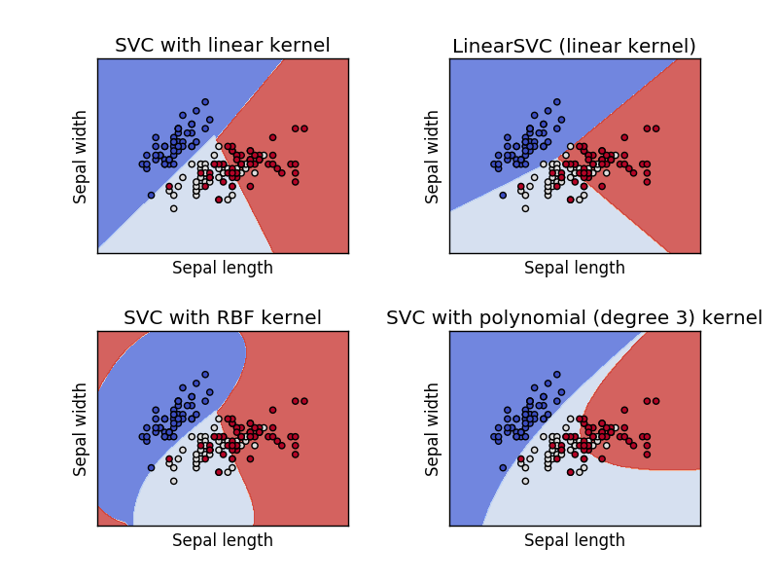
Model Evaluation using SVM
I . ) SVR
Accuracy on training set: 79.95
Accuracy on test set: 74.99
II . ) Linear SVC
Accuracy on training set: 96.67
Accuracy on test set: 86.67
Iii . ) SVC
Accuracy on training set: 98.33
Accuracy on test set: 90.00

Slide 12
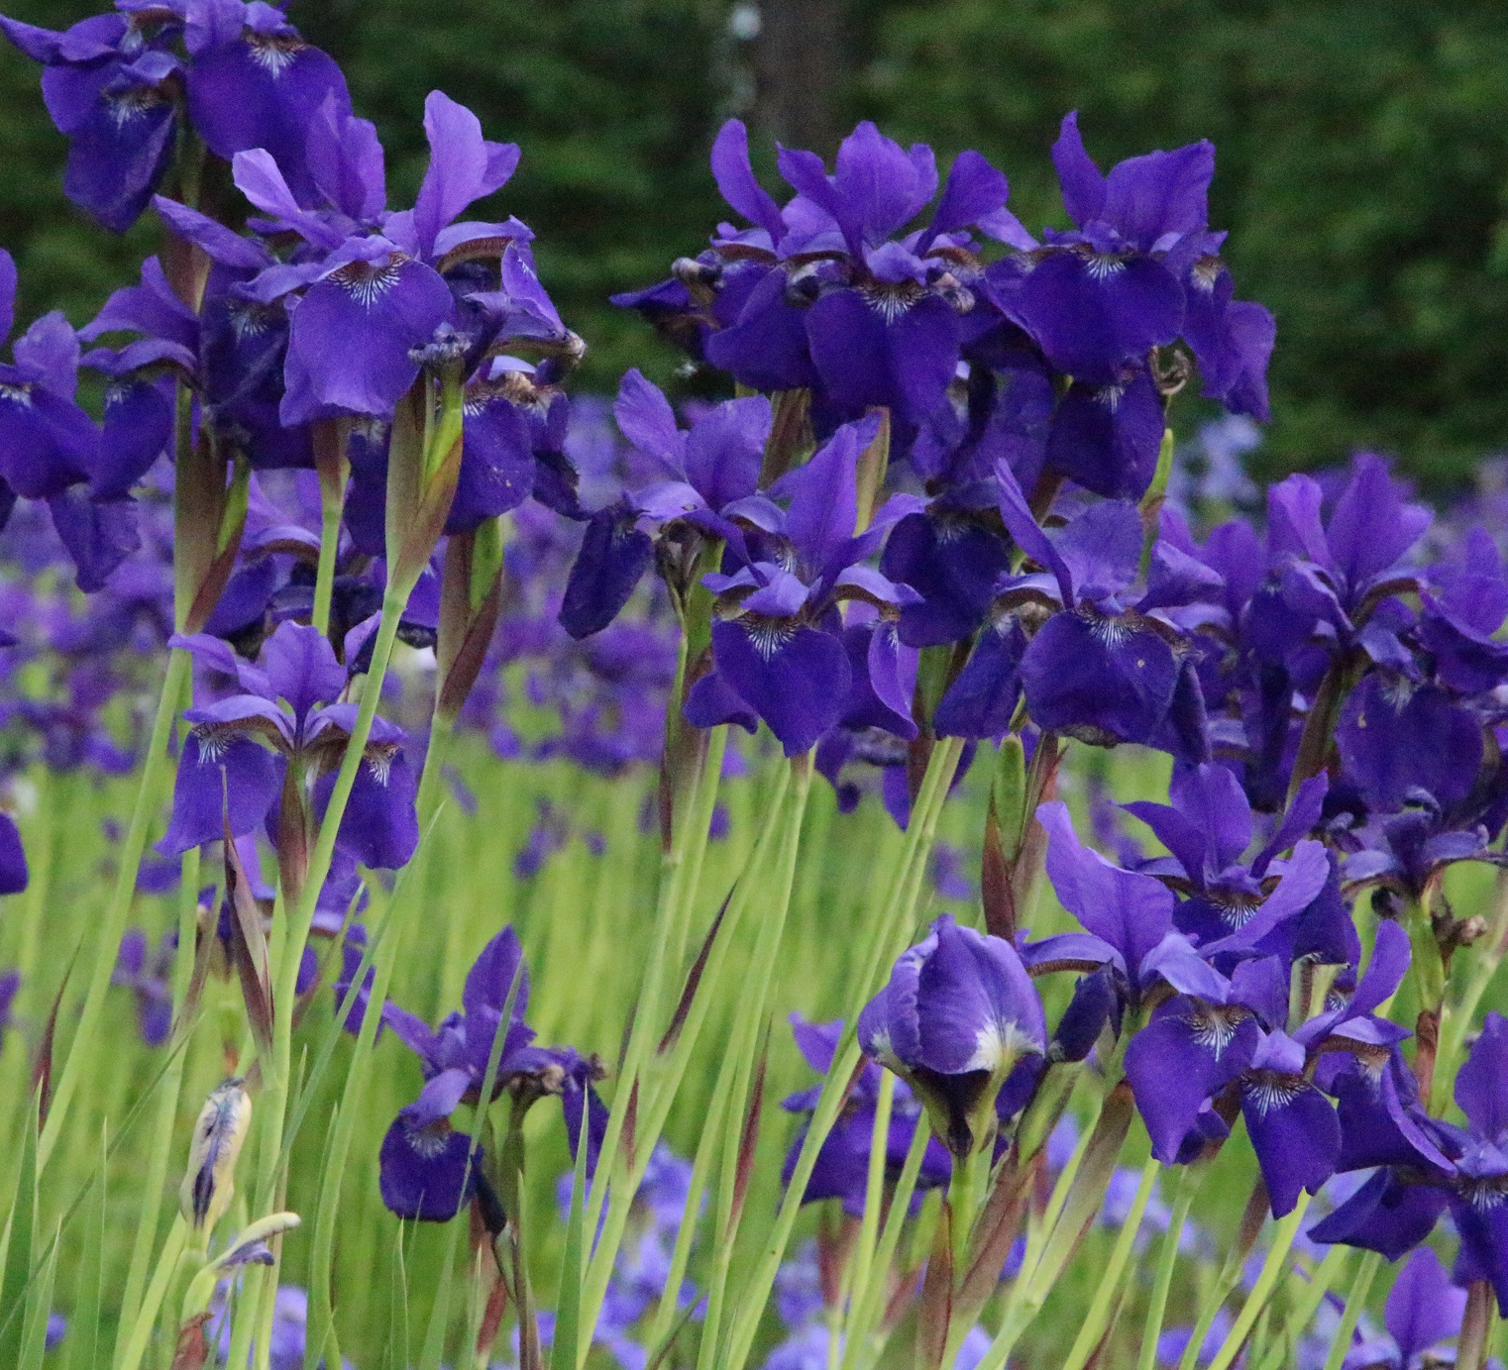
CONCLUSION
PCA doesn’t seem to have much impact
due to the lesser number of
components and less variance.
The optimal number of
neighbors in KNN algorithm is 3.
The accuracy of KNN model is 93%.
SVC Model (SVM) has higher
accuracy for training set data ,
but for test data it is only 90%.
Hence, KNN Model can be considered
as the best prediction method in this
case.

