Slide 1
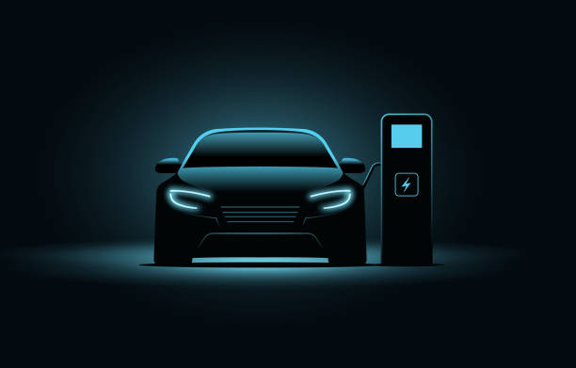
India’s Electric Vehicle Analysis

Slide 2
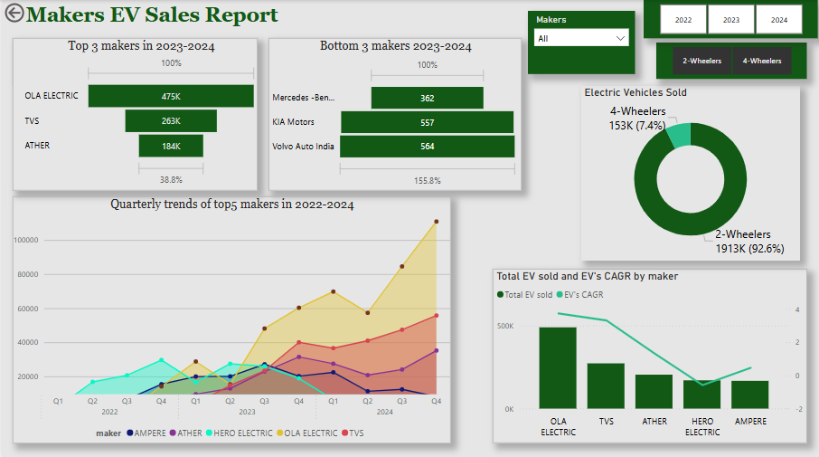

Slide 3
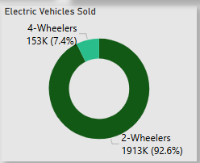
Two-wheelers dominate the EV market in India, accounting for an impressive 92.6% of total sales nationwide.
There are several reasons ;
Affordability: Electric two-wheelers cost less than cars and have lower running and maintenance expenses.
Commuting Demand: Ideal for India's urban and semi-urban areas due to ease of use and congestion handling.
Minimal Infrastructure Needs: Smaller batteries and faster charging make them home-chargeable.
Government Support: Subsidies like FAME II reduce costs and boost adoption.

Slide 4

The quarterly sales trend indicates that Hero Electric's sales have dropped below 10,000 units, while Ola Electric's sales are consistently increasing, reaching new highs as of Q4 2024.

Slide 5
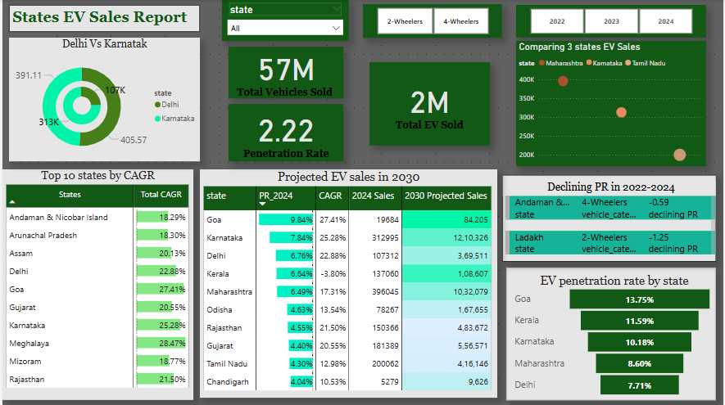

Slide 6
States Providing the Most EV Subsidies in India
Delhi:
₹30,000 subsidy for 2Ws.
₹10,000 per kWh subsidy for 4Ws (up to ₹1.5 lakh).
Exemption from road tax and registration fees.
Maharashtra:
₹10,000 per kWh subsidy for 2Ws and 4Ws.
₹25,000 for 2Ws and ₹1.5 lakh for 4Ws.
Early-bird incentives and road tax exemptions.
Gujarat:
₹10,000 per kWh subsidy for 2Ws and 4Ws.
Maximum subsidy: ₹20,000 for 2Ws, ₹1.5 lakh for 4Ws.
High EV adoption due to generous policies.
Tamil Nadu:
Road tax and registration fee exemptions.
Incentives for local EV manufacturing.
Rajasthan:
₹10,000–₹20,000 subsidy for 2Ws.
Exemptions on registration charges and road tax.
Karnataka:
Exemptions from road tax and registration fees.
Focus on EV infrastructure in urban areas.
These state-level subsidies, along with central incentives, are key drivers penetrating EV sales in India to the next level.

Slide 7
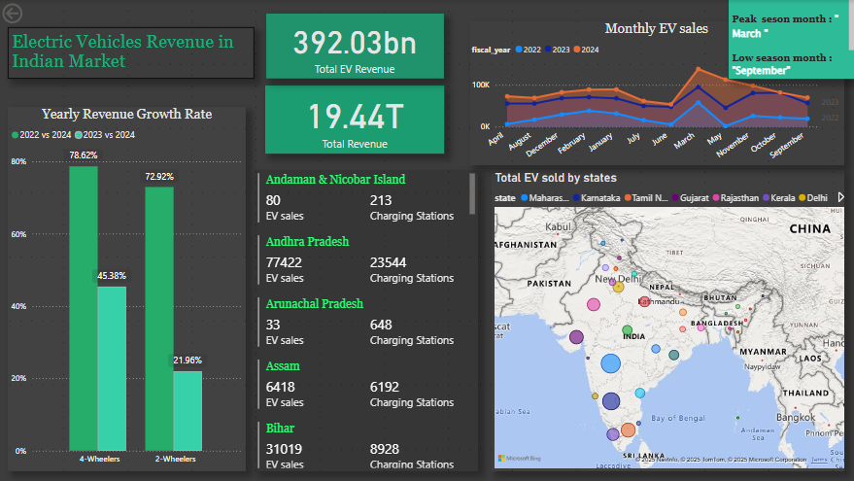

Slide 8
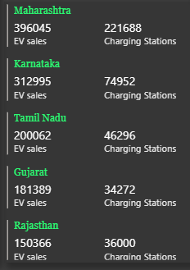
As of February 2, 2024, the number of operational public EV charging stations in the top five states are:
The availability of charging stations in Maharashtra, Gujarat, Karnataka, Tamil Nadu, and Rajasthan is directly driving higher EV sales.
This data indicates that Maharashtra leads in charging infrastructure, followed by Karnataka, Tamil Nadu, Gujarat, and Rajasthan. Press Information Bureau
The availability of charging stations is a key factor influencing EV adoption rates. States with more charging stations, like Maharashtra and Karnataka, tend to have higher EV penetration rates. Conversely, states with fewer charging stations, such as Gujarat and Rajasthan, may experience slower adoption rates.

Slide 9
Based on the visuals, Goa and Karnataka are emerging as top states for electric vehicle (EV) adoption in India.
Goa:
CAGR: Goa has demonstrated a remarkable 27.41% Compound Annual Growth Rate (CAGR) in its EV market, indicating rapid adoption and growth.
EV Penetration: As of FY24, Goa's EV penetration stood at 9.84%, reflecting a strong shift towards electric mobility.
Karnataka:
CAGR: Karnataka is projected to experience a 25-30% CAGR in EV sales by 2030, driven by initiatives in cities like Bengaluru.
Projected Sales for 2030: Karnataka is expected to become one of the top states in terms of total EV sales of more than 12 lakhs units by 2030, with Bengaluru leading the charge.
Conclusion:
While Gujarat remains a strong contender for EV manufacturing due to its infrastructure and business-friendly environment, Goa and Karnataka offer higher growth rates and substantial projected sales, making them attractive options for future EV market expansion.

Slide 10
