Slide 1


SIMATS ENGINEERING
SAVEETHA INSTITUTE OF MEDICAL AND TECHNICAL SCIENCES
Porter Stemmer: Design, Working Mechanism, and Applications
DSA0302 – NATURAL LANGUAGE PROCESSING
Guided by:
Dr. T. DEVI
Presented by:
K. SHALINI [192472213]

Slide 2


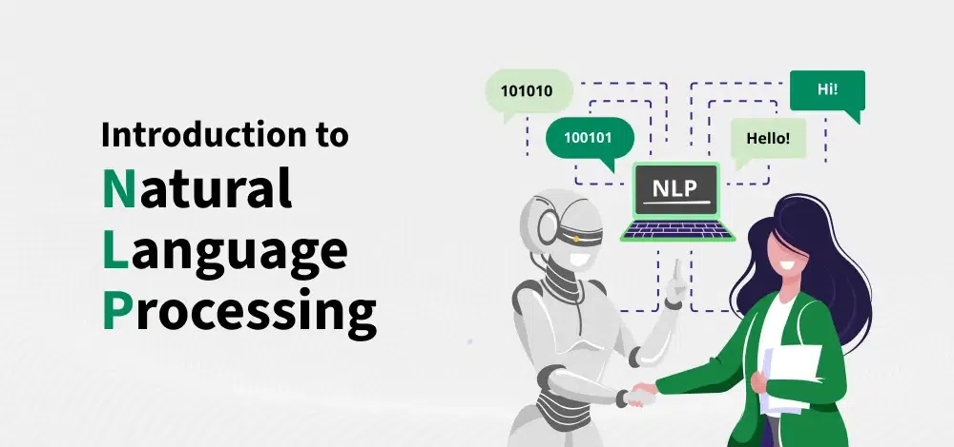
INTRODUCTION
Natural Language Processing (NLP) enables computers to understand human language.
Before text analysis, words must be normalized.
Porter Stemmer is one of the most widely used stemming algorithms for text preprocessing.
Example:
Running → Run
Playing → Play
Studies → Studi

Slide 3
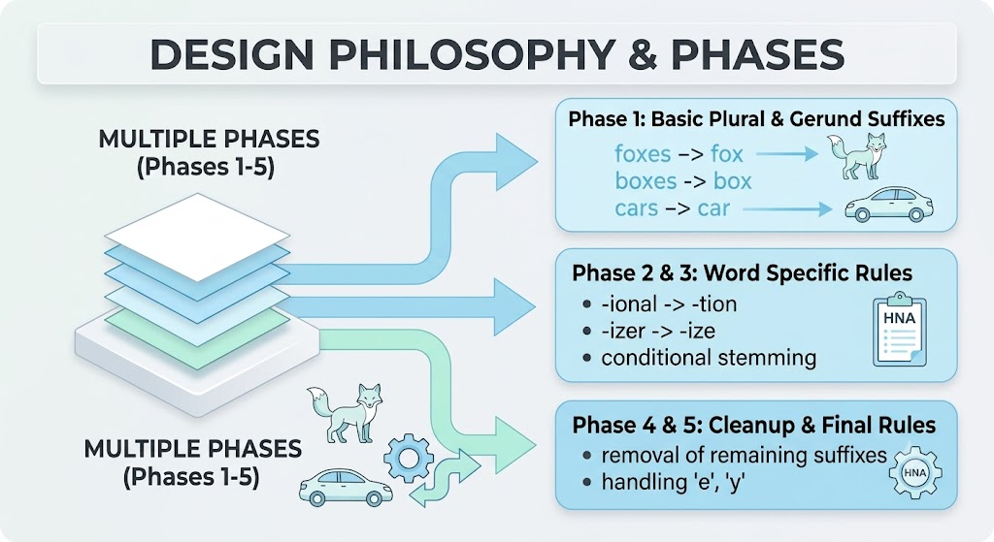
What is Porter Stemmer?
Definition
Porter Stemmer is a rule-based stemming algorithm developed by Martin Porter in 1980. It removes common suffixes from English words to produce their stem (base form).
Purpose
Reduce different word forms to a common stem.
Improve text processing efficiency.
Reduce vocabulary size.
Prepare text for NLP tasks.
Original Word | Stemmed Word
Eating | Eat
Universally | Univers
Connected | Connect
Foxes | Fox
Studies | Studi

Slide 4
Working Mechanism
How Porter Stemmer Works :
The algorithm applies a sequence of predefined rules to remove suffixes.
Steps
Read the input word.
Check for common suffixes.
Apply stemming rules.
Remove the suffix.
Return the stemmed word.
Flow
Example
Input Word
│
Check Suffix
│
Apply Rule
│
Remove Suffix
│
Stemmed Word
Connections
↓
Remove "-ions"
↓
Connect

Slide 5
Python Implementation (Execution)
Algorithm Used :
Porter Stemmer from NLTK
Python Code :
from nltk.stem import PorterStemmer
ps = PorterStemmer()
words = ["running","playing","studies"]
for word in words:
print(word,"->",ps.stem(word))
Output :
running → run
playing → play
studies → studi
GUI Demonstration :
Enter multiple words.
Click Stem Words.
View original and stemmed words instantly.

Slide 6
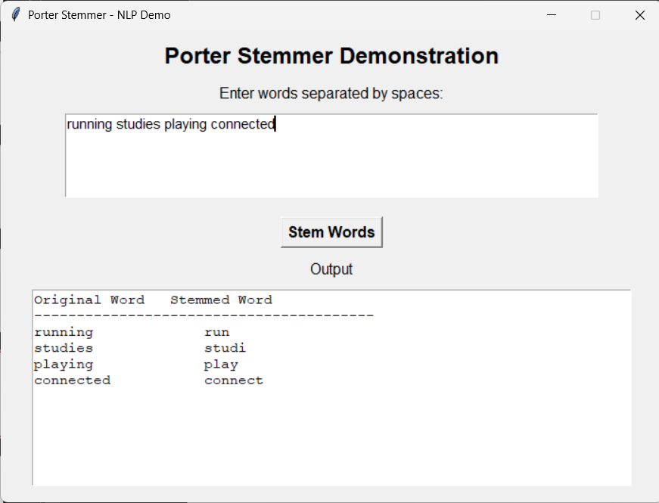
OUTPUT

Slide 7
Applications, Advantages & Limitations
Applications | Advantages | Limitations
Information Retrieval Systems (Google Search, Digital Libraries) | Simple and fast | Does not always produce valid dictionary words
Search Engines | Reduces vocabulary size | May over-stem or under-stem words
Chatbots | Improves NLP preprocessing | Works mainly for English
Sentiment Analysis | Easy to implement | Cannot understand word context
Spam Detection | Increases search efficiency | May lose semantic meaning
Text Classification | Reduces storage requirements | Less suitable for highly inflected languages
Document Clustering | Improves text analysis | Rule-based only

Slide 8
Conclusion & Future Scope
Conclusion
Porter Stemmer is one of the most popular stemming algorithms in NLP.
It removes suffixes to generate stem words.
It improves text preprocessing and reduces computational complexity.
It is widely used in search engines, text mining, and information retrieval systems.
Future Scope
Support multiple languages.
Improve stemming accuracy using machine learning.
Combine stemming with lemmatization.
Use deep learning for context-aware word normalization.

Slide 9
THANK YOU

