Slide 1
TABLE OF CONTENT
ACKNOWLEDGEMENT
COMPANY PROFILE
COMPANY OVERVIEW
COMPANY’s VISSION AND FOCUS
AUTOCLUSTER SERVICES
5.1 TRAINING
5.2 Common Effluent Treatment Plant – Operational at large sector
5.3 TOOL ROOM
5.4 EXHIBITION CENTER
5.5 METALLURGY
.6 METROLOGY & CALIBARTION
6. WEEKLY INTERNSHIP OVERVIEW

Slide 2
ACKNOWLEDGEMENT
First I would like to thank Rajeev Kumar, chief executive officer of Aditypur Autocluster for giving me the opportunity to do an internship within the organization.
I also would like all the people that worked along with me in Aditypur Autocluster with their patience and openness they created an enjoyable working environment.
I am highly indebted to our Principal Dr. Shukla Mahanti for the facilities provided to accomplish this internship.
nd advices to get and complete internship in above said organization.
I am extremely great full to my department staff members and friends who helped me in successful completion of this internship. throughout my internship.
shruti jha

Slide 3
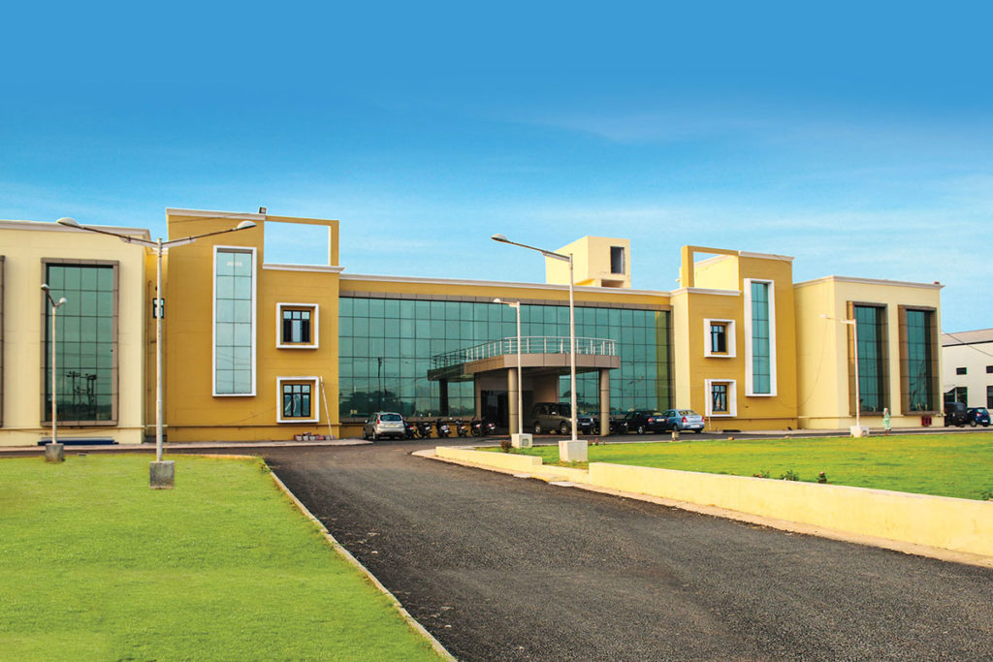
ADITYAPUR AUTO CLUSTER

Slide 4
COMPANY PROFILE
Adityapur Auto Cluster a Company registered under the Companies Act, (AAC)-SPV formed by the members of ASIA for implementation of IIUS Scheme of Govt. of India at Adityapur, Jamshedpur.
Adityapur Auto Cluster came into existence to implement the project under IIUS, the members of Adityapur Small Industries Association (ASIA) formed a Special Purpose Vehicle (SPV) in the Name of Adityapur Auto Infrastructure Company Limited, later on its name changed to “ADITYAPUR AUTO CLUSTER” (AAC). Purpose of AAC is to develop the Industrial Infrastructure facilities in Adityapur Industrial Area with the help of financial assistance as non refundable grant from Government of India and Government of Jharkhand with nominal investments by the local industrial units. Government of India through Ministry of Commerce & Industries launched a Scheme called. INDUSTRIAL INFRASTRUCTURE UPGRADATION SCHEME (IIUS) for development of Infrastructure of Industrial Area all over the Country for the rapid development of economy.Under this Scheme, Government of India has provided a grant of 75% of Total Project Cost or Rs.50.00 Crore , whichever is lower. Spread over 42 acres of land which is provided by AIDA free of cost.

Slide 5
COMPANY OVERVIEW
ADITYAPUR AUTO CLUSTER
Adityapur Auto Cluster is a Non-govt company, incorporated on 20 Jan, 2005. It's a public unlisted company and is classified as'company limited by shares'. Company's authorized capital stands at Rs 2000.0 lakhs and has 22.3525% paid-up capital which is Rs 447.05 lakhs. Adityapur Auto Cluster last annual general meet (AGM) happened on 28 Sep, 2016. The company last updated its financials on 31 Mar, 2016 as per Ministry of Corporate Affairs (MCA). Adityapur Auto Cluster is majorly in Community, personal & Social Services business from last 16 years and currently, company operations are active. Current board members & directors are SANTOSH KHETAN, SURESH NARAYAN THAKUR, RAJESH KUMAR SINHA, INDER KUMAR AGARWAL, DILIP KUMAR GOYAL, MAHESH KUMAR AGRAWAL, AKHILESHWAR PRASAD SINGH, HARI KUMAR KESHRI, KRISHNAPPAN SRINIVASAN and KAMARAJ RAVIKUMAR . Company is registered in Jharkhand (Jharkhand) Registrar Office. Adityapur Auto Cluster registered address is PLOT NO. 41 & 45 (P), PHASE-7 TATA KANDRA MAIN ROAD, ADITYAPUR INDUSTRIAL AREA JAMSHEDPUR Seraikela JH 832108 IN.

Slide 6
COMPANY’s VISION & FOCUS
VISION
FOCUS
MISSION
GOI through the Ministry of Commerce & Industry, launched a Scheme called Industrial Infrastructure Upgradation Scheme (IIUS) for development of Infrastructure od industrial area all over the country for the rapid development of economy.
Our focus is to provide the industrial infrastructure facilities to industry with the help of financial assistance from GOI with nominal investments by local industrial units so that they can consistently perform YoY to make tangible gains in current market.
Purpose of AAC is to develop the Industrial Infrastructure facilities in Adityapur Industrial Area with the help of financial assistance as non refundable grant from Government of India and Government of Jharkhand with nominal investments by the local industrial units.

Slide 7
AUTO CLUSTER SERVICES
1. Training
Catia, Auto Cad, CNC Programming & Operation, VMC, Metallurgy Lab, Metrology Lab (For Mechanical Students)
Hardware & Networking, Software Development, Web Design & Development Database, C++, Java, .NET&PHP (For IT Students)
Tally ERP9(For Accounts Students)
PLC Scada (For Electrical Students)
Live Project for CS, BCA, MCA, Internship for Engineering Student, Soft Skill.

Slide 8
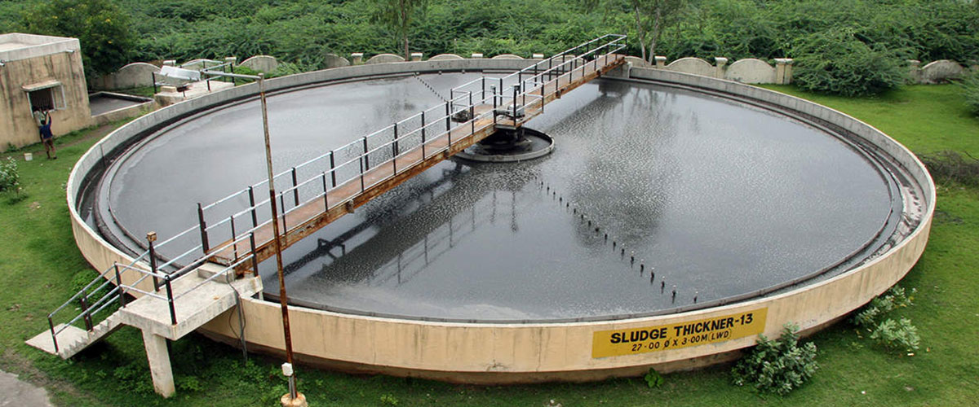
2.Common Effluent Treatment Plant – Operational at large sector

Slide 9
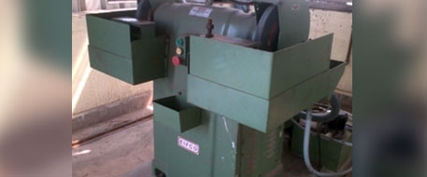
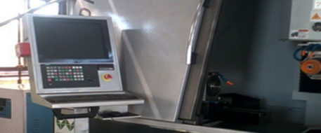
3.Tool Room VMC 5 up, Tools Re-Grinding & Re-Sharpening, Dies & Tool Manufacturing, MIG, ARC Welding, Fixture Manufacturing & Design, Band Saw Cutting, Surface Grinding, Cylindrical Grinding, Convez Lathe, CNXC Turing
Pedestal Grinder M/C
Tool and Cutter Grinding M/C

Slide 10
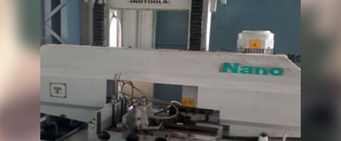
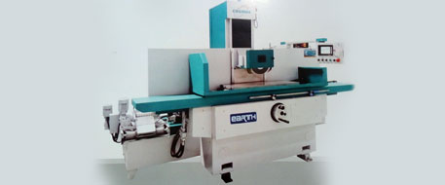
Machine Bend Saw
It is used for cutting the raw material as per required size for making a tools & tool room item like fixture, die, jigs etc.
Surface Grinding Machine
To produce smooth finish on flat surfaces.

Slide 11
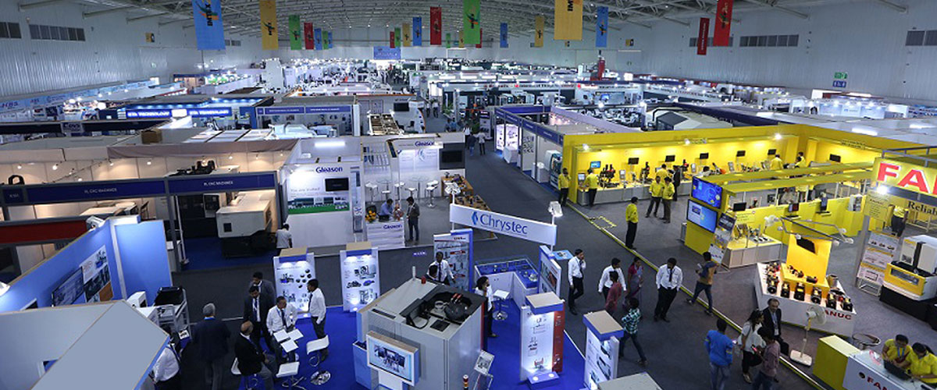
4. Exhibition Center World class Exhibition Center.

Slide 12
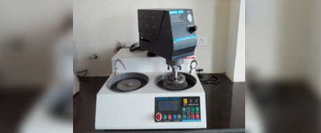
5.Metallurgy Millipore Testing, Salt Spray Testing, Microscope Testing, Vicker Hardness Test, Rockwell Hardness Test, Brinel Hardness Test, UV Tester Paint/ Coating, Plastics & Polymer Impact Testing, Corrosion Testing For Paint/ Coating, Metallographic/ Micro Structure Test, Spectro Analysis (Ferros and Non-Ferros), DFT Testing And Microscope Testing, Universal Tensile Testing Machine (Rubber & Polymer)-20KN, Universal Tensile Testing Machine (For Metal Product) – 1000KM
Double Disc Grinder

Slide 13
6.Metrology & Calibartion
a.Mechanical Scope – Dimension(Length, Dia, Vernier, Micrometer, Hole/Shaft Gauges, Thread Gauges, Fixture, Height Gauge, Radius, Angle etc), Pressure(Industrial Pressure, Gauge Pressure , Pressure Switch, ransmitter, Vacuum etc.), Mass(Balance, Weight), Force(UTM, CTM,TTM), Hardness, Volumatic Instruments
b.Thermal – Temp, Humidity
c.Electro Technical
3D Scanner
Surface Roughness Tester
Universal Length Measurement Machine
Nikon CMM with polyworks software
Pressure Calibration Comparator
Profile Projector
Temperature Calibration System
Volume And Mass Calibration

Slide 14
WEEKLY INTERNSHIP OVERVIEW

Slide 15
SOFTWARES
ATOM
1.FRONT END

Slide 16
SOFTWARES
XAMPP SERVER
2. BACK END

