Slide 1
Adventure Works
- By Group 2

Slide 2

AGENDA
01
Project Recap
02
Problem Statement
03
The Analytics Team
04
Process
05
Insights
06
Summary

Slide 3
PROJECT RECAP
Adventure Work Cycles is a large, multinational manufacturing company based in Bothell, Washington that mainly manufactures bicycles. The company has its foothold in North America, Europe and Australia.
In 2000s, the company acquired a small manufacturing plant in Mexico which manufactures several critical subcomponents for the company’s product line. Since 2001, this manufacturing plant is the sole manufacturer and distributor of the touring bicycle product group.

Slide 4

PROBLEM STATEMENT
The company is looking to broaden its market share by,
Targeting the sales to their best customers.
Ensuring product availability
Reducing the cost of sales
But what does our data say?

Slide 5


THE ANALYTICS TEAM
Chethana B
Sahil Kumar Thakur
Kadiyala Shalini
Kanchan

Slide 6
PROCESS
1
2
3
4
5
Data Understanding
Data Cleaning
Data Modeling
Data Analysis
Uncovering Insights

Slide 7





INSIGHTS
KPIs
From Dec-2010 to Jan-2014, the company has generated about
2.94 Cr
1.21 Cr
1.73 Cr
60,398
In
Sales
In Profit
In Production Cost
In Quantity Ordered

Slide 8
INSIGHTS
Year-wise Analysis
The sales have increased steadily from 2010 to 2013
Year 2013 having highest recorded sales
Years 2014 and 2010 recorded lowest sales

Slide 9
INSIGHTS
Quarter-wise Analysis
The sales have increased steadily through all the quarters
Q4 having highest recorded sales
Q1 having lowest recorded sales

Slide 10
INSIGHTS
Monthly Trends
The sales have increased steadily through all the months
June month accounted sudden spike in sales
December month having highest recorded sales
January recorded lowest sales

Slide 11
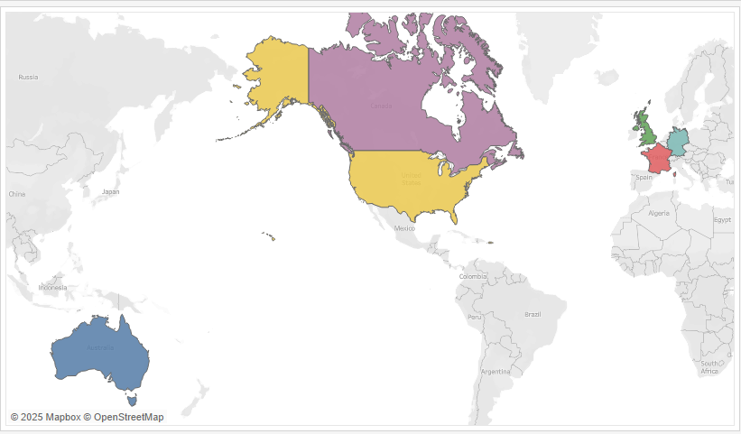

INSIGHTS
Global Market Distribution
Canada
UK
USA
Germany
Australia
France

Slide 12
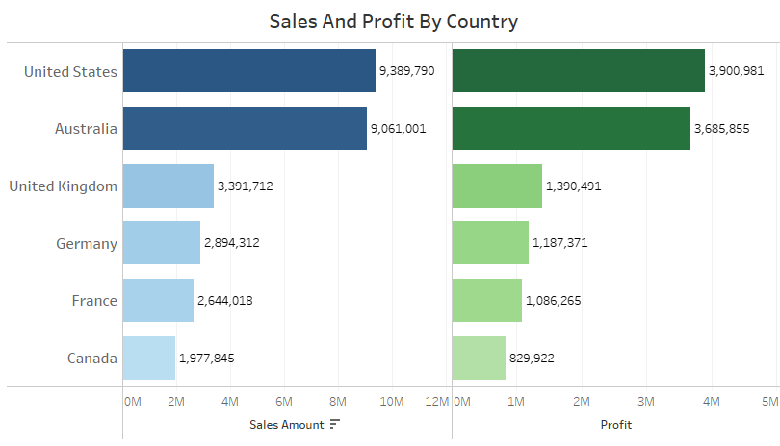
INSIGHTS
Country-wise Analysis
The USA and Australia have highest sales and profits by country
Canada and European countries have the lowest sales and profits by country

Slide 13
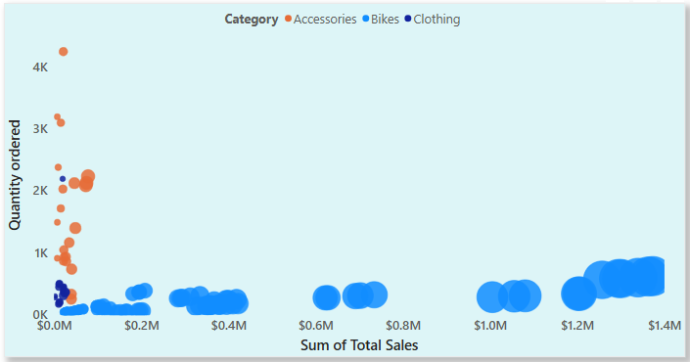
INSIGHTS
Product Category Analysis
Bikes category has amounted to highest sales and profits, although the quantity ordered is low
Accessories and Clothing Categories are ordered in great numbers yet the sales and profits are less compared to bikes

Slide 14
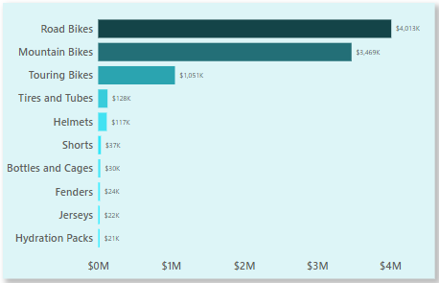
INSIGHTS
Top 10 Subcategories By Profit
Road bikes and Mountain bikes generated highest profits
Touring bikes, Helmets, Tires and Tubes also contributed significantly

Slide 15
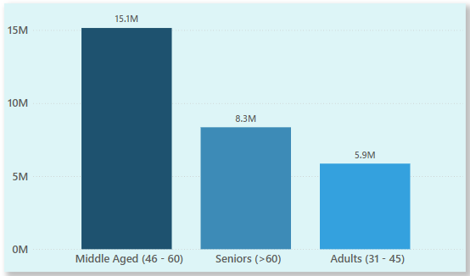
INSIGHTS
Customer Demographics
Middle Aged customers have generated more sales for the company
Adults, on the other hand, have generated less sales

Slide 16
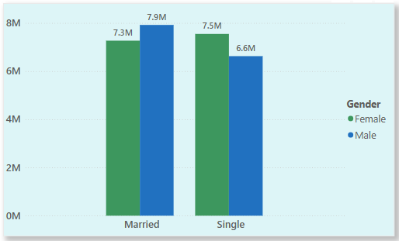
INSIGHTS
Customer Segments
Married males and unmarried females represent strong segments
Unmarried males represent comparatively weaker segment

Slide 17
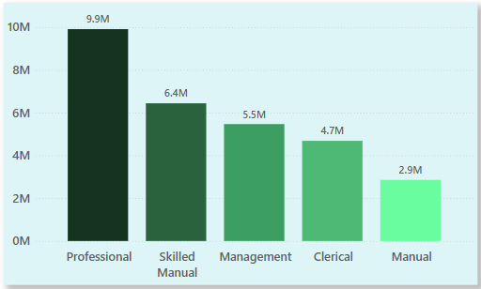
INSIGHTS
Customer Occupation
Professional and Skilled Manual customers have generated more sales
Manual customers have generated least sales

Slide 18

SUMMARY
2013 was a strong year in sales, profit and order quantity. The decline in the sales for 2014 suggest for strategic decisions
Highest sales during December and sudden spike in sales in June indicate that customers buy more products during holiday seasons and summers
Bikes have dominated the sales and profits. This can be leveraged to expand into global markets
Accessories and Clothing have amounted for lower sales and profits despite more number orders, suggesting the need for lower production costs to maximize profits
The company needs to target Canada and European markets for more sales by campaigning and also sponsoring sports events to get global recognition

Slide 19
SUMMARY
Most of the customer base comprises of Middle-Aged people, suggesting the need for targeting customers of other age groups
Married customers tend to purchase more compared to single customers, indicates the role family dynamics in sales
Customers with Professional and Skilled Occupations order more products, suggests financial stability can increase the purchasing power of people

Slide 20
THANK YOU

