Slide 1



Slide 2
AGENDA
01
Project Recap
02
Problem Statement
03
The Analytics Team
04
Process
05
Insights
06
Summary

Slide 3

PROJECT RECAP
CRM ANALYTICS
OPPORTUNITY
Opportunities in CRM Analytics help track, analyze, and forecast sales performance, enabling businesses to optimize their sales pipeline, prioritize high-value deals, and improve revenue forecasting
LEAD
Lead in CRM Analytics helps businesses capture, analyze lead dynamics, conversions, qualify, track, and analyze potential customers to optimize sales and marketing efforts.

Slide 4
PROJECT RECAP
CRM ANALYTICS
OPPORTUNITY
Opportunities in CRM Analytics help track, analyze, and forecast sales performance, enabling businesses to optimize their sales pipeline, prioritize high-value deals, and improve revenue forecasting
LEAD
Lead in CRM Analytics helps businesses capture, analyze lead dynamics, conversions, qualify, track, and analyze potential customers to optimize sales and marketing efforts.

Slide 5

PROBLEM STATEMENT
The company is looking to broaden its market share by,
Effectively track, prioritize, and convert leads into opportunities.
Aims to address the issues by providing predictive insights
Enhance sales performance and conversion rates.
But what does our data say?

Slide 6


THE ANALYTICS TEAM
Shalini Kadiyala
Sagar Chauhan
Urmila Sen
Arpita Pritam Havaldar

Slide 7
PROCESS
1
2
3
4
5
Data Understanding
Data Cleaning
Data Modeling
Data Analysis
Uncovering Insights

Slide 8






INSIGHTS
OPPORTUNITY
KPIs
From 2013 to 2021, the company has generated about
$184.14M
1272
35.71%
31.06%
68.94%
In
Expected
Amount
In
Active Opportunities
In
Conversion rate
In
Win Rate
In
Loss Rate

Slide 9
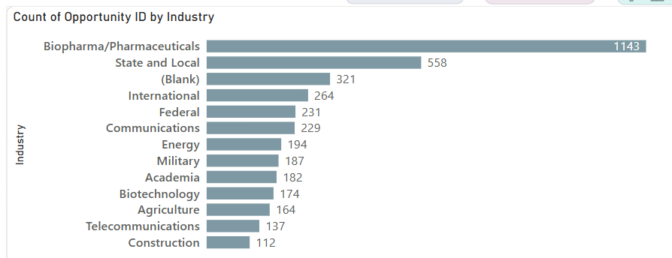
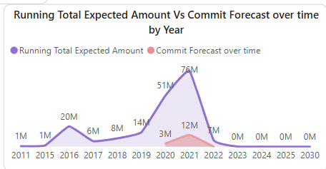
INSIGHTS
OPPORTUNITY
Trend wise Analysis
From 2013 to 2021, the company has generated about
Expected Amount vs Commit forecast over time by Year
Industry by Opportunity
Biopharma/Pharmaceuticals is the leading industry in terms of sales opportunities.
From 2017, Biopharma/Pharmaceuticals has majorly been on top.
The Expected Amount has grown significantly over the years, reaching 76M by 2021.
The Commit Forecast was zero until 2020, after which it increased gradually, reaching 12M

Slide 10
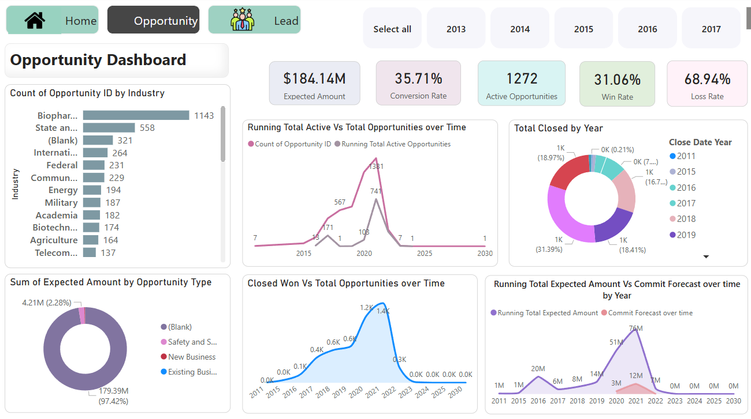
The Opportunity Dashboard provides an overview of opportunity generation, conversion rates and sales performance over time

Slide 11
The Opportunity Dashboard provides an overview of opportunity generation, conversion rates and sales performance over time

Slide 12
INSIGHTS
LEAD
KPIs
From 2013 to 2021, the company has generated about
$184.14M
10K
1016
411
10.33%
In
Expected
Amount
In
Total
Leads
In
Converted
Accounts
In
Converted
Opportunities
In
Lead Conversion Rate

Slide 13
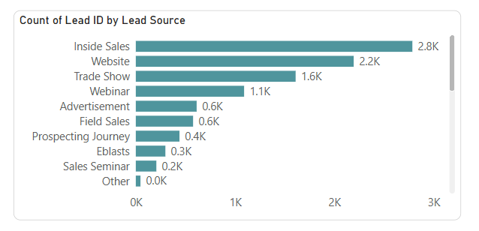
INSIGHTS
LEAD
Inside Sales has generated more leads
Inside Sales has been performing best from the year 2019
Service has been generated least leads

Slide 14
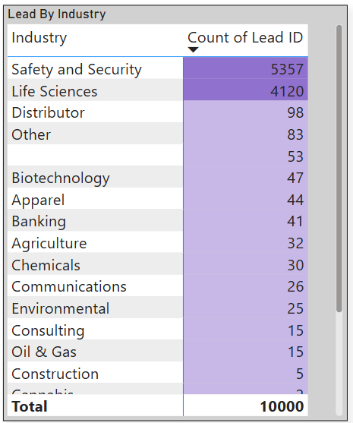
INSIGHTS
LEAD
Highest leads have been generated from Safety and Security Industry.
Applied markets, Hydro Carbon Processing, Rebel are the lowest Industries with least leads.
Safety and Security, Life Sciences Industries performed best in generating leads of all time.

Slide 15
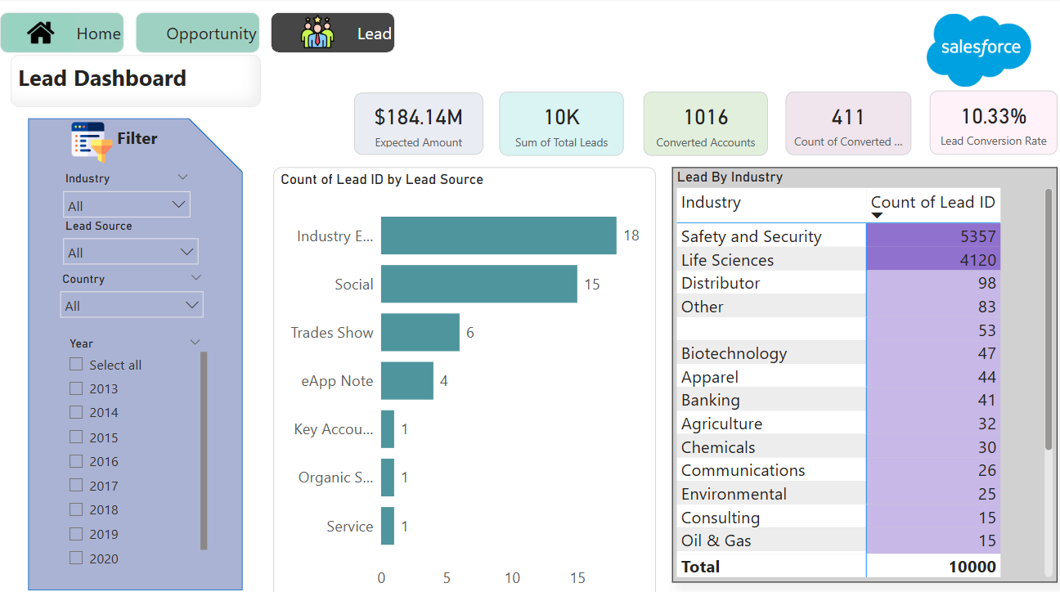
The Lead Dashboard provides an overview of Lead generation, conversion rates and sales performance over time

Slide 16
The Lead Dashboard provides an overview of Lead generation, conversion rates and sales performance over time

Slide 17
SUMMARY
2019 to 2021 are the strong years in sales and expected revenue for Opportunity. The decline in the sales for 2014 suggest for strategic decisions.
2016 to 2018 are the 0 converted leads, making it the lowest performing year
2020 had the highest conversion success.
Q1 is the strongest quarter, indicating a strong start to the year in Leads.
Q3 (July-Sept) is the weakest quarter, possibly due to seasonal slowdowns in Leads.
The Commit Forecast was zero until 2020, after which it increased gradually, reaching 12M
Safety and Security Industry has dominated sales and revenue of all time.

Slide 18
THANK YOU

