Slide 1


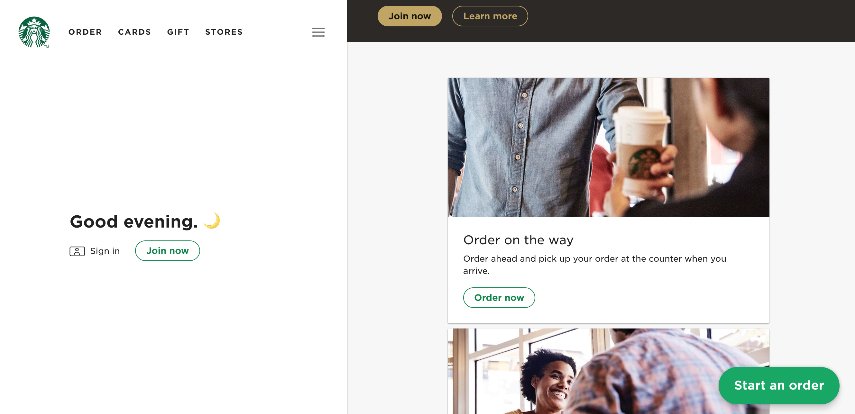
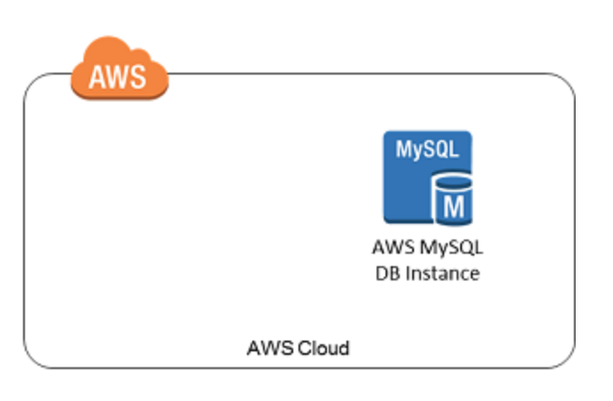

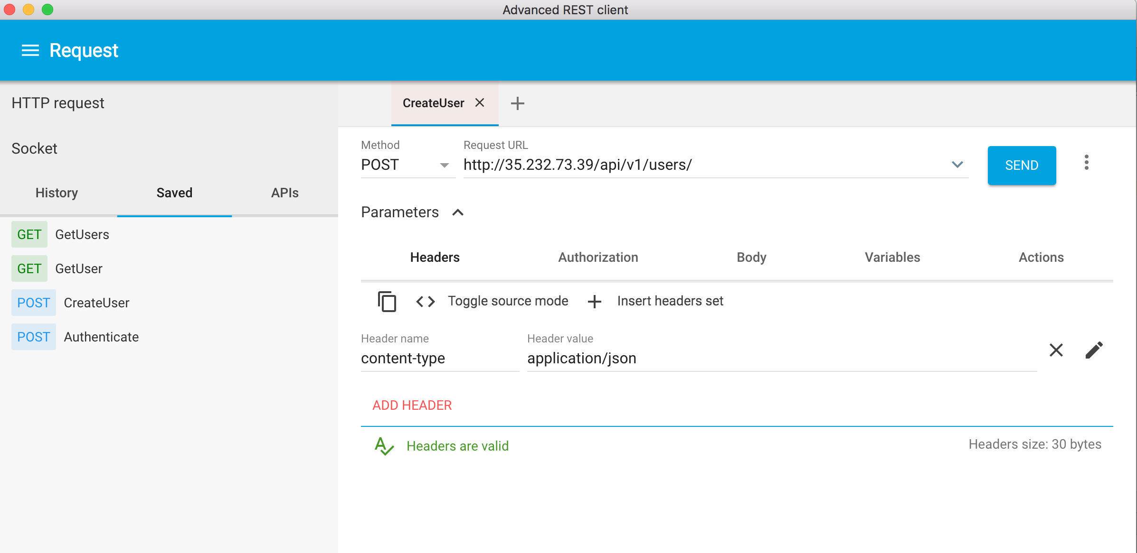
Clients
Microservices
Cloud Container Services
Database in Cloud
User Service
GKE
Order Service
Card Service
AWS ECS
Payment Service

