Slide 1
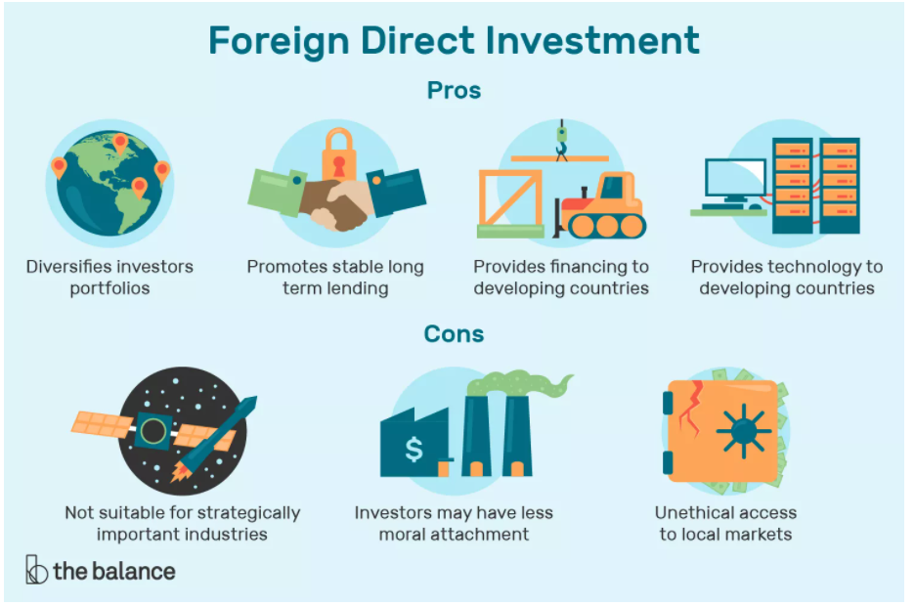
FDI Case Study

Slide 2
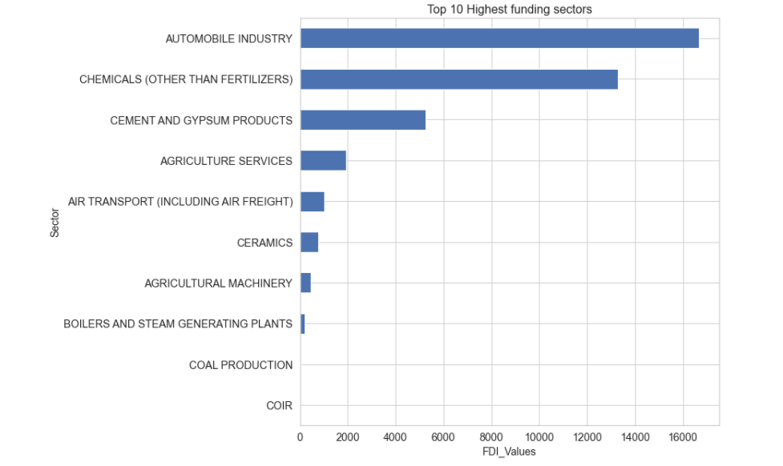
Which sector receive the maximum direct funding?
Automobile, Chemical(other than fertilizer),Cement and gypsum product Sectors are top investment sectors

Slide 3
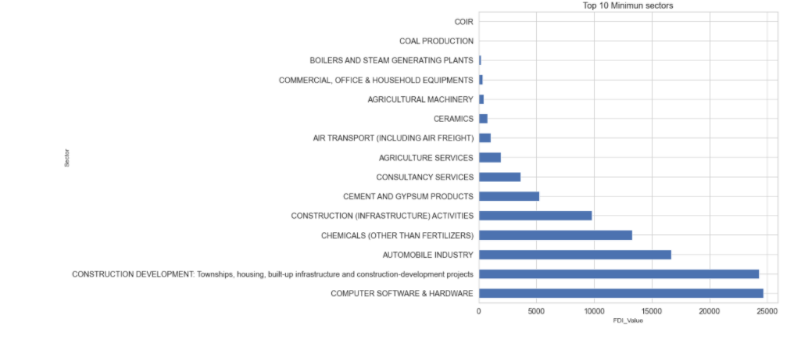
Which sector receive the minimum direct funding?
Investors should avoid investment in Coir, Coal products, Boilers and steam generation plants Sectors.

Slide 4
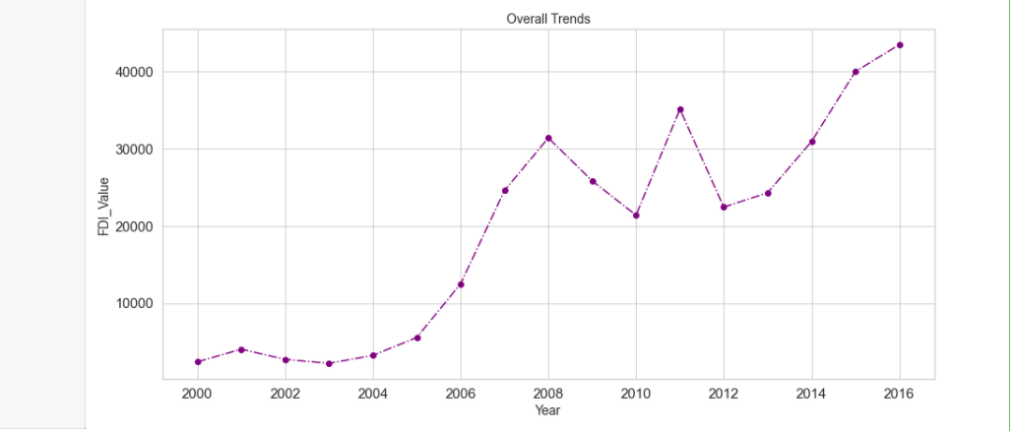
Overall Trends (Year Wise) for direct investments in individual sector
The above trends graph indicates the increment of investment in every year but there was a noticeable decline during 2010 & 2012.Highest scale of investment seems to be in 2016.

Slide 5
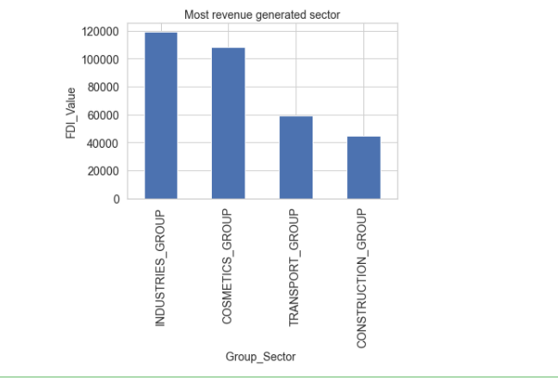
Which Sector received more FDI_Value(comparison between grouped sectors)?
Industries _Group has the highest FDI_value but Construction _Group is the least grouped sector, which received the lowest FDI_value.

Slide 6
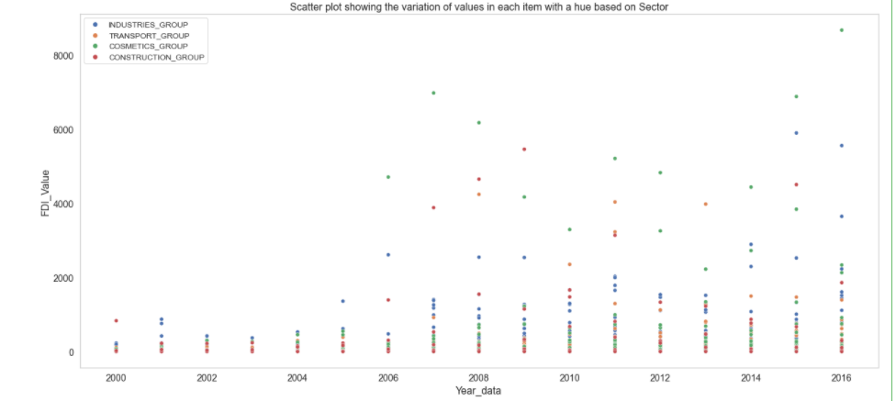
Which sector is growing more over the years?
In between 2001 & 2006,Industries_group sector was the first choice of the investment but investment amount was low. Since 2010 onwards, Cosmetics_group sector became the top investment sector with high investment amount. In 2016,There was a large investment amount difference between Cosmetics _group & Industries_group.

Slide 7
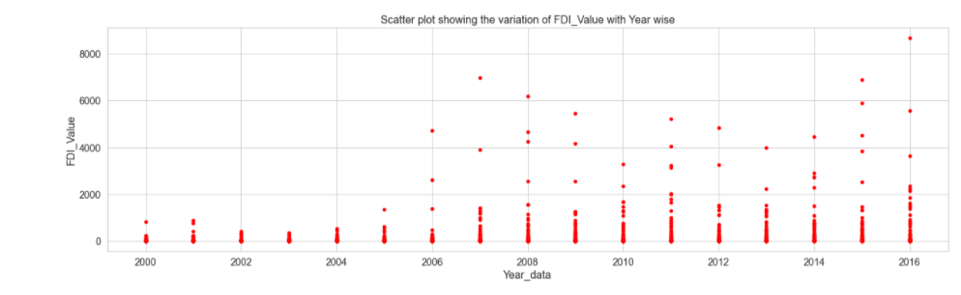
Incline and Decline pattern of investment in each year
Investment FDI_Value gradually increase since 2007 but with slightly decline in every year till 2015 and it seems that 2016 was the most invested year of decade. Investors were becoming more interested and investing huge amount in between 2015 & 2016.

Slide 8
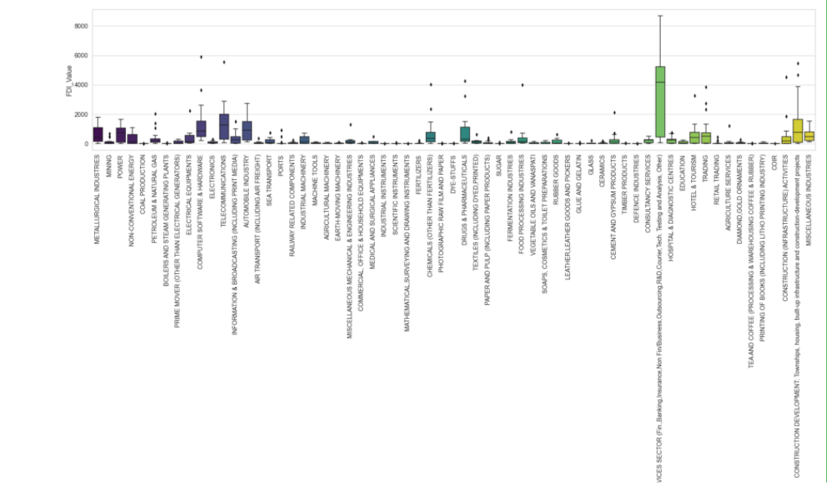
Which sector reported most variations overall ?
Highest growth sectors are Service sector, Telecommunication and computer sector. In future, Investors should be invested more into these sectors for growth.

Slide 9
THANK YOU

