Slide 1

Integrating Accessibility testing with automation frameworks
Nawaz • TechShare 2016• March 4, 2016
Notes:
This is the logo we created for AATT tool

Slide 2


Bootstrap Accessibility Plugin, Skipto plugin, amCharts plugin, AATT HTML5 Accessible Video Player http://paypal.github.io/a11y/
Our other Opensource Projects
Notes:
Except HTML5 Player, I’m the main developer for these projects. Bootstrap plugin is my idea skipto and amCharts were Victor’s idea and AATT was Srinivasu’s idea

Slide 3
Table of contents
Why we need automation Process for Inducing Automation Challenges
Birth of AATT Architecture How to get it Running on your system Advantages
Demo

Slide 4
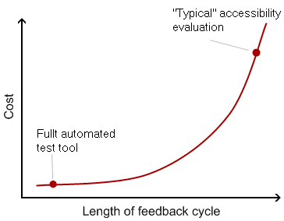
Automation?
Detecting Issues Early in process is cost effective Most of the commonly found mistakes are detectable at an early stage, with tools
Notes:
Top 10 Accessibility error:
1. Missing alt text 2. Anchor element with no link text
3. Outline: none 4. Poor color contrast 5. Form does not contain a submit button 6. Lang attribute missing 7. Missing labels 8. Doesn’t work with keyboard 9. Datatables with no headers 10. Error recovery is tuff. Now : Mostly tested before release by QA and accessibility team finds problems post production. Issues found may not be fixed as it may have high design or code changes, also needs Product Management decision.

Slide 5

Automation process
2012
2013
2014
2016
Accessibility testing
Started developing tool
Tool Developed for Java and NodeJS platform
Adopted slowly
Notes:
The process we took to include this tool as part of testing: We started our accessibility testing journey in year 2012. 2013 is when we started developing the tool. 2014 Development was done for testing page by page. Early 2015 opened up API for Java Testing Framework and NodeJS Testing Framework. We see good adoption since mid 2015.

Slide 6

Steps
Influencing process change takes time
Educate, build empathy accessible products remove barriers for people with disabilities. Empower Engineers to start testing early in process
Notes:
Challenges for adoption We had to conduct lots and lots of training Propagate Accessibility from top to bottom
Build Accessibility lab, people experience on how people with disability use technology

Slide 7
Introduce Testing templates Educate and inspire Test Engineers Work with QA infra team to bring in Automation
Test Engineers
Developers
Have their own level of testing and have separate testing tools and process (Grunt, Gulp) Find tools that can integrate into their existing processes/test tools if possible.

Slide 8
AIM
Tool that can work for both Developers and QA Both Developer and QA should test early in cycle
Notes:
Recognize that only using automation testing to detect accessibility issues is late in the process, also I've got feedback: engineers should use tools to test themselves so QA is more regression testing /sanity checking that everything is working: goal is few errors which means the process is working. if lots of errors can use that data to go back to dev and make sure they are following processes.

Slide 9
Other Challenges
Finding the right Tool – Search https://www.w3.org/WAI/ER/tools/ Automation Framework is already in place
Include a tool into existing continuous integration framework
Java Framework
Test cases are already written and reside in Test Suite, can’t ask them to write accessibility test cases
No control over QA Environment, so difficult to inject new accessibility framework
QA infra team upgrade their tools, need to maintain the tool and test cases
Notes:
https://www.w3.org/WAI/ER/tools/ has so many choices, few are browser plugins, few of them are OS specific like .exe for windows , most of them can’t be used behind firewall or can’t test password protected pages

Slide 10
AATT was Born
AAT was created as a stand alone tool for testing internal pages Runs on NodeJS with PhantomJS a headless webkit browser Mimics session data and can be used to test password protected URL’s For automation opened up API to evaluate and send back HTML page as result Created maven plugin which fits into their (QA) CI process
Test engineer will run the automation test suite
Will check for accessibility errors like they do for performance, security etc. with Enterprise tester and log bugs
Can be run in sync or async , mostly runs as async in batch job

Slide 11
AATT was Born (Contd.)
Later in 2015, with for web applications, moved from Java to NodeJS for responsive web user experiences. Open source automation test framework was created (Nemo). AATT plugin supports not only Java based web experiences, but the new nodejs based.
NodeJS Testing framework changed to Nemo (https://github.com/paypal/nemo)
One more plugin , Nemo Accessibility Plugin for the new framework - https://github.com/paypal/nemo-accessibility

Slide 12
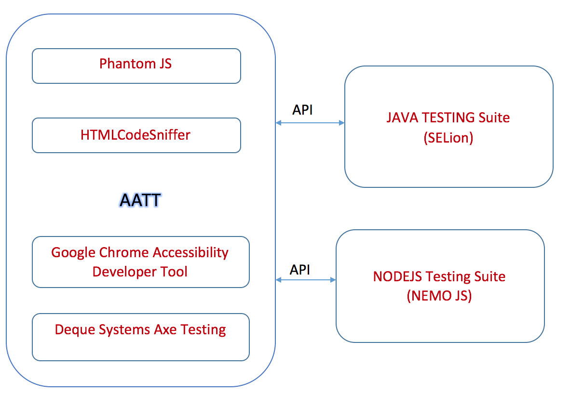
Architecture
Notes:
Recently one of the teams didn’t want to use SeLion or NemoJS, they started on opensource testing framework NightWatch.js. Was able to adapt easily

Slide 13
Customization
Initially there were false positives and unreported errors, so we returned back only errors and left of warning and notice
Rulesets were customized to upgrade some warnings to error and some errors to warnings can customize rules to better capture errors we deemed as must fix to meet our accessibility goals

Slide 14
How to get it running
$ git clone https://github.com/paypal/AATT.git $ cd AATT $ sudo npm install $ git submodule init $ git submodule update $ sudo DEBUG=AATT* http_port=80 node app.js If you want to test this API with NemoJS $ npm install nemo-accessibility $ DEBUG=nemo* node example/usingNemoAccessibility.js

Slide 15
Configuration
"source" to send the HTML source of the page. Can be a whole page or partial page source "priority" to fetch reqults based on issue priorities like P1, P2, Pr or P4. It is a comma-separated value. Eg P1,P2,P3,P4 "ouput" to get the jsonified string. E.g. output=json. If this parameter is not set or left empty, it will return a string with table data that can be parsed or appended directly into your page. "engine" E.g. engine=htmlcs. This is the engine which will scan the code. It accepts a single value of "axe", chrome" or "htmlcs". Default to "htmlcs” "level" This option applies only for the default htmlcs evaluation engine. Options can be either of the following WCAG2AA, WCAG2A, WCAG2AAA, Section508 . Defaults to "WCAG2A"

Slide 16
Advantages
Platform independent
Being a separate plugin, any changes to this plugin is independent of Framework and vice versa
Custom rules
Existing Framework test cases can be used to evaluate for accessibility errors
Screen snaps
In addition to reporting errors, creates screen snaps and snapshot of the html source to help troubleshoot and fix errors found more quickly Offline Reports
Accessibility Reports can also be generated offline on demand, after the build is completed as well. Plug and Play open source engines
Currently 3 open source engines, but can add more…

Slide 17
DEMO
Notes:
Demo of just localhost, then show with screenshots, show login box for password protected urls Demo of DEBUG=nemo* node example/test.js
Demo of dynamic and partial page DEBUG=nemo* node example/dynamicpage.js

Slide 18
Usage Guidelines
Slide Description: Closing Slide
This is the default closing slide for all branded presentations.
Thanks & Contact
PayPal Accessibility on Twitter / @PayPalInclusive Github: http://paypal.github.io/a11y/
This box will not be visible in Slide Show mode or when printed.

