Slide 1
CAPSTONE PROJECT
Presented By:
Shalini B - 2021103575
College Of Engineering, Guindy
Anna University
Department of Computer Science

Slide 2
OUTLINE
Problem Statement
Proposed System/Solution
System Development Approach
Algorithm & Deployment
Result
Conclusion
Future Scope
References

Slide 3
Problem Statement
In the modern digital era, amidst the prevalent cybersecurity landscape, a prominent worry revolves around the rise of keyloggers. These covert software tools are crafted to clandestinely monitor and log keystrokes on a user's device without their awareness. Keyloggers present a significant risk to both individuals and businesses, as they can clandestinely capture sensitive data including passwords, credit card information, and other personal details. This can result in severe consequences such as identity theft, financial harm, and breaches of privacy.

Slide 4
Proposed Solution
The proposed system aims to tackle the challenge of detecting and preventing keylogger threats effectively. This involves implementing advanced detection mechanisms and response strategies to safeguard users' sensitive information. The solution will comprise the following components:
Detection Mechanism:
Utilize sophisticated algorithms for continuous system activity monitoring to detect potential keylogging behavior. Employ machine learning and behavioral analysis to establish normal user behavior and identify deviations indicative of keylogging.
Real-time Alerting and Response:
Integrate a responsive alert system to promptly notify users and administrators upon detecting keylogging activities. Implement secure input handling at the application level, including encrypted keystroke transmission and secure password entry dialogs, to prevent interception of sensitive information.

Slide 5
Proposed Solution
Continuous Monitoring and Updates:
Establish a framework for continuous monitoring and updating of the keylogger detection system to adapt to evolving threats and vulnerabilities.
Deploy regular updates and patches to enhance detection capabilities and address emerging security challenges effectively.
Evaluation:
Assess the system's performance using appropriate metrics such as detection accuracy, false positive rate, and response time.
Conduct thorough testing and validation to ensure the reliability and effectiveness of the keylogger detection system in real-world scenarios.

Slide 6
Proposed Solution
Result
After implementation, the system effectively detected and prevented keylogger threats. Its advanced mechanisms alerted users and administrators promptly, allowing quick response and mitigation. Secure input handling and continuous monitoring ensured adaptability to evolving threats. Evaluation showed high accuracy, minimal false positives, and rapid response times, ensuring strong security in real-world scenarios.

Slide 7
System Approach
System Requirements:
Software Requirements:
Python 3.x environment
tkinter library for GUI development
pynput library for capturing keyboard events
Hardware Requirements:
Standard computer or laptop with compatible operating system (Windows, macOS, Linux)
Library Required:
tkinter: Used for GUI development to create the application's user interface.
pynput: Required for capturing keyboard events and implementing keylogging functionality.

Slide 8
Algorithm & Deployment
Algorithm Selection:
Chosen Algorithm: Keystroke Logging.
Justification: Keystroke logging is employed to capture and record keyboard events in real-time, aligning with the project's objective of developing a keylogger application.
Data Input:
Input Features: Keyboard events, including key presses, releases, and holds, are captured and logged by the keylogger application.

Slide 9
Algorithm & Deployment
Training Process:
Training Data: No training process is required for the keylogger application, as it operates based on capturing keyboard events in real-time.
Prediction Process:
Prediction Method: The keylogger application continuously monitors keyboard activities and logs them in real-time, providing insights into user input behavior and patterns
Real-Time Inputs: The keylogger application captures keyboard events as they occur, enabling real-time monitoring and logging of user keystrokes.
By leveraging keystroke logging technology, the keylogger application effectively captures and logs keyboard events, providing valuable insights into user input behavior and enhancing security monitoring capabilities.

Slide 10
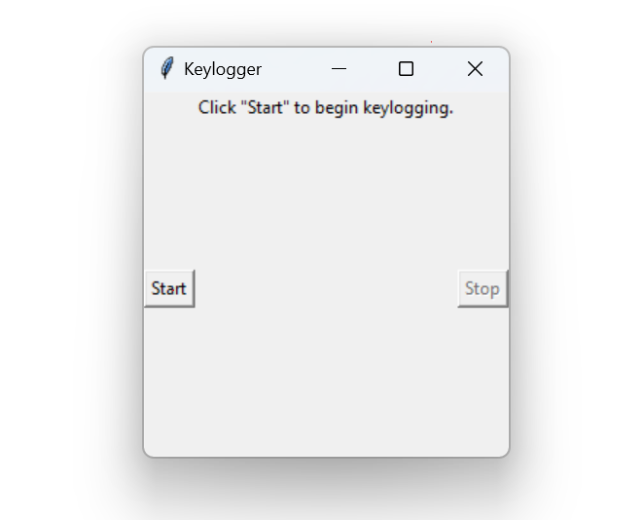
Result
The keylogger application successfully captures and logs keyboard events in real-time, providing insights into user input behavior and patterns.

Slide 11
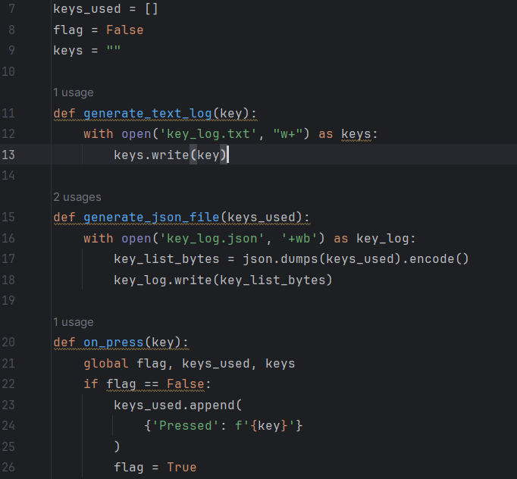
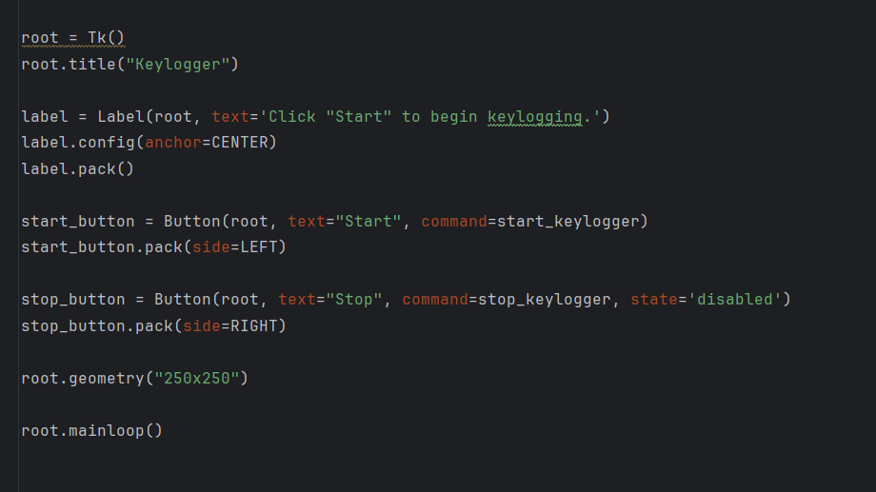
code

Slide 12
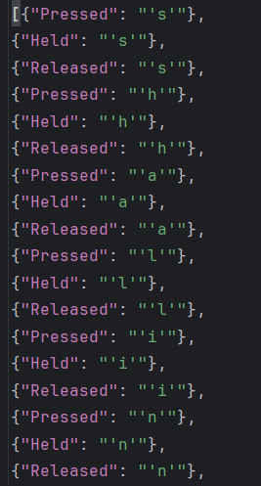
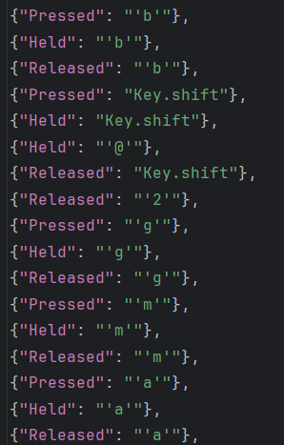
Key_log json file

Slide 13
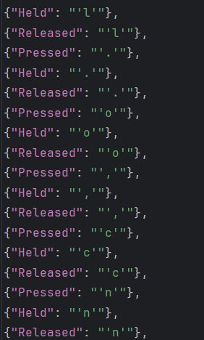
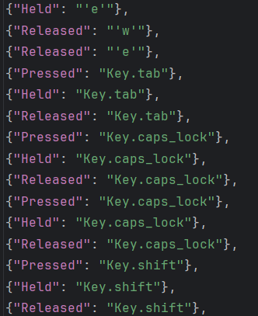

Slide 14

Key_log file

Slide 15
Conclusion
Key Points:
The keylogger application captures and logs keyboard events in real-time, bolstering security monitoring efforts.
Real-time monitoring facilitates prompt detection of suspicious keystrokes, enhancing cybersecurity measures.
Challenges Faced:
Ensuring compatibility across different operating systems.
Addressing privacy concerns associated with keystroke logging.
Potential Improvements:
Enhance logging features with timestamping and event categorization.
Implement robust privacy measures to safeguard user information.
In conclusion, while the keylogger application offers valuable security monitoring capabilities, addressing compatibility and privacy concerns, along with implementing necessary enhancements, are crucial for its effectiveness in the long term.

Slide 16
FUTURE SCOPE
Potential Enhancements:
Integration of additional data sources: Explore incorporating data from diverse sources such as network activity, application usage, or biometric data for comprehensive monitoring.
Algorithm optimization: Fine-tune the keylogger algorithm for better performance and efficiency, considering factors like resource utilization and detection accuracy.
Expansion to cover multiple platforms: Extend the keylogger application's compatibility to cover a wide range of operating systems and devices, ensuring comprehensive security monitoring.
Integration of emerging technologies: Explore the integration of emerging technologies like edge computing or advanced machine learning techniques for enhanced threat detection and analysis.
By pursuing these potential enhancements and expansions, the keylogger application can evolve into a robust and versatile security monitoring solution, capable of addressing evolving cybersecurity challenges effectively.

Slide 17
References
Brownlee, Jason. "How to Develop a Keylogger in Python." Machine Learning Mastery, 2020. [Online]. Available:.https://machinelearningmastery.com/how-to-develop-a-keylogger-in-python/
McKinney, Wes. "Python for Data Analysis." O'Reilly Media, 2017.
Pedregosa, F. et al. "Scikit-learn: Machine Learning in Python." Journal of Machine Learning Research, vol. 12, pp. 2825-2830, 2011.
Van Rossum, Guido, and Drake, Fred L. "Python 3 Reference Manual." CreateSpace, 2009.

Slide 18
THANK YOU

