Slide 1
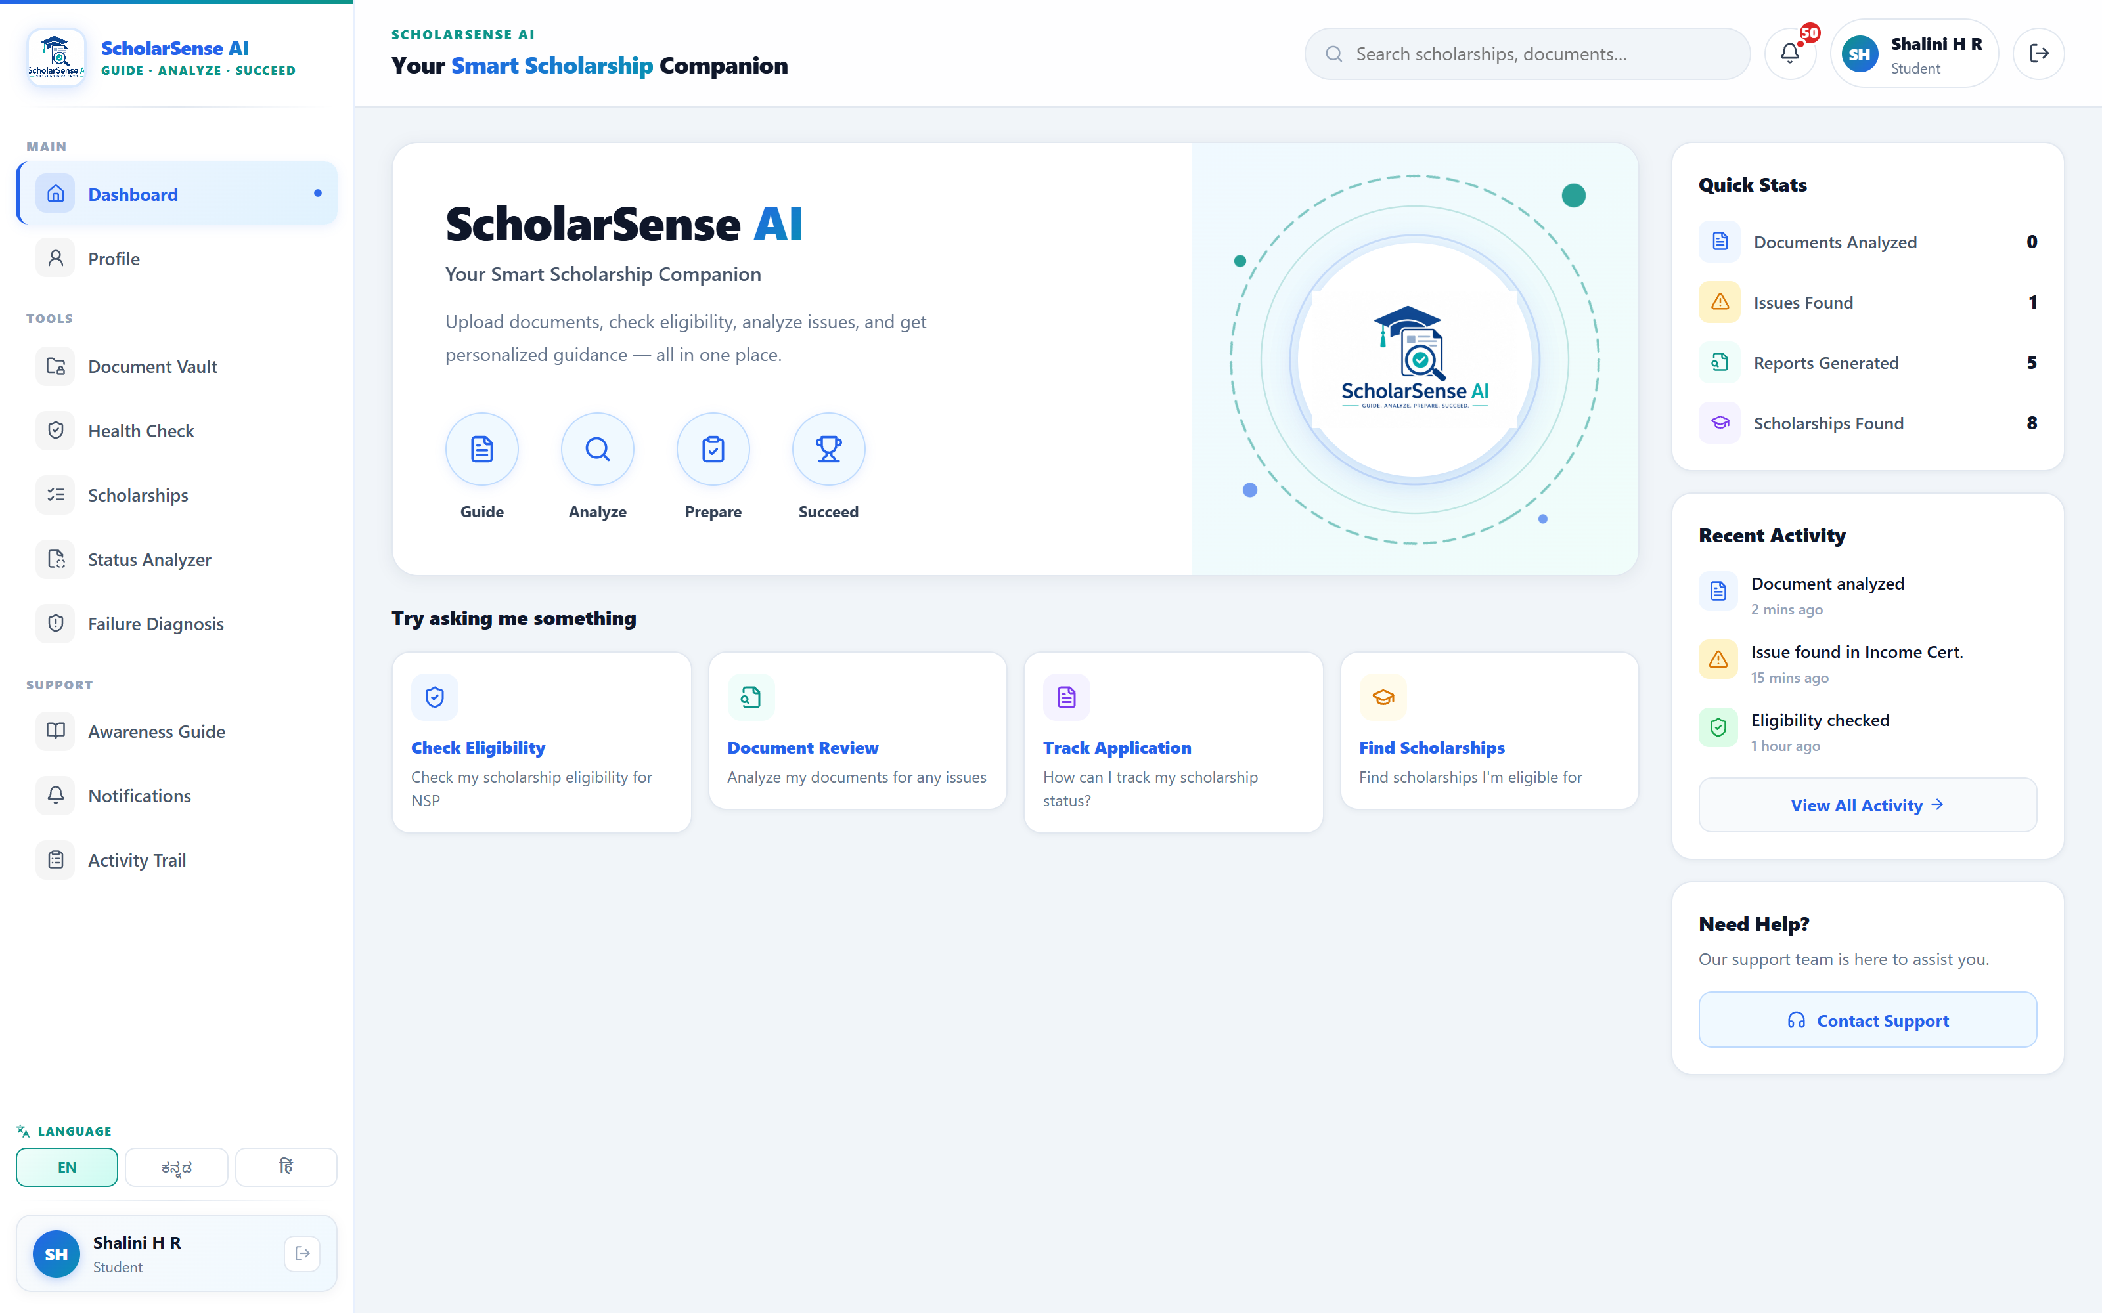
GUIDE · ANALYZE · PREPARE · SUCCEED
ScholarSense AI
OCR-Driven Scholarship Intelligence &
Decision Support System
For eligible Indian students applying through NSP & Karnataka SSP
Live product — profile-driven dashboard
Presented by Shalini H R | MCA, GM University
Guide: Mr. Varun K S Academic Year 2026 – 27

Slide 2
THE PROBLEM
Why eligible students still lose scholarship money
1
Eligibility is invisible
Students don't know which of 100+ NSP & SSP schemes they actually qualify for.
60%+
2
Deadlines slip
Application and yearly renewal windows are missed — the scholarship simply lapses.
of scholarship payment failures come from wrong bank details or DBT not being enabled.
3
Payment fails at PFMS / DBT
Aadhaar not seeded to the bank, DBT not enabled, or Aadhaar name ≠ bank name.
4
Documents get rejected
5 avoidable failure modes → one lost academic year.
Expired income certificate, or name / date-of-birth mismatch across papers.
5
Portal statuses are unreadable
“Defective”, “Sent to PFMS”, “Institute Verification Pending” — with no explanation.

Slide 3
THE SOLUTION
One companion for the whole journey
Guide → Analyze → Prepare → Succeed
Eligibility Engine
Document Vault + OCR
Health Check
Readiness Score
Failure Diagnosis
Status Analyzer
Profile-driven dashboard — one place to guide, analyze, prepare and succeed.
WhatsApp Alerts
AI Chatbot

Slide 4
SYSTEM DESIGN
System architecture
FRONTEND
React 18 · Vite · React Router · i18next (EN / ಕನ್ನಡ / हिंदी) · Recharts
▼
API LAYER
Node.js + Express REST · JWT authentication · Multer file uploads
▼
CORE SERVICES
Eligibility Engine · OCR Cross-Validation · Readiness & Diagnosis · Notifications + Cron Scheduler
▼
DATA
MongoDB (Mongoose) ⇄ Local JSON store — atomic writes, offline-capable
▼
EXTERNAL
OCR.space · Groq LLM (gpt-oss-120b) · Puppeteer scraper · Nodemailer · UltraMsg WhatsApp
MERN-style, ESM · runs fully offline with local JSON fallback — no cloud dependency for the demo.

Slide 5
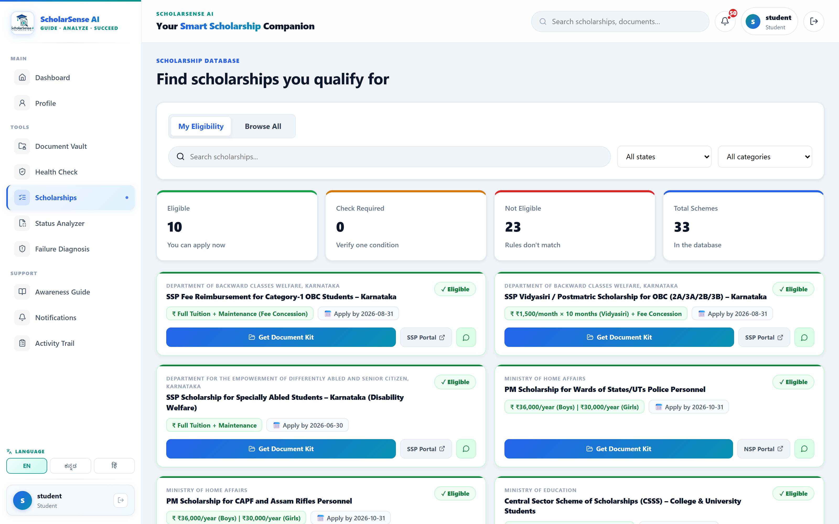
KEY FEATURE 1
Eligibility engine + document cross-validation
Rule-based matching
Income limits, category & sub-category (SC / ST / OBC-2A), minimum marks, course level, state and gender — a missing field returns “Check”, never a false reject.
OCR field extraction
Name, DOB, IFSC, account number, income and category pulled from Aadhaar, bank passbook, income certificate and marksheet.
Cross-checks that prevent rejection
Aadhaar ↔ bank name match · DOB consistency · income-certificate expiry · missing IFSC detection.
10 matched from 33 real NSP + Karnataka SSP schemes for this profile.

Slide 6
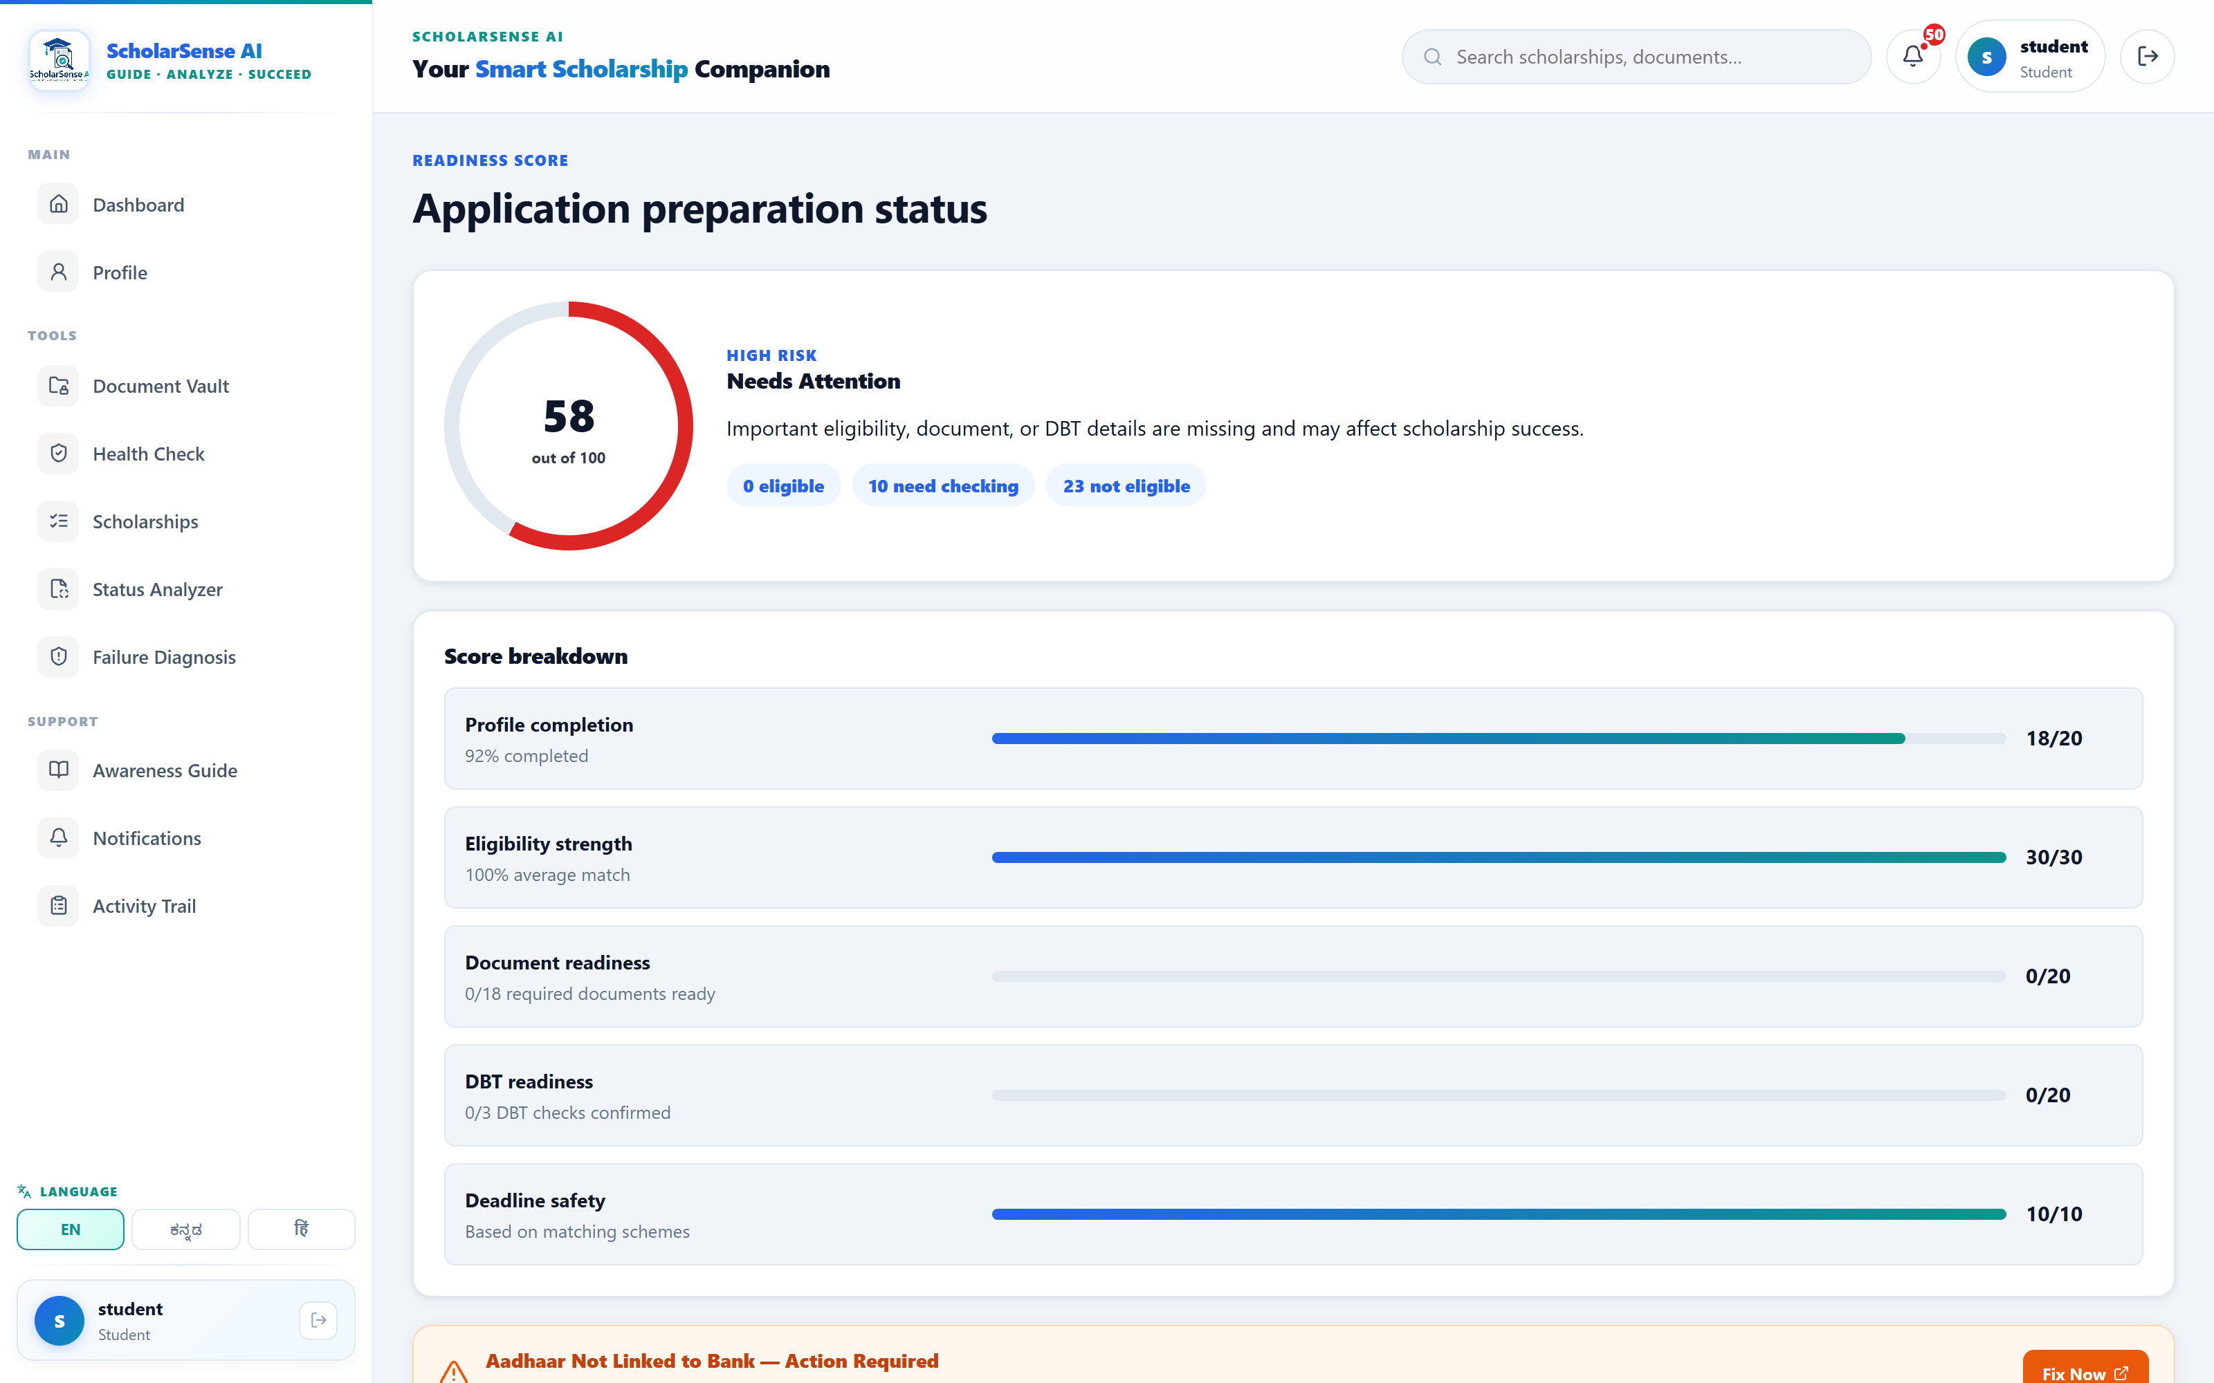
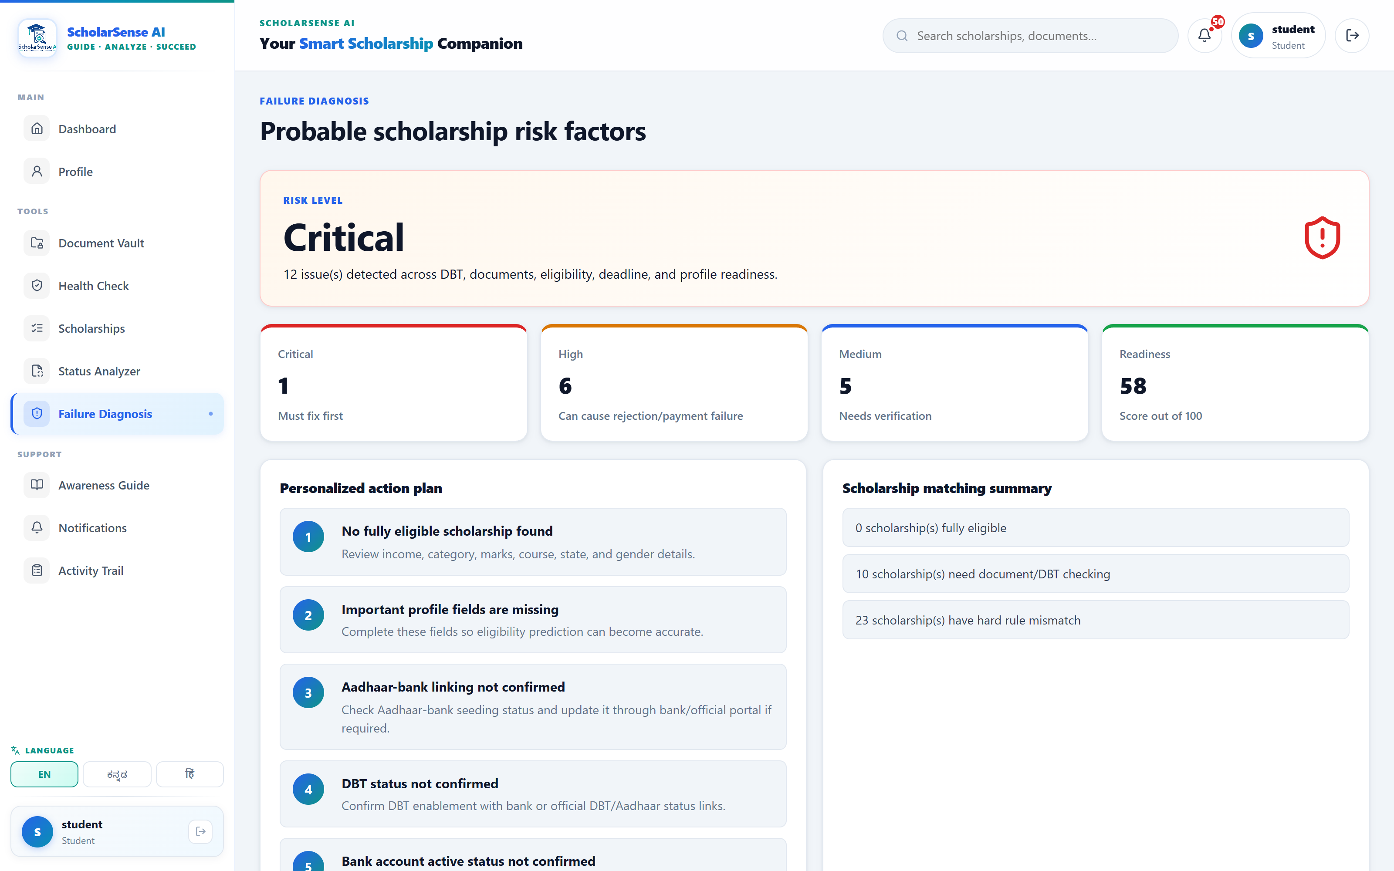
KEY FEATURE 2
From a score to a personalized action plan
Readiness Score
Failure Diagnosis
Health Check
5 dimensions: Profile · Eligibility · Documents · DBT · Deadline.
Issues ranked Critical / High / Medium, each with a concrete fix.
“Will my application be rejected?” with per-document status.

Slide 7
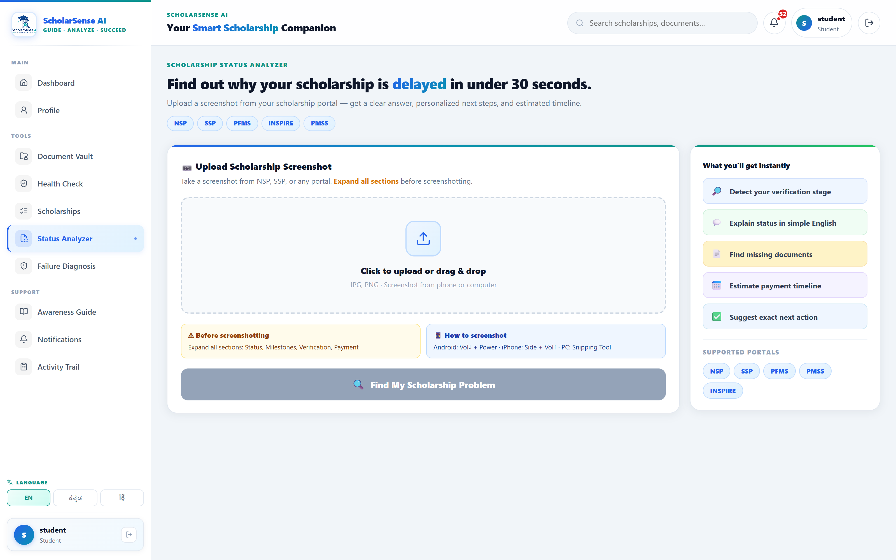
KEY FEATURE 3
Understand your status — ask in your language
S
ScholarSense AI
● Online · answers from your profile
“Yes — you meet the academic (≥75%), income (≤₹2.5L) and category criteria for NSP central + Karnataka SSP post-matric schemes. → Do this now: complete the SSP application and confirm your Aadhaar–bank seeding.”
English
ಕನ್ನಡ
हिंदी
Actual chatbot reply · grounded in the student's saved profile · Groq LLM (gpt-oss-120b).
Upload an NSP / SSP / PFMS / INSPIRE / PMSS screenshot → stage, plain-English meaning, next action, payment timeline.

Slide 8
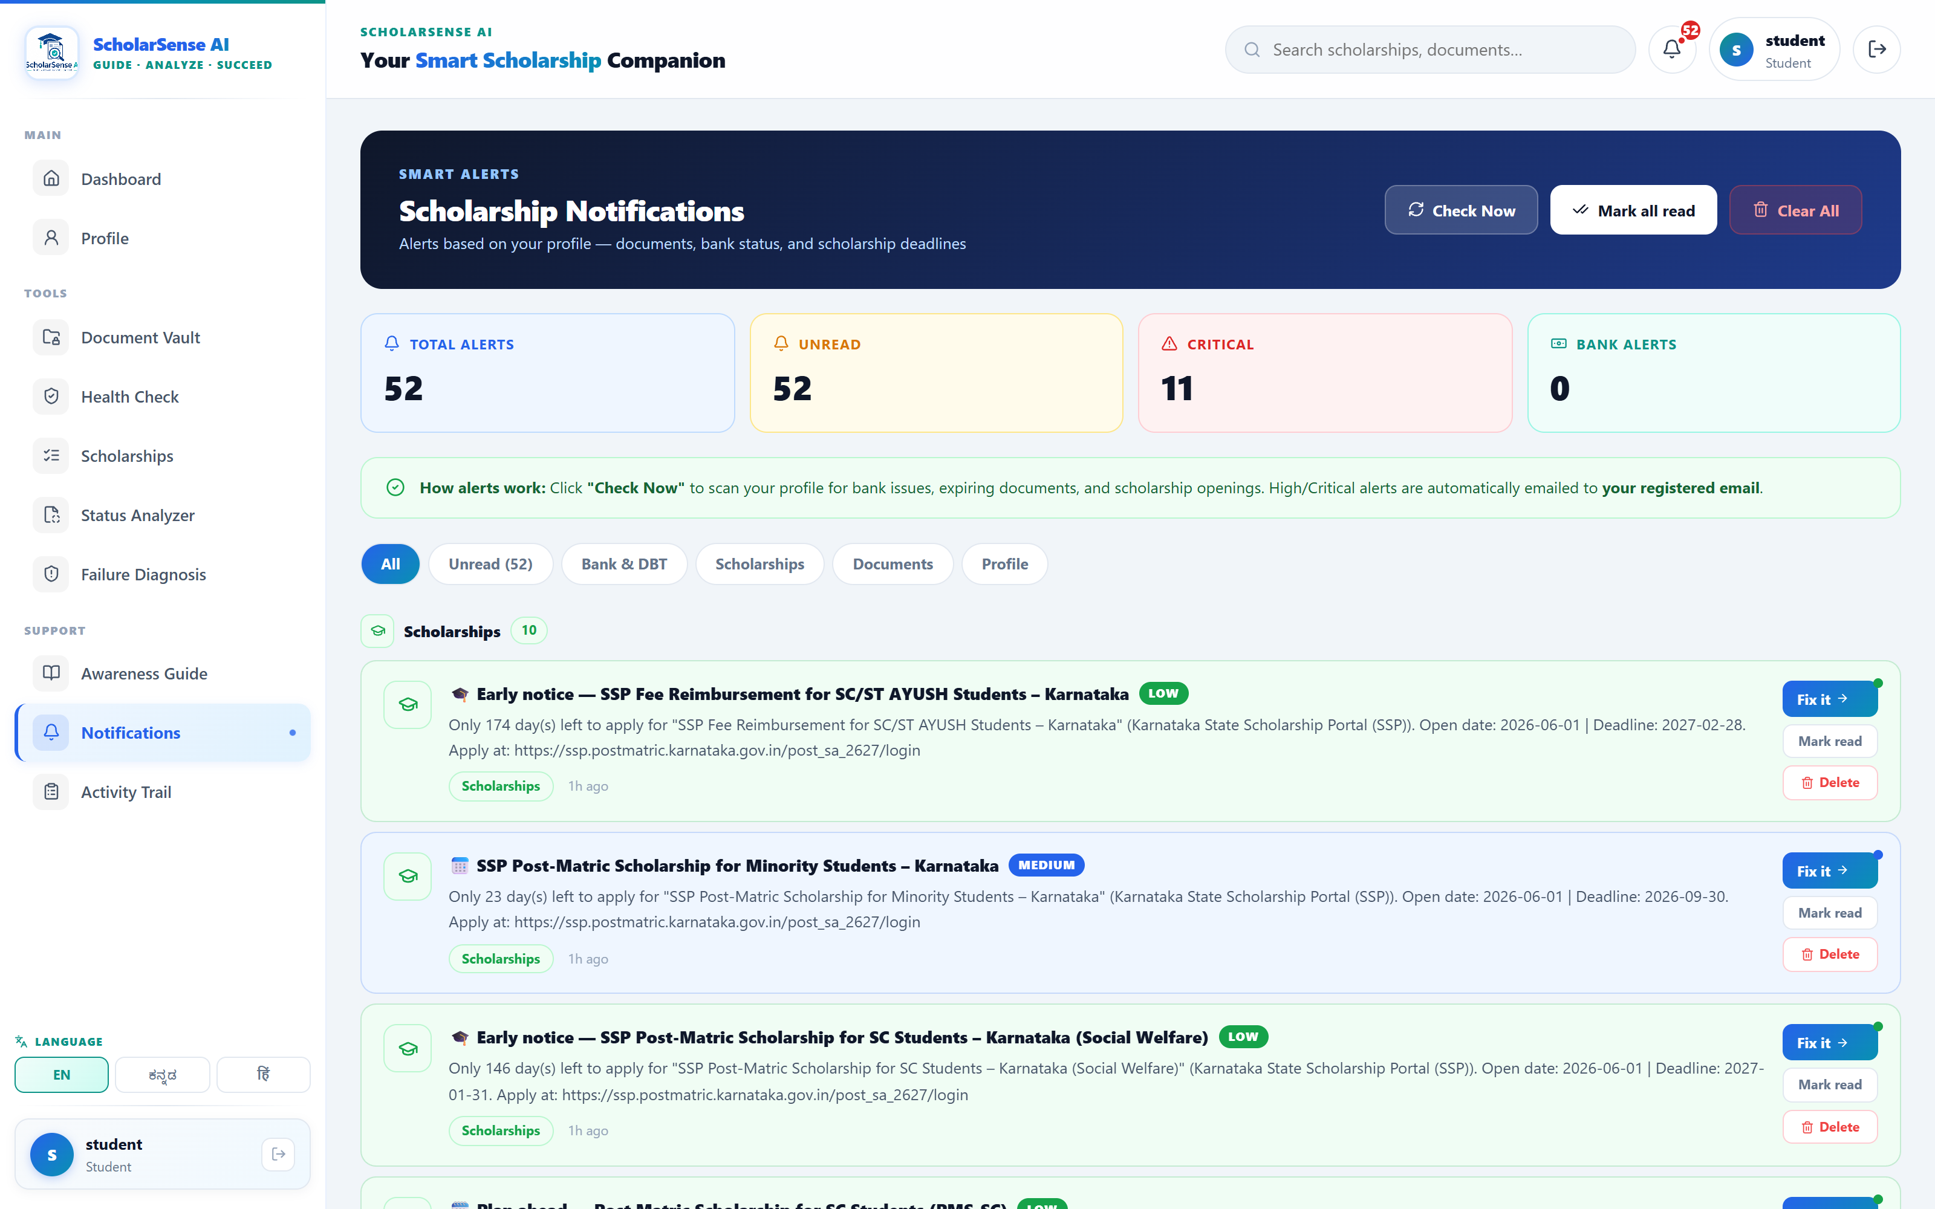
IMPACT & RESULTS
A working system — not a mock-up
33
13
5
3
schemes modelled
REST API modules
failure modes addressed
languages supported
Working today
Live eligibility matching — 10 eligible of 33 for the demo profile
OCR field extraction + cross-document validation
Scheduled deadline monitor — runs daily at 6 AM IST
Kannada WhatsApp alerts sent to the parent / guardian
Atomic JSON store — corruption-safe offline mode
Impact: a multi-portal, jargon-heavy process becomes one guided, vernacular, proactive flow — aimed at the exact points where students lose money.
Smart Alerts — profile-driven, high-priority alerts auto-emailed.

Slide 9
CONCLUSION
FUTURE SCOPE
A working decision-support
system for scholarship
applicants
Live NSP / SSP deadline synchronization
WhatsApp-first onboarding for low-literacy users
Wider scheme coverage with yearly rule updates
Distribution via colleges, NGOs and nodal officers
Real PFMS payment-status integration
Targets the 5 avoidable failure modes end-to-end
Profile-driven, vernacular and proactive by design
Runs today — offline-capable, with real scheme data
Thank You
Shalini H R · shalinidvg16@gmail.com

