Slide 1
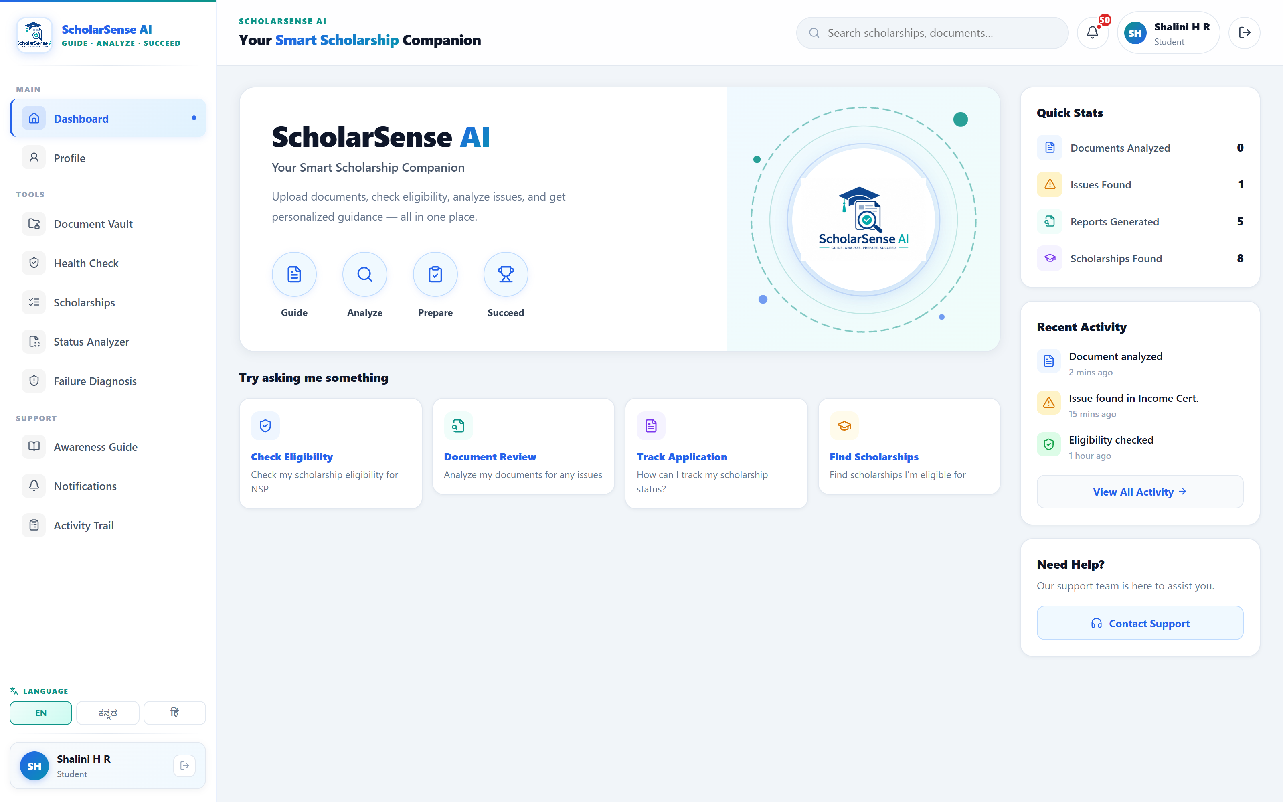
GUIDE · ANALYZE · PREPARE · SUCCEED
ScholarSense AI
OCR-Driven Scholarship Intelligence &
Decision Support System
For eligible Indian students applying through NSP & Karnataka SSP
Live product — profile-driven dashboard
Presented by Shalini H R | MCA, GM University
Guide: ____________________ Academic Year 2026 – 27
01 / 14

Slide 2
INTRODUCTION
The problem: eligible students still lose scholarship money
1
Eligibility is invisible
Students can't tell which of 100+ NSP & SSP schemes they qualify for.
60%+
2
Deadlines slip
Application and yearly renewal windows are missed — the scholarship lapses.
of scholarship payment failures come from wrong bank details or DBT not being enabled.
3
Payment fails at PFMS / DBT
Aadhaar not seeded to the bank, DBT off, or Aadhaar name ≠ bank name.
4
Documents get rejected
Expired income certificate, or name / date-of-birth mismatch across papers.
5 avoidable failure modes → one lost academic year.
5
Portal statuses are unreadable
“Defective”, “Sent to PFMS” — with no explanation of what to do.
02 / 14

Slide 3
OBJECTIVES
What the system sets out to do
Match a student to NSP & Karnataka SSP scholarships with a rule-based eligibility engine.
Extract and cross-validate documents (Aadhaar, passbook, income certificate, marksheet) via OCR.
Detect the failure modes that cause rejection — document mismatch, expired certificate, DBT gaps.
Decode multi-portal status codes (NSP / SSP / PFMS / INSPIRE / PMSS) into plain-language steps.
Deliver personalized, vernacular guidance in English, Kannada and Hindi.
Give one readiness score and a prioritized action plan before the student applies.
Scope: assistive decision support for the applicant — the system guides and validates; it does not submit on the official portals.
03 / 14

Slide 4
LITERATURE SURVEY
Existing systems & the gap they leave
Capability | NSP / SSP portals | Aggregator apps | Manual agents | ScholarSense AI
Automatic eligibility check | ✗ | partial | manual | ✓
OCR document validation | ✗ | ✗ | ✗ | ✓
Cross-document consistency (name / DOB / IFSC) | ✗ | ✗ | manual | ✓
Portal status explained in plain language | ✗ | ✗ | verbal | ✓
DBT / Aadhaar-seeding guidance | ✗ | ✗ | varies | ✓
Vernacular (Kannada / Hindi) | partial | partial | ✓ | ✓
Proactive deadline & risk alerts | ✗ | list only | ✗ | ✓
Gap: no existing tool combines eligibility matching, OCR validation and portal-status decoding for the applicant in one vernacular flow.
04 / 14

Slide 5
PROPOSED SYSTEM
One companion for the whole journey
Guide → Analyze → Prepare → Succeed
Eligibility Engine
Document Vault + OCR
Health Check
Readiness Score
Failure Diagnosis
Status Analyzer
Profile-driven dashboard — one place to guide, analyze, prepare and succeed.
WhatsApp Alerts
AI Chatbot
05 / 14

Slide 6
SYSTEM DESIGN
System architecture
FRONTEND
React 18 · Vite · React Router · i18next (EN / ಕನ್ನಡ / हिंदी) · Recharts
▼
API LAYER
Node.js + Express REST · JWT authentication · Multer file uploads
▼
CORE SERVICES
Eligibility Engine · OCR Cross-Validation · Readiness & Diagnosis · Notifications + Scheduler
▼
DATA
MongoDB (Mongoose) ⇄ Local JSON store — atomic writes, offline-capable
▼
EXTERNAL
OCR.space · Groq LLM (gpt-oss-120b) · Puppeteer scraper · Nodemailer · UltraMsg WhatsApp
MERN-style, ESM · runs fully offline with local JSON fallback — no cloud dependency for the demo.
06 / 14

Slide 7
METHODOLOGY
Modules & processing pipeline
Student profile
›
Eligibility
›
Document OCR
›
Cross-validation
›
Readiness
›
Diagnosis
›
Email + WhatsApp alerts
Failure Diagnosis Engine
Status Analyzer (NSP / SSP / PFMS / INSPIRE / PMSS)
Notifications + Deadline Scheduler (node-cron)
Multilingual AI Chatbot (profile-grounded)
Authentication & Student Profile
Scholarship Eligibility Engine (rule-based + ML-assisted)
Document Vault + OCR extraction
Health Check — cross-document validation
Readiness Score (5 dimensions)
Failure Diagnosis Engine
Status Analyzer (NSP / SSP / PFMS / INSPIRE / PMSS)
Notifications + Deadline Scheduler (node-cron)
Multilingual AI Chatbot (profile-grounded)
Development model: Agile / incremental · REST API contract · component-wise unit testing · local-JSON fallback for offline builds.
07 / 14

Slide 8
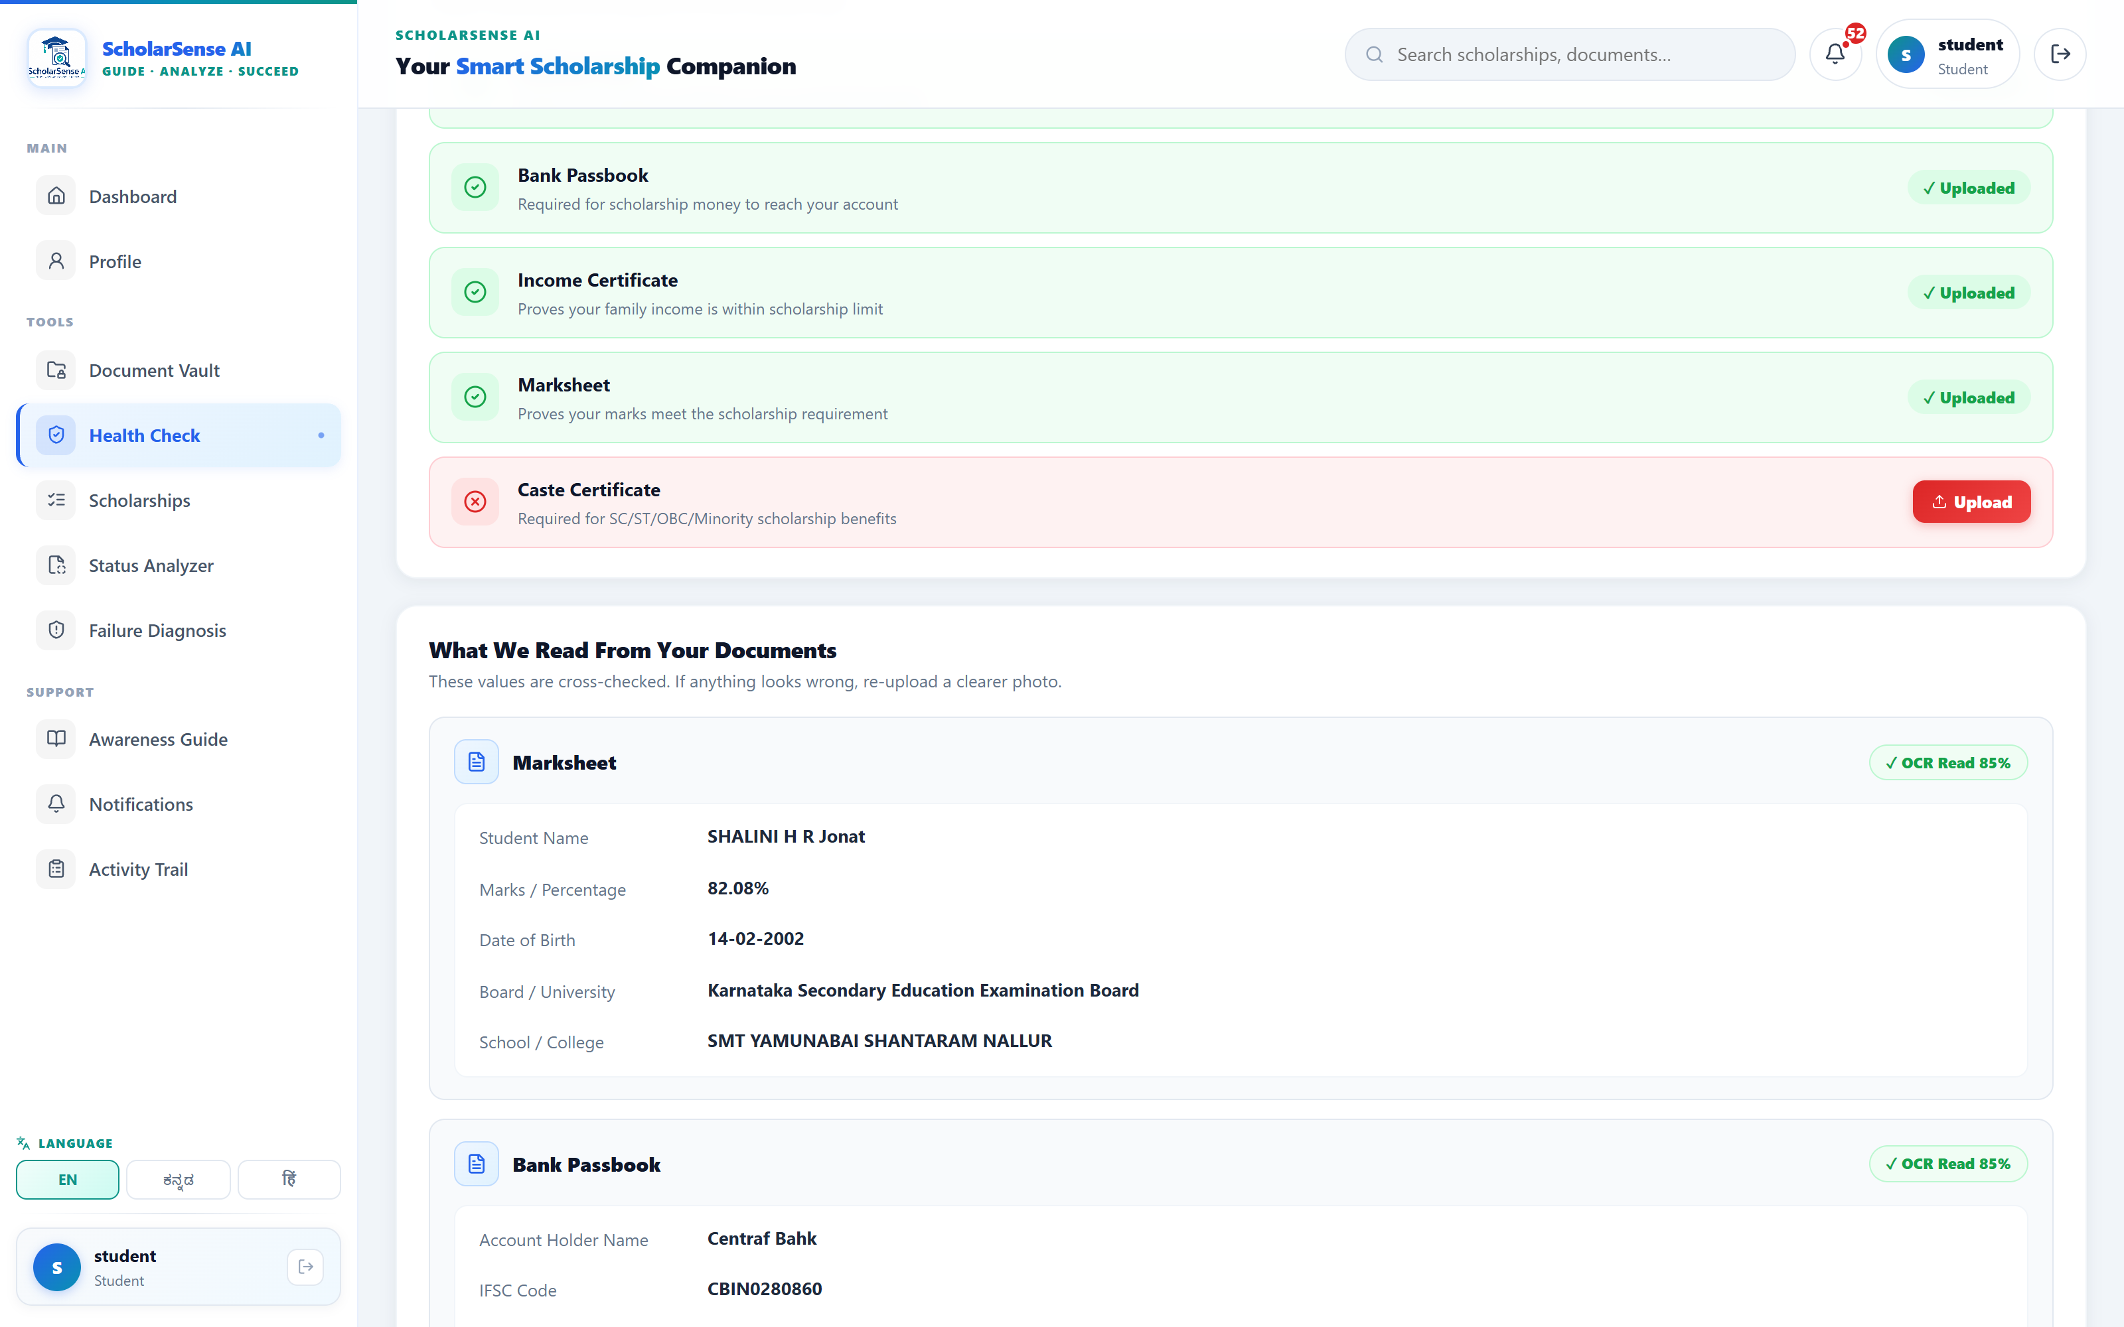
MODULE 1
Eligibility engine + OCR document validation
Rule-based matching
Income limits, category & sub-category (SC / ST / OBC-2A), marks, course level, state, gender — a missing field returns “Check”, never a false reject.
OCR field extraction
Name, DOB, IFSC, account number, income and board pulled from Aadhaar, passbook, income certificate and marksheet (~85% confidence).
Aadhaar ↔ bank name match · DOB consistency · income-certificate expiry · missing IFSC.
Cross-checks that prevent rejection
Live output — extracted fields are cross-checked; the demo profile is flagged “Income Certificate Expired — issued 01/01/2021, will cause rejection.”
08 / 14

Slide 9
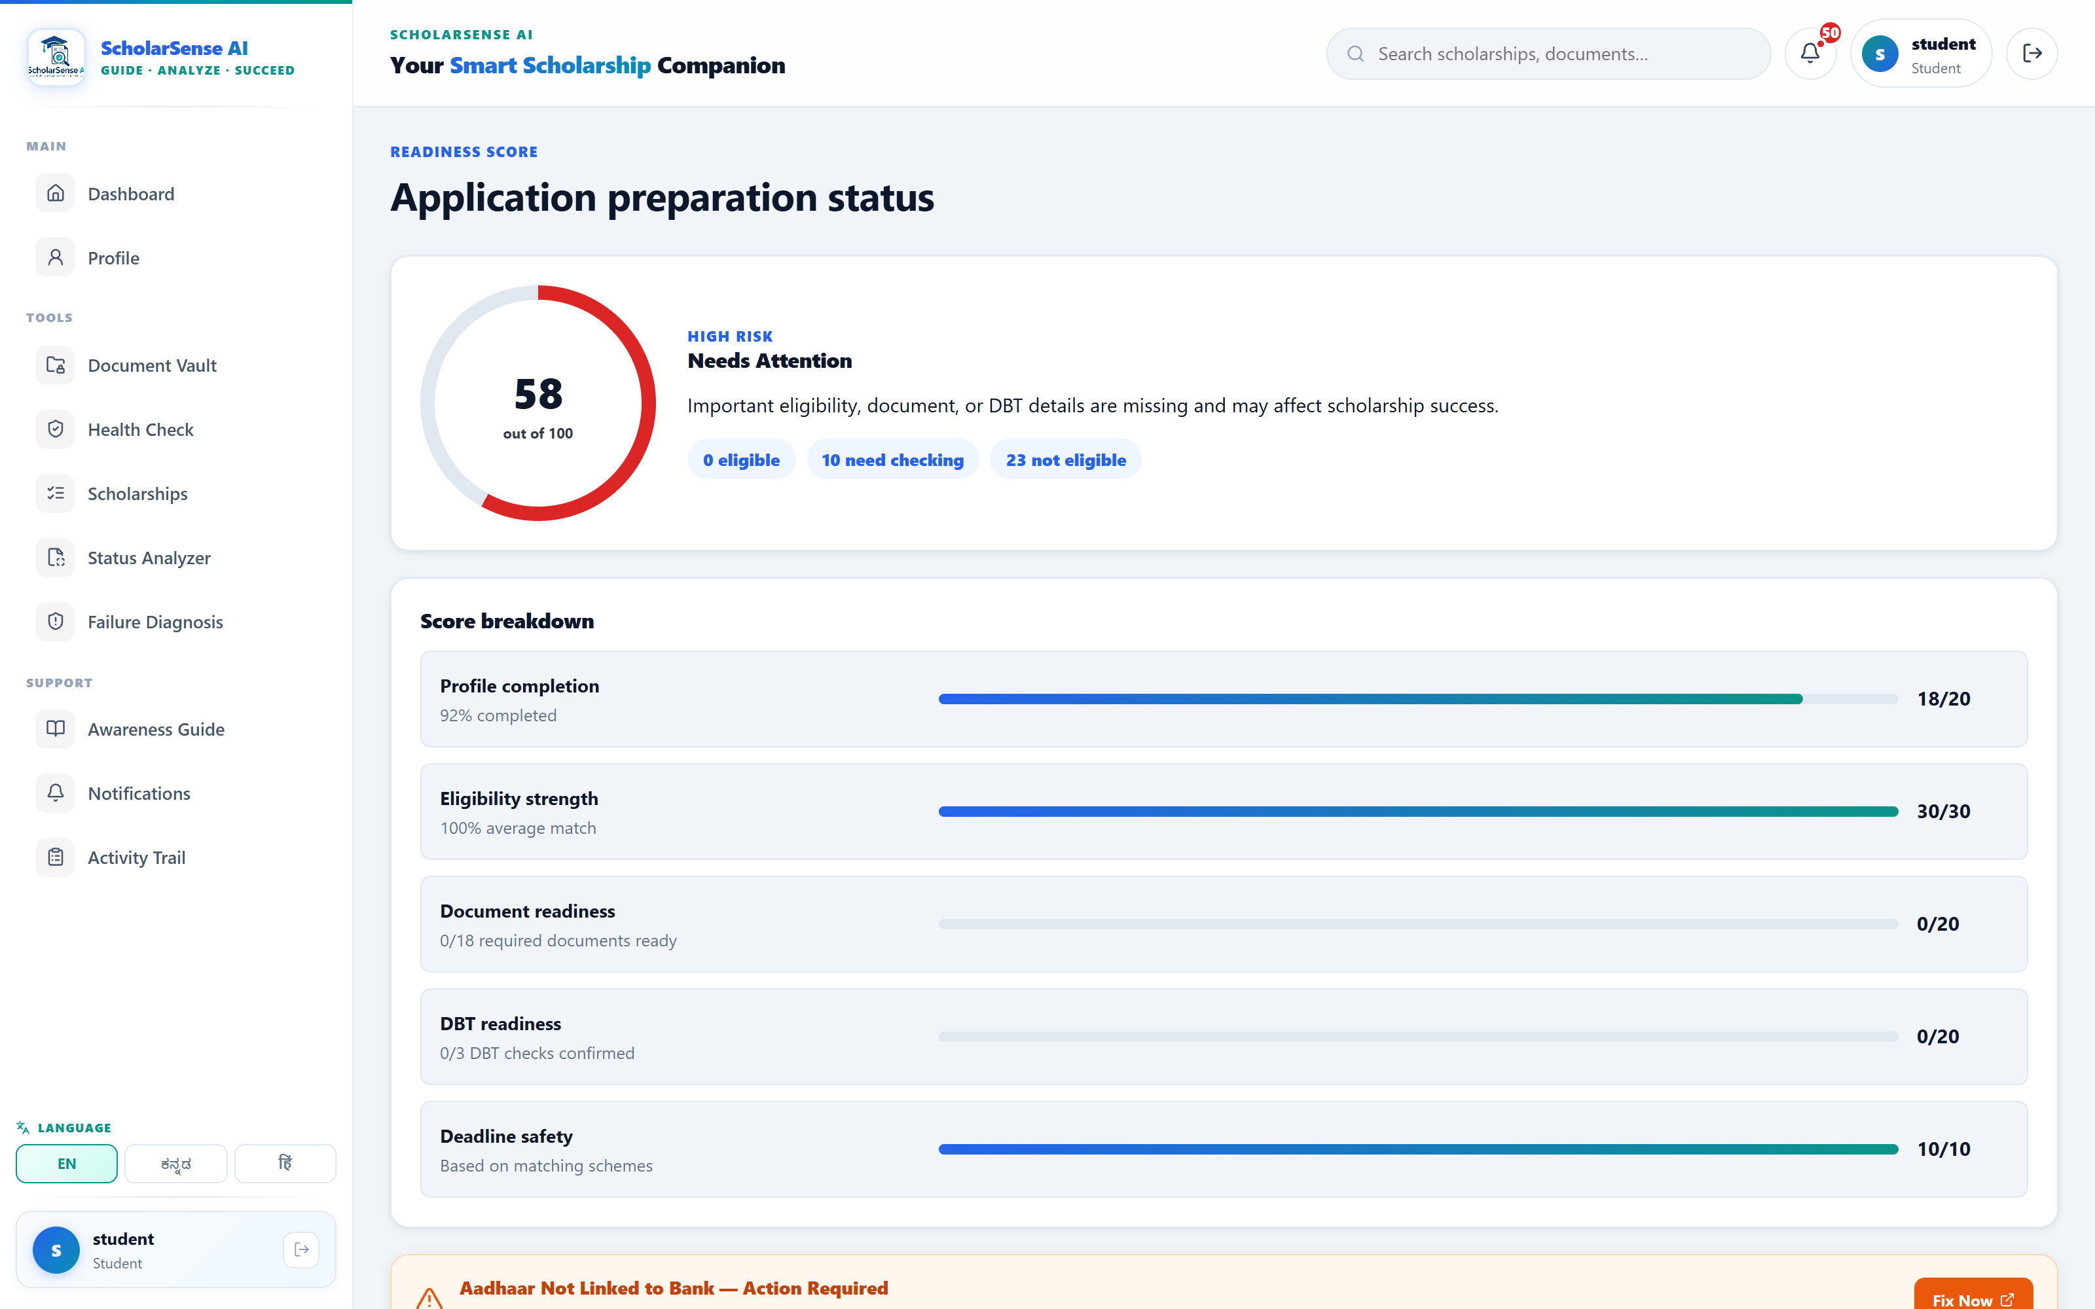
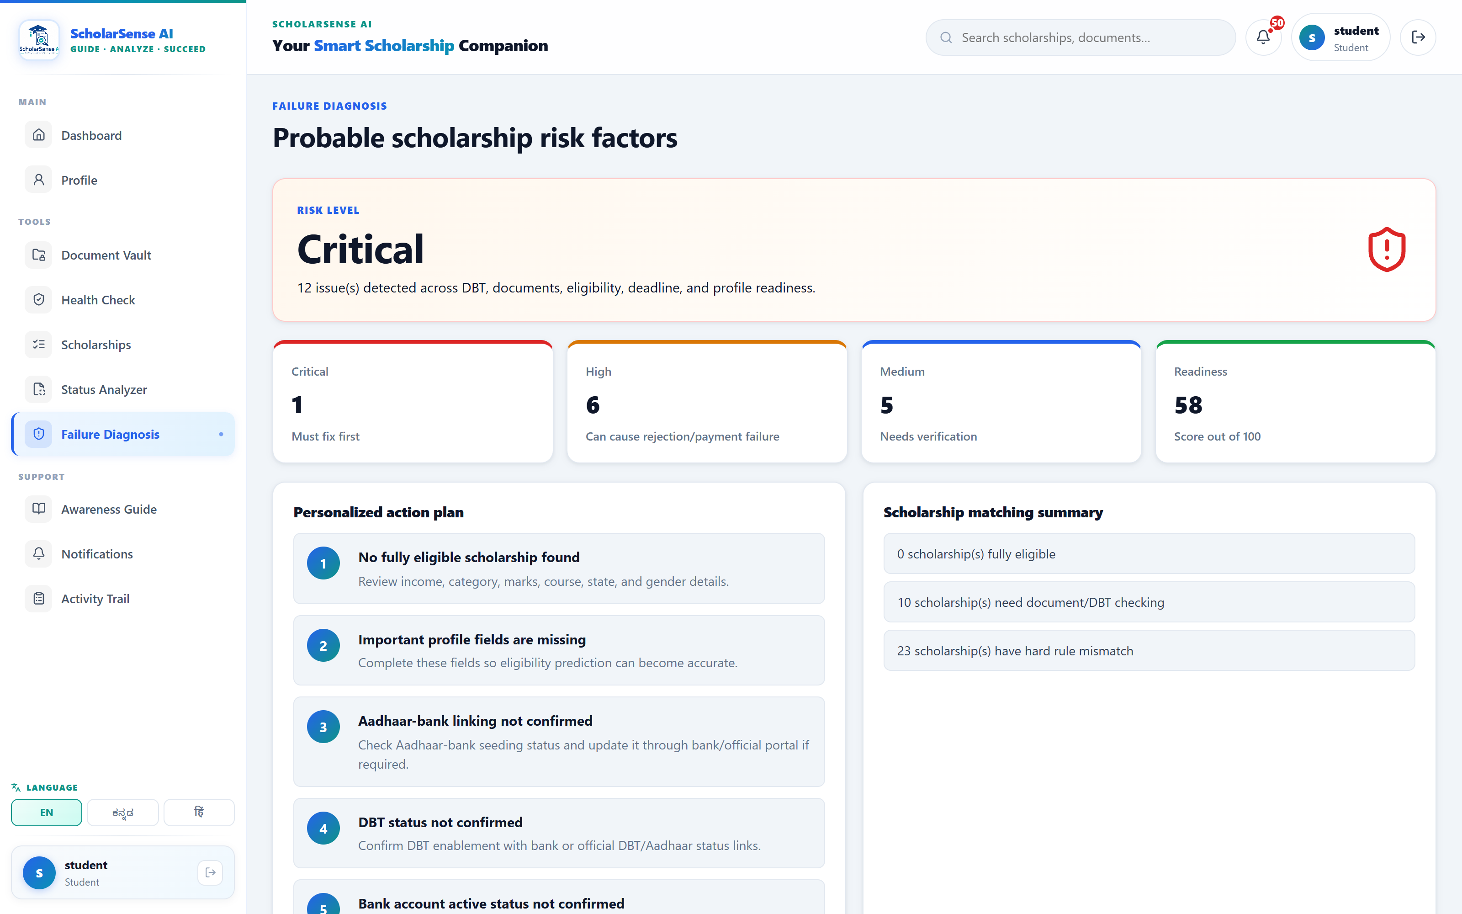
MODULE 2
From a score to a personalized action plan
Readiness Score
Failure Diagnosis
Status Analyzer
Profile · Eligibility · Documents · DBT · Deadline.
Issues ranked Critical / High / Medium, each with a fix.
Upload a portal screenshot → stage, meaning, next action, timeline.
09 / 14

Slide 10
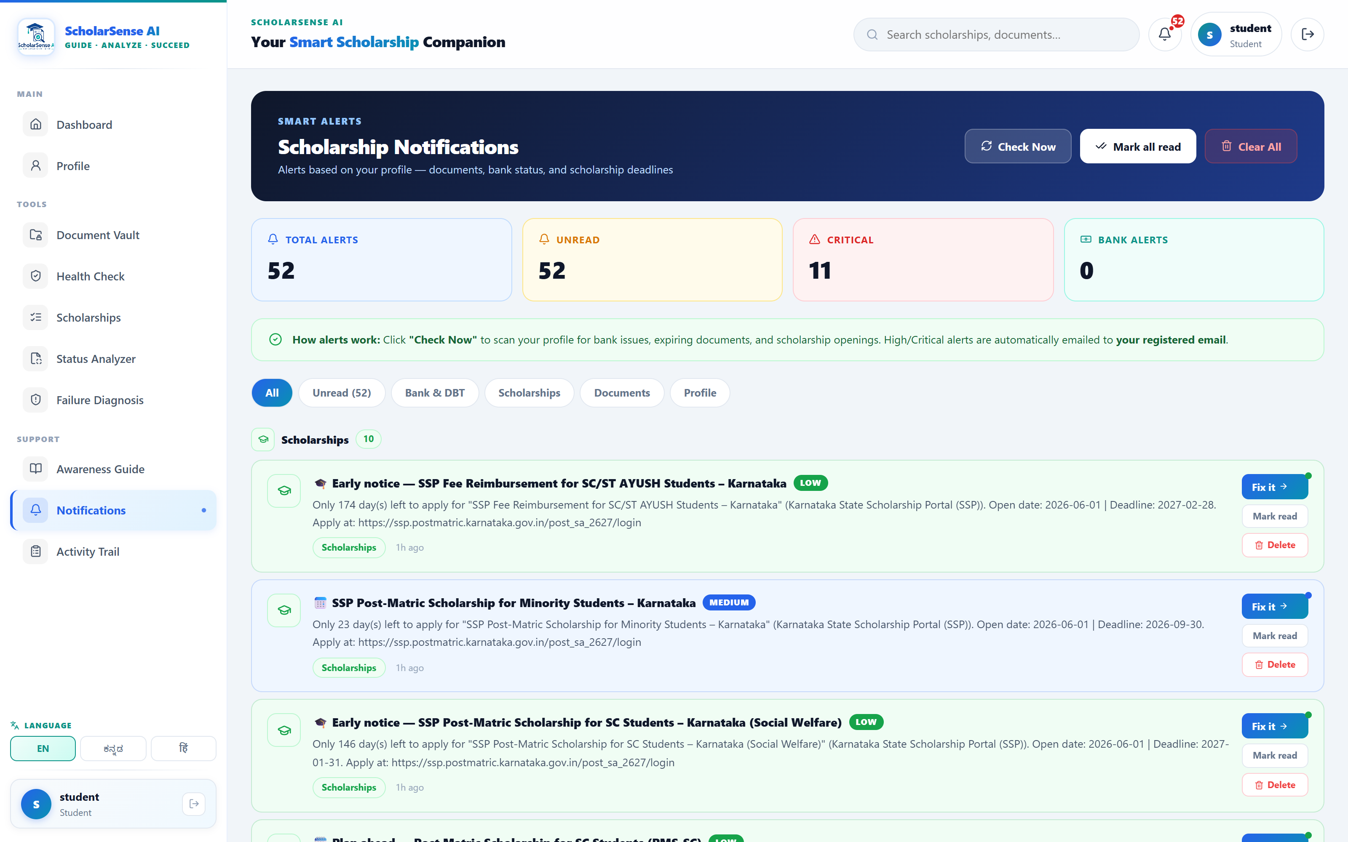
MODULE 3
Multilingual AI chatbot & smart notifications
S
ScholarSense AI
● Online · answers from your profile
“Yes — you meet the academic (≥75%), income (≤₹2.5L) and category criteria for NSP central + Karnataka SSP post-matric schemes. → Do this now: complete the SSP application and confirm your Aadhaar–bank seeding.”
English
ಕನ್ನಡ
हिंदी
Actual reply · grounded in the student's saved profile · Groq LLM (gpt-oss-120b).
Smart Alerts — profile-driven; high-priority alerts auto-emailed and sent to the parent's WhatsApp in Kannada.
10 / 14

Slide 11
REQUIREMENTS
Hardware & software requirements
Processor — Intel i3 / equivalent or higher
RAM — 4 GB minimum (8 GB recommended)
Storage — 500 MB free disk space
Network — internet for OCR / LLM / WhatsApp APIs
Client — any laptop or Android phone with a browser
OS — Windows 10/11, Linux or macOS
Runtime — Node.js 18+, npm
Database — MongoDB 6+ (optional; local JSON fallback)
Frontend — React 18, Vite 5, React Router, i18next
Backend — Express 4, Mongoose 8, JWT, Multer, node-cron
APIs — OCR.space, Groq LLM, UltraMsg WhatsApp, Nodemailer
Hardware
Software
11 / 14

Slide 12
TESTING
Functional test cases
Module | Test case | Expected result | Result
Auth | Register + login with valid credentials | JWT issued, student profile auto-created | Pass
Eligibility Engine | OBC-2A profile, ₹60,000 income, 83% | Karnataka SSP OBC schemes = “Eligible” | Pass
Document Vault / OCR | Upload marksheet image | Name, %, DOB, board extracted (~85%) | Pass
Health Check | Income certificate issued in 2021 | Flagged “Expired — will cause rejection” | Pass
Status Analyzer | Upload “Sent to PFMS” screenshot | Stage detected + next action returned | Pass
AI Chatbot | Query typed in Kannada | Reply returned in Kannada script | Pass
Notifications | Save profile with an eligible scheme | Alert created; WhatsApp message queued | Pass
Approach — manual functional testing, REST API testing, and a concurrent-write stress test on the local JSON store (atomic writes verified).
12 / 14

Slide 13
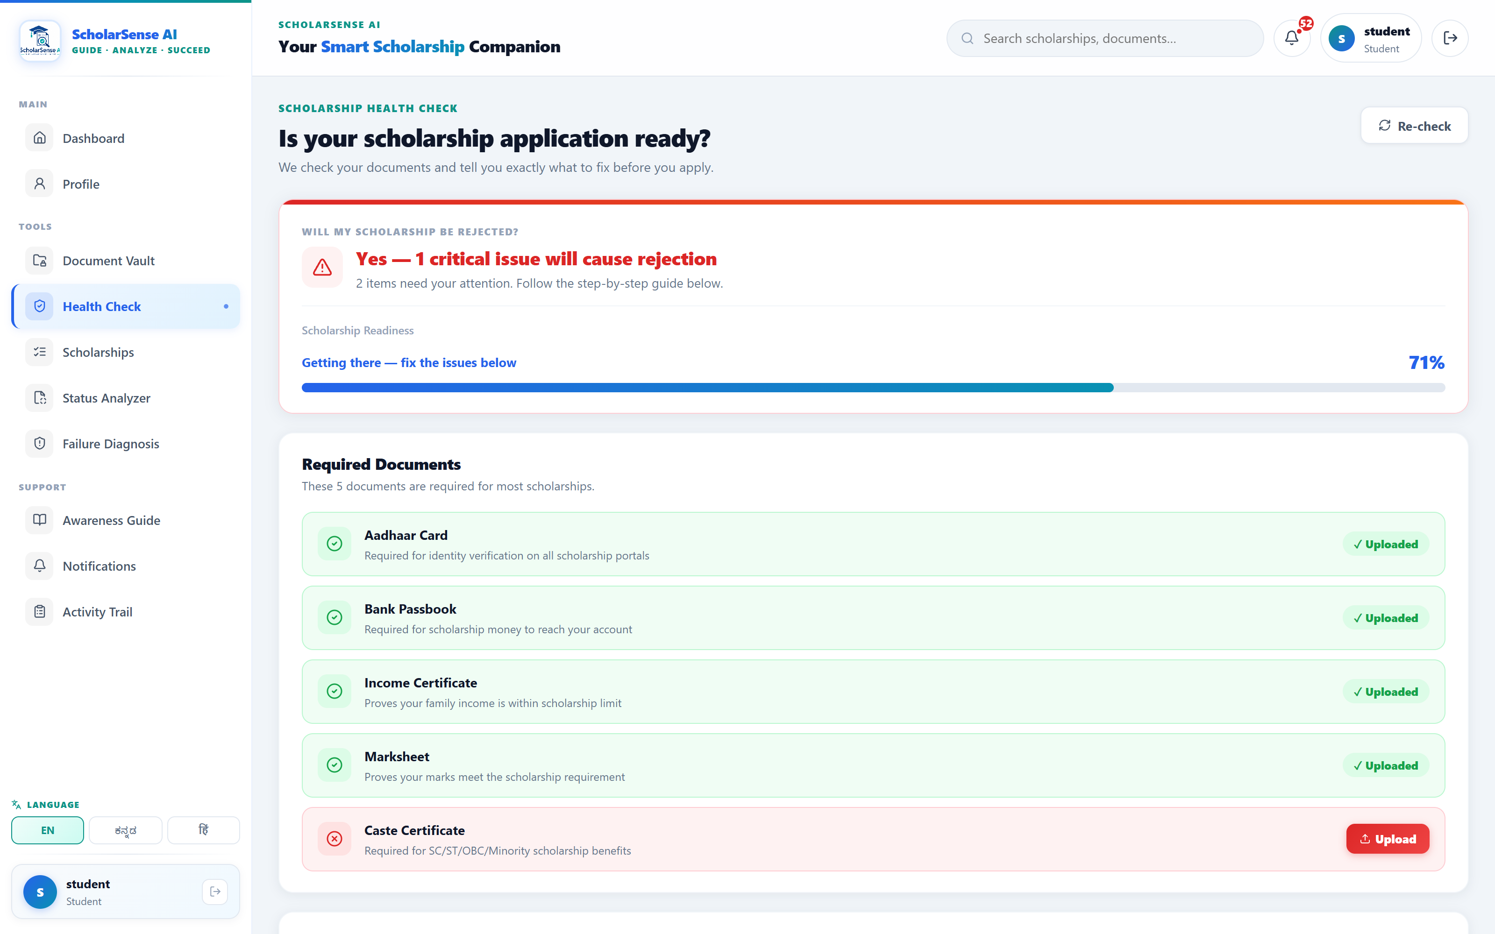
RESULTS & IMPACT
A working system — not a mock-up
33
13
5
3
schemes modelled
REST API modules
failure modes addressed
languages supported
Working today
Live eligibility matching — 10 eligible of 33 for the demo profile
OCR field extraction + cross-document validation
Scheduled deadline monitor — runs daily at 6 AM IST
Kannada WhatsApp alerts sent to the parent / guardian
Atomic JSON store — corruption-safe offline mode
A multi-portal, jargon-heavy process becomes one guided, vernacular, proactive flow — aimed at the exact points where students lose money.
Health Check verdict — “Yes, 1 critical issue will cause rejection”, with a step-by-step fix.
13 / 14

Slide 14
CONCLUSION
REFERENCES
A decision-support system
that runs today
National Scholarship Portal — scholarships.gov.in
Karnataka SSP — ssp.karnataka.gov.in
PFMS — pfms.nic.in
DBT Bharat / NPCI Aadhaar Payment Bridge
OCR.space API documentation
Groq API — console.groq.com/docs
React, Node.js, Express, MongoDB documentation
i18next — internationalization framework
Targets the 5 avoidable failure modes end-to-end
Profile-driven, vernacular and proactive by design
Offline-capable, built on real NSP & SSP scheme data
FUTURE SCOPE
Live NSP / SSP deadline synchronization
WhatsApp-first onboarding for low-literacy users
Wider scheme coverage with yearly rule updates
Real PFMS payment-status integration
Thank You
Shalini H R · shalinidvg16@gmail.com
14 / 14

