Slide 1
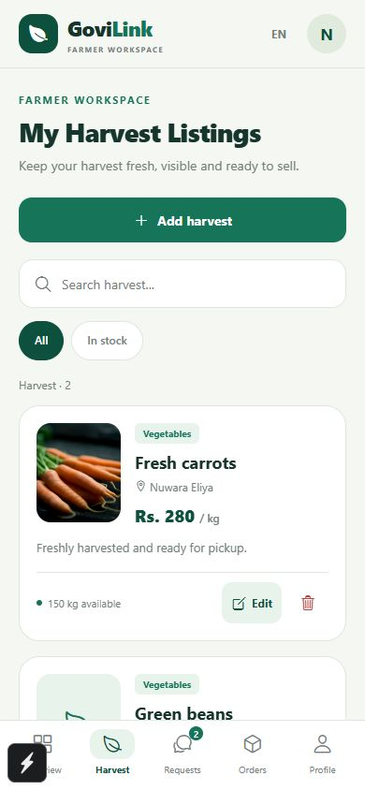
GoviLink
Farmers, buyers and
drivers connected
Business pitch · SE3050
User Experience Engineering · Semester 2, 2026
Student names and IDs: add before submission
GoviLink / 1
Notes:
Opening, 20 seconds. GoviLink is a three-role mobile app prototype connecting Sri Lankan farmers, produce buyers and drivers through linked trading and delivery workflows. We propose a focused pilot to test whether this workflow leads to repeat, completed orders. Screenshots throughout use demonstration data. The project has no verified commercial traction supplied by the team.

Slide 2
Three roles, one coordination problem
Farmer
Buyer
Driver
Finding demand and confirming harvest quantity, price and pickup timing.
Finding suitable supply and understanding when the order will arrive.
Coordinating pickup and destination details while reporting delivery progress.
The gap we will test
Can connected order information reduce repeated coordination for all three roles?
FAO provides supply-chain context. Role-specific pain points require customer interviews.
GoviLink / 2
Notes:
25 seconds. Farmers need to find demand and prepare agreed quantities. Buyers need to locate supply and know order progress. Drivers need usable pickup details, delivery information and a way to report trip progress. These pain points are hypotheses to validate. FAO describes post-harvest losses in traditional produce chains, including Sri Lankan cases. Software complements physical handling and transport practices. Source: https://www.fao.org/family-farming/detail/en/c/1756714/

Slide 3
Market context in Sri Lanka
2.10 million
70.8%
people employed in agriculture
25.7% of employment, Q2 2025
digital literacy, ages 5–69
January–June 2025
A focused first market
Vegetable growers in Nuwara Eliya and recurring produce buyers on one reachable delivery route.
DCS 2025 releases. Broad context, not a validated market-size estimate.
GoviLink / 3
Notes:
25 seconds. DCS reports 2,104,353 agricultural workers, 25.7% of employment, in Q2 2025. DCS reports 70.8% digital literacy among people aged 5–69 in January–June 2025. These are national context measures, not our addressable customer count or farmers’ smartphone ownership. We will estimate the reachable market by counting eligible farms and repeat buyers on a chosen route. Sources: https://www.statistics.gov.lk/Resource/en/LabourForce/Bulletins/LFS_Q2_Bulletin_2025.pdf
https://www.statistics.gov.lk/Resource/en/ComputerLiteracy/Bulletins/2025-FirstSixMonths.pdf

Slide 4
Our first users
Farmers
Business buyers
Small and medium vegetable growers. Need simple listings, clear demand and visible order progress.
Grocers, restaurants and small wholesalers. Need repeat supply with known quantity and timing.
Drivers
Research before launch
Local drivers and vehicle owners. Need vehicle management, trip details and delivery updates.
Interview 15 farmers, 10 buyers and 5 drivers. Test tasks with 5 users per main role.
GoviLink / 4
Notes:
25 seconds. These are proposed segments, not observed demographics. We will recruit adult small and medium vegetable growers, including people who use a shared household smartphone. Buyers are purchasing decision-makers at groceries, restaurants and small wholesalers. Language preference, device access, order frequency and current sourcing practices will be measured through interviews. Drivers are a core app user segment as well as delivery partners. They are not assumed paying subscribers.

Slide 5
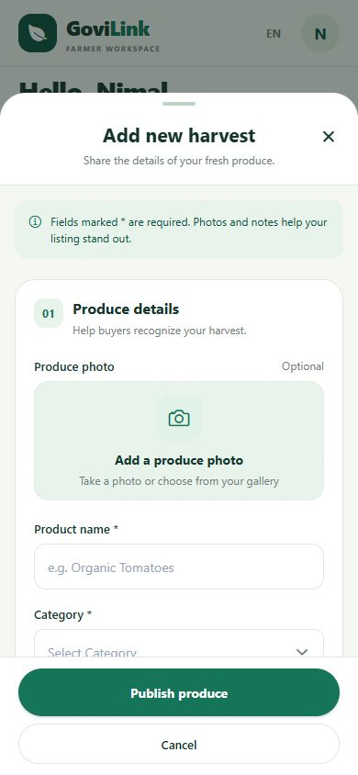
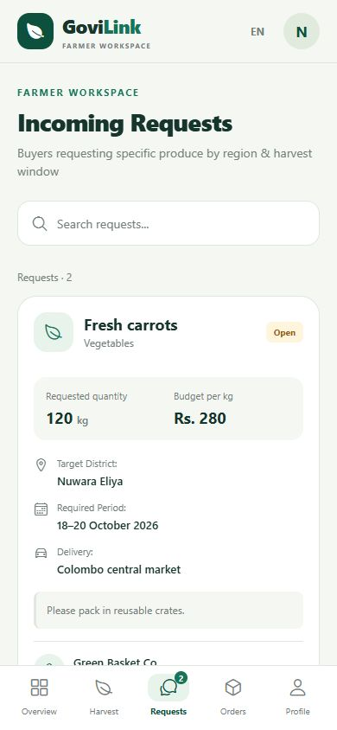
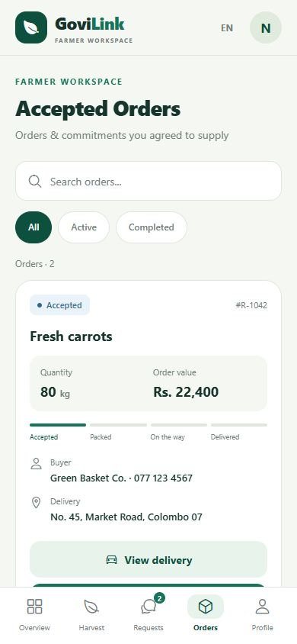
Farmer journey
01 Publish a harvest
02 Review demand
03 Manage the order
GoviLink / 5
Notes:
35 seconds. A farmer publishes a harvest with quantity, unit, price and date. Farmers can review buyer requests and manage accepted orders. The codebase includes buyer request creation, order status transitions and driver assignment. These are prototype features, not proof of field reliability. The current UI includes some Sinhala and Tamil support, but full language coverage still needs an audit. Screenshots are from this project with demonstration data.

Slide 6
Buyer journey
Step | Buyer action | Intended benefit
01 Find supply | Search, filter and compare harvest listings | See quantity, price and origin
02 Order or request | Place an order or post a custom requirement | Source available or future produce
03 Confirm details | Enter quantity, destination and delivery notes | Communicate what the buyer needs
04 Follow progress | Review orders and delivery-status details | Understand what happens next
Prototype workflows. Payment processing and delivery pricing need further validation.
GoviLink / 6
Notes:
35 seconds. Buyers can search produce and filter by category or origin district, then sort results and view listing details. They can place a direct order with quantity, destination and notes. A second route is posting a custom requirement by region and date for farmers to review. The order view and delivery details show progress. Benefits are hypotheses: less sourcing effort and clearer order visibility. The prototype uses a fixed delivery fee in the direct-order form. Commercial delivery pricing and payment settlement still require validation. Evidence: BuyerHomeScreen.js and BuyerRequestProduceScreen.js.

Slide 7
Driver journey
Step | Driver action | Intended benefit
01 Prepare | Manage vehicles and duty status | Keep transport information available
02 Review the job | Check pickup, destination and handling notes | Understand the delivery task
03 Pick up and deliver | Update the job to in transit, then delivered | Share progress across the order
04 Review activity | View completed jobs and earnings summary | Keep a record of delivery work
Earnings shown in the prototype do not confirm a settled payment. Dispatch requires field testing.
GoviLink / 7
Notes:
35 seconds. Drivers can register and manage vehicles, including an active vehicle. The dashboard displays an on-duty control and delivery jobs with farmer details, pickup location, buyer destination and handling notes. The trip action moves an eligible order to in transit and then delivered. The dashboard calculates an earnings summary from completed jobs. This is an indicative record, not proof of payment settlement. Do not claim automated route optimization, verified GPS tracking, driver-specific access control or guaranteed earnings. Evidence: DriverHomeScreen.js, DriverVehiclesListScreen.js and AddVehicleScreen.js.

Slide 8
How the three journeys connect
Stage | Farmer | Buyer | Driver
Match | Publish a harvest or accept demand | Browse supply or post a request | Maintain vehicle information
Prepare | Confirm quantity and prepare harvest | Provide destination and requirements | Review the coordinated delivery job
Transport | Hand over the produce | Follow order progress | Report pickup and in-transit status
Complete | Review order completion | Review delivery status | Mark delivered and review activity
Coordinator/admin supports driver assignment. Buyer self-pickup is an alternative where selected.
GoviLink / 8
Notes:
35 seconds. This is the intended service handoff, not a guarantee that every state transition or notification is production-ready. A farmer publishes supply and a buyer places an order, or a buyer posts demand that a farmer accepts. The farmer prepares produce. Where delivery is needed, a coordinator arranges a driver using the assignment workflow. The driver reviews the job, reports pickup and marks delivery. The buyer follows progress. A buyer request can also specify self-pickup, so driver delivery is not compulsory for every transaction. Payment reconciliation remains a separate proposed operating process.

Slide 9
Our proposed advantage
Connected trade and delivery workflows
Farmers publish supply. Buyers order produce or post requirements.
Drivers manage vehicles and report pickup and delivery progress.
Shared value to prove: clearer handoffs and dependable completed orders.
Prototype today. Commercial reliability and customer outcomes remain unproven.
GoviLink / 9
Notes:
25 seconds. GoviLink brings harvest listings, buyer demand, order progress and delivery coordination into a consistent role-based workflow. This is our positioning, not a claim of exclusive features. We aim to win through reliable completion and support on one route. We must validate usability, language completeness and partner reliability before expanding.

Slide 10
Competitive landscape
Alternative | Documented role / strength | GoviLink response
Govi Mithuru | Crop advice and agricultural alerts | Focus on trading and order coordination
Govipola | Marketplace and supply–demand matching¹ | Prove reliable service on one route
Calls and messages | Familiar communication² | Test value of shared order records
¹ Historical CBSL description, 2019. Current service status unverified.
² Customer-behaviour hypothesis for interviews. No exclusivity claim.
GoviLink / 10
Notes:
25 seconds. Govi Mithuru’s published app listing describes agricultural advice, crop information and alerts. Govipola is a direct marketplace precedent documented by CBSL in 2019. We have not verified its present operational status, pricing or complete feature set. Phone and messaging workflows are an assumed alternative to investigate. We will run task-based comparisons rather than assert missing competitor features. Sources: https://play.google.com/store/apps/details?id=com.arimaclanka.android.govimithuru
https://www.cbsl.gov.lk/sites/default/files/cbslweb_documents/publications/annual_report/2019/en/13_Box_04.pdf

Slide 11
Revenue and value across all roles
Free access for farmers, buyers and drivers
A proposed 3% fee on completed, settled produce orders
Farmer and buyer
Driver
Proposed seller fee on completed produce trades. Buyers receive a separate delivery quote.
Proposed delivery earnings funded by the delivery charge. No driver subscription in the pilot.
GoviLink / 11
Notes:
25 seconds. Free registration and listings keep adoption simple. After an introductory pilot waiver, test a 3% fee on the produce value of completed, settled orders, deducted from the seller payout with consent and disclosure. Delivery is a separately quoted buyer charge passed to the delivery partner. Drivers are core users with no proposed pilot subscription. Driver payment comes from delivery charges, not the 3% platform produce fee. Fee collection and payment reconciliation are planned work, not verified production functionality. Do not charge on cancellations. Test willingness to pay before fixing prices. Premium buyer tools are a later option, excluded from projections.

Slide 12
Business model canvas
Key partners | Key activities | Value proposition | Relationships | Customer segments
Farmer groups Buyers Delivery operators | Role onboarding Order and trip support Quality checks | Supply and demand Order visibility Delivery coordination | Role-specific setup Trade and trip support Dispute resolution | Growers Business buyers Drivers
 | Key resources |  | Channels
 | Three role workflows Team and backend Partner network |  | Cooperatives Buyer visits Referrals
Cost structure |  |  | Revenue streams
Product, hosting, support, onboarding and field operations |  |  | Proposed completed-order fee Future premium buyer tools
GoviLink / 12
Notes:
Optional detail, 20 seconds. Proposed model. Partners: farmer groups, recurring buyers and delivery operators. Activities: onboarding, marketplace operations, quality checks and dispute handling. Resources: app, cloud backend, staff and partner network. Value: visible supply and coordinated orders. Relationships: assisted onboarding and support. Channels: cooperatives, buyer visits and referrals. Customer/user segments: growers, business buyers and drivers. Costs: product, hosting, support and acquisition. Revenue: completed-order fees, with premium tools only after validation. No partners or contracts are confirmed.

Slide 13
Pilot and growth plan
Days 1–30
Days 31–60
Customer interviews, field visits, language review and delivery-route validation.
Assisted onboarding and a small live trial with recurring business buyers.
Days 61–90
Expansion gate
Target 100 farmers, 30 buyers and 5 active drivers. Aim for 100 orders in month three.
Target ≥80% order completion and ≥30% buyer repeat. Track on-time driver pickups.
Targets, not achieved results. Expand to a second route only after the pilot meets its gates.
GoviLink / 13
Notes:
30 seconds. First, interview customers and confirm one viable route. Next, seek a farmer group and recurring buyers, then run a controlled 90-day pilot. Recruitment targets are 100 registered farmers, 30 registered buyers and 5 active drivers by day 90, not current traction. Aim for 100 completed orders in month three, at least 80% completion of accepted orders and 30% of transacting buyers returning within 30 days. Define cohorts so late users are not counted prematurely. An active driver completes at least one pilot delivery in the measurement month. Measure pickup timeliness and net driver earnings per trip after fuel and time costs. Set an on-time target after confirming the route baseline. Expand only after reliability, repeat purchasing and positive contribution per order.

Slide 14
Illustrative monthly economics
Monthly metric | Low | Base | High
Completed orders | 100 | 300 | 600
Produce traded (Rs.) | 1,000,000 | 3,000,000 | 6,000,000
Fee revenue at 3% (Rs.) | 30,000 | 90,000 | 180,000
Variable costs (Rs.) | 10,000 | 30,000 | 60,000
Fixed costs (Rs.) | 100,000 | 100,000 | 100,000
Operating result (Rs.) | −80,000 | −40,000 | 20,000
Rs. 10,000 average order. Rs. 100 variable cost per order.
Simplified break-even: 500 orders/month. All inputs are unvalidated assumptions.
Excludes initial development, founder compensation and tax.
GoviLink / 14
Notes:
30 seconds. These scenarios are assumptions, not forecasts or actual performance. Average completed produce order value is Rs. 10,000. At 3%, revenue is Rs. 300 per order. Assume Rs. 100 variable cost per order, leaving Rs. 200 contribution. At Rs. 100,000 monthly fixed operating cost, simplified operating break-even is 500 orders. The high scenario yields Rs. 20,000 before tax. Excludes initial development, founder compensation, delivery pass-through, payment fees beyond the allowance and extraordinary refunds. At Rs. 200 variable cost, break-even doubles to 1,000 orders. Validate every cost and collection assumption.

Slide 15
Risks and safeguards
Risk | Proposed response
Too few matching buyers | Recruit recurring buyers before broad farmer acquisition
Quality disputes or cancellations | Agree grades, confirm quantities and record handover
Unreliable delivery | Limit routes and maintain a backup delivery partner
Digital access and language gaps | Assisted onboarding and Sinhala/Tamil usability testing
Payment and role access | Validate settlement and restrict buyer/driver access to relevant orders
GoviLink / 15
Notes:
25 seconds. Marketplace liquidity is the central risk: sign up repeat buyers before recruiting widely. For quality issues, agree grades and record handover evidence. For missed deliveries, cap coverage and maintain a backup partner. For digital access, offer assisted onboarding and test local language task completion. Before launch, review permissions, payment reconciliation and data handling. Measure outcomes rather than promise a fixed income increase or waste reduction.

Slide 16
The pilot partnership request
One farmer organization
Ten recurring produce buyers
Five pilot drivers
A 90-day pilot for farmers, buyers and drivers
Next step: a pilot discovery meeting
Contact: add your team email or phone before presenting
GoviLink / 16
Notes:
20 seconds. We are seeking introductions to one farmer organization, ten recurring produce buyers and five pilot drivers. We also need mentorship to test pricing and service operations. No partnership, funding or customer commitment is confirmed. Our next step is a discovery meeting to agree the route, pilot responsibilities and measurable outcomes. Contact details and presenter identity must be added before presentation.

Slide 17
Questions to expect
Why will users switch?
Why will farmers pay?
We must demonstrate less coordination effort and reliable completed orders during the pilot.
Only if the service creates enough value. Test the fee after a free introductory period.
What prevents off-app trading?
How will it scale?
Useful sourcing, order records and delivery support may encourage return use. Leakage remains a risk.
Expand route by route after repeat demand, service reliability and viable costs.
GoviLink / 17
Notes:
Appendix. Use the expanded questions and answers in the companion guide. Avoid claiming verified traction, full translation coverage, a production payment system or guaranteed profits. Be candid about pilot assumptions.

Slide 18
Sources and evidence
1 Department of Census and Statistics
Labour Force Survey, Q2 2025, Table 5. Agricultural employment.
2 Department of Census and Statistics
Computer Literacy Statistics, January–June 2025. Digital literacy.
3 Food and Agriculture Organization
South Asian produce supply-chain case studies, including Sri Lanka.
4 Dialog Axiata
Govi Mithuru app listing. Published advisory features.
5 Central Bank of Sri Lanka
Annual Report 2019, Box 4. Historical Govipola description.
Full source links in slide notes and companion guide. Prototype screenshots use demo data.
GoviLink / 18
Notes:
Reference appendix. Sources accessed 12 October 2026. National statistics use the named 2025 periods, not a claim to the latest release. Govipola evidence is historical. App screenshots and implemented feature descriptions derive from the project source and demo previews. All pilot figures, commercial terms and economics are proposed assumptions.
employment: https://www.statistics.gov.lk/Resource/en/LabourForce/Bulletins/LFS_Q2_Bulletin_2025.pdf
digital: https://www.statistics.gov.lk/Resource/en/ComputerLiteracy/Bulletins/2025-FirstSixMonths.pdf
loss: https://www.fao.org/family-farming/detail/en/c/1756714/
dialog: https://play.google.com/store/apps/details?id=com.arimaclanka.android.govimithuru
govipola: https://www.cbsl.gov.lk/sites/default/files/cbslweb_documents/publications/annual_report/2019/en/13_Box_04.pdf

