Slide 1
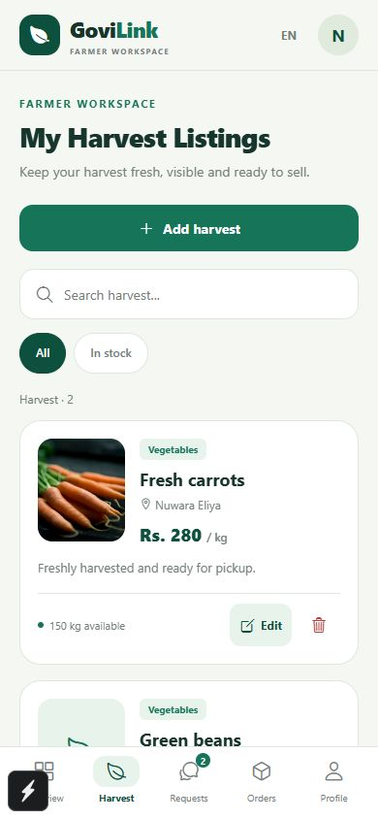
GoviLink
A clearer path from
harvest to buyer
Business pitch · SE3050
User Experience Engineering · Semester 2, 2026
Student names and IDs: add before submission
GoviLink / 1
Notes:
Opening, 20 seconds. GoviLink is a mobile app prototype connecting Sri Lankan farmers with produce buyers and supporting delivery coordination. We propose a focused pilot to test whether this workflow leads to repeat, completed orders. Screenshots throughout use demonstration data. The project has no verified commercial traction supplied by the team.

Slide 2
The problem
Farmer
Buyer
Finding a buyer before produce loses value can take time and repeated follow-up.
Checking quantity, price and collection details across suppliers adds work.
The gap we will test
Can one shared listing and order workflow reduce coordination effort and help more orders reach completion?
Evidence: FAO supply-chain cases. Specific customer pain points remain hypotheses.
GoviLink / 2
Notes:
25 seconds. Farmers need timely demand information and a clear route to a buyer. Buyers need dependable quantities and agreed collection times. FAO describes post-harvest quality and quantity losses in traditional South Asian produce chains, including Sri Lankan cases. Our specific assumptions about phone calls, missed orders and willingness to change require interviews. Software alone cannot fix packaging, storage or road conditions. Source: https://www.fao.org/family-farming/detail/en/c/1756714/

Slide 3
Market context in Sri Lanka
2.10 million
70.8%
people employed in agriculture
25.7% of employment, Q2 2025
digital literacy, ages 5–69
January–June 2025
A focused first market
Vegetable growers in Nuwara Eliya and recurring produce buyers on one reachable delivery route.
DCS 2025 releases. Broad context, not a validated market-size estimate.
GoviLink / 3
Notes:
25 seconds. DCS reports 2,104,353 agricultural workers, 25.7% of employment, in Q2 2025. DCS reports 70.8% digital literacy among people aged 5–69 in January–June 2025. These are national context measures, not our addressable customer count or farmers’ smartphone ownership. We will estimate the reachable market by counting eligible farms and repeat buyers on a chosen route. Sources: https://www.statistics.gov.lk/Resource/en/LabourForce/Bulletins/LFS_Q2_Bulletin_2025.pdf
https://www.statistics.gov.lk/Resource/en/ComputerLiteracy/Bulletins/2025-FirstSixMonths.pdf

Slide 4
Our first users
Farmers
Business buyers
Small and medium vegetable growers. Need simple listings, clear demand and visible order progress.
Grocers, restaurants and small wholesalers. Need repeat supply with known quantity and timing.
Delivery partners
Research before launch
Local drivers and cooperative coordinators. Need clear pickup and handover information.
Interview 15 farmers, 10 buyers and 5 drivers. Test tasks with 5 users per main role.
GoviLink / 4
Notes:
25 seconds. These are proposed segments, not observed demographics. We will recruit adult small and medium vegetable growers, including people who use a shared household smartphone. Buyers are purchasing decision-makers at groceries, restaurants and small wholesalers. Language preference, device access, order frequency and current sourcing practices will be measured through interviews. Drivers and cooperative coordinators are delivery partners, not assumed paying subscribers.

Slide 5
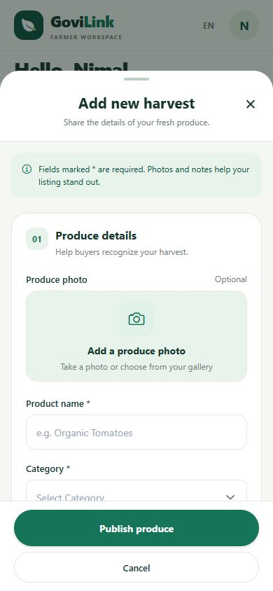
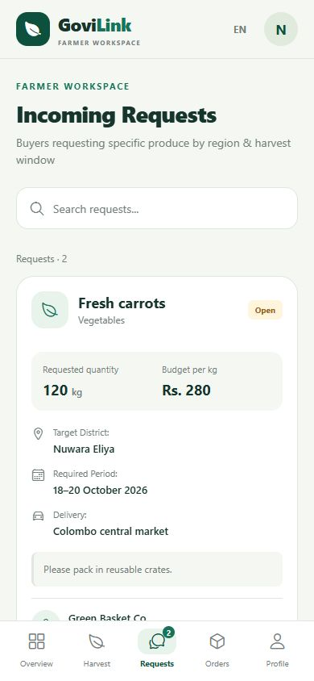
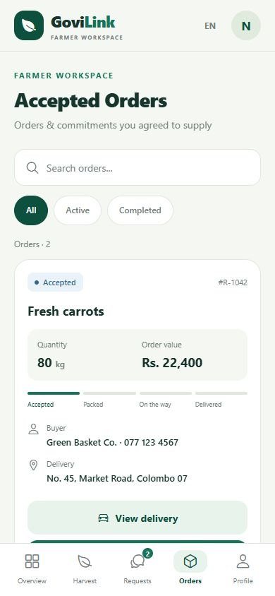
The GoviLink workflow
01 Publish a harvest
02 Review demand
03 Manage the order
GoviLink / 5
Notes:
35 seconds. A farmer publishes a harvest with quantity, unit, price and date. Farmers can review buyer requests and manage accepted orders. The codebase includes buyer request creation, order status transitions and driver assignment. These are prototype features, not proof of field reliability. The current UI includes some Sinhala and Tamil support, but full language coverage still needs an audit. Screenshots are from this project with demonstration data.

Slide 6
Our proposed advantage
A focused workflow for repeat local trade
Harvest details and buyer requests stay connected to order progress.
Farmer, buyer and driver roles support the same transaction.
Pilot advantage to prove: easier coordination and reliable handover.
Prototype today. Commercial reliability and customer outcomes remain unproven.
GoviLink / 6
Notes:
25 seconds. GoviLink brings harvest listings, buyer demand, order progress and delivery coordination into a consistent role-based workflow. This is our positioning, not a claim of exclusive features. We aim to win through reliable completion and support on one route. We must validate usability, language completeness and partner reliability before expanding.

Slide 7
Competitive landscape
Alternative | Documented role / strength | GoviLink response
Govi Mithuru | Crop advice and agricultural alerts | Focus on trading and order coordination
Govipola | Marketplace and supply–demand matching¹ | Prove reliable service on one route
Calls and messages | Familiar communication² | Test value of shared order records
¹ Historical CBSL description, 2019. Current service status unverified.
² Customer-behaviour hypothesis for interviews. No exclusivity claim.
GoviLink / 7
Notes:
25 seconds. Govi Mithuru’s published app listing describes agricultural advice, crop information and alerts. Govipola is a direct marketplace precedent documented by CBSL in 2019. We have not verified its present operational status, pricing or complete feature set. Phone and messaging workflows are an assumed alternative to investigate. We will run task-based comparisons rather than assert missing competitor features. Sources: https://play.google.com/store/apps/details?id=com.arimaclanka.android.govimithuru
https://www.cbsl.gov.lk/sites/default/files/cbslweb_documents/publications/annual_report/2019/en/13_Box_04.pdf

Slide 8
Proposed revenue model
Free to join and list
A proposed 3% fee on completed, settled produce orders
Clear charging rules
Test before charging
Show seller fees before acceptance. Quote delivery separately. No fee on cancelled orders.
Waive the first pilot month. Validate willingness to pay and payment reconciliation.
GoviLink / 8
Notes:
25 seconds. Free registration and listings keep adoption simple. After an introductory pilot waiver, test a 3% fee on the produce value of completed, settled orders, deducted from the seller payout with consent and disclosure. Delivery is a separately quoted buyer charge passed to the delivery partner. Fee collection and payment reconciliation are planned work, not verified production functionality. Do not charge on cancellations. Test willingness to pay before fixing prices. Premium buyer tools are a later option, excluded from projections.

Slide 9
Business model canvas
Key partners | Key activities | Value proposition | Relationships | Customer segments
Farmer groups Buyers Delivery operators | Onboarding Order support Quality checks | Visible harvest supply Buyer demand Order coordination | Assisted setup Support Dispute resolution | Vegetable growers Grocers Restaurants Wholesalers
 | Key resources |  | Channels
 | App and backend Team Partner network |  | Cooperatives Buyer visits Referrals
Cost structure |  |  | Revenue streams
Product, hosting, support, onboarding and field operations |  |  | Proposed completed-order fee Future premium buyer tools
GoviLink / 9
Notes:
Optional detail, 20 seconds. Proposed model. Partners: farmer groups, recurring buyers and delivery operators. Activities: onboarding, marketplace operations, quality checks and dispute handling. Resources: app, cloud backend, staff and partner network. Value: visible supply and coordinated orders. Relationships: assisted onboarding and support. Channels: cooperatives, buyer visits and referrals. Customers: growers and business buyers. Costs: product, hosting, support and acquisition. Revenue: completed-order fees, with premium tools only after validation. No partners or contracts are confirmed.

Slide 10
Pilot and growth plan
Days 1–30
Days 31–60
Customer interviews, field visits, language review and delivery-route validation.
Assisted onboarding and a small live trial with recurring business buyers.
Days 61–90
Expansion gate
Target 100 farmers, 30 buyers and 100 completed orders in month three.
Target ≥80% accepted-order completion and ≥30% buyer repeat within 30 days.
Targets, not achieved results. Expand to a second route only after the pilot meets its gates.
GoviLink / 10
Notes:
30 seconds. First, interview customers and confirm one viable route. Next, seek a farmer group and recurring buyers, then run a controlled 90-day pilot. Recruitment targets are 100 registered farmers and 30 registered buyers by day 90, not current traction. Aim for 100 completed orders in month three, at least 80% completion of accepted orders and 30% of transacting buyers returning within 30 days. Define cohorts so late users are not counted prematurely. Expand only after reliability, repeat purchasing and positive contribution per order.

Slide 11
Illustrative monthly economics
Monthly metric | Low | Base | High
Completed orders | 100 | 300 | 600
Produce traded (Rs.) | 1,000,000 | 3,000,000 | 6,000,000
Fee revenue at 3% (Rs.) | 30,000 | 90,000 | 180,000
Variable costs (Rs.) | 10,000 | 30,000 | 60,000
Fixed costs (Rs.) | 100,000 | 100,000 | 100,000
Operating result (Rs.) | −80,000 | −40,000 | 20,000
Rs. 10,000 average order. Rs. 100 variable cost per order.
Simplified break-even: 500 orders/month. All inputs are unvalidated assumptions.
Excludes initial development, founder compensation and tax.
GoviLink / 11
Notes:
30 seconds. These scenarios are assumptions, not forecasts or actual performance. Average completed produce order value is Rs. 10,000. At 3%, revenue is Rs. 300 per order. Assume Rs. 100 variable cost per order, leaving Rs. 200 contribution. At Rs. 100,000 monthly fixed operating cost, simplified operating break-even is 500 orders. The high scenario yields Rs. 20,000 before tax. Excludes initial development, founder compensation, delivery pass-through, payment fees beyond the allowance and extraordinary refunds. At Rs. 200 variable cost, break-even doubles to 1,000 orders. Validate every cost and collection assumption.

Slide 12
Risks and safeguards
Risk | Proposed response
Too few matching buyers | Recruit recurring buyers before broad farmer acquisition
Quality disputes or cancellations | Agree grades, confirm quantities and record handover
Unreliable delivery | Limit routes and maintain a backup delivery partner
Digital access and language gaps | Assisted onboarding and Sinhala/Tamil usability testing
Payment and data handling | Reconciliation, access controls and pre-launch review
GoviLink / 12
Notes:
25 seconds. Marketplace liquidity is the central risk: sign up repeat buyers before recruiting widely. For quality issues, agree grades and record handover evidence. For missed deliveries, cap coverage and maintain a backup partner. For digital access, offer assisted onboarding and test local language task completion. Before launch, review permissions, payment reconciliation and data handling. Measure outcomes rather than promise a fixed income increase or waste reduction.

Slide 13
The pilot partnership request
One farmer organization
Ten recurring produce buyers
Two delivery partners
A 90-day pilot to test repeat demand and dependable delivery
Next step: a pilot discovery meeting
Contact: add your team email or phone before presenting
GoviLink / 13
Notes:
20 seconds. We are seeking introductions to one farmer organization, ten recurring produce buyers and two delivery partners. We also need mentorship to test pricing and service operations. No partnership, funding or customer commitment is confirmed. Our next step is a discovery meeting to agree the route, pilot responsibilities and measurable outcomes. Contact details and presenter identity must be added before presentation.

Slide 14
Questions to expect
Why will users switch?
Why will farmers pay?
We must demonstrate less coordination effort and reliable completed orders during the pilot.
Only if the service creates enough value. Test the fee after a free introductory period.
What prevents off-app trading?
How will it scale?
Useful delivery support and records may encourage return use. Leakage remains a risk.
Expand route by route after repeat demand, service reliability and viable costs.
GoviLink / 14
Notes:
Appendix. Use the expanded questions and answers in the companion guide. Avoid claiming verified traction, full translation coverage, a production payment system or guaranteed profits. Be candid about pilot assumptions.

Slide 15
Sources and evidence
1 Department of Census and Statistics
Labour Force Survey, Q2 2025, Table 5. Agricultural employment.
2 Department of Census and Statistics
Computer Literacy Statistics, January–June 2025. Digital literacy.
3 Food and Agriculture Organization
South Asian produce supply-chain case studies, including Sri Lanka.
4 Dialog Axiata
Govi Mithuru app listing. Published advisory features.
5 Central Bank of Sri Lanka
Annual Report 2019, Box 4. Historical Govipola description.
Full source links in slide notes and companion guide. Prototype screenshots use demo data.
GoviLink / 15
Notes:
Reference appendix. Sources accessed 12 October 2026. National statistics use the named 2025 periods, not a claim to the latest release. Govipola evidence is historical. App screenshots and implemented feature descriptions derive from the project source and demo previews. All pilot figures, commercial terms and economics are proposed assumptions.
employment: https://www.statistics.gov.lk/Resource/en/LabourForce/Bulletins/LFS_Q2_Bulletin_2025.pdf
digital: https://www.statistics.gov.lk/Resource/en/ComputerLiteracy/Bulletins/2025-FirstSixMonths.pdf
loss: https://www.fao.org/family-farming/detail/en/c/1756714/
dialog: https://play.google.com/store/apps/details?id=com.arimaclanka.android.govimithuru
govipola: https://www.cbsl.gov.lk/sites/default/files/cbslweb_documents/publications/annual_report/2019/en/13_Box_04.pdf

