Slide 1
Conditional Random Fields
-- Something Related
Conghui Zhu
Mentor: Tiejun Zhao
2009.09
MITLAB 2009 CRFs Study

Slide 2
Outline
Brief introduction for usage
A example of CRFs
  English Chunk
  CRF++ (V0.47)
Shortcoming of CRFs
Related resources on Internet
MITLAB 2009 CRFs Study

Slide 3
Brief Introduction
CRFs (conditional random fields)
  Supervised
  Sequence labeling
  Structure classification
  Train weights w_{i} for each features
O₁
O₂
O₃
O:
Thinking
is
being
S:
noun
verb
noun
S₁
MITLAB 2009 CRFs Study
S₂
S₃

Slide 4
Why CRFs?
Sequence Labeling Model
  HMM
  MEMM
  CRFs
HMM
  Genereate model
MEMM
  Label bias
MITLAB 2009 CRFs Study

Slide 5
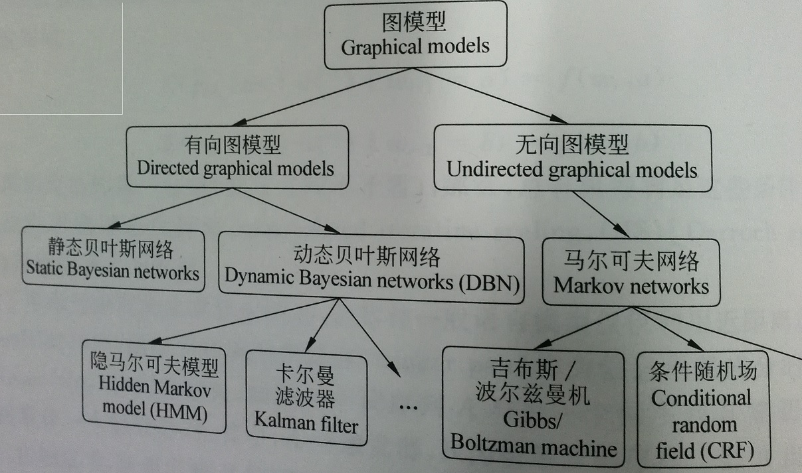
MITLAB 2009 CRFs Study

Slide 6
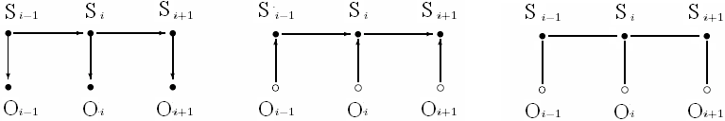
CRF on Simple Chain Graph
We will handle the case when G is a simple chain: G = (V = {1,…,m}, E={ (i,i+1) })
HMM (Generative)
MEMM (Discriminative)
CRF
MITLAB 2009 CRFs Study
Notes:
箭头-归一化-损失信息

Slide 7
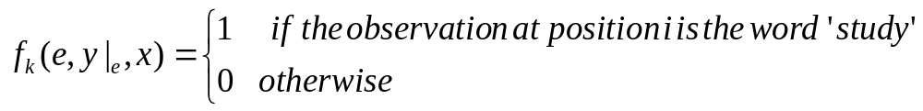
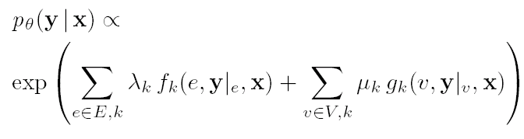
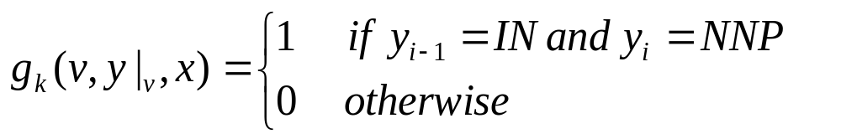
Fundamental Theorem of Random Fields
Assumption:
  G structure is a tree, of which simple chain is a private case, x is observation, y is state
MITLAB 2009 CRFs Study

Slide 8
Introduction of CRF++
STL C++, windows and linux
Important file
  crf_learn.exe
  crf_test.ext
  template
  train.data
  test.data
MITLAB 2009 CRFs Study

Slide 9
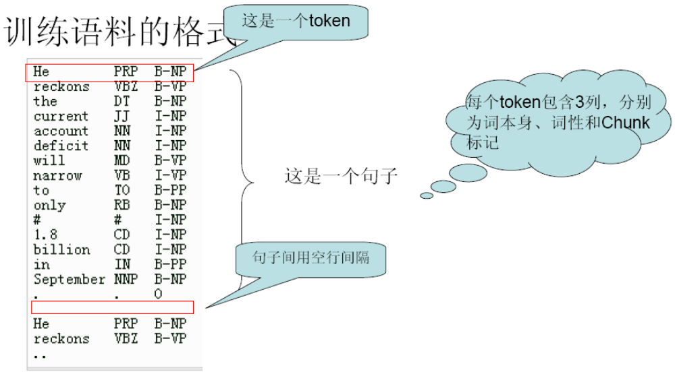
Format of Training and Testing Data
MITLAB 2009 CRFs Study

Slide 10
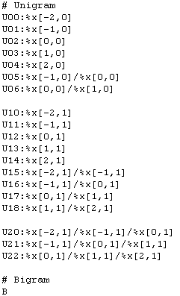
Format of Template(1)
special macro %x[row,col] will be used to specify a token in the input data. row specfies the relative position from the current focusing token and col specifies the absolute position of the column
MITLAB 2009 CRFs Study

Slide 11
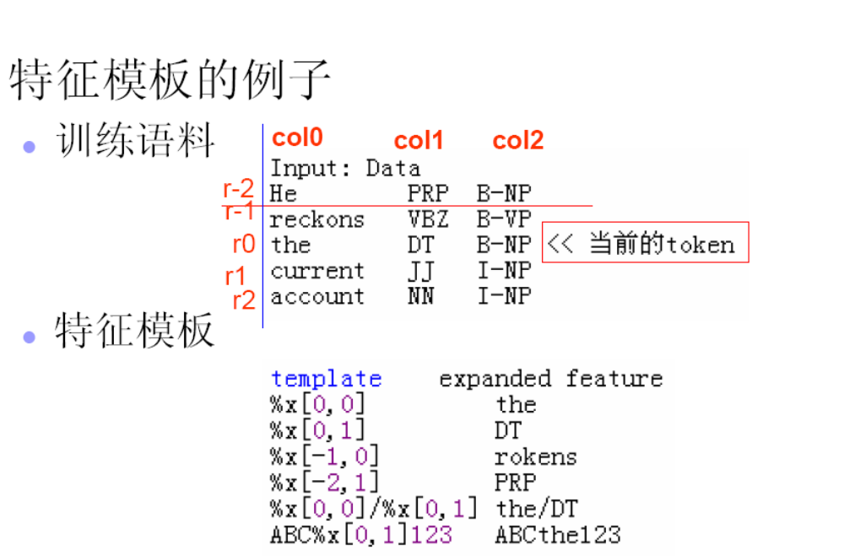
Format of Template(2)
MITLAB 2009 CRFs Study

Slide 12
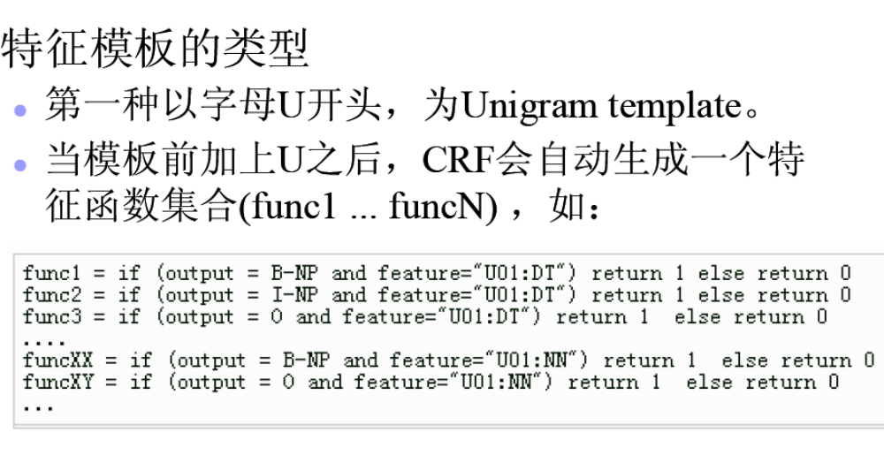
Format of Template(3)
MITLAB 2009 CRFs Study

Slide 13
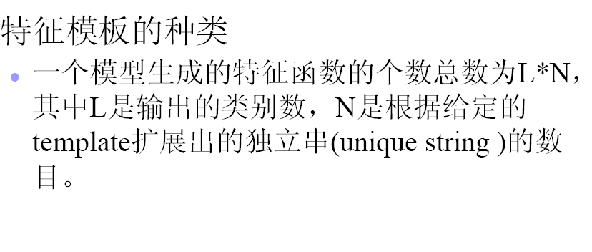
Format of Template(4)
MITLAB 2009 CRFs Study

Slide 14
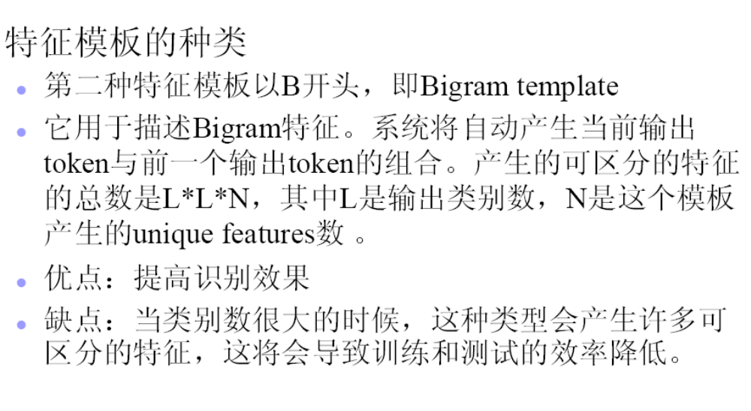
Format of Template(5)
MITLAB 2009 CRFs Study

Slide 15
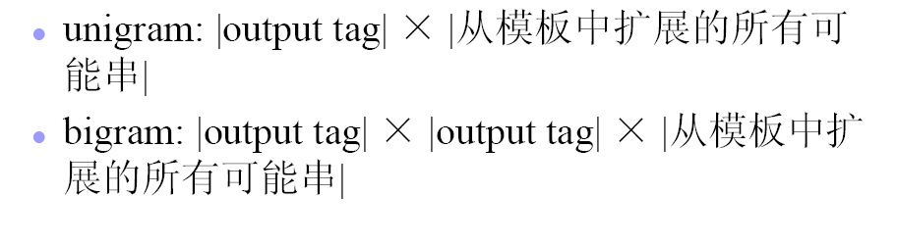
Format of Template(6)
MITLAB 2009 CRFs Study

Slide 16
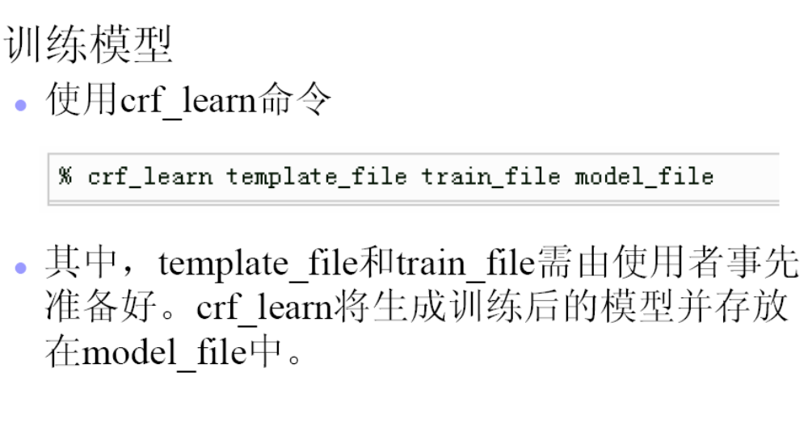
Usage of crf_learn(1)
MITLAB 2009 CRFs Study

Slide 17
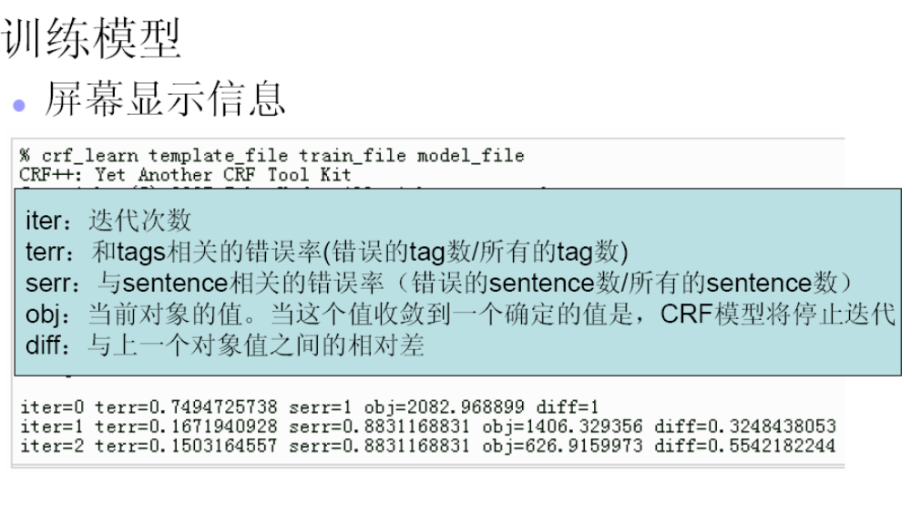
Usage of crf_learn(2)
MITLAB 2009 CRFs Study

Slide 18
Usage of crf_learn(3)
-c float:
With this option, you can change the hyper-parameter for the CRFs. With larger C value, CRF tends to overfit to the give training corpus. This parameter trades the balance between overfitting and underfitting.
-f NUM:
This parameter sets the cut-off threshold for the features. CRF++ uses the features that occurs no less than NUM times in the given training data. The default value is 1.
-p NUM: number of threads(default 1)
-t : build also text model file for debugging
MITLAB 2009 CRFs Study

Slide 19
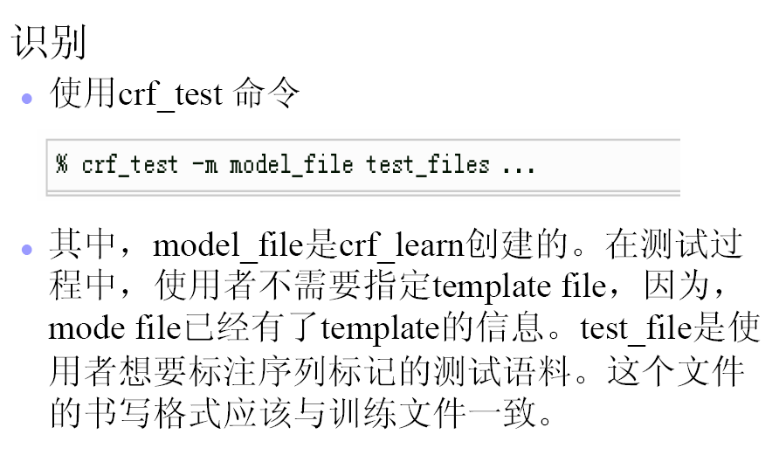
Usage of crf_test(1)
MITLAB 2009 CRFs Study

Slide 20
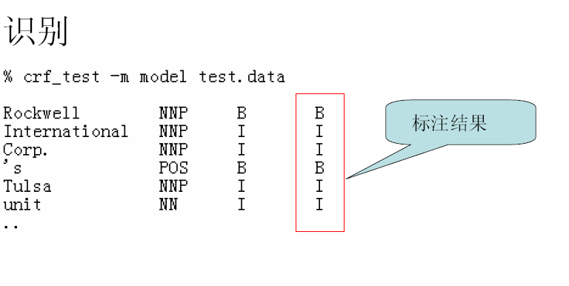
Usage of crf_test(1)
MITLAB 2009 CRFs Study

Slide 21
Chunk Example
Data model given
Data add uppercasing fearture
Data add casing fearture
Difference between two features
  Template
  Model
MITLAB 2009 CRFs Study

Slide 22
Shortcoming
Heavy computation
Feature exploding
MITLAB 2009 CRFs Study

Slide 23
Related Resources
CRF工具包
  http://crf.sourceforge.net/doc/
  java，documents are good
FlexCRFs: Flexible Conditional Random Fields
  Programer: Xuan-Hieu Phan and Le-Minh Nguyen
  C++
  http://www.jaist.ac.jp/~hieuxuan/flexcrfs/flexcrfs.html
CRF++: Yet Another CRF toolkit
  C++，windows, Linux
  http://chasen.org/~taku/software/CRF++/#features
Mallet
  http://mallet.cs.umass.edu/index.php/Main_Page#Developing_in_MALLET
  java
MITLAB 2009 CRFs Study

Slide 24
Q&A
MITLAB 2009 CRFs Study

