Slide 1

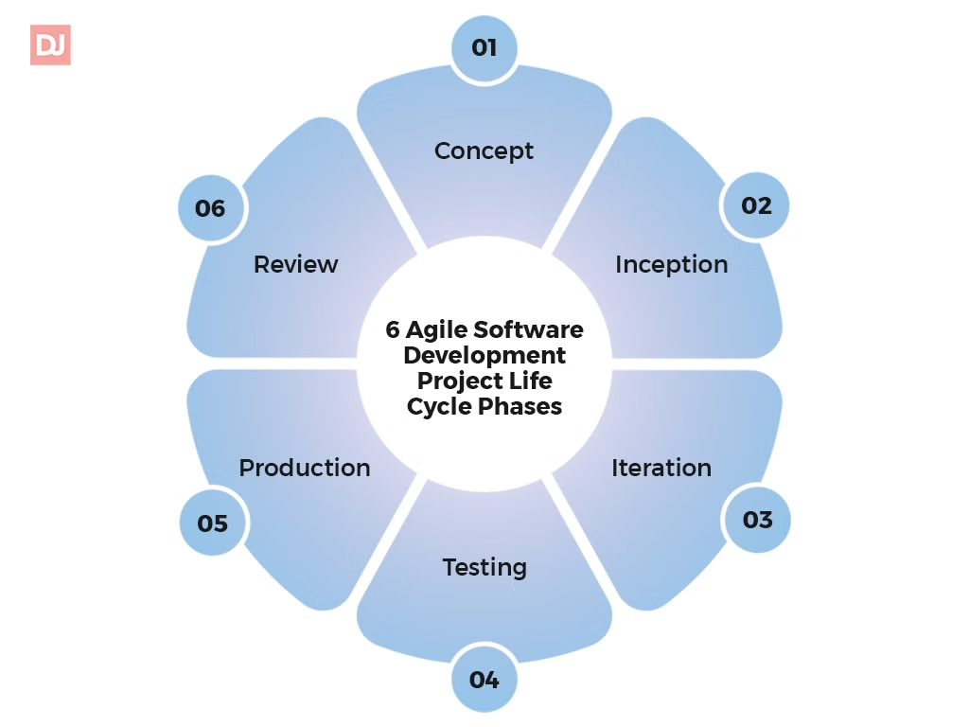
The Software Development Life Cycle
s

Slide 2
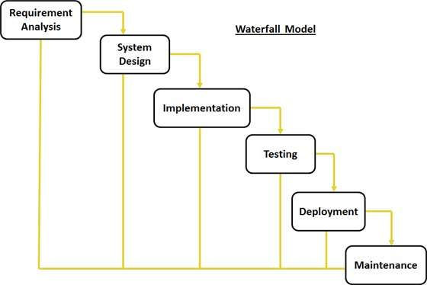
Waterfall Model
Linear Approach
The Waterfall model follows a sequential, linear process where each phase must be completed before moving to the next.

Slide 3

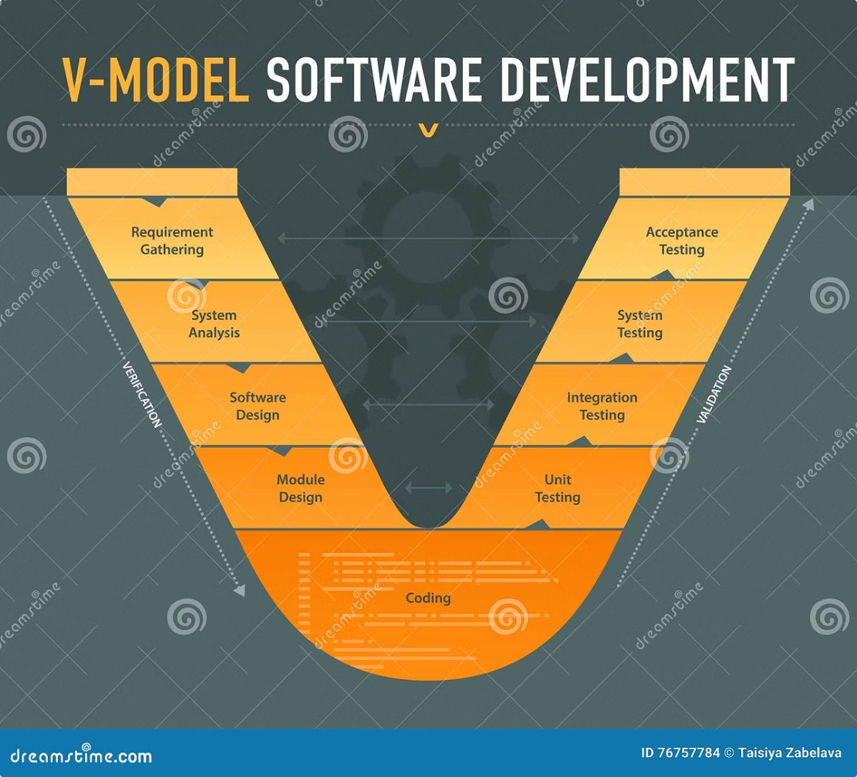
V-Model (Validation and Verification)
1
Requirements
Validation occurs to ensure the software meets the specified requirements.
2
Design
Verification checks that the design matches the requirements.
3
Testing
Testing is carried out in parallel with each development stage.

Slide 4

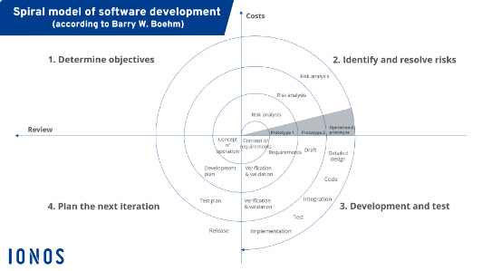



Spiral Model
Risk Assessment
Iterative Development
Risk-Driven Approach
The Spiral model focuses on identifying and addressing risks at each phase.
Software is developed through an iterative process, allowing for continuous refinement.
The model emphasizes risk management, making it suitable for complex, high-risk projects.

Slide 5
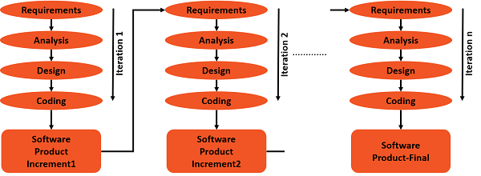
Iterative Model
In this Model, you can start with some of the software specifications and develop the first version of the software. After the first version if there is a need to change the software, then a new version of the software is created with a new iteration. Every release of the Iterative Model finishes in an exact and fixed period that is called iteration.

Slide 6

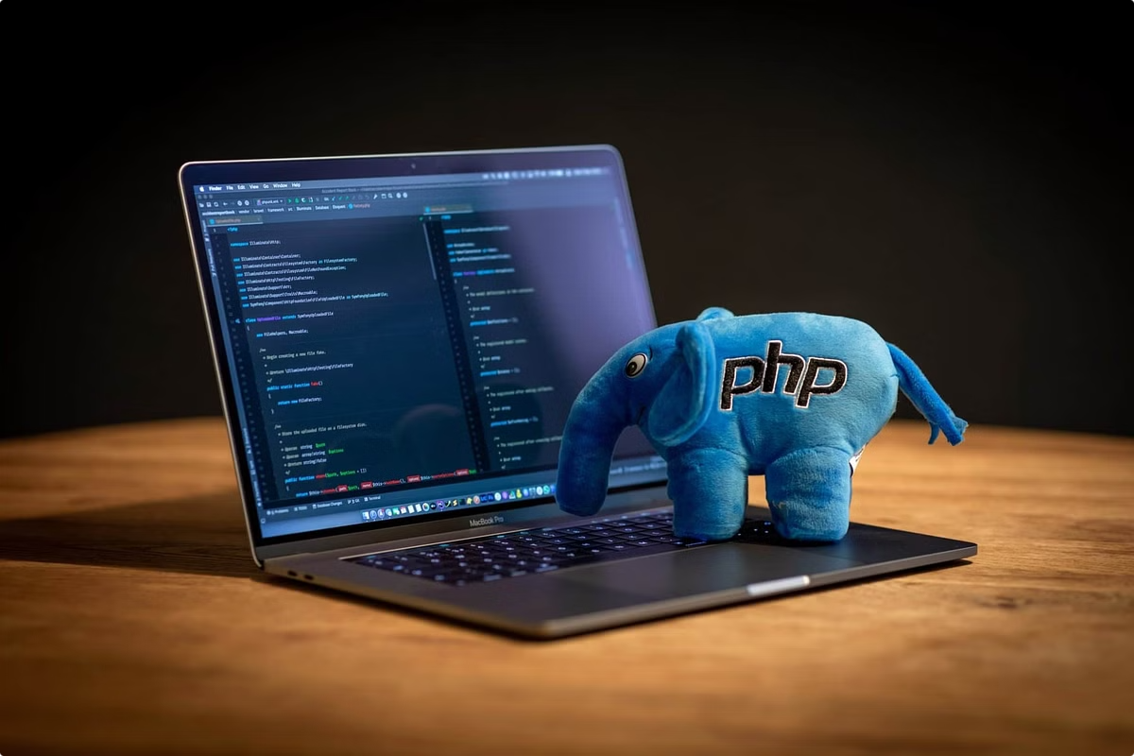
Challenges in SDLC
Changing Requirements
Unexpected shifts in customer or business requirements can disrupt progress, especially in rigid models.
Communication Gaps
Poor collaboration between teams can lead to misunderstandings or delays.
Security Concerns
Ensuring robust security mechanisms throughout the SDLC is critical but challenging.

Slide 7
From my perspective I think the Spiral Model stands out as one of the best approaches, especially for complex and large-scale projects

