Slide 1

Group Project : Forex Service
Group 1:-
Shalmali Nighot
2.Shivani Padwal

Slide 2
Introduction:
Forex Services or Foreign Exchange Services is exchanging a particular currency for another or converting cash to another.
Forex exists so that large amounts of one currency can be exchanged for the equivalent value in another currency at the current market rate.
Foreign exchange uses currency pairs, priced in terms of one versus the other.
Forwards and futures are another way to participate in the forex market.

Slide 3
Problem Statement
To create an application based on Forex Service so the users should save their details on the application for registering to use the system also users can view current rates of world currencies and their conversions so users can send between any of this currencies.
Transferring money to another bank can include Recipient Bank Details and any other details needed.
After transaction, Users can download transaction Data in PDF format.
Admin can manage the currency rates for particular days.
Other data that be generated contain things like which currencies where mostly send, which countries, which user is the most frequent one, etc

Slide 4
Road Map :
Application is developed in following Sprint –
Spring Boot + Rest Controller + JPA with Hibernate
Plan :
Design
Generate the skeleton as per class design provided
TDD approach
Identify test cases for each module
Write Failing Test cases
Convert the Test Cases in GREEN
Implement the case study in incremental manner

Slide 5
Modules Of System :
Admin
Users
Exchange rate
User Bank Details
Transaction
Report

Slide 6
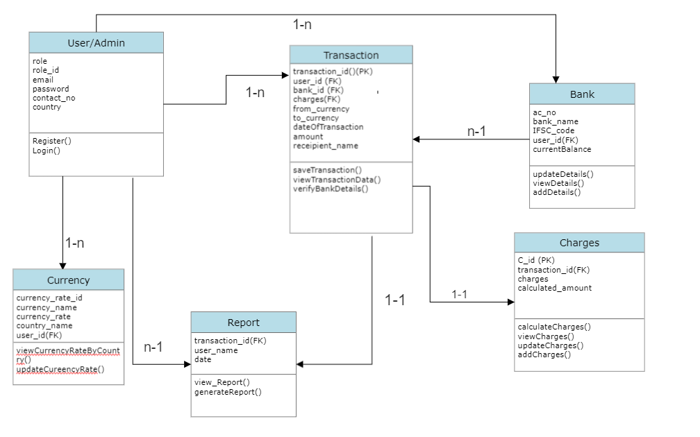
Class Diagram:

Slide 7
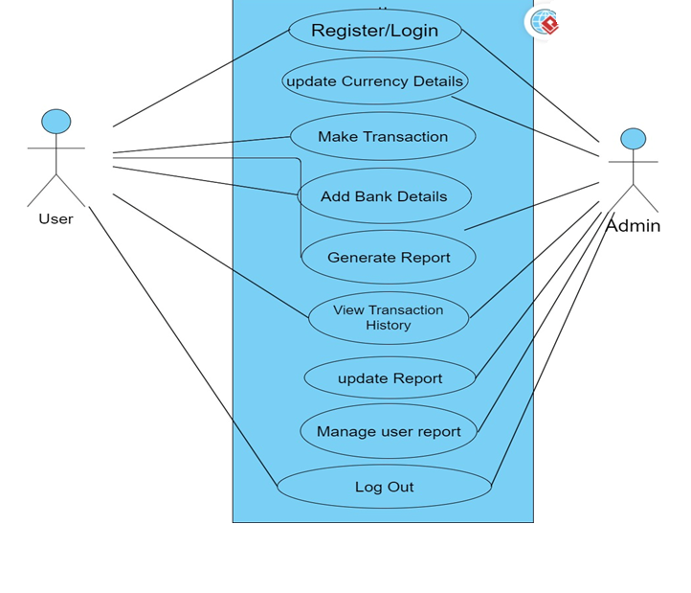
Use-Case Diagram:

Slide 8
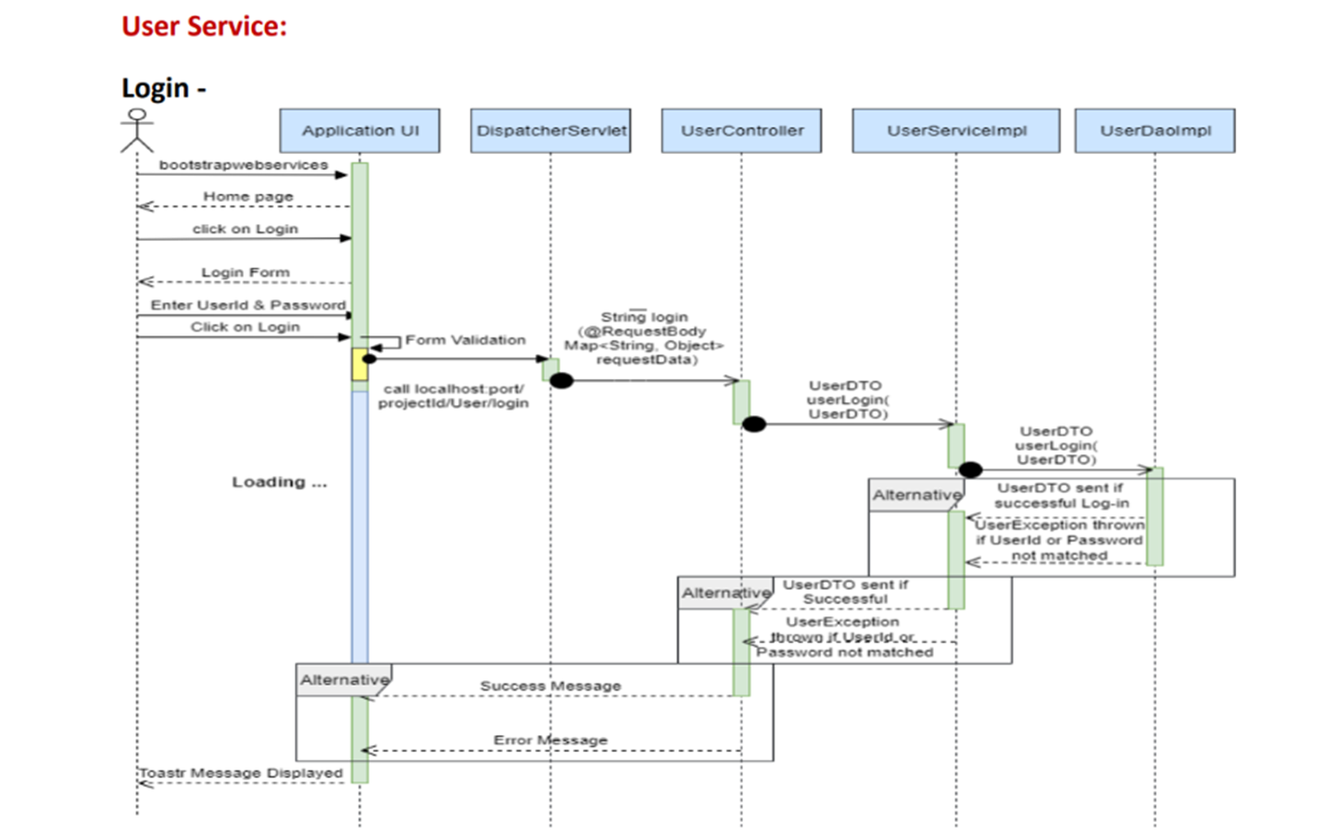
Sequence Diagram :

Slide 9
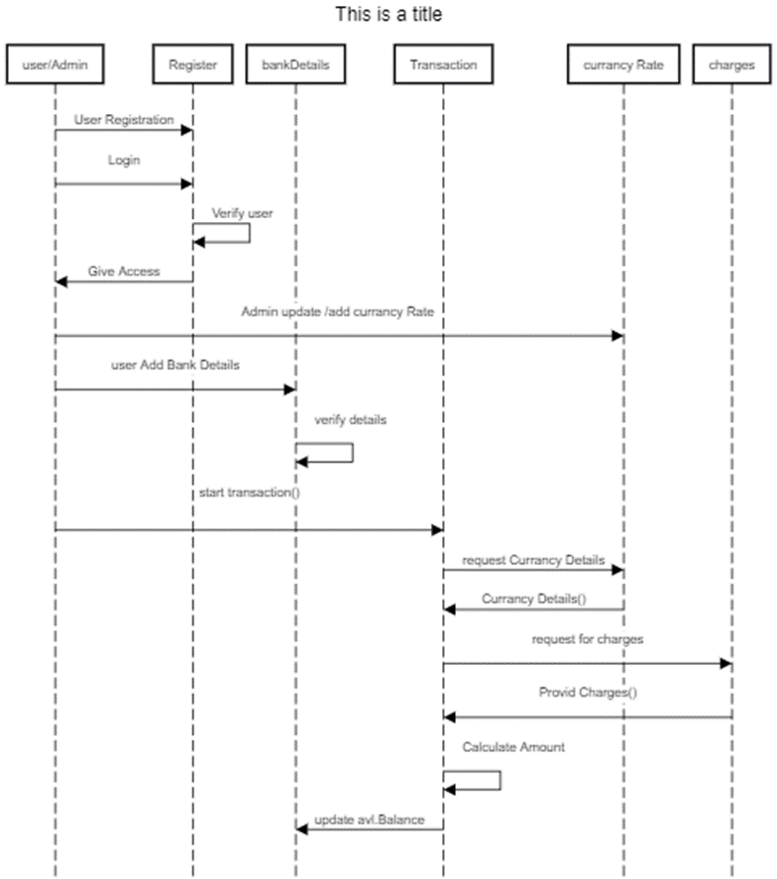
Sequence Diagram :

Slide 10
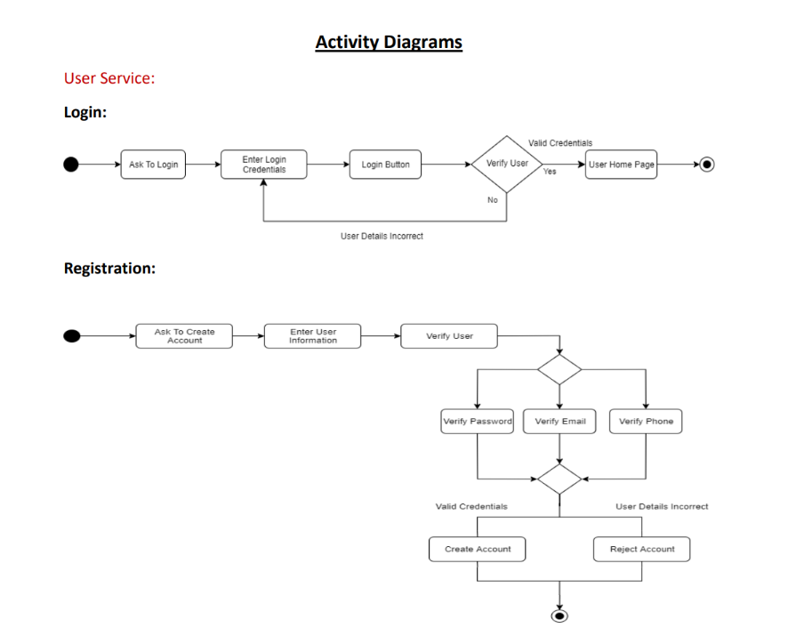

Slide 11
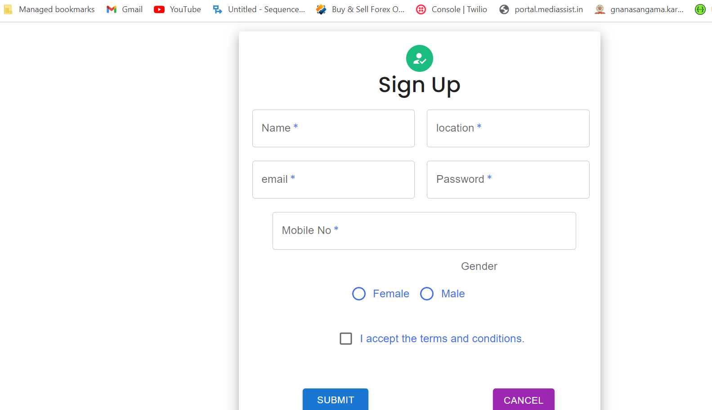

Slide 12
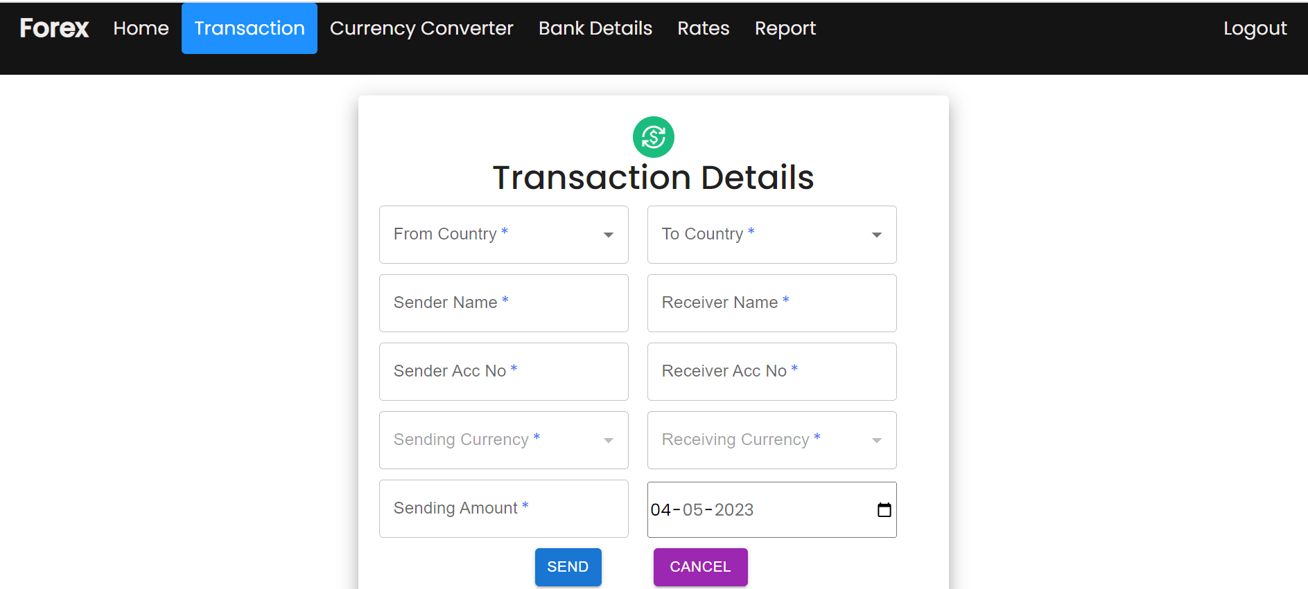
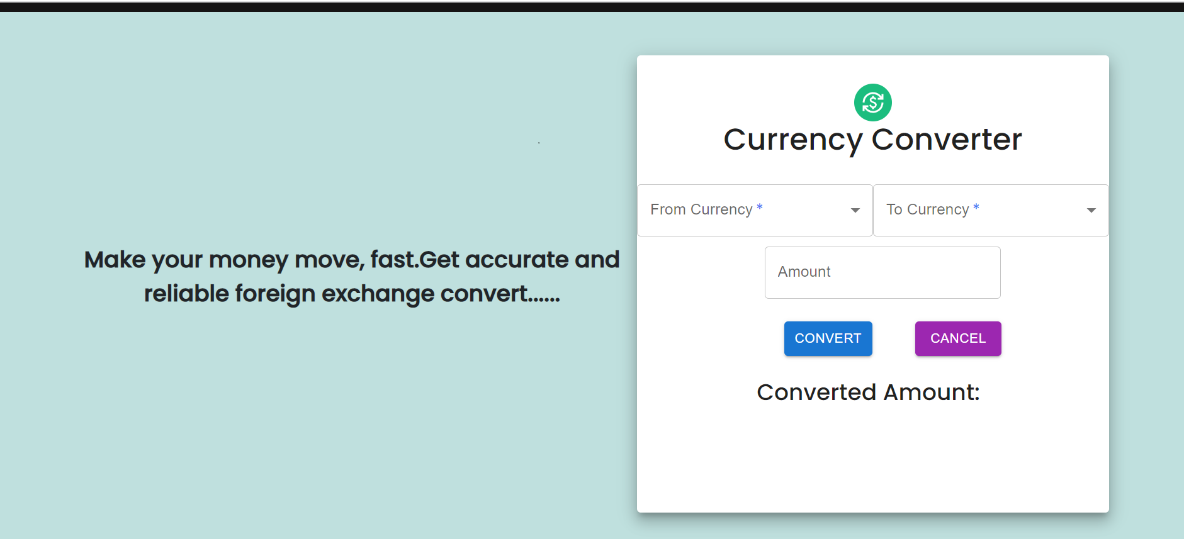

Slide 13
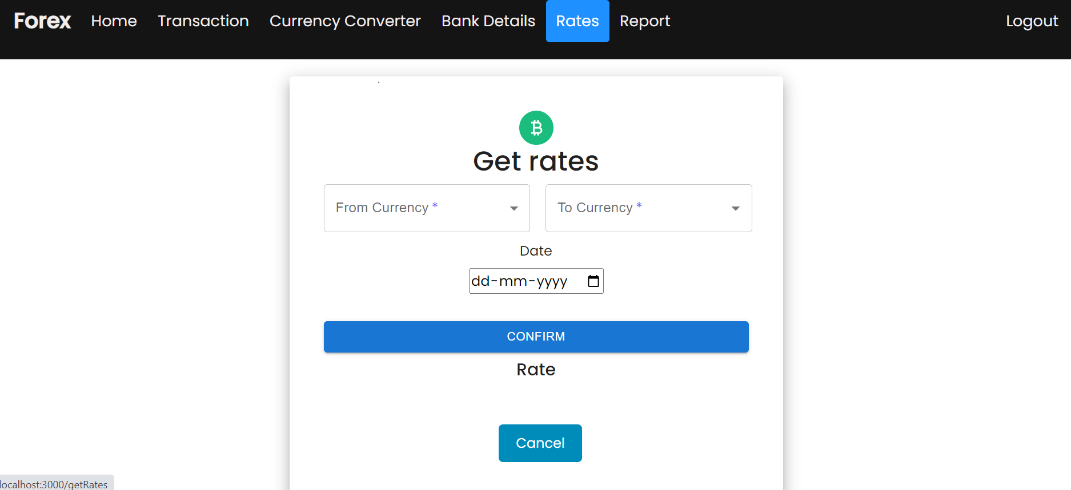

Slide 14
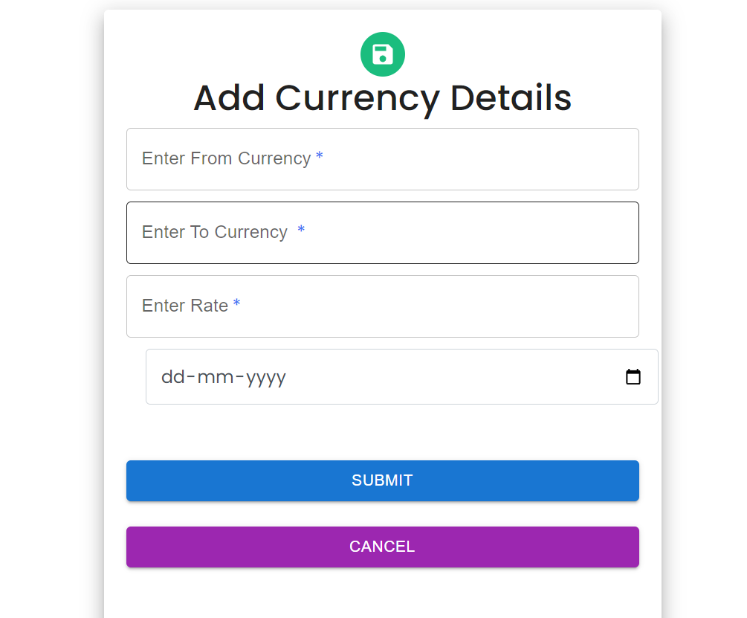
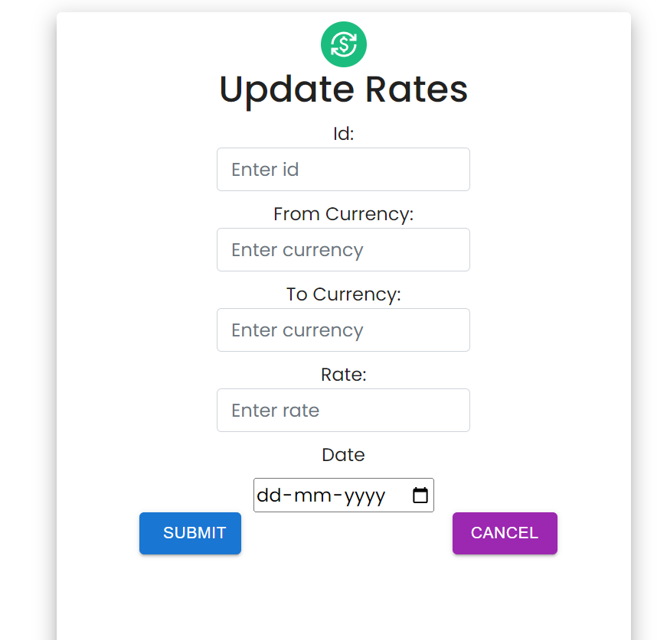

Slide 15
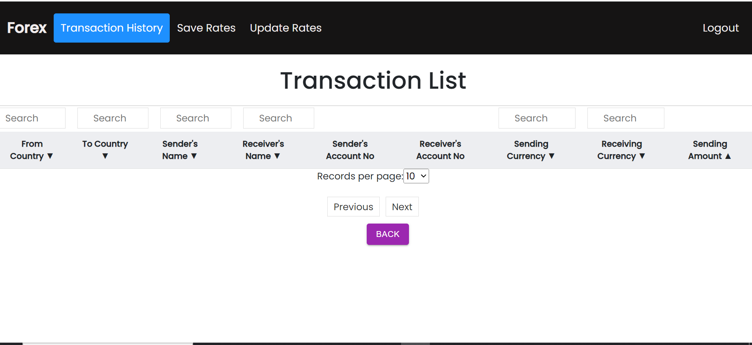

Slide 16
Table Structure
User Bank Details:
ATTRIBUTE | DATA TYPE | CONSTRAINTS
bank_id | int | Primary key
acc_number | long | Unique/Not null
acc_holder_name | varchar | Not null
bank_name | varchar | Not null
Contact_number | int | Not null
Ifsc_code | varchar | Not null
User_id | int | Foreign Key

Slide 17
Verification Table :
User/Admin
ATTRIBUTES | DATA TYPES | CONSTRAINTS
user_id | int | Primary Key
name | varchar | not null
email | varchar | Not null
Password | varchar | Not null
contact_no | int | Not null
country | varchar | Not null
ATTRIBUTE | Data Type | CONSTRAINTS
Verification_id | int | Primary key
Email | varchar | -
otp | int | -

Slide 18
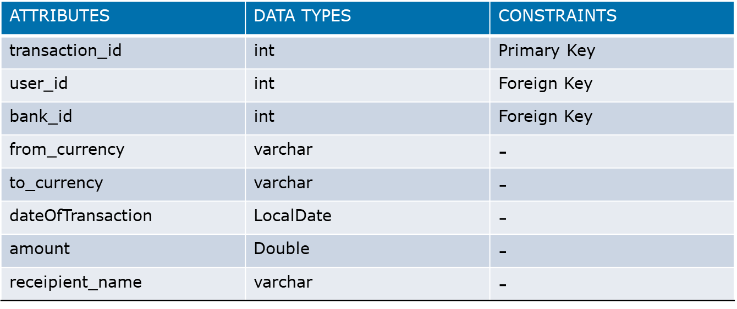
Transaction Table:
Currency_Converter
ATTRIBUTES | DATA TYPE | CONSTRAINTS
Currency_id | int | Primary key
From_currency | varchar | Not null
To_currency | varchar | Not null
Amount | double | Not null

Slide 19
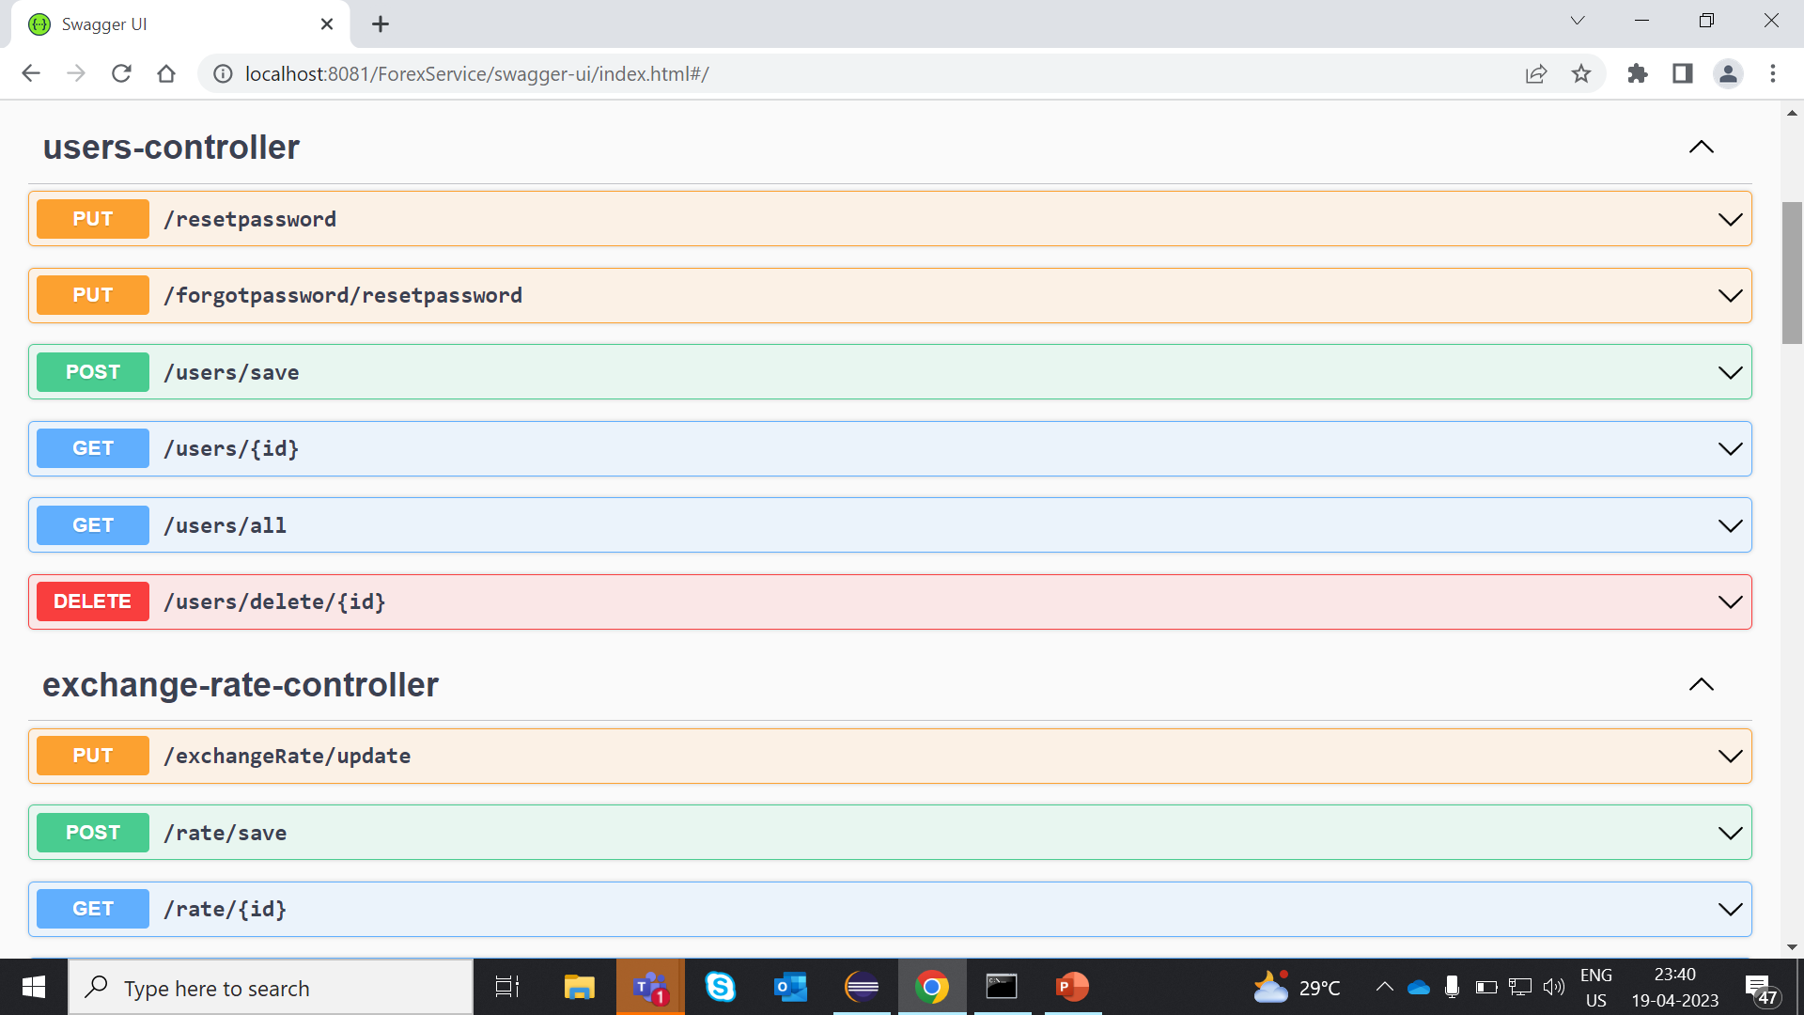
API Endpoints

Slide 20
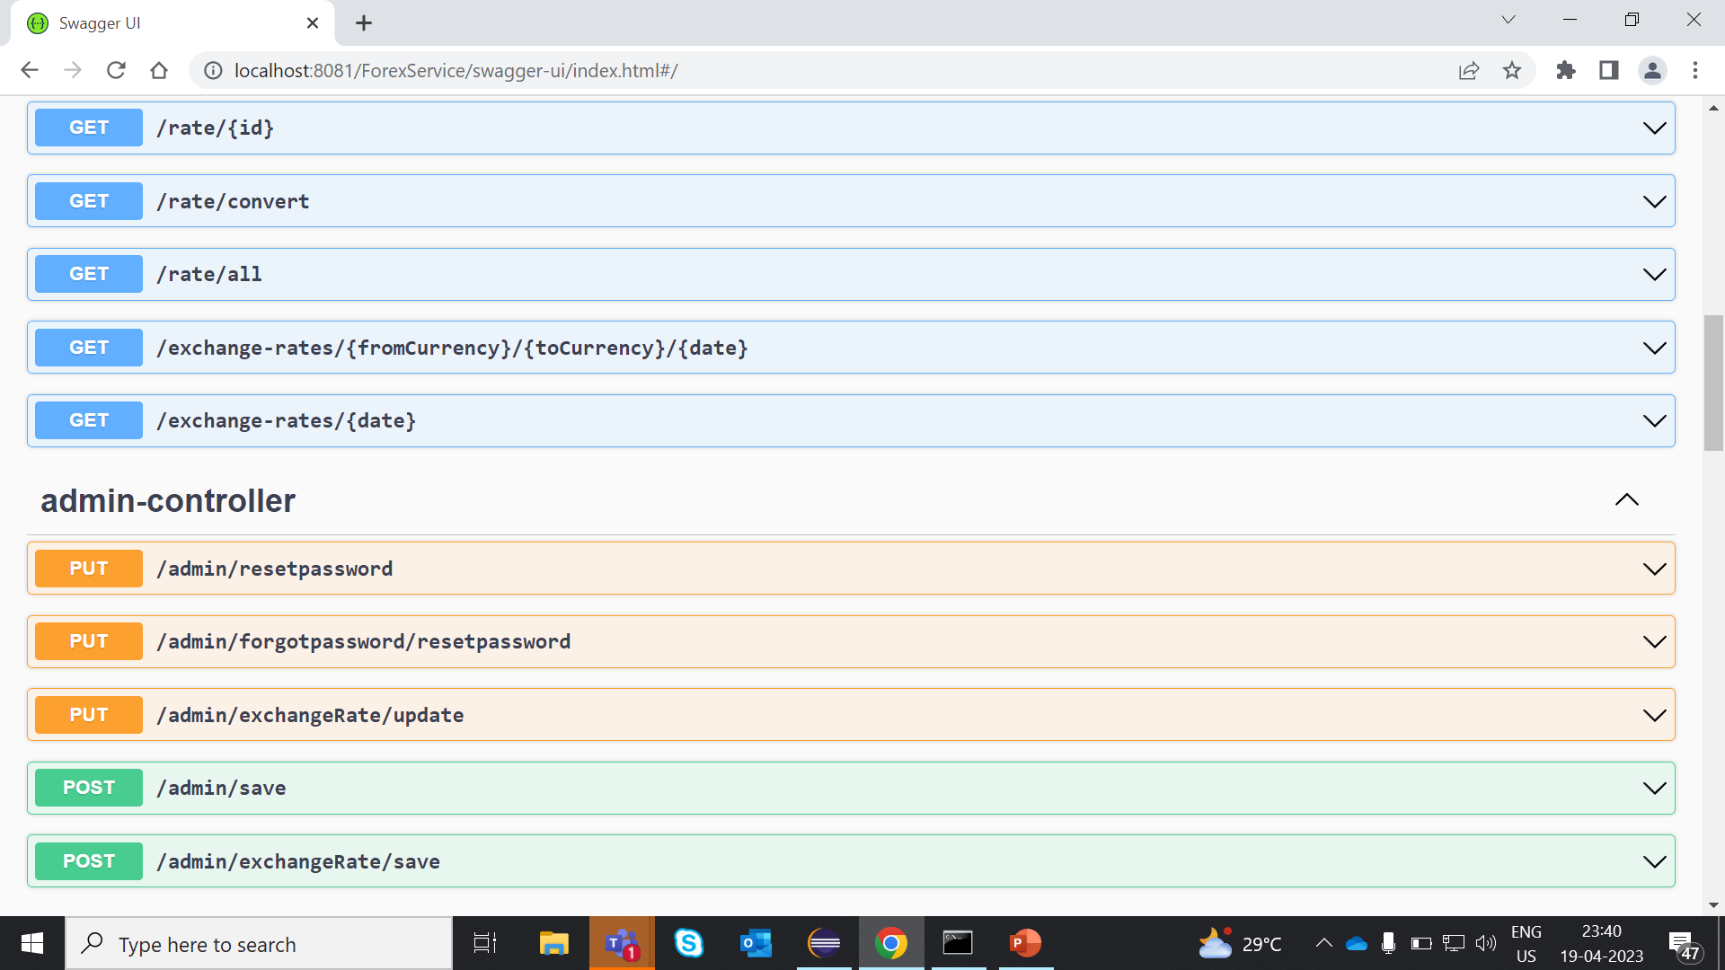

Slide 21
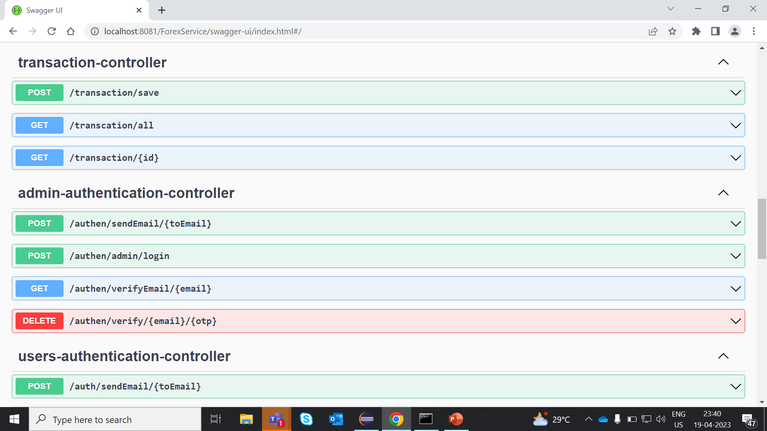

Slide 22
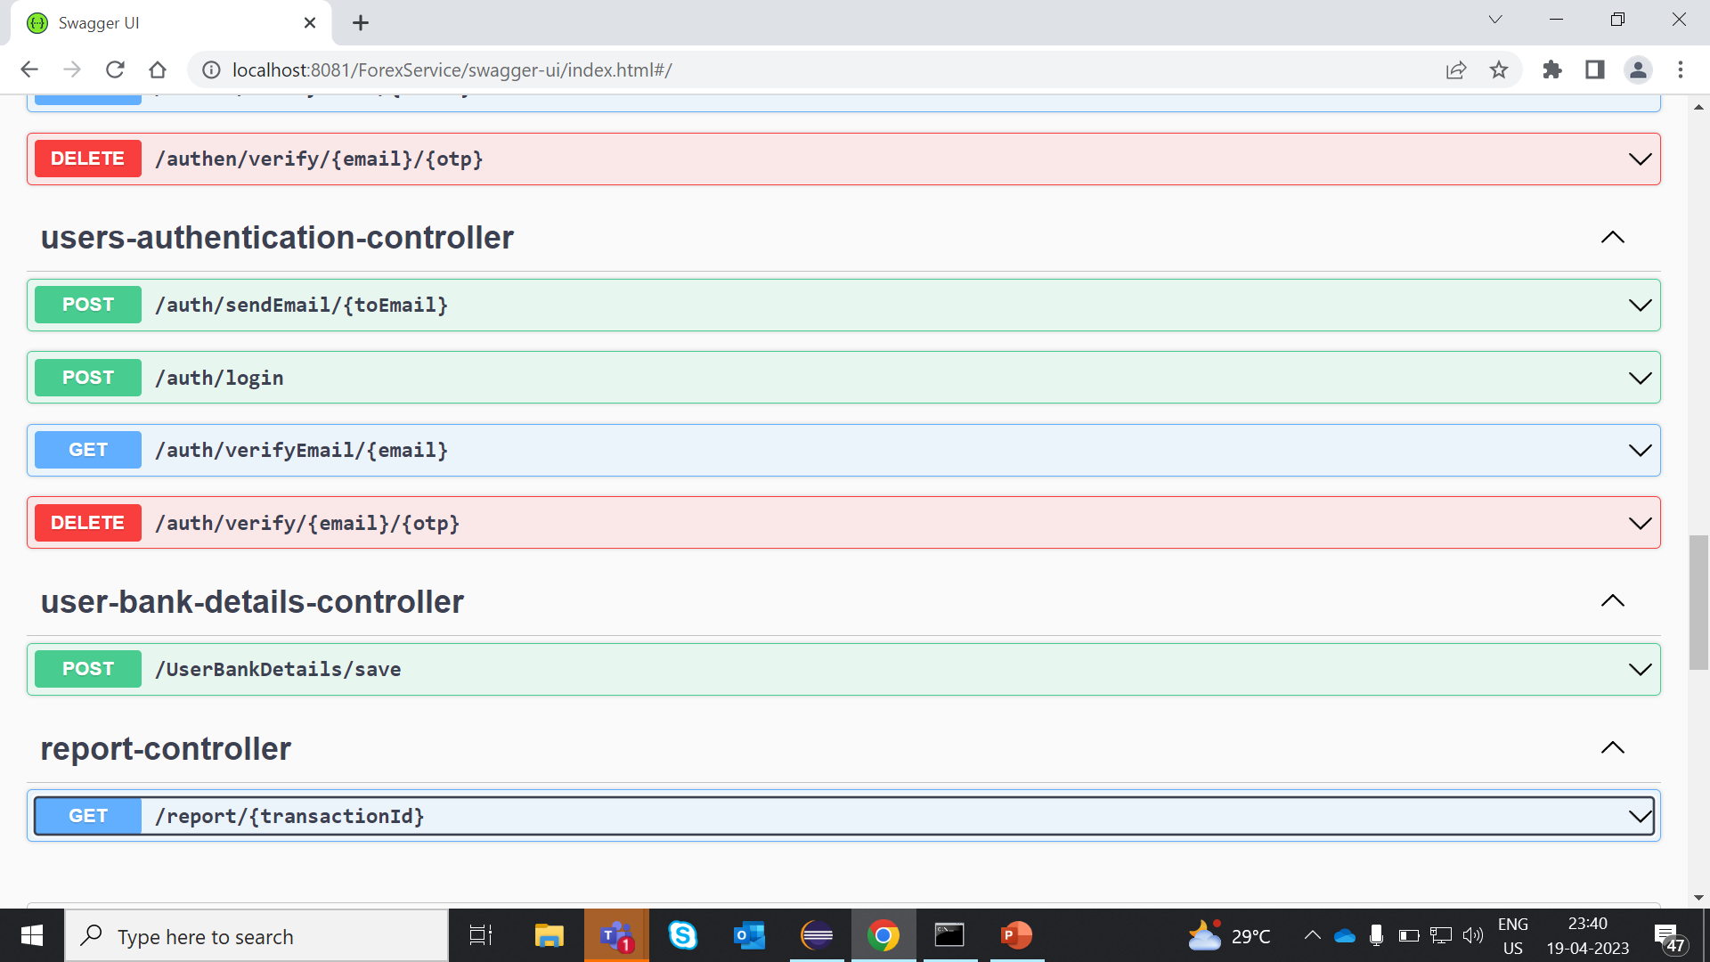

Slide 23
Jenkins Pipeline Snapshot :

Slide 24
THANK YOU

