Slide 1
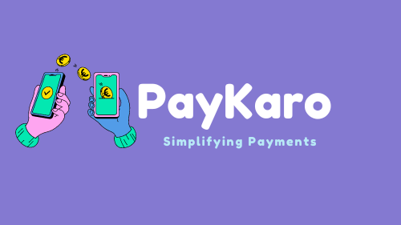
-Shalmali Nighot

Slide 2
Introduction:
PayKaro is a mobile wallet and payment application designed to offer users a convenient way to manage their finances, make transactions, and earn rewards. The application focuses on providing various financial services and features that cater to users' everyday needs.

Slide 3
Road Map :
Application is developed in following Sprint –
Spring Boot Microservices+ Rest Controller + JPA with Hibernate
Plan :
Design
Generate the skeleton as per class design provided
TDD approach
Identify test cases for each module
Write Failing Test cases
Convert the Test Cases in GREEN
Implement the case study in incremental manner

Slide 4
Key features and functionalities :
User can register themselves on Pay Karo (via phone no & email id)
User can add money to Pay Karo Wallet (by card or bank account) •
User can check balance of Pay Karo Wallet
User can transfer money to any Pay Karo User
User will get cashback / rewards on every transaction
Cashback should be added to Pay Karo wallet
User can view cashback / reward history

Slide 5
Modules Of System :
Wallet
Transaction
User Bank Details
BillUtility
Users
Rewards

Slide 6
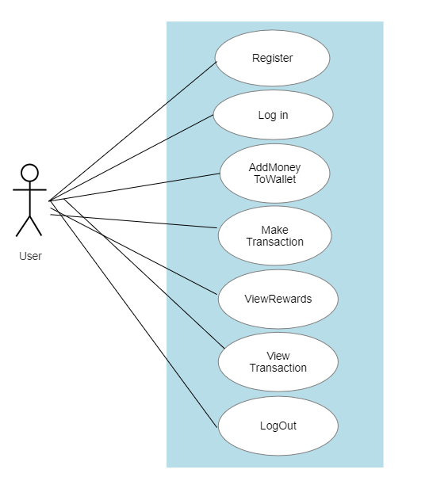
Use-Case Diagram:

Slide 7
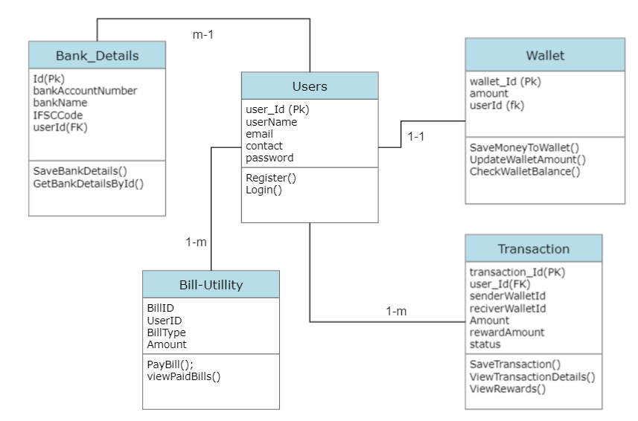
Class Diagram:

Slide 8
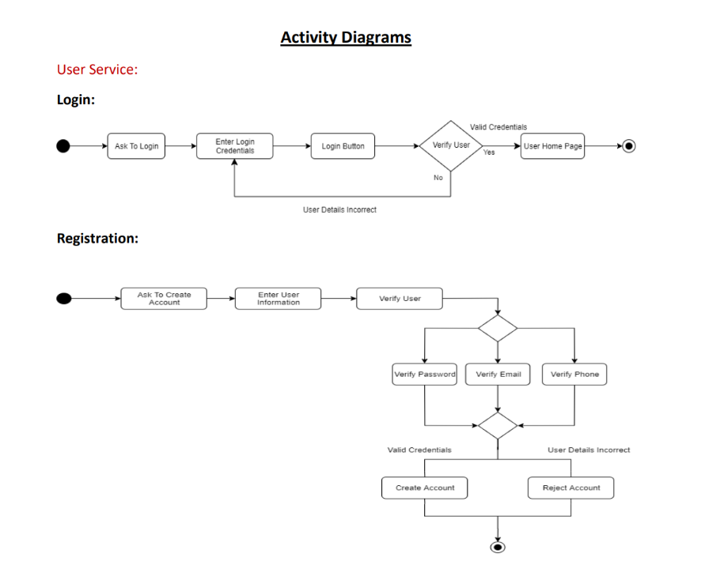

Slide 9
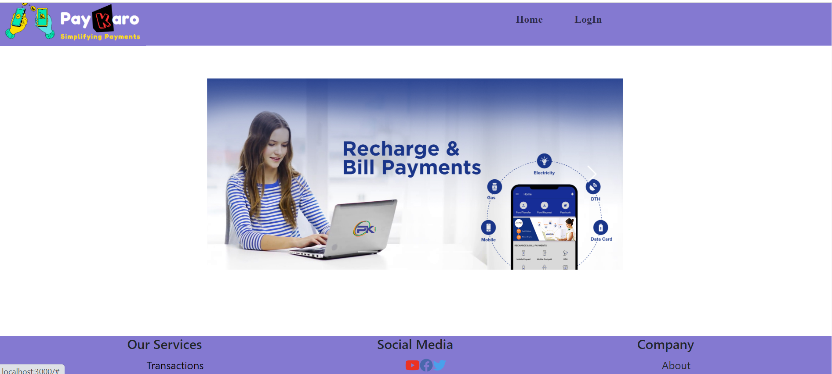

Slide 10
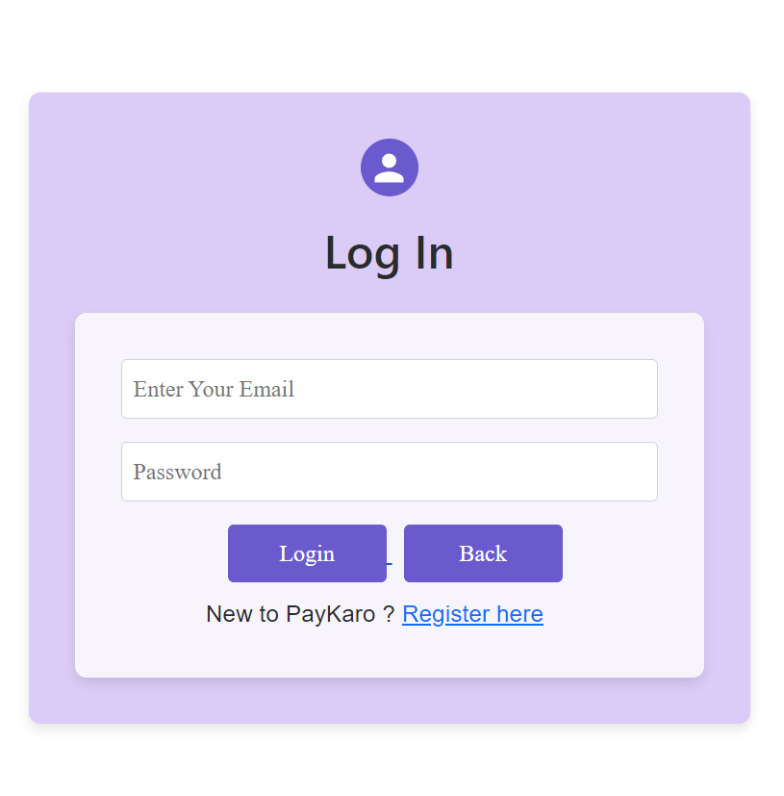

Slide 11
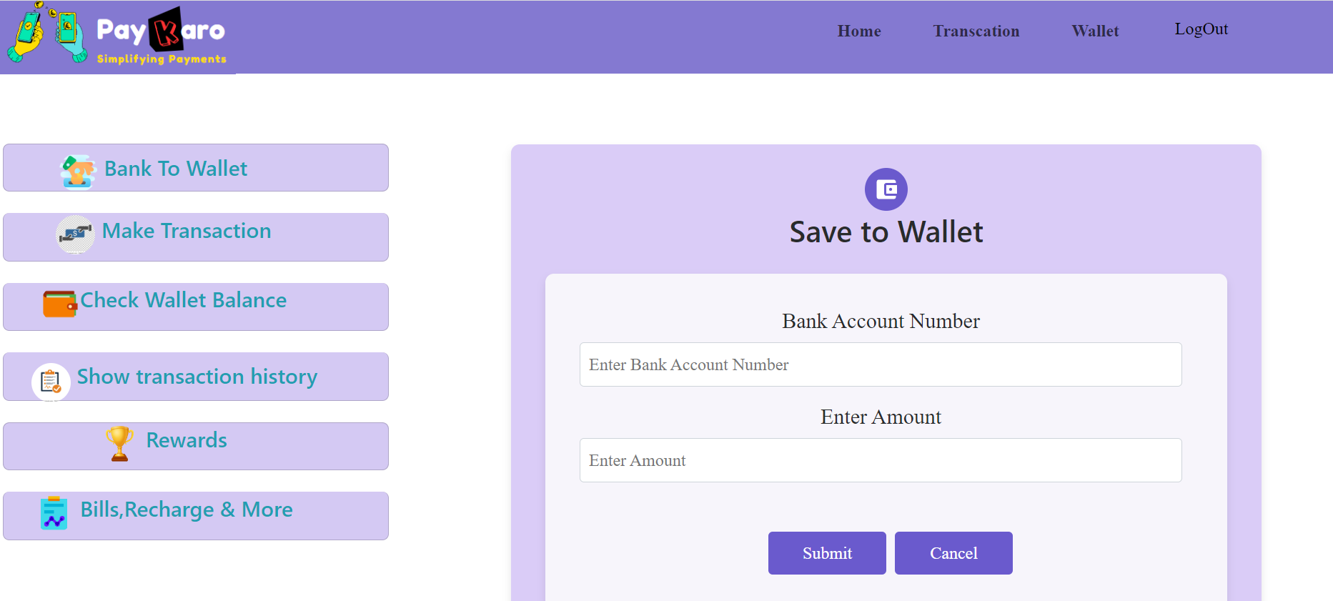

Slide 12
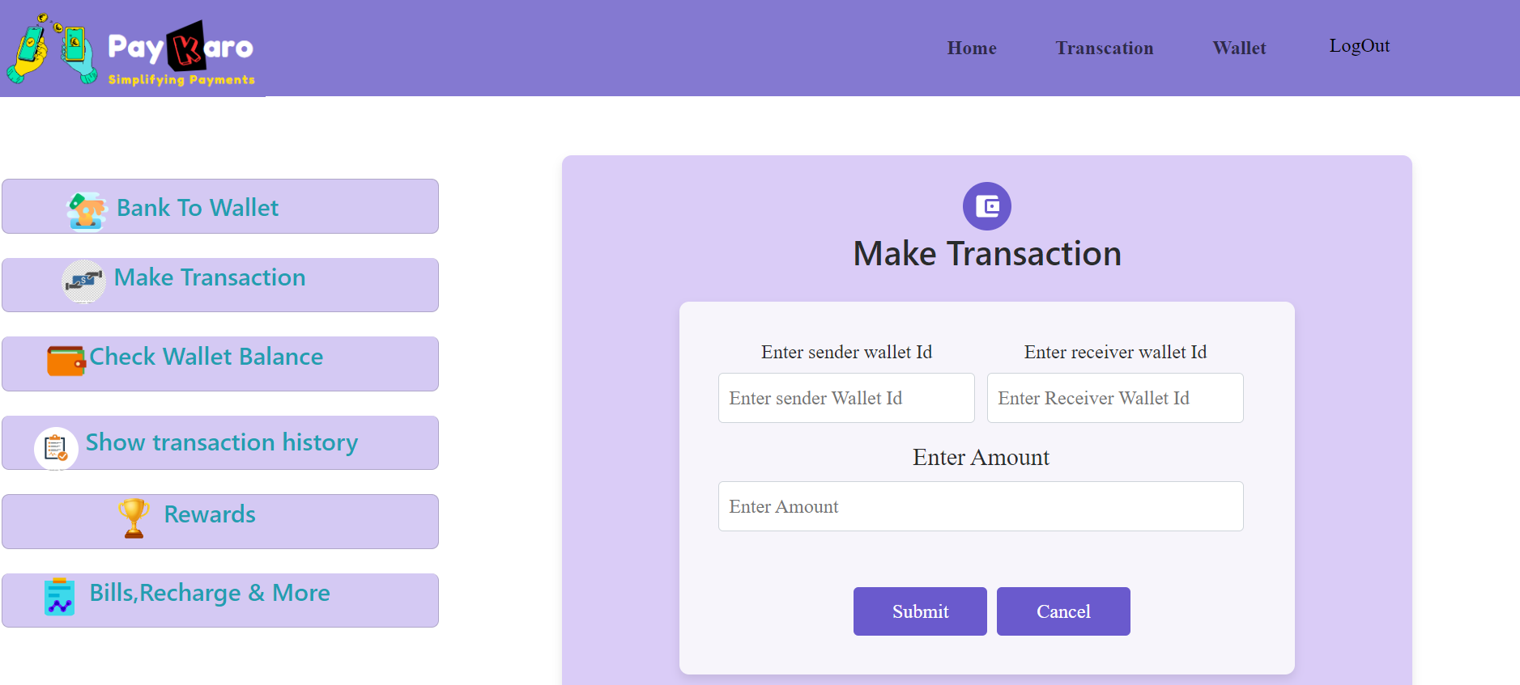

Slide 13
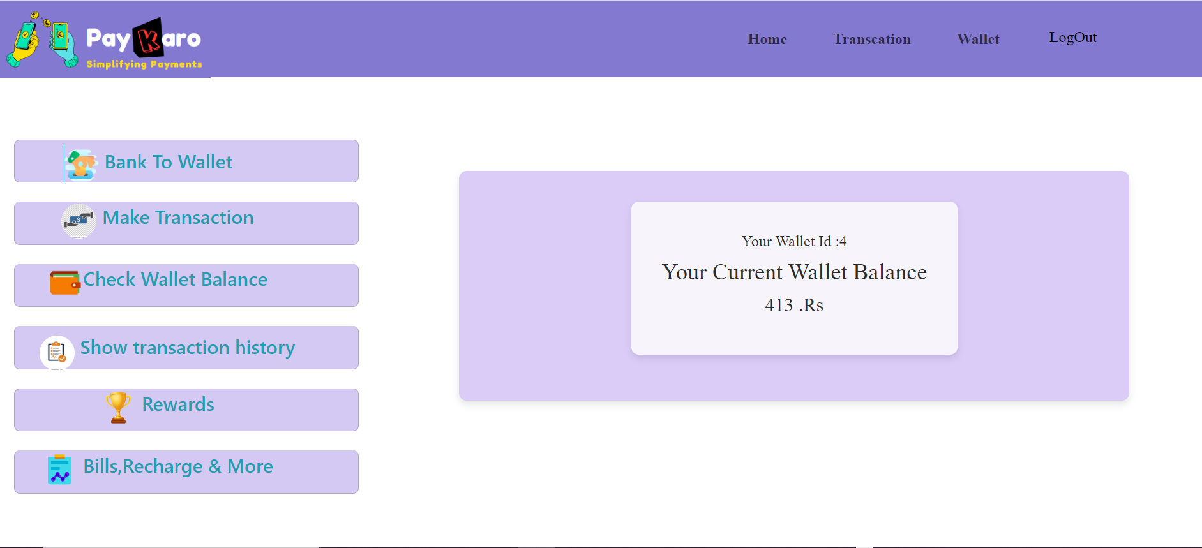

Slide 14
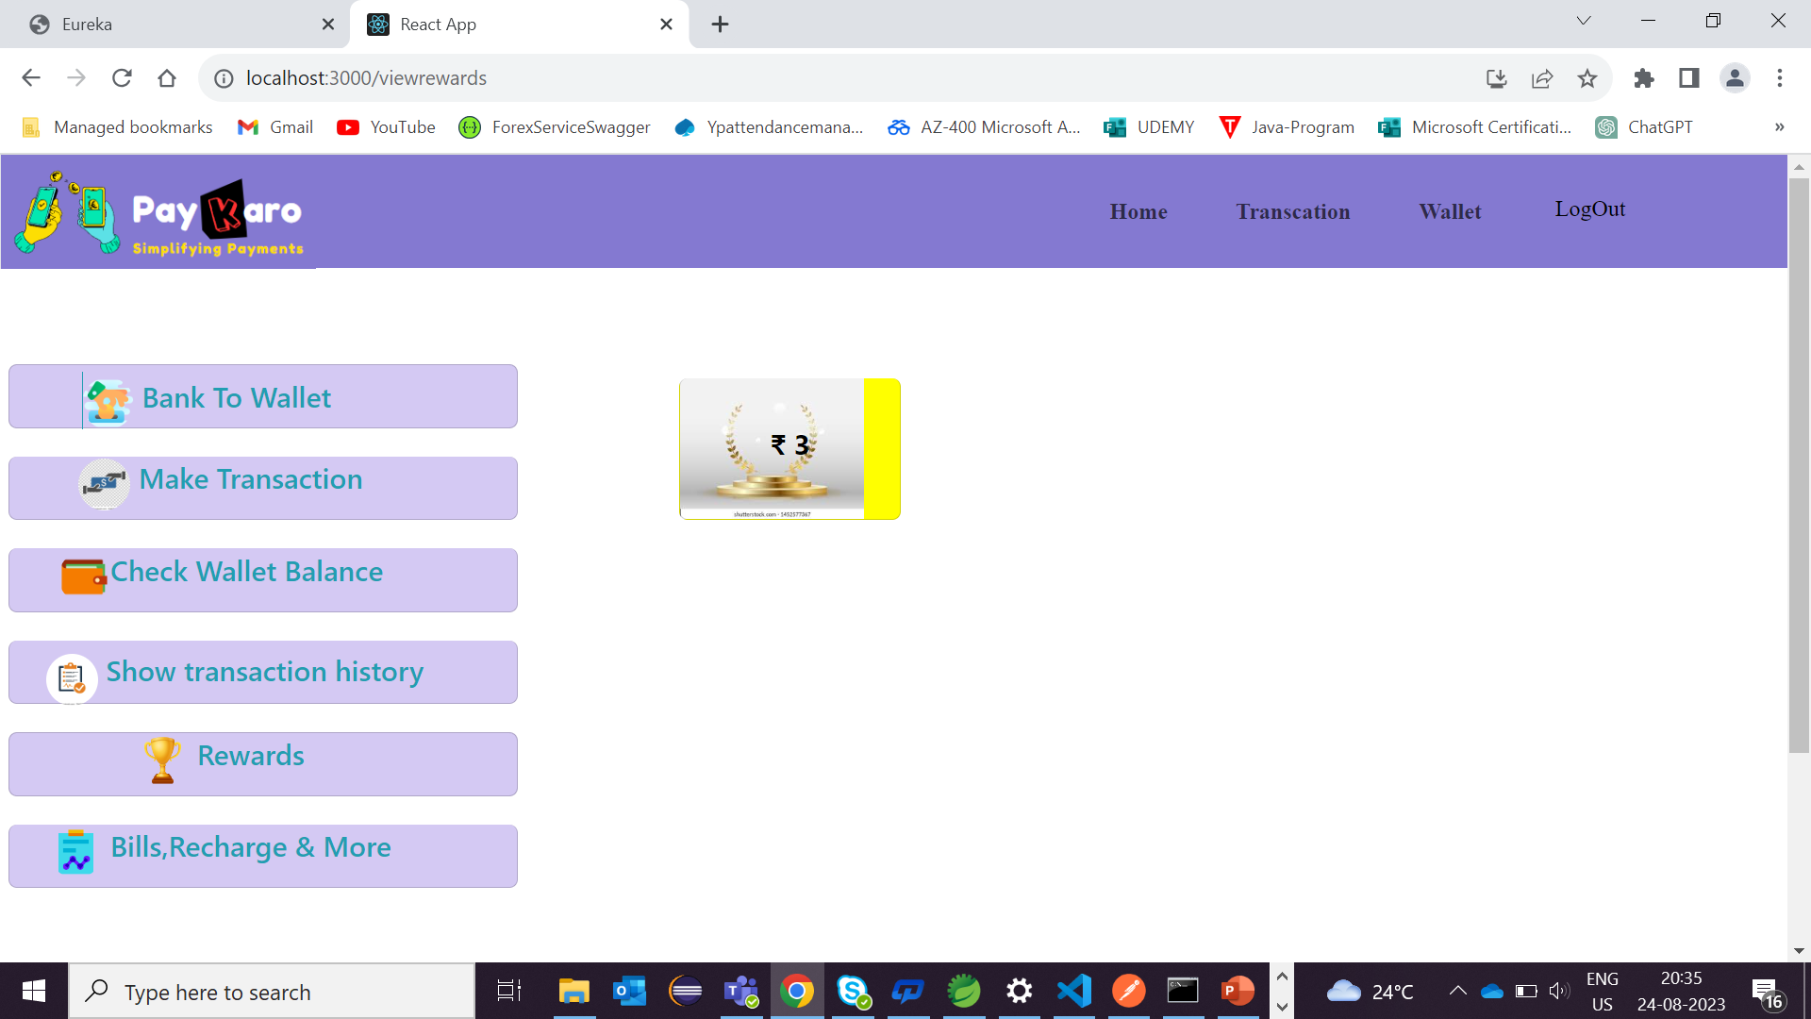

Slide 15
Thank you

