Slide 1

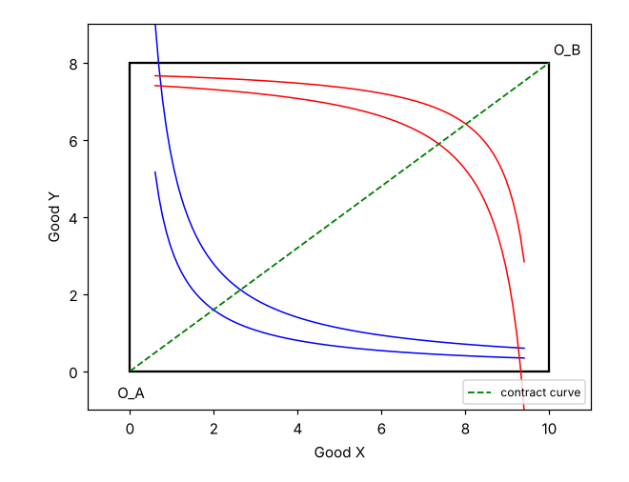
Edgeworth box
• Two consumers share a fixed endowment
• Each corner is one consumer's origin
• Efficient points lie on the contract curve
Microeconomics 101 - Lecture 4 - Fall term

Slide 2
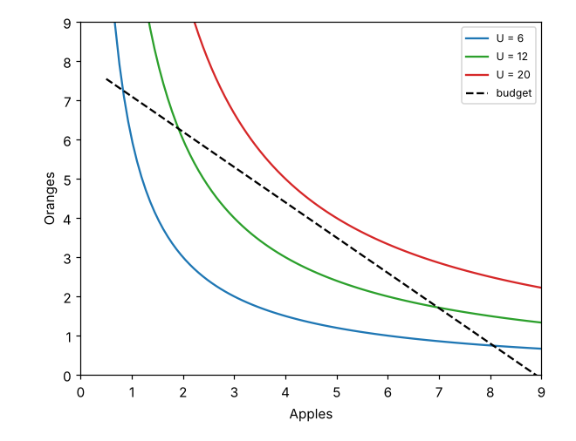
Indifference curves
• Higher curves mean more utility
• Curves are convex to the origin
• The optimum is where the budget line is tangent

Slide 3
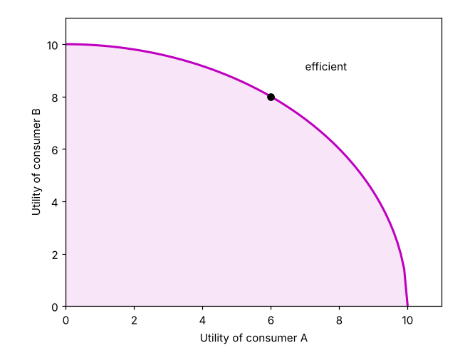
Utility possibility frontier
• Maps every efficient allocation to utilities
• Points inside the frontier are wasteful
• Points outside are infeasible
Microeconomics 101 - Lecture 4 - Fall term

Slide 4
Summary
• Efficiency is not fairness
• Trade-offs live on the frontier

