Slide 1
E D A
EDA on US shooting
take out some insights and analyse the story around racism in America.

Slide 2
Presentation Content
Hypothesis
This will talk about the hypothesis we made before we performed the EDA
E D A
QUESTIONS
This will cover the questions we used for the EDA
VISUALIZATION
This will cover the analysis we made with the data
INSIGHT FROM VISUALIZATION
This will cover the meaning we made from the data

Slide 3
Hypothesis
?
There is racism behind the recent police shooting in US

Slide 4
Questions
How many number of killings according to race were recorded?
Which race used the highest arms(category)?
which race had the highest number of killings?. How many men and women were killed under a specific race?
How many suspects attempted fleeing?
which state recorded the highest number of killings?
How many suspects below and above 18 years were killed? How many are males and females?
Which city has the highest shooting?
Percentage of armed and unarmed victims

Slide 5
Visualization
This will cover the analysis we made with the data

Slide 6
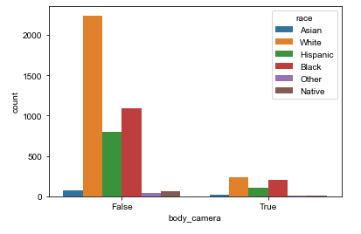
How many number of killings according to race were recorded?
white recorded the highest number of killing but it has the almost the same number of recorded cases as Blacks. from this we can infer that killing of the whites are mostly not recorded

Slide 7
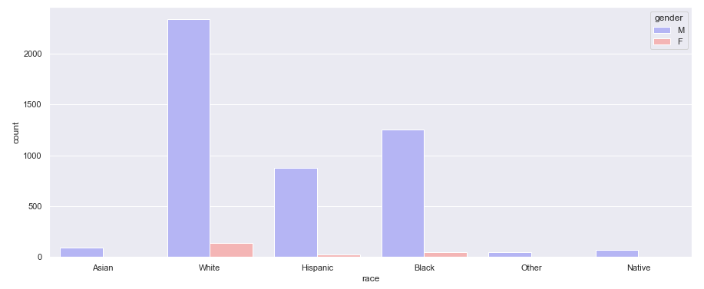
which race had the highest number of killing?. How many men and women were killed under a specific race?
The whites has the highest number of killing followed by the blacks.
others have the least number if killing

Slide 8
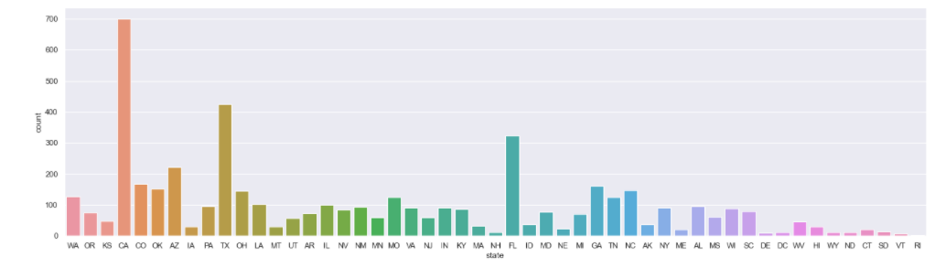
which state recorded the highest number of killings?
The census conducted by the United state census Berea shows that the whites are the most dominate people living in the states that recorded low number of killing and they are the least dominate at the states that recorded high number of killing.
From this we can infer that the whites are not the target of the killing

Slide 9
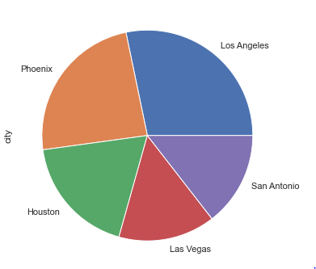
Which city has the highest shooting?
The pie chart above indicate the top five cities with high number of killing. all the cities are found in the states that have less number of whites. From this we can infer that the killing the target of the killing was not the whites but the other races.

Slide 10
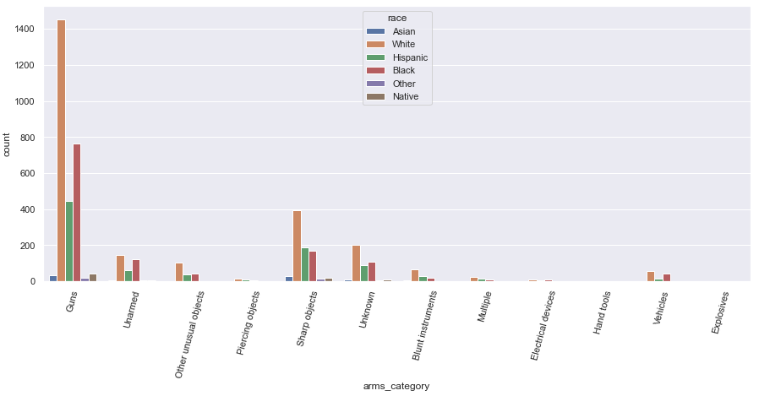
Which race used the highest arms(category)?
the number of unarmed whites are close to the number of unarmed blacks but the white are two times more that the blacks.
this shows that the whites uses arms more than the non-whites. This means that the whites are more likely to attack than all the other races together (non-whites).

Slide 11
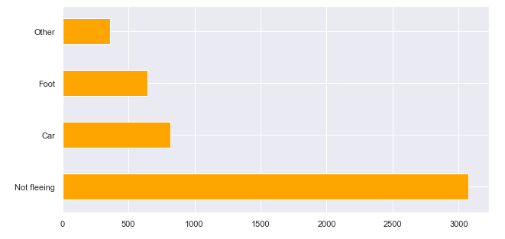
How many suspects attempted fleeing?

Slide 12
INSIGHT FROM VISUALIZATION
We realized that the non-whites are the target of the killing, therefore there is racism in the US police killing

Slide 13
E D A
Thank You

