Slide 1

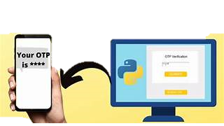
Project Title: OTP Verification System
Python Capstone Project
Submitted by : Shalu Chauhan
SID- S8252

Slide 2
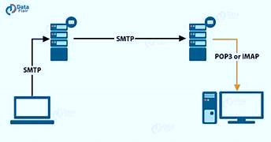
STAGES OF THE PROJECT
1.
Implementing function to generate a 6-digit OTP randomly
Using smtplib to stimulate an automated email sending system
2.
Implementing Function to take OTP input from the user
Implementing the logic using conditionals and loops to verify OTP
3.
Using tkinter library to create a basic GUI
Connecting the above functions into the tkinter interface

Slide 3
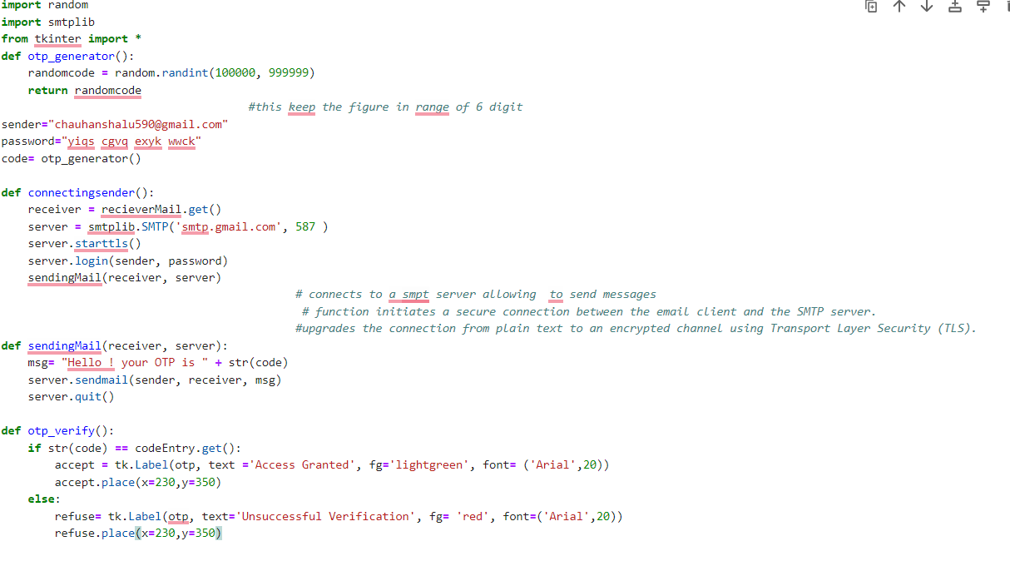
BIFURCATING THE PROBLEM IN VARIOUS FUNCTIONS
Created a function for generating random numbers. Customized it to give exactly 6 digits.
Establishing the connection – SMTP library –
Chose a default email and enabled two set verification to allow SMTP server to connect to it and send mail.
Used starttls() to start a Transport Layer Security (TLS) encryption session with the SMTP server and ensure that the communication between the client and the server is encrypted and secure.
Login function help safe log in to default mail
Created a function to receive the receiver ID and linked it to the window of tinker UI using recieverMail.get()
Created a function to initiate the message sending.

Slide 4
Created a function to verify the OTP:
Here connection to the tinker interface was made to receive OTP from the user through codeEntry.get()
Created a tk label to display access granted if the user code matches with the random OTP generated.

Slide 5
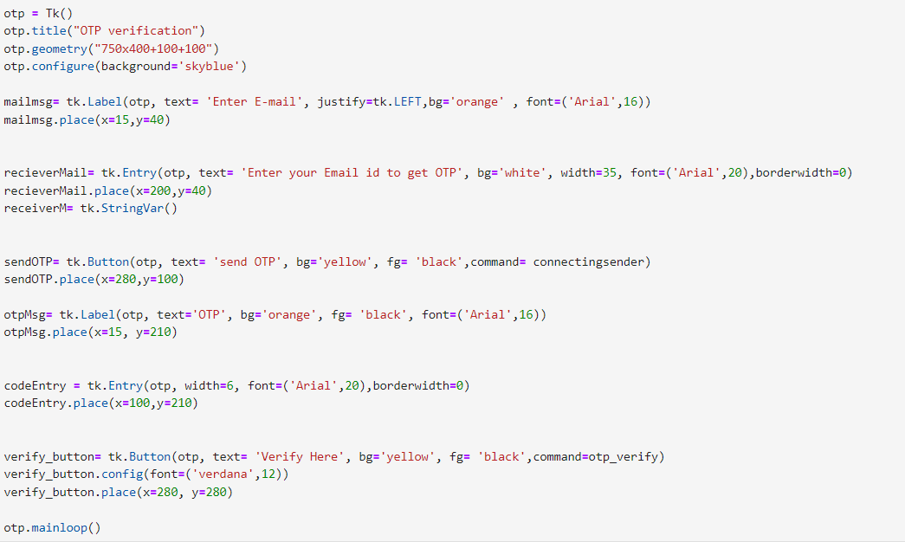
THE USER INTERFACE TKINTER LIBRARY
Created an object of tkinter class as otp
The basic dialogue box-
Using general syntax (otp.customisation(specification)
Implementing the above added title, defined space of the box and configuration
Genral steps following this –
1. Creating a label referring to the tk object- OTP and specifying details , and further placing it on specific coordinates
2. Creating a variable to trigger the Entry function referign to OTP which provides space for user input
3. Creating a button variable using tk.button which refers to OTP object and triggers the connecting sender function in the base code
4. Repeating the above steps to create an otp entry and verification display and button

Slide 6
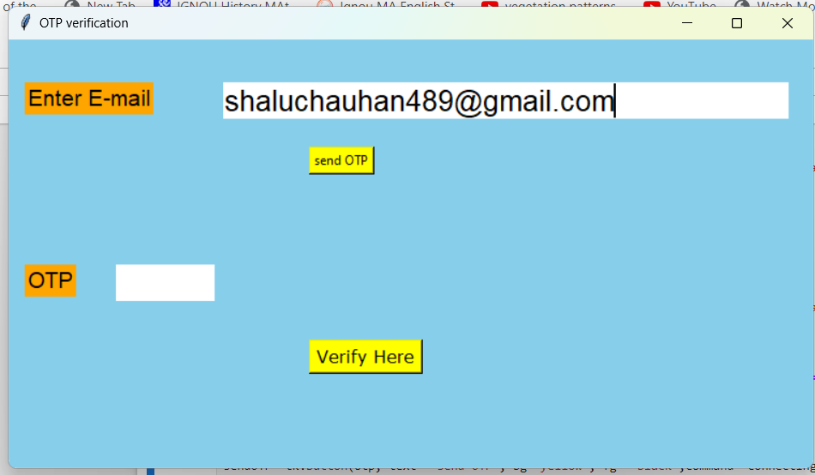
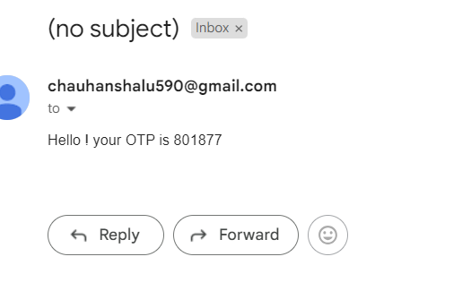
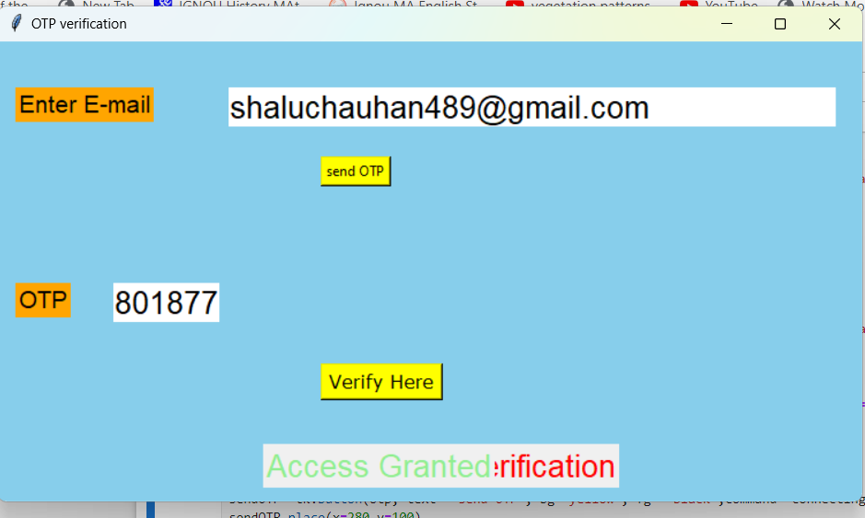
The Output and GUI
the output first creates a dialogue box prompting the user to enter the email
Send OTP trigger email sending function
Email received in the entered ID
OTP is entered
The Verify here button triggers the verification function
The access is granted

Slide 7
THANK YOU !!

