Slide 1
SQL PROJECT PRESENTATION
ANALYSING AMAZON SALES DATASET

Slide 2
OBJECTIVE
Analyzing sales data with a focus on three primary themes:
1. Product Analysis
2. Sales Analysis
3. Customer Analysis
Subsequently, providing actionable insights to enhance sales performance at each branch.

Slide 3
STAGES OF PROJECT
1. CREATING DATA BASE /STANDARDISING
2. EDA ON COLUMNS- AGGREGATION /WINDOWFUNCTIONS
3. DATA MANIPULATION - NEW COLUMNS BASED ON EXISTING ONES
4. TEMPORAL ANALYSIS - SPLITTING EXISTING COLUMNS - FEATURE ENGINEERING
5. GRAPHICAL REPRESENTATION USING PYTHON

Slide 4
STANDARDISATION
UPDATE AND ALTER statements
replace spaces in column names to '_'
Alter table amazon
change `Invoice ID` `Invoice_ID` varchar(50)
change `Customer type``Customer_type` varchar(50)
change `Unit price` `Unit_price` varchar(50)
change `gross margin percentage``gross_margin_percentage` varchar(50)
LEARNINGS-
use case difference between UPDATE AND ALTER
use of CHANGE command -- also encountered CAST command

Slide 5
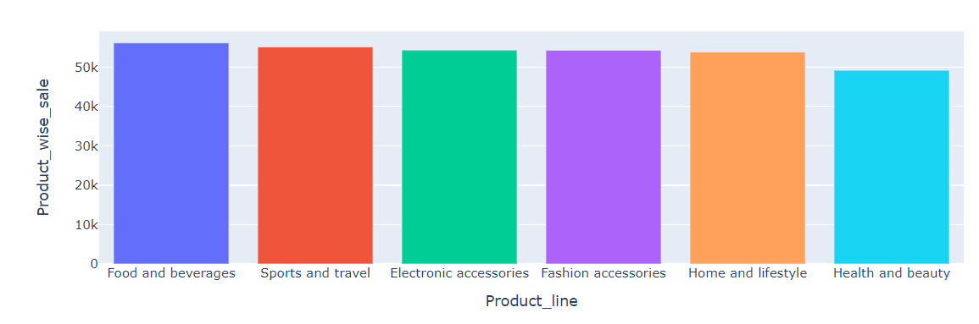
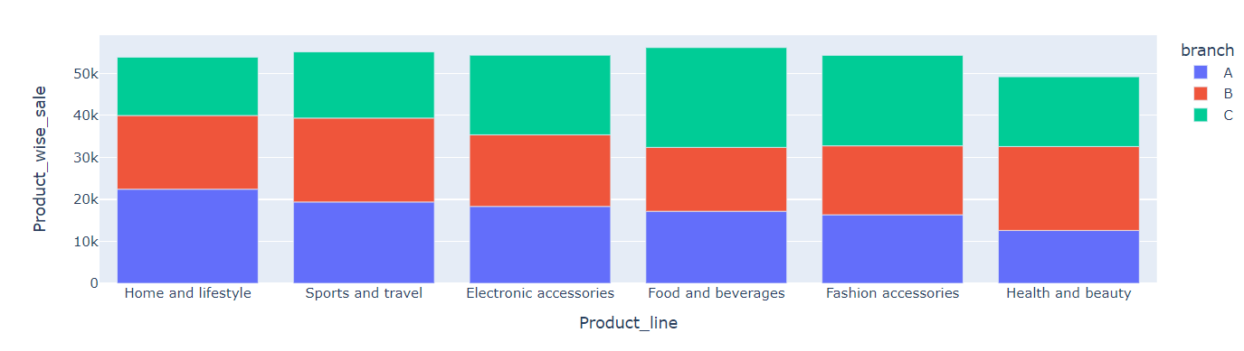
PRODUCT ANALYSIS
Overall –
6 distinct product line
Food and beverage have max revenue
INDIVIDUALLY –
C branch- food beverage > fashion acc> Electronic are most popular
home < sports < lowest
A branch - home and lifestyle>sports>electronics
Health <fashion < food - bottom three
B branch -sports> health> home
Food in b
INSIGHTS –
It must be analysed whether better performance is due to customer demographic, and regional biases or learnings from other branches can be done like marketing strategy, and quality as we see that pricing is the same for all

Slide 6
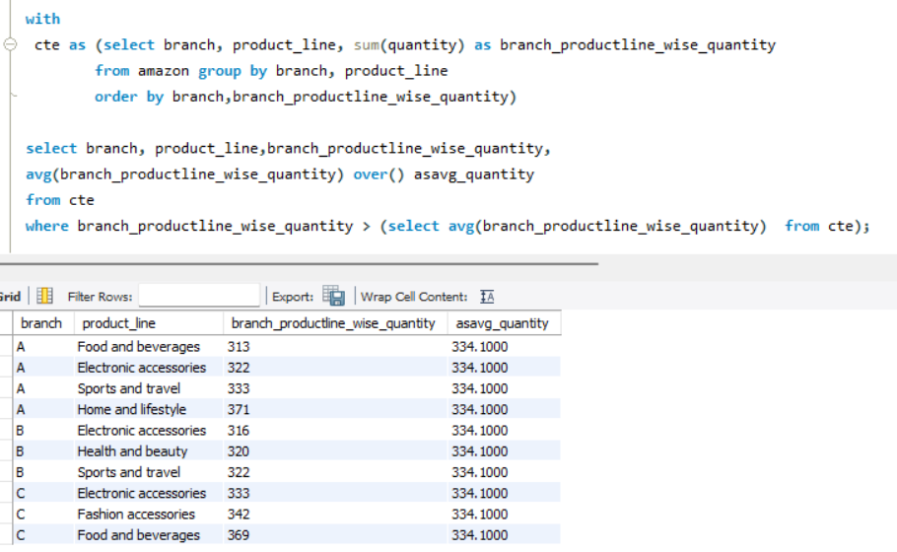
Branch that exceeded the average number of products sold.
CODE SNIPPET
Summing the quantity branch and product line wise
Further using it as an average in the subquery and window function
INSIGHTS–
In all three branches A had 4 categories exceeding the average quantity sold
Max was home and lifestyle in A followed by food and beverages in C and fashion accessories in C
Electronics as a category occurs most times thus it can be enquired why despite maximum sales its revenue is not highest
Food and beverage in C links to its max revenue there
Similarly home and lifestyle in A corresponds to its max revenue in A

Slide 7
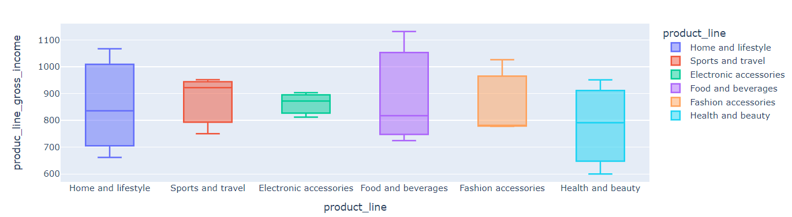
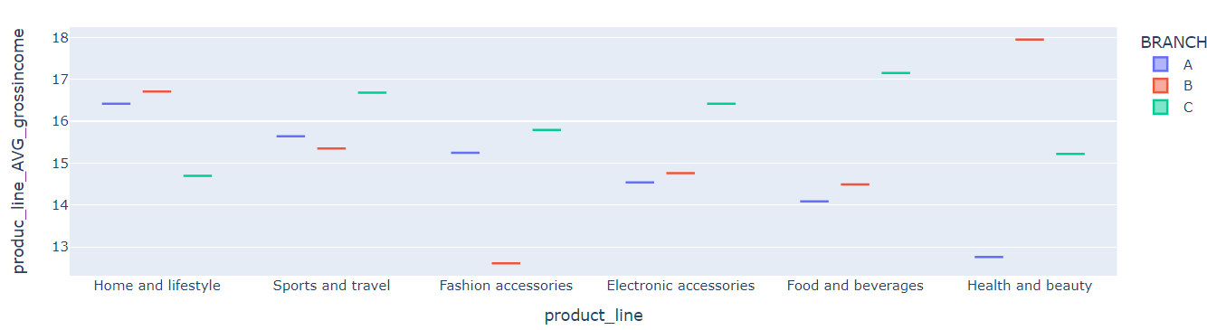
PRODUCT GROSS INCOME ANALYSIS
GROSS INCOME –
top three income sources –
food beb> sport> elect
bottom 3 –
health, home fashion
AVERAGE GROSS INCOME –
Best avg gross income-
for A
Home > Sports >
For B-
health > home > sports
For C
food> sports >electronics

Slide 8
INSIGHTS –
Observe that revenue and gross income are not the same for
Goods so probably cost of goods is high.
Hence, businesses must reduce it to make high revenue categories more profitable

Slide 9
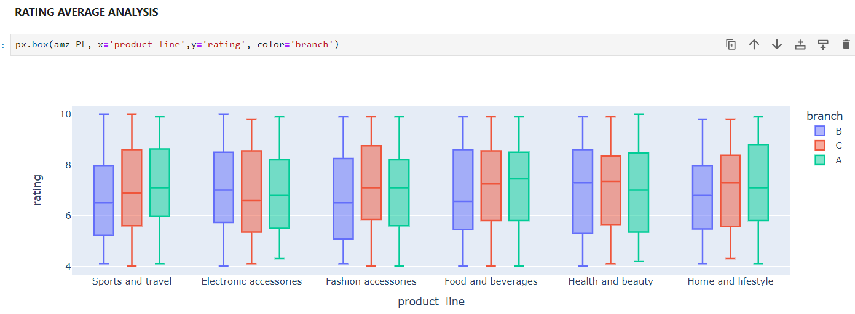
RATING ANALYSIS
AVERAGE RATING –
A highest average rating in –
sports and travel, Fashion, food
B best rated in –
Electronics, Health
C best rated in
fashion, health, food and home
INSIGHTS –
We can link the branch-wise product line with the best revenue and gross income and see whether ratings impact

Slide 10
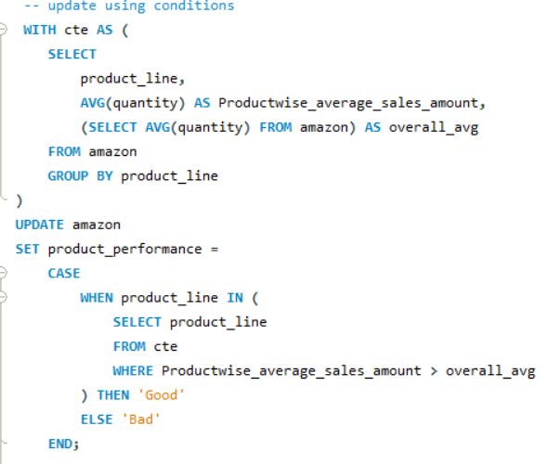
Column Creation
STEP 1- CREATE column
alter table amazon add column product_performance varchar(10);
STEP 2- POPULATE the column
using case statements and
Use of CTE and SUBQUERY
to create a customised column and categorise the data based on condition
Here if the sales quantity is greater than the average sales in that product line the order comes as good otherwise bad

Slide 11
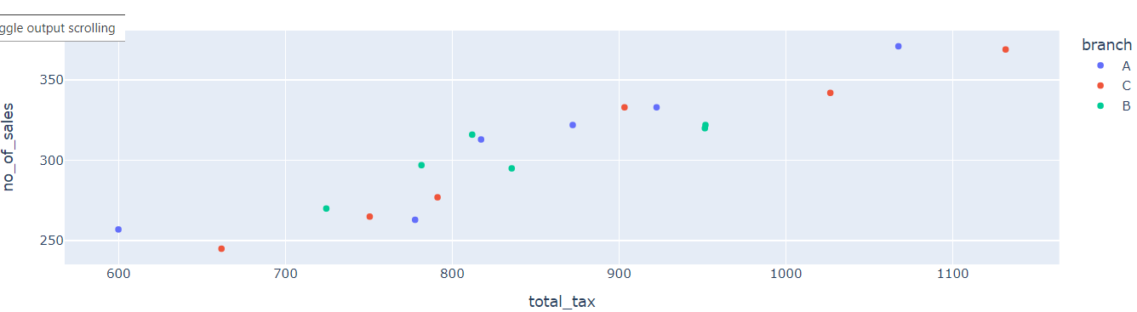
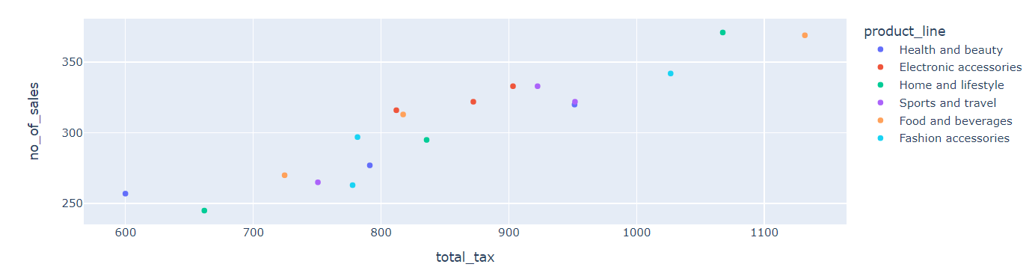
SALES VS TAX
Combining two aggregate columns- Sales and total tax and grouping by product and branch
have a linear relationship with each other – since the query is grouped by branch and product line we get corresponding points. Read by combining
Highlighting Branch –
For A
Health and beauty total tax is around 600 for 250 sale
fashion tax- 790 for sales 260
Food tax- 817 for sales 313
Electronics 872 for sales 322
Sports 922 for sales 333
Home lifestyle 1000 sales- 371
For B
Health and beauty total tax is around 951 for 320 sale
fashion tax- 781 for sales 297
Food tax- 724 for sales 270
Electronics 811 for sales 316
Sports 951 for sales 322
Home lifestyle 835 sales- 295

Slide 12
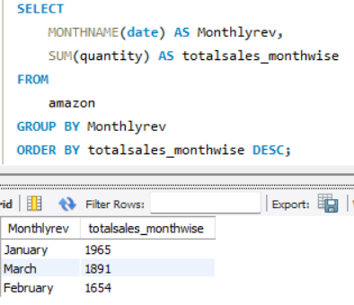
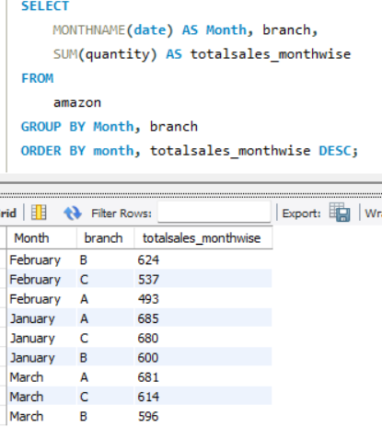
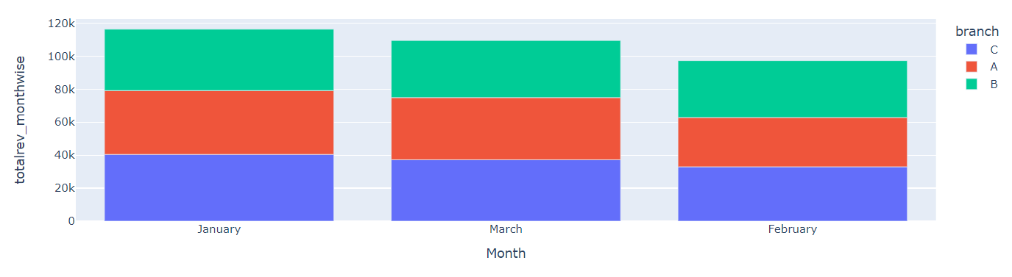
TEMPORAL ANALYSIS
COLUM MANIPULATION
Simply extract the month using - MONTHNAME(date) AS Monthlyrev
January has the maximum revenue followed by March and feburary
With C>A>B in Jan
C and A again performing better than B in March
Whereas in Feb B performs better

Slide 13
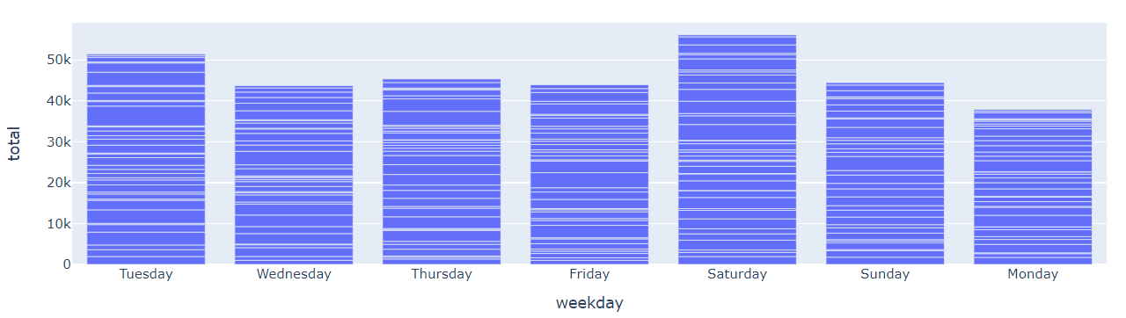
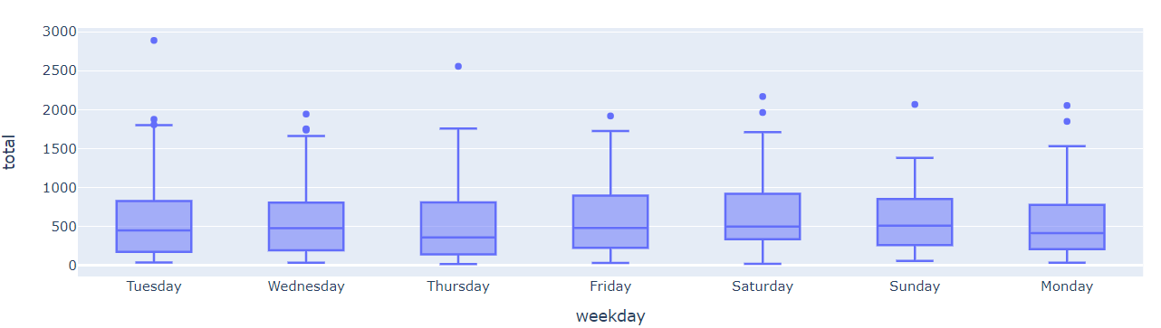
WEEKDAY TRENDS
TECHNIQUE – COLUMN MANIPULATION
Saturday > Tuesday> (Thursday/Friday/Sunday)
Weekend demand
AVERAGE REVENUE ANALYSIS
Sunday averages best followed by Saturday
Thursday has lowest average revenue

Slide 14
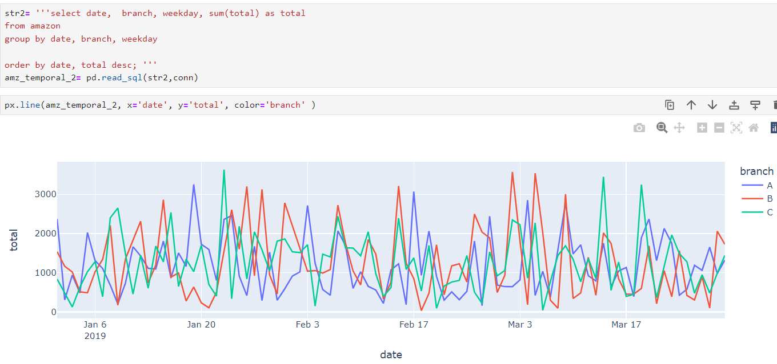
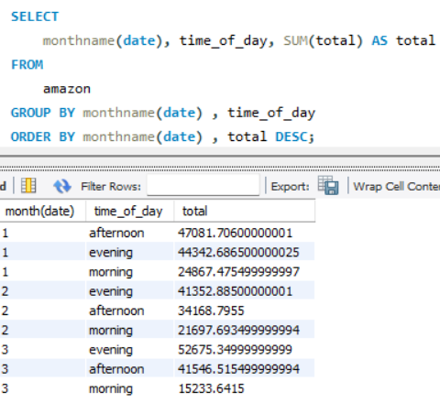
DATE-WEEKDAY TRENDS
Non-linear trends in all the branches
Observe the different peaks in different time to see which branch performs well
Non-linear trends in all the branches
Observe the different peaks at different times to see which branch performs well
Morning- performing low overall in all three months
Evening - best time however in Jan we also see afternoon sales
ACTIONABLE-INSIGHTS –
By combining the best product line in each branch from the above analysis we can target customers better and also improve performance of low performing goods

Slide 15
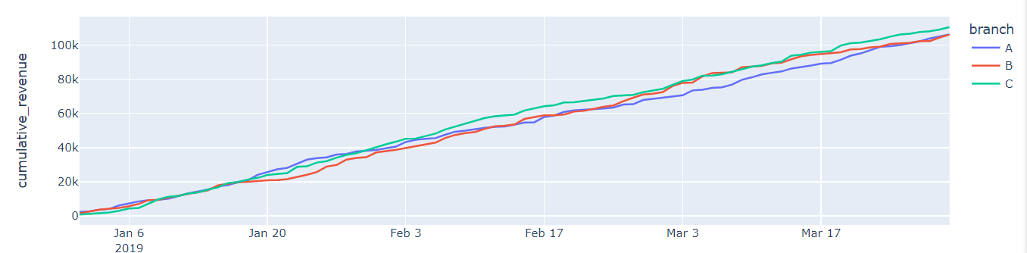
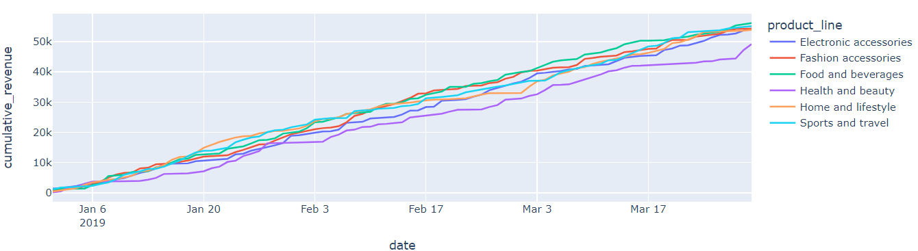
WINDOW – LEAD FUNCTON
select date, sum(total) as daily_revenue,lead(date) over(order by date) nxt, from amazon group by date
The cumulative of c is lower initially but from February accelerates more than A and B
A performs well in Jan lowers in Feb and continues
B good revenue in Jan the declines reasonably in last weeks of Jan catches up to be top in the beginning of march then again drops by March end
Similarly, the cumulative revenue of product-line is best for food and bev lowest for health and beauty.
Insights – since tax is equal unit pricing must be checked as the products might be expensive
Even home revenue falls considerably from peak in Jan
And electronics fall

Slide 16
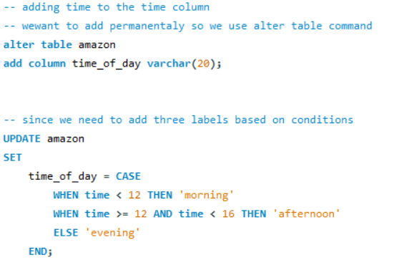
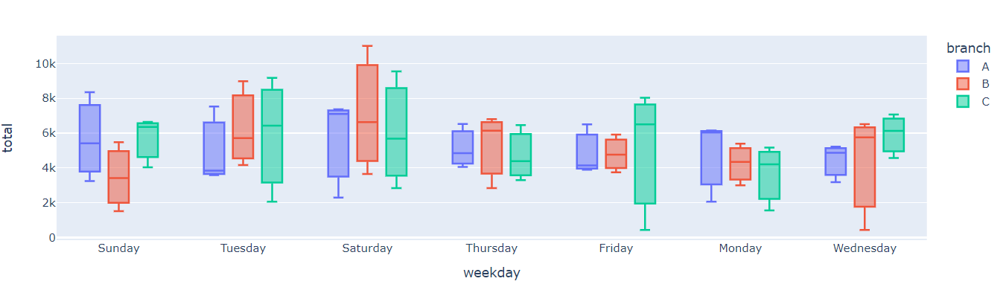
COLUMN ENGINEERING
Adding a new column / populating the column based on conditions
INTRADAY TRENDS
Saturday is the average overall
However for C we can observe higher mean revenue on Friday and Wednesday
Other days for B apart from Saturday is Thursday and Wednesday
For A Monday which is good
ACTIONABLE INSIGHTS –
Probably these days can be targeted which otherwise don’t yield much revenue
This strategy can help increase sales in combination with product line in next slide.

Slide 17
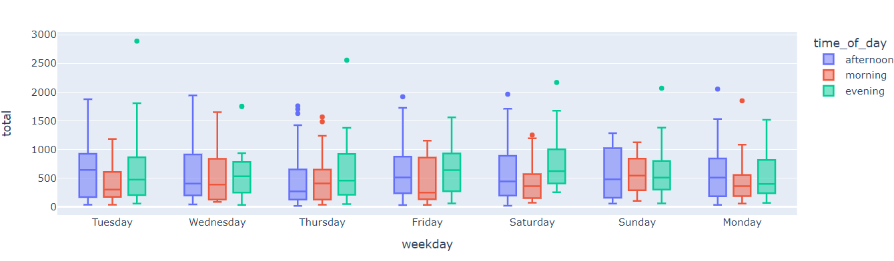
TIME OF DAY – BRANCH WISE ANALYSIS
From the above Sat is best for all plus Fri/wed for C, thr/wed for b and Mon for A
Below best avg on
Fri, wed is in the evening >morning > noon
Thurs- even> morn
Monday- noon> even> morn
Thus strategy based on this can be built

Slide 18
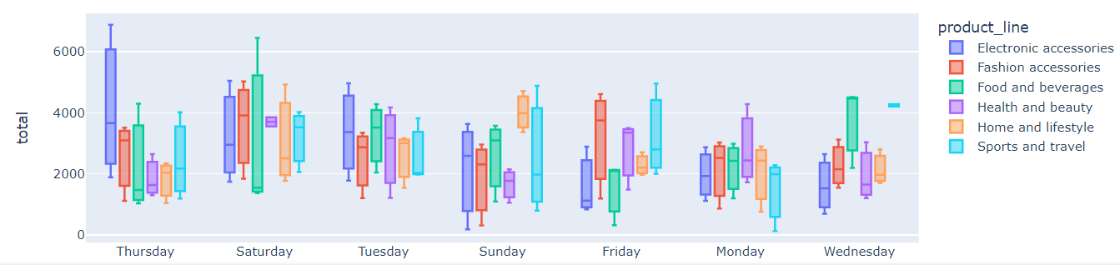
Insights –
STRATEGY 1- branches tap on the days where their revenue or sales average high and improve the weak product
STRATEGY 2- observe which product performs better on a specific weekday and time of day to target a better
ACCLERATE GOOD PERFORMING CATEGORIES –
Sat, Fri wed yield good revenue for C
and product line wise, sat and Fri are good for fashion
thus C can up its fashion sales strategically on these days
on Wednesday C can accelerate food sales which is already a good
For B on thru – electronics can be targeted
For A on Monday- since most averages are the same, A can improve its performing product lines
INPROVE POOR PERFORMING CATEGORIES
C performs low in home health and sports
Since the home has good average revenue on Sunday – prob C can strategise, for health – sat and Fri
For A health and fashion bad- thus target – sat and Fri
For B food and fashion are bad. Thus target Fri, and wed respectively

Slide 19
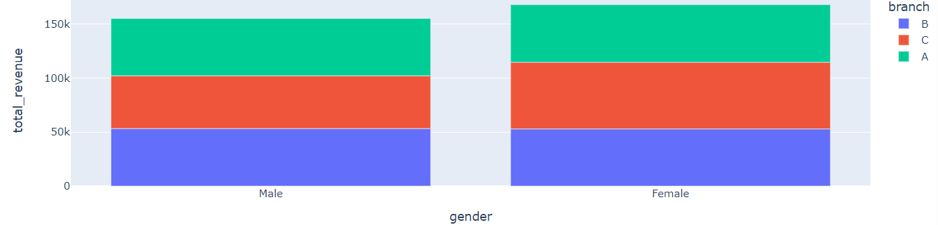
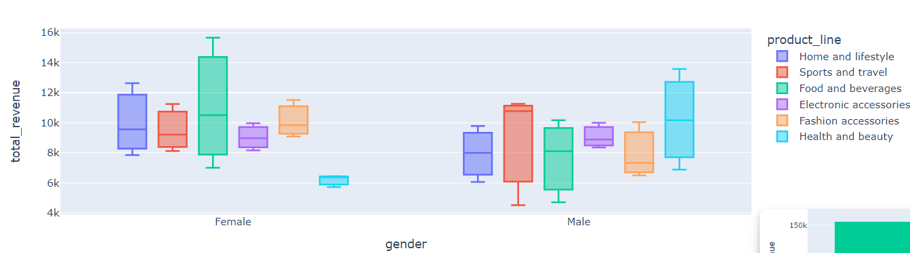
GENDER WISE ANALYSIS
In all the branches the distribution of gender is approximately the same
further count of product purchases equal too.
Revenue from female customers is slightly higher in C and A branches
For females, the preference order is food >fashion>home
Strategy to better these can be taken weekday and time of day wise
For males preference order is sports>health>electronics

Slide 20
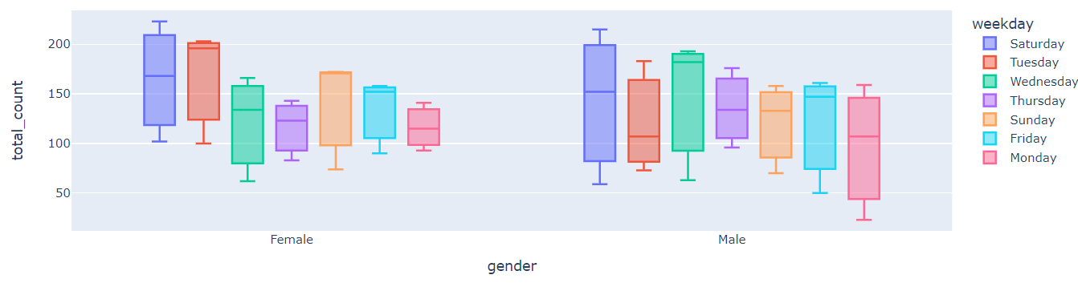
Combining weekday- gender and weekday- product line trends
INSIGHTS –
STRATEGY 1- gender-centre
Seeing the day preference and further time of day preference customers can be targeted
Eg-
Since b has fewer female customers –it can probably build a strategy catering to females on Tuesday as well
Increasing food and fashion product targeting on Tuesday
Secondly since on Tuesday electronic have good average revenue it can target these products to females and male as well who already prefer
STRATEGY 2- PRODUCTLINE CENTRIC
Observing which product is preferred by which gender and the weekday when that product is already in high demand targeting can be done

