Slide 1








Slide 2
Web scraping Project
Analysis of Covid-19 from different countries and their continents

Slide 3
About me
Background ?
Bachelor of Engineering in Electronics and Communication Engineering.
Why you want to learn Data Science?
My aim is to become a data scientist.
This is the most developing technology where data scientist are in demand.
I am very much interested and curious in predicting future outcome of any Business organization.
Any work experience?
2 years and 3 months work experience as Test Engineer in Rising Stars Mobile India Private Limited.
What like you about Innomatics Research lab?
Teaching is good.
Very dedicated.
Many projects, Assignments, quizzes to make everyone get strong foundation in each module.
Good placement assistance

Slide 4
Problem Statement
Analysis to determine which countries and continents needs to take immediate preventive actions in order to minimize the effect of covid in future.

Slide 5
Website for data scraping
https://www.worldometers.info/coronavirus/

Slide 6
Total rows and columns: 224 rows and 21 columns.
Features:
Country
TotalCases
NewCases
TotalDeaths
NewDeaths
TotalRecovered
NewRecovered
ActiveCases
Serious,Critical
TotCases/1M pop
Deaths/1M pop
TotalTests
Tests/1M pop
Population
Continent
1 Caseevery X ppl
1 Deathevery X ppl
1 Testevery X ppl
New Cases/1M pop
New Deaths/1M pop
Active Cases/1M pop

Slide 7
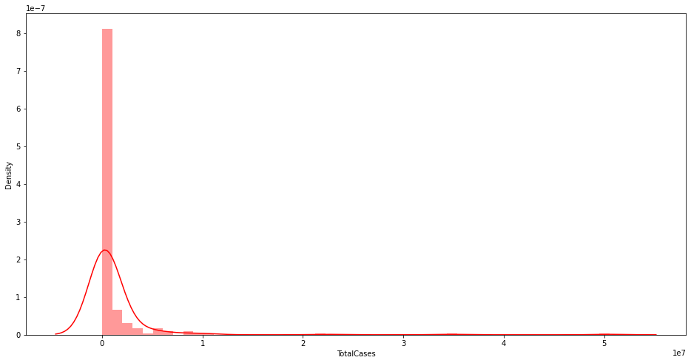
The distribution of total cases across countries
Most of the countries have total cases from 1 – 10 crore total cases.
Some of the countries are above 2 crore total cases.

Slide 8
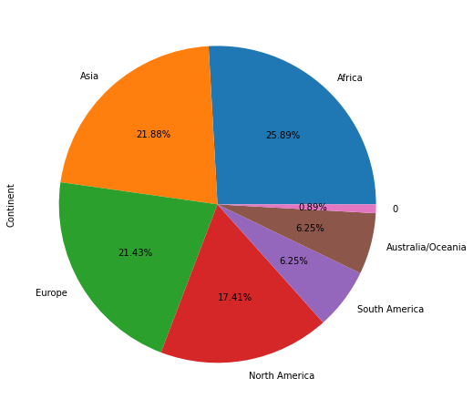
The overall contribution total cases for each continent.
The highest contribution is from Africa, Asia and Europe continents which is almost 25.89%, 21.88% and 21.43% respectively.

Slide 9
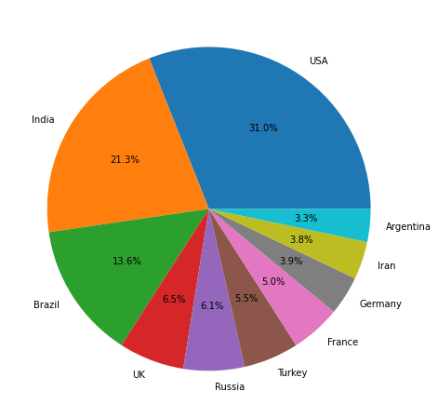
Percentage of top 10 Countries and the Total Cases for each country
USA has the total cases of 31%.
India has 21% and the Brazil has 13.6%.
These are the top countries that has total cases

Slide 10
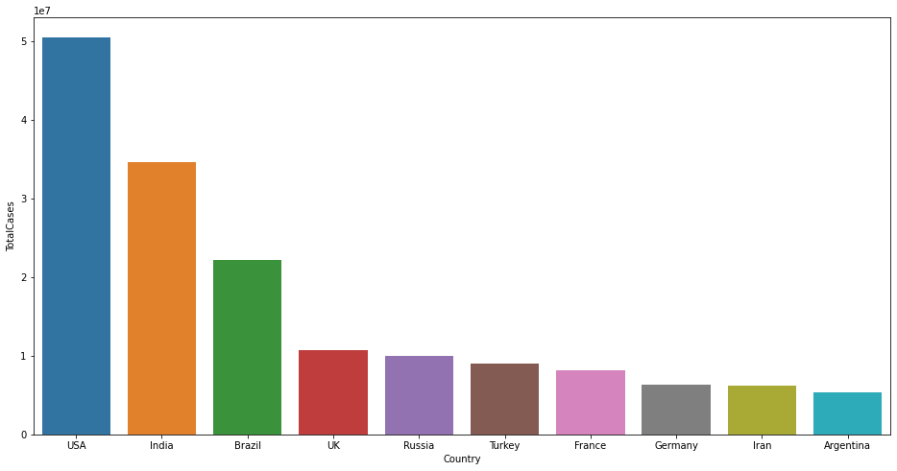
Top 10 Countries and the Total Cases for each country
Brazil, India, USA are the countries which has above 2 crore cases
USA has the highest number of cases in the world i.e. around 5 crore cases

Slide 11
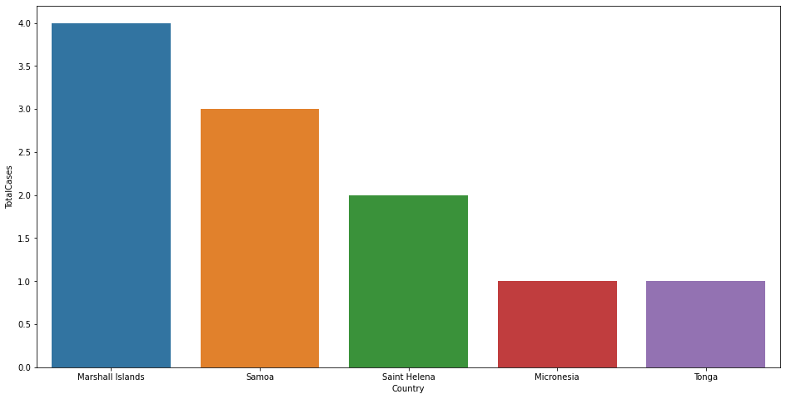
Country which has least number of cases
Tonga and Micronesia has the least number of cases in the world i.e. 1

Slide 12
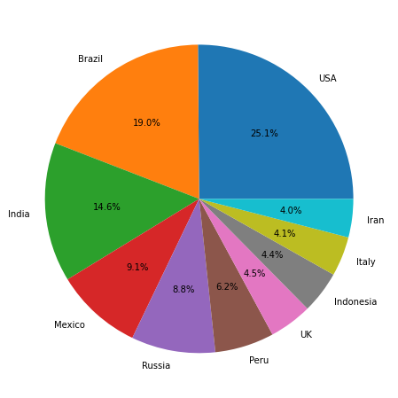
Top 10 Countries and the Total Deaths in each country
USA, Brazil, India have the highest number of deaths above 4 Lakhs people.
USA has the highest number of deaths in the world i.e. around 8 Lakhs people.
Countries | Percentage
USA | 25.1%
Brazil | 19%
India | 14.6%

Slide 13
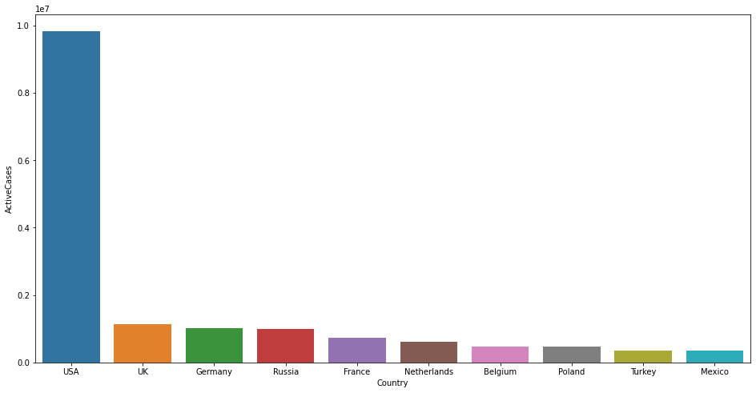
Top 10 Countries and the Active Cases in each country
Out of all countries USA have around 9 Lakhs active cases.

Slide 14
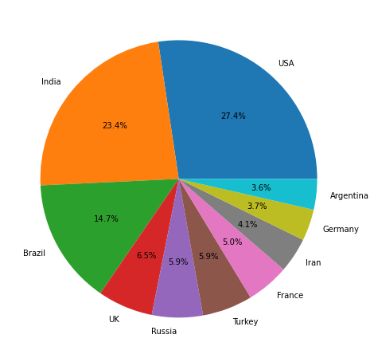
Top 10 Countries and the Total Recovered cases in each country
USA, Brazil and India have above 20 Lakhs recovered cases
USA has an average 40 Lakhs of total recovered cases.
Country | Percentage
USA | 27.4%
India | 23.4%
Brazil | 14.75

Slide 15
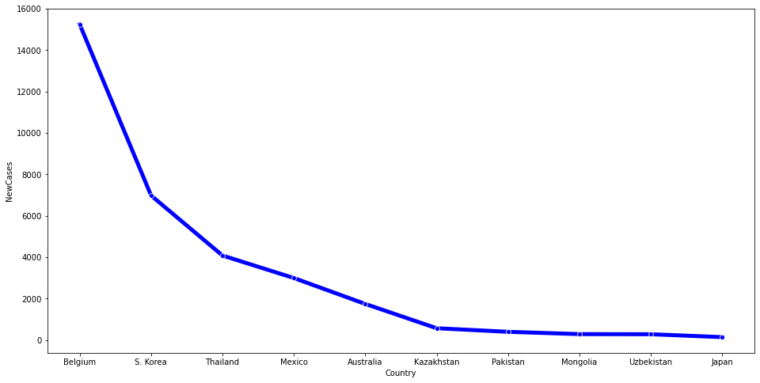
New cases across different countries
Still there are new cases coming to the countries like Belgium and South Korea and Thailand.
Apart from other countries they both are contributing more above 4000 cases.

Slide 16
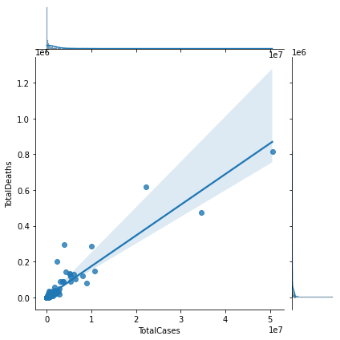
Out of all total cases in each country, what is the average range of total deaths?
We can see that most of the countries contributing total deaths has an average ranging from 1 - 10 Lakh.

Slide 17
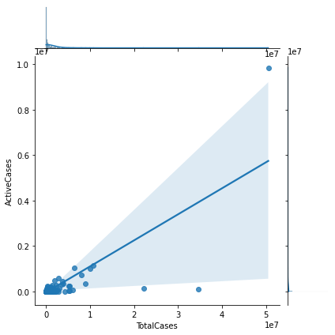
What is the average range of number of active cases still occurring in each country?
We can see that most of the countries contributing active cases has an average ranging from 1 - 10 Lakh.

Slide 18
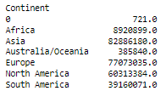
Analysis on the basis of continents
What is this continent 0 and the value 721?
Diamond princess is British-registered cruise ship, and MS Zaandam is also cruise ship owned and operated by Holland America Line near Amsterdam.
They both totally contributed total cases of 721 out of all continents.
Asia, this continent has contributed highest total cases out of all other continents.

Slide 19
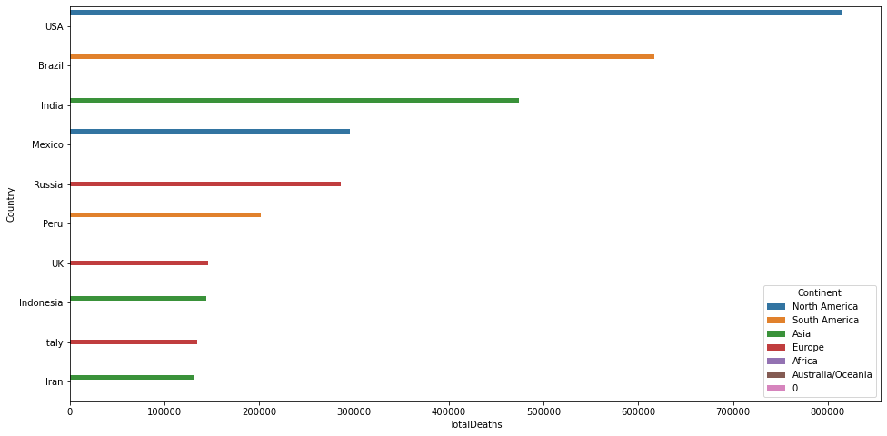
In which continents the total Deaths are maximum with respect to countries?
Countries | Total Deaths | Continents
USA | 800000 | North America
Brazil | 640000 | South America
India | 500000 | Asia

Slide 20
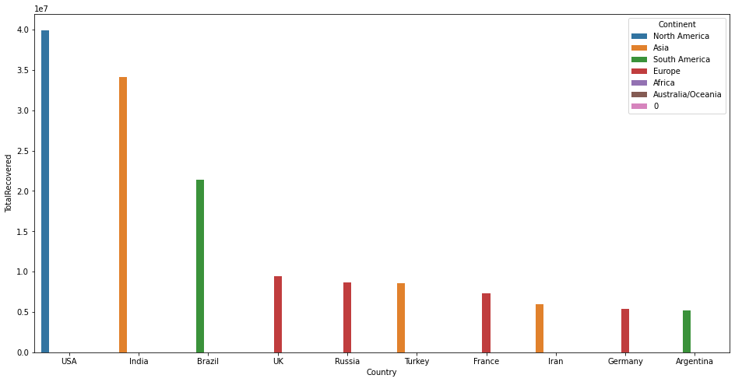
Most of the recovered cases are from North America, Asia, South America and some of the Europe countries. They are improving.
Countries | Total Recovered Cases | Continents
USA | 4 Lakhs | North America
India | 3.5 Lakhs | Asia
Brazil | 2.2 Lakhs | South America

Slide 21
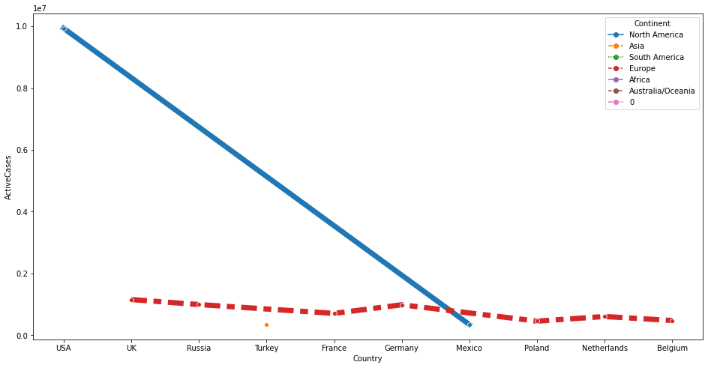
In which continents still have active cases?
Still Active cases are there in North America particularly in USA which is very maximum.
But mostly active cases occurred in Europe countries like UK, Germany, Russia, France, Netherlands, Belgium, Poland.
And only one country from Asia, that is Turkey.

Slide 22
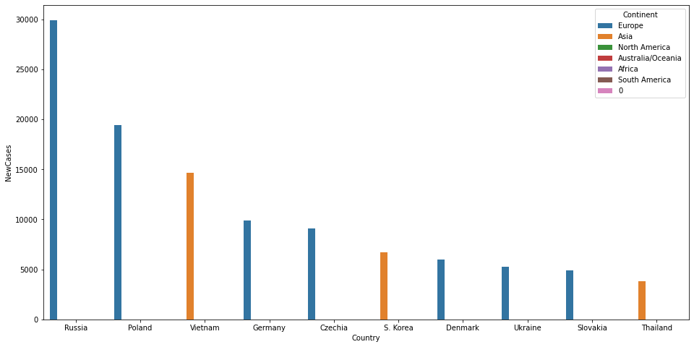
Most of the new cases still now are occurring in Europe and Asia continent in many of the countries. They need to take immediate actions to avoid further
Countries | New Cases | Continents
Russia | 30000 | Europe
Poland | 20000 | Europe
Vietnam | 15000 | Asia

Slide 23
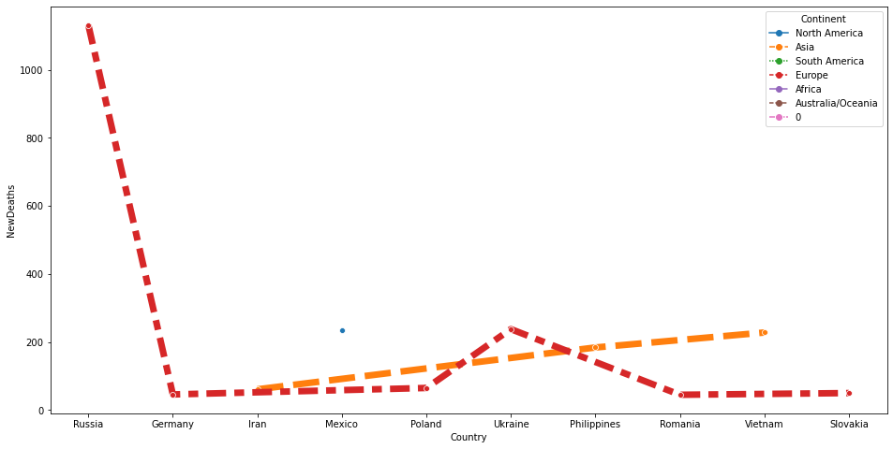
The new deaths are occurring maximum in Europe from Russia which is around 1200
North America countries like Mexico also increasing.
Asia countries like Iran, Philippines and Vietnam are also increasing

Slide 24
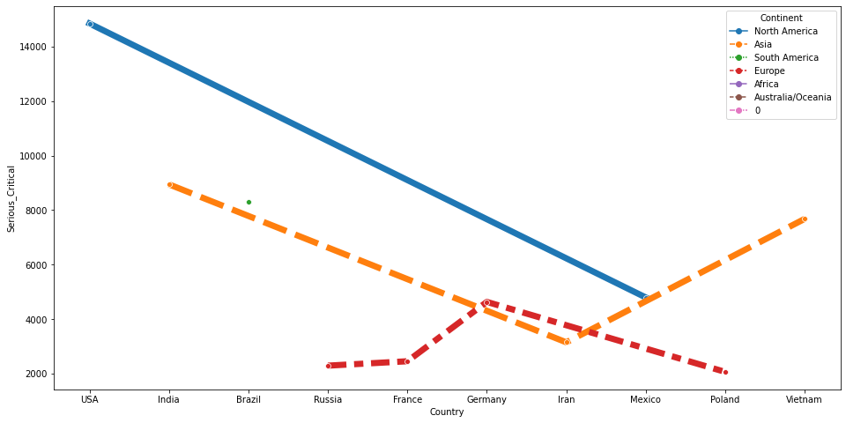
Some of the patients who are serious are from North America in USA around 14000 cases, Asia in India around 9000 cases and Vietnam around 8100 cases, South America in Brazil around 9000 cases, Europe countries like Germany around 5000 cases.

Slide 25
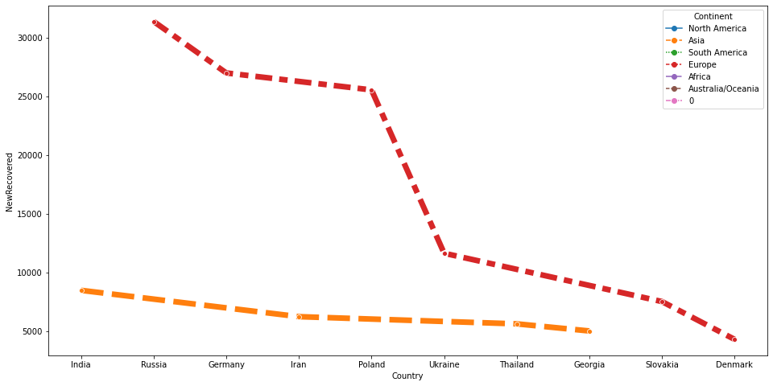
Countries which have recovered soon
In Europe countries like Russia, Germany, Poland and Asian countries like India, Iran, Thailand they are all recovering soon.

Slide 26
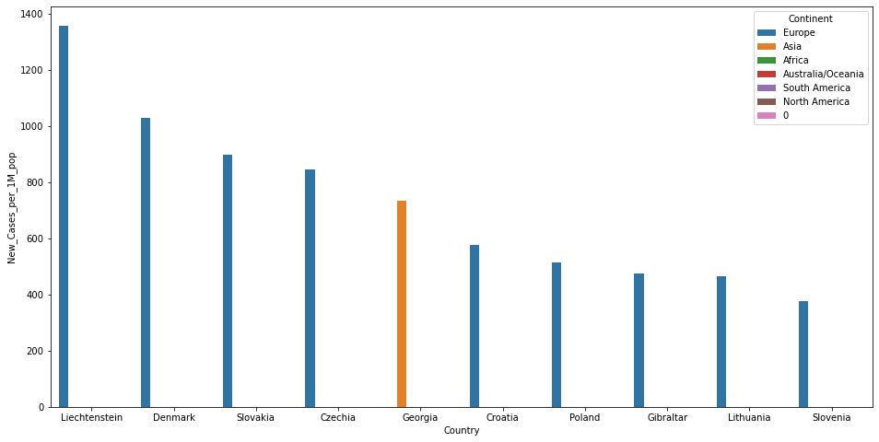
How many new cases after estimation of 1 million population?
New cases after estimation of 1 Million population Liechtenstein, Denmark, Slovakia, Czechia from Europe continent is the highest and the top most has around 1350 cases

Slide 27
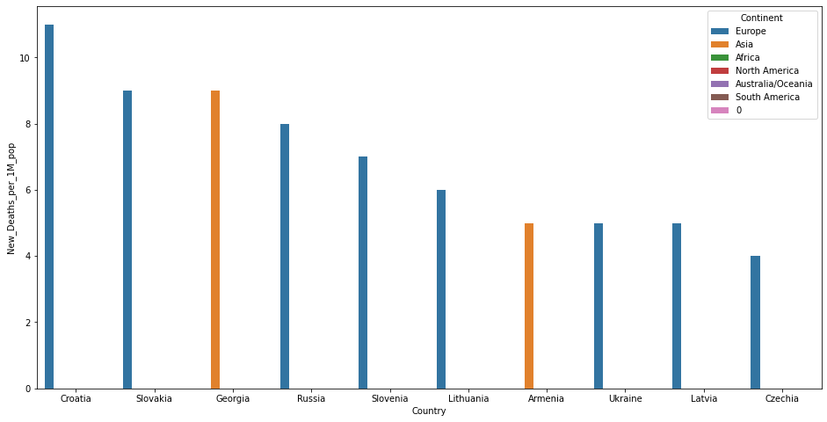
How many new deaths after estimation of 1 million population?
The estimation of new deaths after 1 Million population is high in Europe continents like Croatia around 11 cases.
Slovakia and Georgia both are contributing at the same level around 9 cases from Europe and Asia respectively.

Slide 28
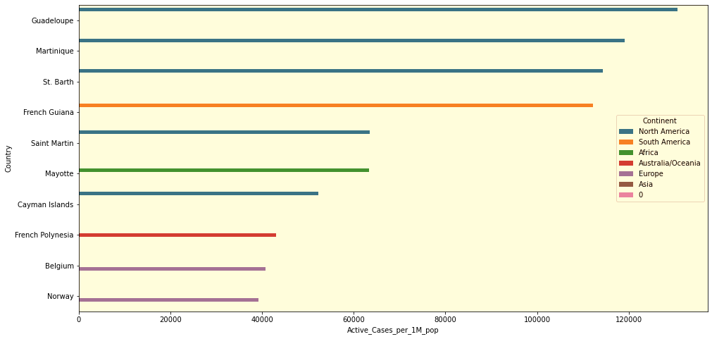
In which of the countries still have active cases?
Active cases still suffering from Covid are from North America and South America continent.

Slide 29
Summary
Based on these analysis the countries needed to be taken care to prevent further cause of covid is Europe, North America and Asia.
Initially from North America especially from USA have high total deaths and soon they have taken proper actions to resolve the issues, so after estimation of 1 Million population USA has dropped down.
Some of the patients who are serious are from North America in USA around 14000 cases, Asia countries like India around 9000 cases and Vietnam around 8000 cases, South America in Brazil around 8100 cases and Europe countries like Germany around 5000 cases.
In many countries they have taken corrective actions but still active cases are there in some of the continents like North America and South America and also in Europe.
New cases are emerging from Europe countries. They need to be taken care of.
New Deaths are high in North America particularly in Mexico around 300 deaths as compared other continents
In Europe countries like Belgium, Asian countries like Thailand, South Korea they are all recovering soon.
As a whole some of the countries mainly in Europe, North America they need to take immediate actions to prevent from covid to avoid further deaths.

Slide 30

THANK YOU

