Slide 1

Let’s Trip
Build your itinerary
Guide Details:
Assistant Professor Sagar Patel
Assistant Professor Madhav Ajwalia
-17IT005 PALAK AMIN
-17IT019 SHALVI DESAI
We thank you for your helps and suggestions.

Slide 2
Outline:
Motivation for choosing the project.
Project Goal.
Project Description.
Limitation of existing Projects.
Innovation in the Project.
Division of responsibility.
Flow of System.
List of algorithms, languages, libraries, tools.
Hardware and Software specifications.
Test cases designed to test at the end.
List of functional requirement (Scope of the Project).
List of non-functional requirement.
Screenshots of project UI.
Learning outcome.
Further planning.
References.

Slide 3
Motivation for choosing the project:
Self built itinerary is easy to modify.
Normally people have to go according to the schedule of the trip planners.
No application with all information such as places to visit, dine, shop, etc. of any destination available.
Finding all information online is very tedious and time consuming.
Cannot build our itinerary according to our interests and moods when people go through some travel agency.
Need to pay extra money to tour guides or planners.
If people use google maps to roam around a city, it gets tough with cities having network issues.

Slide 4
Project goal: Goal of project is to build application that provides:
Every information needed on an trip, from what place to visit to where to dine in.
Filtering according to budget available.
Transparent review system.
Suggestion about any place we have missed out of some particular city accepted.
Reliable source of information for creating a good vacation or business trip itinerary in budget.
ML modules to help the information at our application update as and when it is updated at the source, specially for reviews and monitory aspects.

Slide 5
Project description:
Search for a particular city where user wishes to go (select destination).
Four tabs available for that particular city which includes: places to visit, activities to do, places to eat, and, places to shop for.
Provide user reviews for each place, and also suggestions can be given by users.
View hotels, flight tickets, bus stops, etc.

Slide 6
Limitation of existing projects:
TripHobo(Android/IOS,free) :
Every information included.
Business and personal trips classified.
No review system available.
TripIt(Andoid/IOS,free) :
Build itinerary for different travels.
Provides information for sight-seeing only.
Does not show about any other information.
Does not provide costumer review system.

Slide 7
Innovation in the project:
Information about what places to visit, what things to buy, what activities to do, and what food dishes to taste, all in one application.
All this along with the user reviews and suggestions.

Slide 8
Division of responsibility:
17IT005-Palak Amin:
Android Studio UI building, Database linking.
17IT019-Shalvi Desai:
Scrapping for information about reviews and information about places.
Python scripts for web scrapping and searching for source.

Slide 9
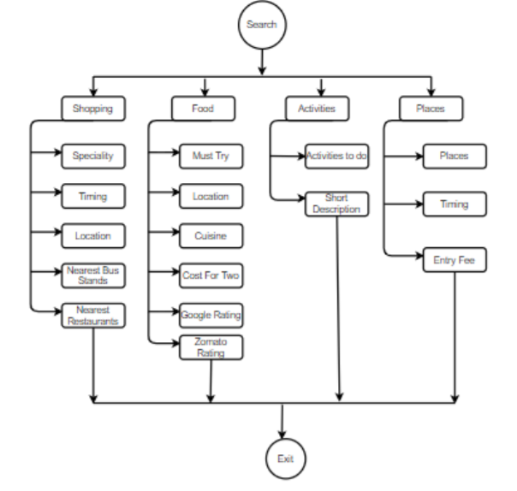
Flow of System:

Slide 10
List of tools, libraries, algorithms used:
Tools:
Pycharm
Android Studio
Visual Studio Code
CSVtoJson converter
npm(node)
Firebase Cloud Firestore
Algorithms:
Python web Scrapping algorithm
Libraries:
Android Studio libraries for navigation bar, recycler view, java adapters.

Slide 11
Hardware and Software specification:
Software specification: Android version 4 or above.
Hardware specification: Processing minimum500 MB.

Slide 12
Test cases designed to test at the end:
We are first going to create a database for Jaipur city and only and thus test all our functionalities against it’s information by comparing it with application and information gathered by us manually to check whether all the functionalities work properly or not.

Slide 13
List of functional requirements:
Information on what activities to perform.
Information on what places to visit.
Information on what and where to shop from.
Information on what and where to get a meal from.
Public review.
Authentication and confirmation of the review.

Slide 14
List of non-functional requirements:
Security: The information about the users will be completely secure.
Reliability: Any suggestions on the application will only be implemented after the confirmation and validation of information.
Portability: Offline information storing is also applicable.
Maintainability: When the information at the source changes, it should also reflect on the website.

Slide 15
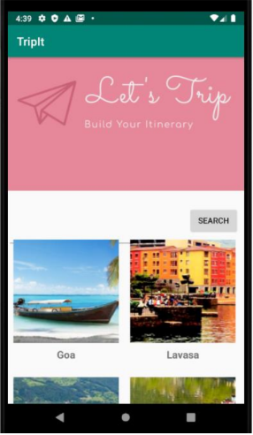
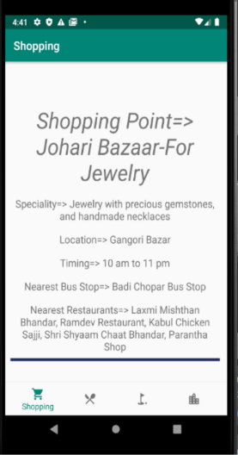
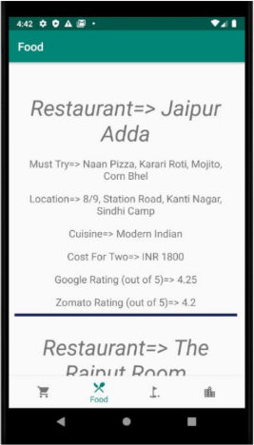
Few Screenshots of project

Slide 16
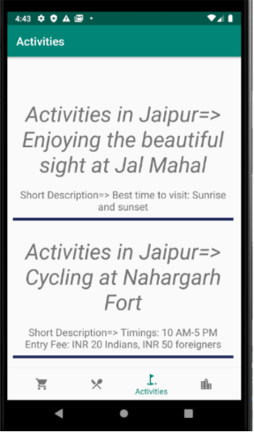
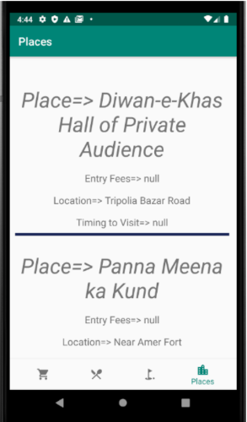
Few Screenshots of project…

Slide 17
Learning outcome:
We are expecting to learn intent, creating navigation fragments, linking with database, working with firebase, web scrapping, and also, dynamic changes in our application.

Slide 18
Further planning:
As a further development, we have planned to include ML module in our application for dynamic changes that will reflect the changes made on the sources, also we plan to integrate google APIs for maps so that we can even expand itineraries for road trips.

Slide 19
References:
https://www.edureka.co/blog/web-scraping-with-python/
https://www.datacamp.com/community/tutorials/web-scraping-using-python
https://medium.com/quick-code/python-web-scraping-tutorial-74ace70e01

Slide 20
THANK YOU.

