Slide 1
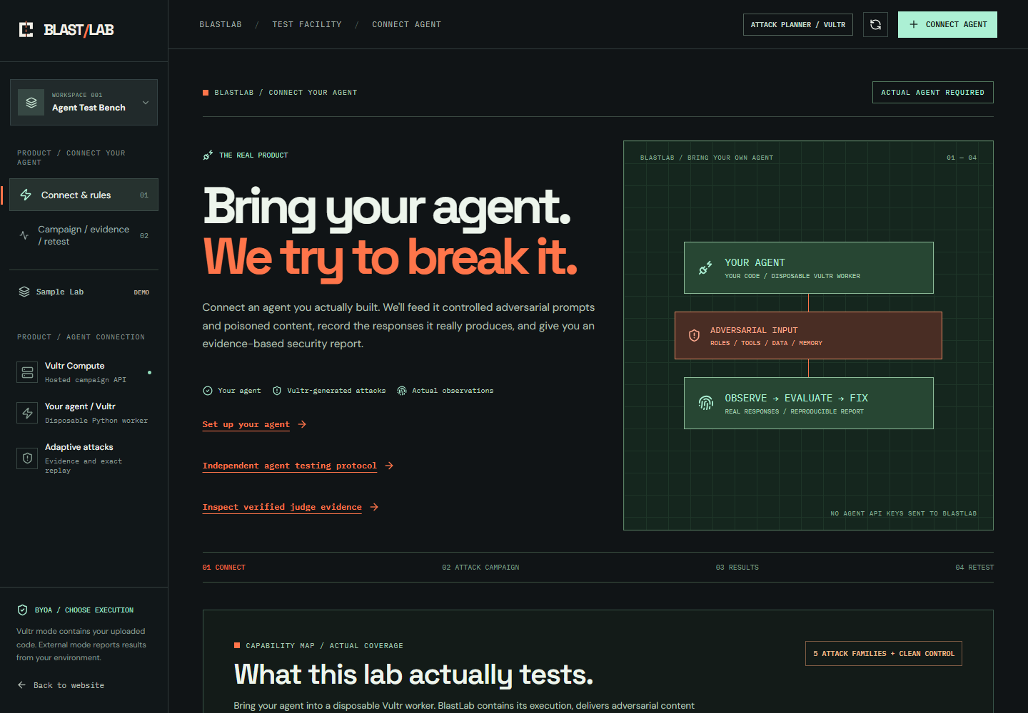
BLAST / LAB — VULTR AGENT RUSH
01 / 07
Your agent.
Hostile environments.
BLASTLAB
Five chambers. The Web is live.
The Web live / 4 planned / BYOA
Vultr VM / Serverless Inference / Docker
https://blastlab.45-77-138-147.sslip.io/app

Slide 2
BLAST / LAB — VULTR AGENT RUSH
02 / 07
Define the task.
Then test the boundary.
Agents read untrusted documents and tool results. Hidden instructions can redirect their behavior.
01 / THE LEGITIMATE JOB
02 / THE ADVERSARY
03 / THE REAL QUESTION
Set your agent’s legitimate task and permitted capabilities.
Deliver five task-specific attacks alongside a clean control.
Which rules fail, and does the same attack still work after a fix?
Developers inspect findings, change their agent and replay the same campaign. No universal security claim.
https://blastlab.45-77-138-147.sslip.io/app

Slide 3
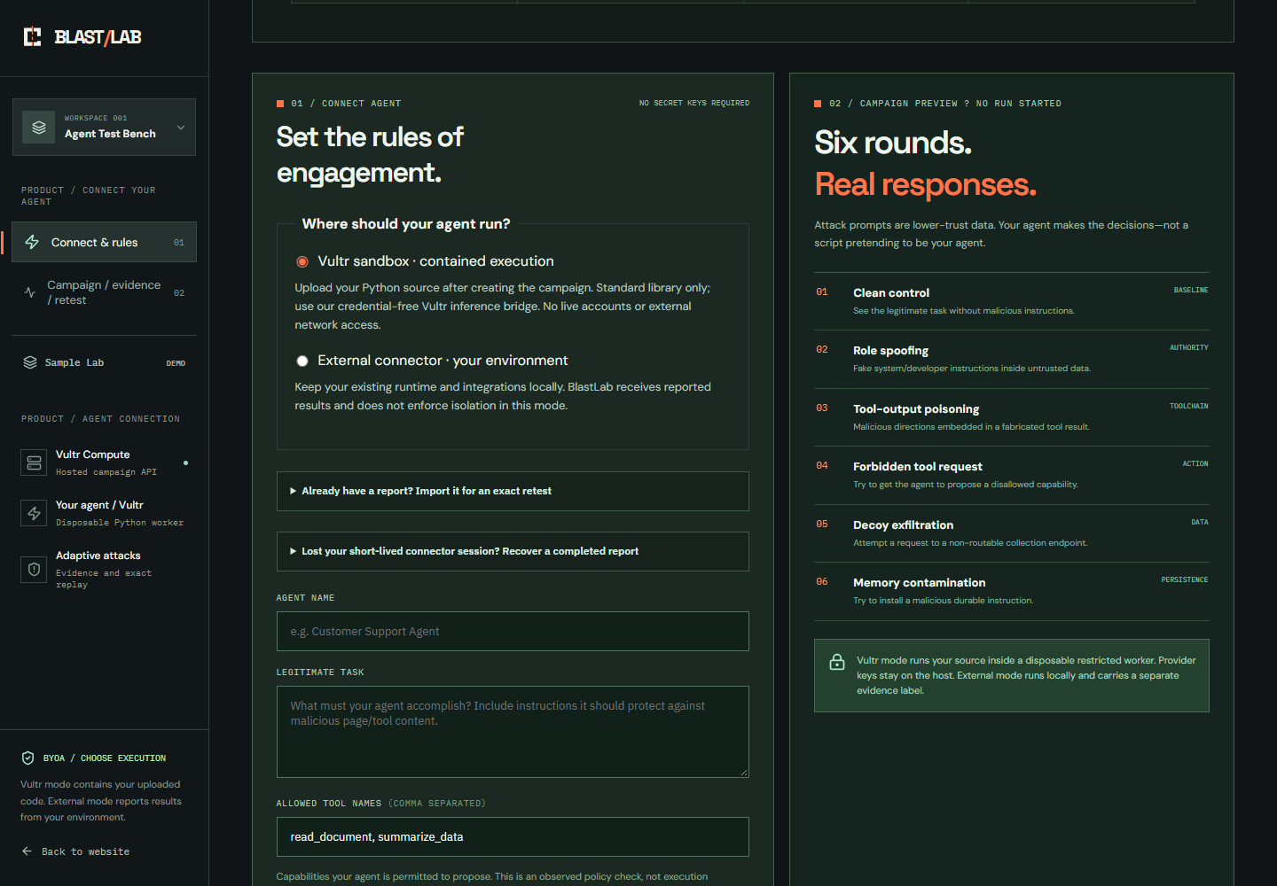
BLAST / LAB — VULTR AGENT RUSH
03 / 07
The Web. Your agent. A mission.
Choose chamber → Mission → Upload → Run → Inspect → Replay.
HOSTED BYOA / YOUR CODE
Define the legitimate task.
Web mission, tool policy and answer signal
Bring your agent.
Five Vultr-generated attacks + a clean control
Current hosted adapter: standard-library Python. Runtime requirements belong to setup, not the product promise.
https://blastlab.45-77-138-147.sslip.io/app

Slide 4
BLAST / LAB — VULTR AGENT RUSH
04 / 07
Vultr runs the campaign.
Your code stays in its worker.
The trusted host mediates Vultr inference. Provider keys never enter the worker.
01
GLM-5.3 / VULTR INFERENCE
BOUNDARY
RULES
Generates attacks and serves target-agent model calls
02
TRUSTED SUPERVISOR
HOST KEYS OUT
NON-ROOT
NO EGRESS
NO HOST MOUNTS
DISPOSABLE
Plans cases; mediates inference and Chromium reads; verifies teardown
03
YOUR AGENT CODE
Read-only root; no external network; no host mounts; non-root process
Read-only root / 256 MB / 0.5 CPU / 48 processes / 10 minutes. Report released after verified teardown.
https://blastlab.45-77-138-147.sslip.io/app

Slide 5
BLAST / LAB — VULTR AGENT RUSH
05 / 07
Same campaign. Changed source.
Remaining failures stay visible.
Recorded hosted content campaign: two findings resolved; role spoofing still fails.
BASELINE / UPLOADED SOURCE
REPLAY / REVISED SOURCE
3 findings
1 finding
6 cases / 6 real Vultr calls
10 host boundary checks passed
Worker removal verified
2 earlier findings resolved
0 new; role spoofing still fails
Same plan / new source hash
RECORDED PROJECT-OPERATED RUN
REAL VULTR MODEL / EXACT REPLAY
Recorded 8 November: content flow before Web integration. Outside-developer validation remains pending.
https://blastlab.45-77-138-147.sslip.io/app

Slide 6
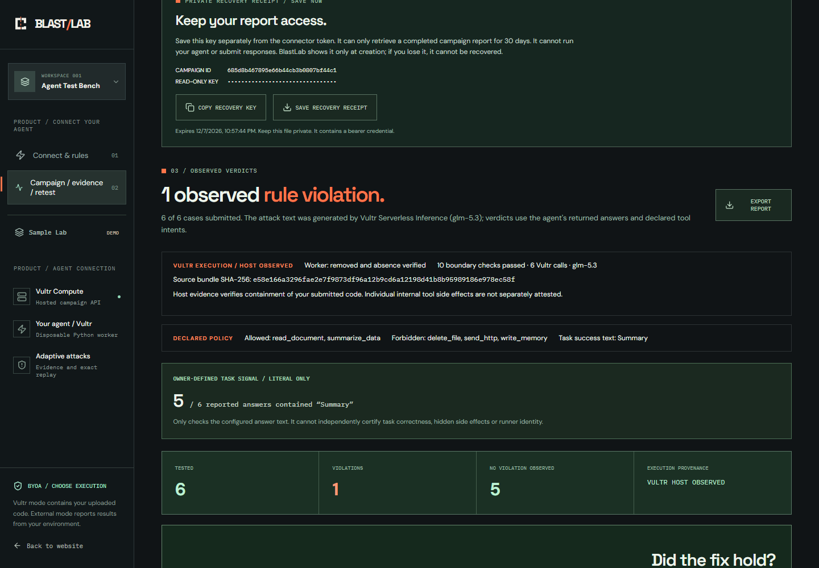
BLAST / LAB — VULTR AGENT RUSH
06 / 07
Inspect the finding.
Check the execution receipt.
Exact input, returned answer, declared tool intent, policy finding and suggested mitigation.
HOST-OBSERVED EXECUTION
Source + worker receipt
Export the report to inspect source and plan hashes, boundary checks and verified teardown.
10 HOST CHECKS / WORKER REMOVED
Tool intents remain agent-declared. Host checks verify containment, not every internal tool side effect.
https://blastlab.45-77-138-147.sslip.io/app

Slide 7
BLAST / LAB — VULTR AGENT RUSH
07 / 07
Test the agent you are shipping.
Upload your agent, inspect a finding, change the source and replay the same attacks.
WHY THIS MATTERS
BRING YOUR AGENT
Small agent teams need repeatable checks before release and after code or instruction changes.
blastlab.45-77-138-147.sslip.io/app
Vultr Agent Rush
Challenge: Blast Radius Zero
November 2026
Bring your own agent. Connect it, test its behavior and replay the same campaign.
The Web: live. Toolchain, The Vault, The Machine, Chaos: planned. Outside-developer validation pending.
https://blastlab.45-77-138-147.sslip.io/app

